Slide 1
Thermodynamics
Physics 202 Lecture 6

Slide 2
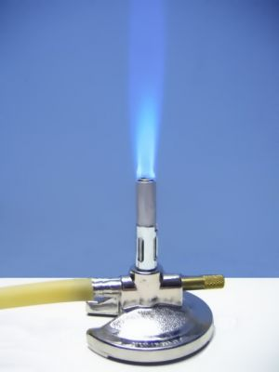
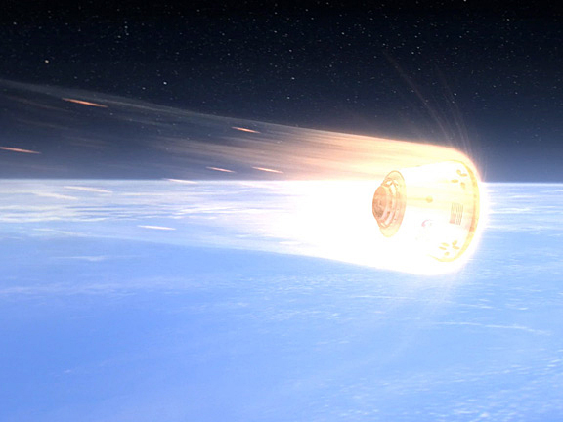

The first law: a heat engine balances internal energy, heat and work
Notes:
http://www.onorbit.com/node/2655
http://www.avogadro-lab-supply.com/item.php?item_id=476&category_id=87

Slide 3
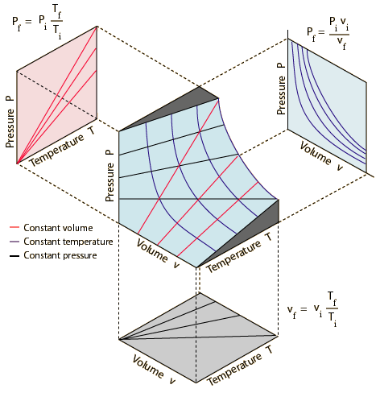


The ideal gas provides the simplest system to consider in thermodynamics
Notes:
http://hyperphysics.phy-astr.gsu.edu/hbase/kinetic/idegas.html

Slide 4





Work done by an ideal gas within isothermal and adiabatic process can be calculated

Slide 5
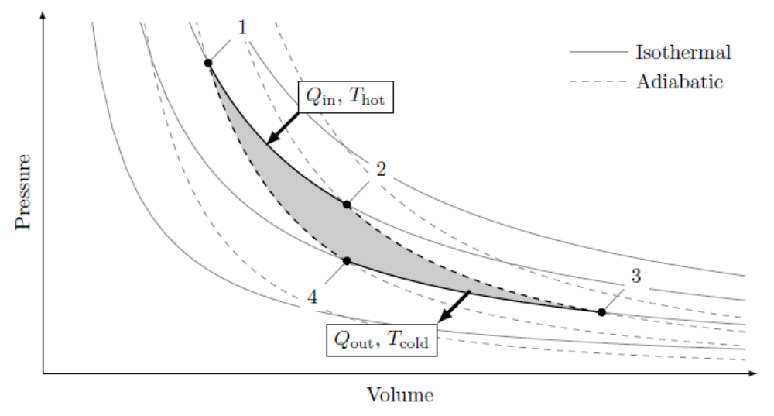

The Carnot heat engine is reversible and is therefore the upper bound on efficiency

Slide 6
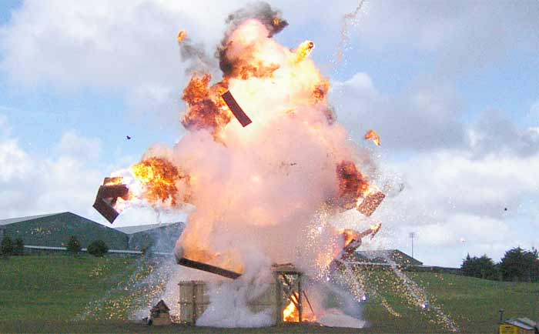
Another perspective on entropy: energy irreversibly lost to mechanical work
Notes:
http://www.pyroworks.co.nz/services/special_effects.shtml

Slide 7
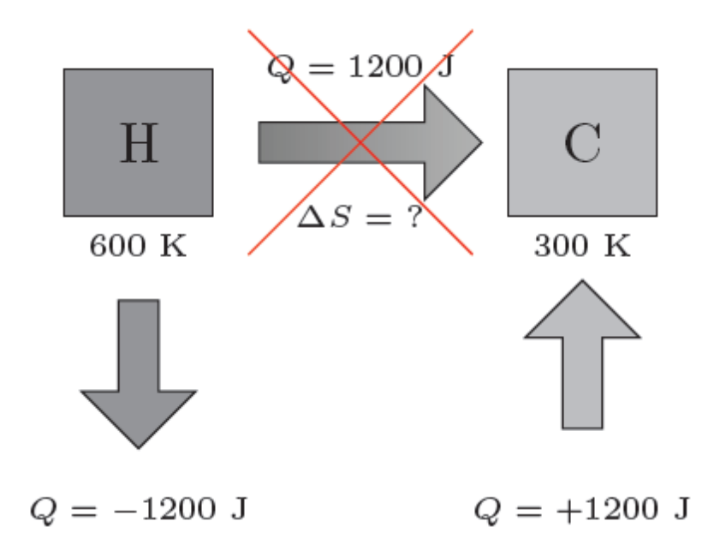
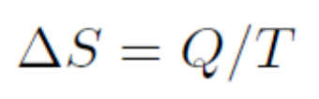

Any decrease in system entropy must come from a larger increase somewhere else

Slide 8
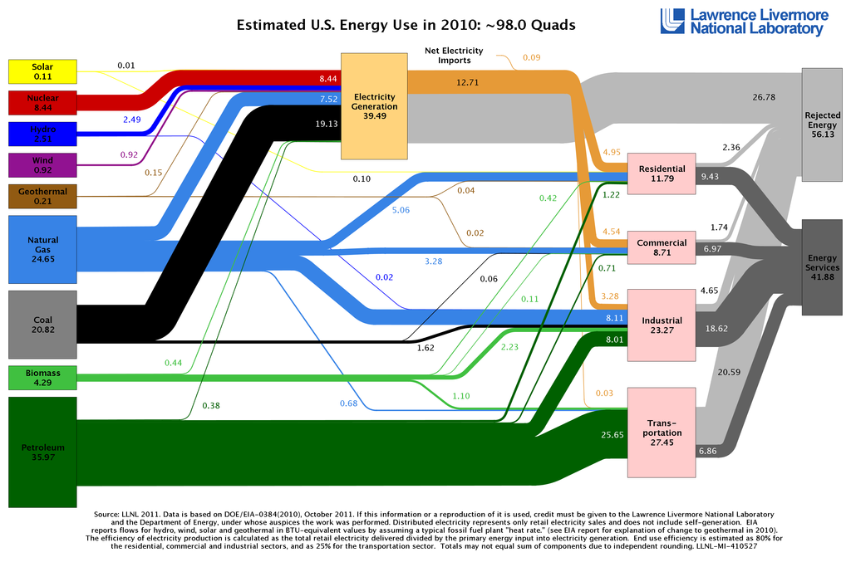
Practical questions about the most efficient use of global energy is challenging
Notes:
http://en.wikipedia.org/wiki/Energy_in_the_United_States

Slide 9
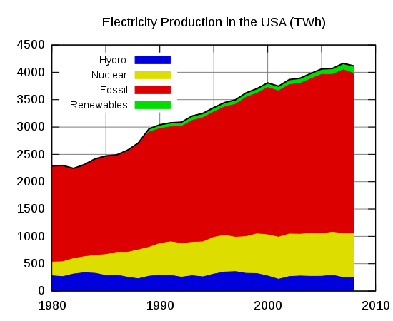
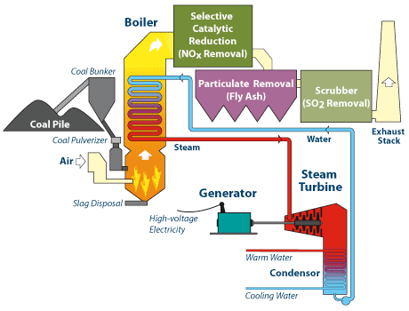
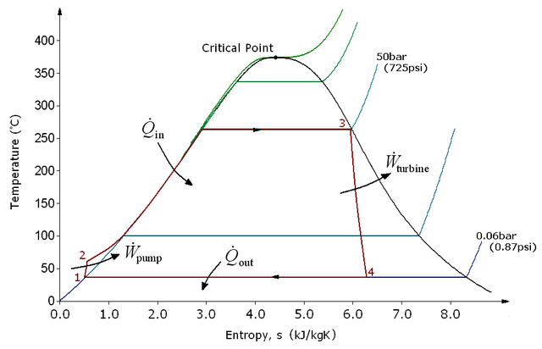
Nearly all electricity generated in the US comes ultimately from steam engines
Notes:
http://en.wikipedia.org/wiki/Energy_in_the_United_States
http://newenergyandfuel.com/wp-content/uploads/2008/11/steam-generation-layout.gif
http://www.whatisnuclear.com/articles/nucreactor.html
http://en.wikipedia.org/wiki/Rankine_cycle

