Slide 1
Radiation: Particles, Waves, Rays
Physics 202 Lecture 7

Slide 2



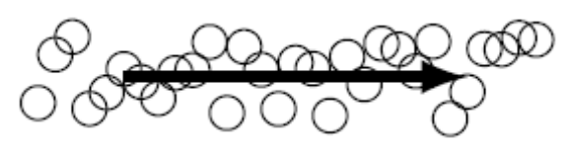
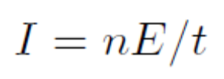
Energy flow and intensity is related to the amplitude and power of the driving source
Notes:
http://www.acs.psu.edu/drussell/Demos/rad2/mdq.html

Slide 3
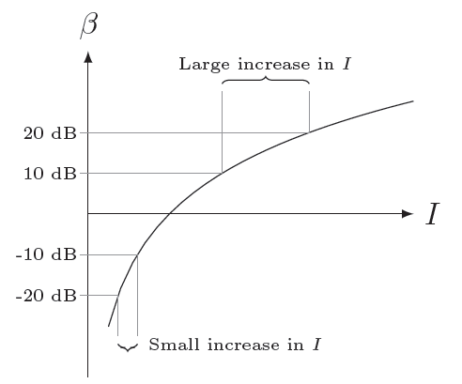
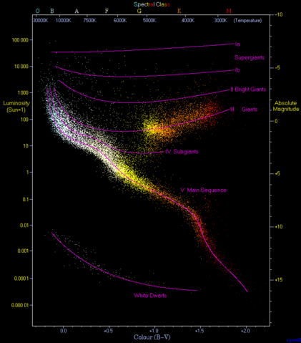

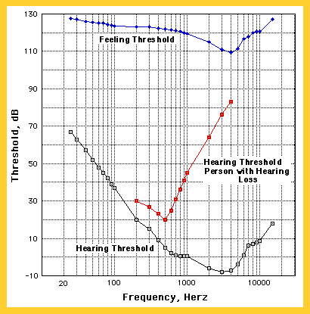



“Intensity level” recalibrates the definition of intensity to our physiological sensation
Notes:
http://acccn.net/Bio/book/Bio50/LecNotes/lecnot31.html
http://en.wikipedia.org/wiki/Hertzsprung-Russell_diagram

Slide 4


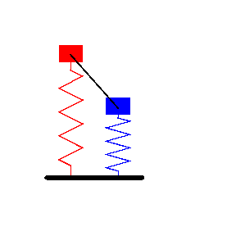
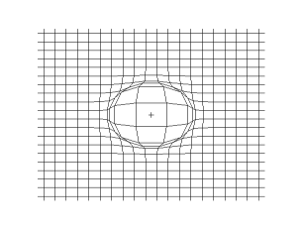
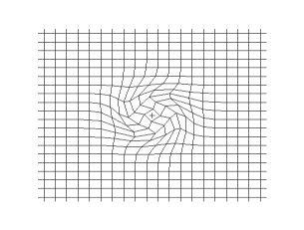
Waves require a source and a medium made up of coupled oscillators near equilibrium
Longitudinal
Transverse
Notes:
http://www.acs.psu.edu/drussell/Demos/coupled/coupled.html
http://en.wikipedia.org/wiki/Longitudinal_wave
http://en.wikipedia.org/wiki/Transverse_wave

Slide 5

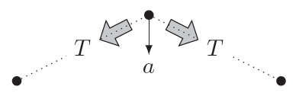




Any disturbance in the medium acts as a damped oscillator as energy radiates away
Solid
Liquid
Gas
Air

Slide 6
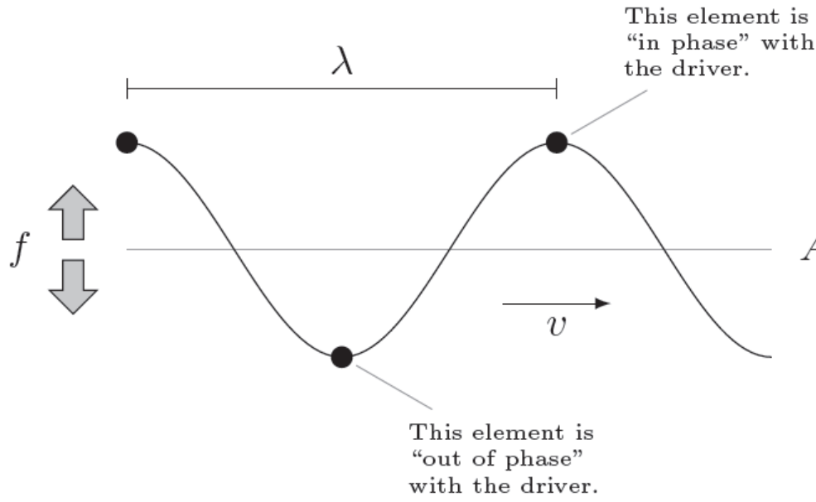

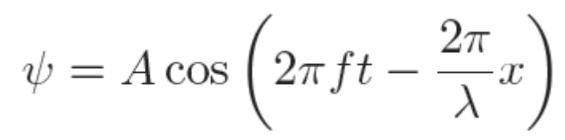

All the elements of the medium match the oscillation of the source with a phase shift

Slide 7

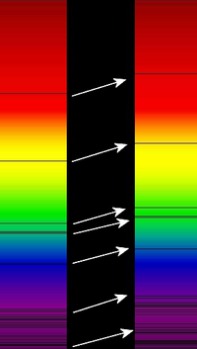
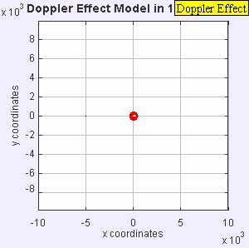
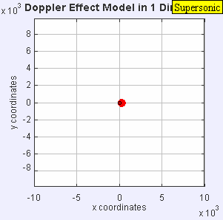
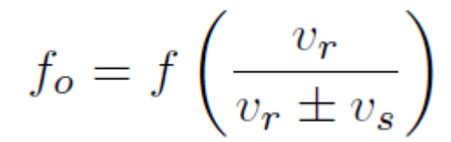

If the source is moving, the observed frequency suffers a Doppler shift
Notes:
http://en.wikipedia.org/wiki/Doppler_effect

Slide 8

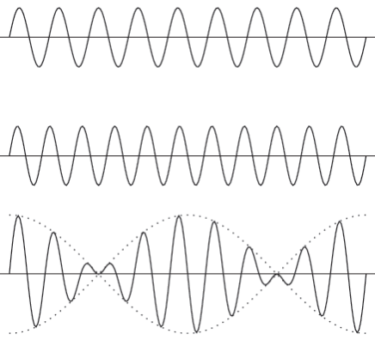





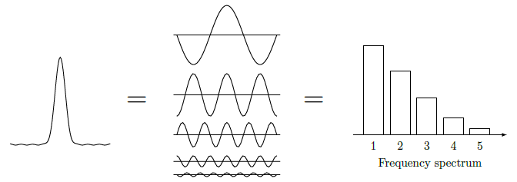
When the frequencies of two sources differ, non-sinusoidal beats result
Fourier
Analysis

Slide 9

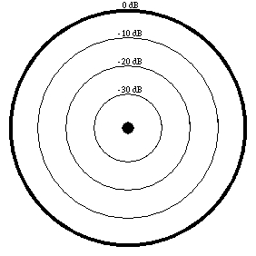
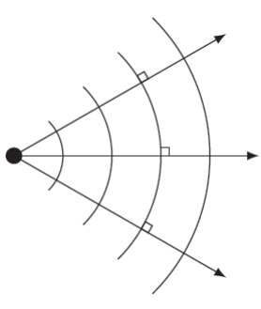
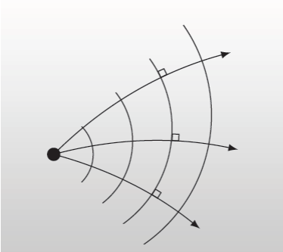

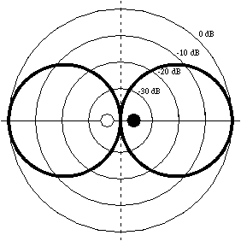
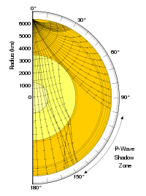

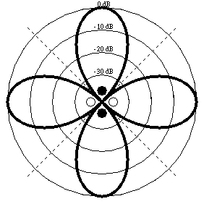
Energy propagates along “rays” which move perpendicular to the overall wave fronts
Slow
Notes:
http://www.acs.psu.edu/drussell/Demos/radiation/radiation.html
http://www.acs.psu.edu/drussell/Demos/rad2/mdq.html
http://en.wikipedia.org/wiki/File:Earthquake_wave_shadow_zone.svg

