Slide 1
Geometric Optics
Physics 202 Lecture 9

Slide 2
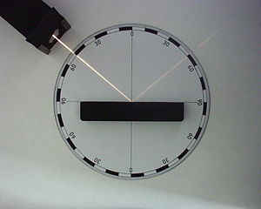
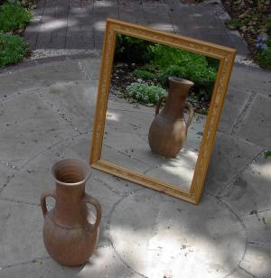
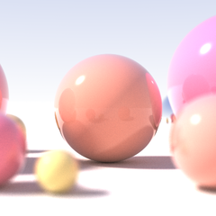
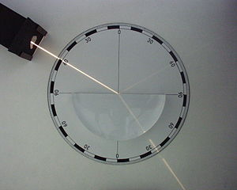
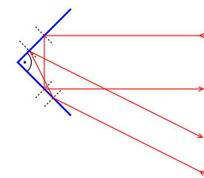
Geometric optics ignores the wave nature of light and is based on geometric laws
Notes:
http://en.wikipedia.org/wiki/Ray_tracing_(graphics)
http://en.wikipedia.org/wiki/Ray_tracing_(physics)
http://en.wikipedia.org/wiki/Reflection_(physics)
http://en.wikipedia.org/wiki/Mirror_image

Slide 3
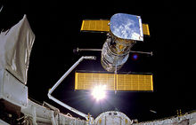
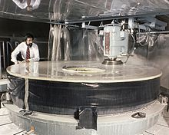
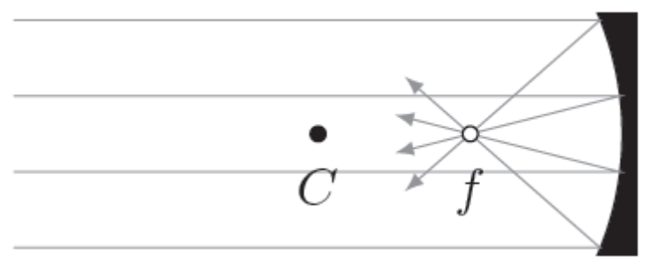
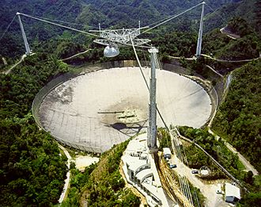

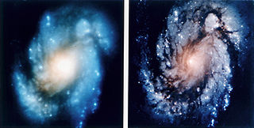
A curved mirror will act as a lens creating a magnified image based on its focal length
Notes:
http://en.wikipedia.org/wiki/Hubble_telescope
http://en.wikipedia.org/wiki/Parabolic_antenna

Slide 4
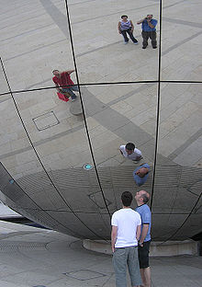
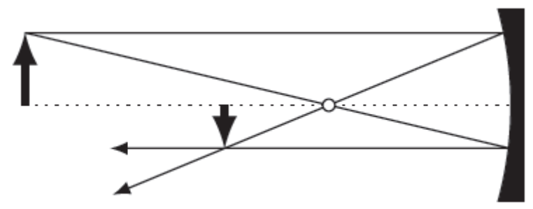
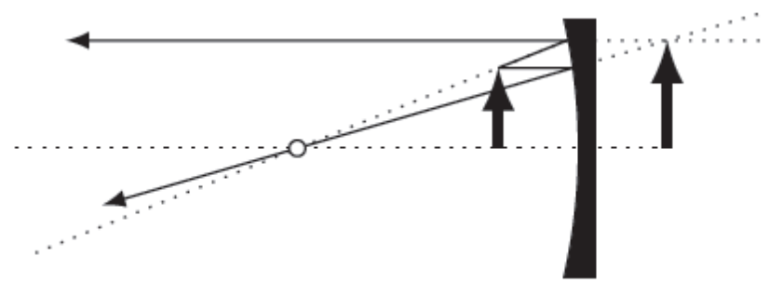
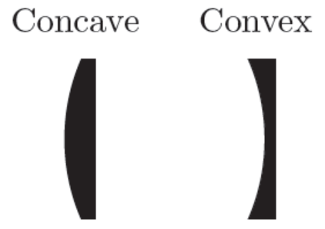
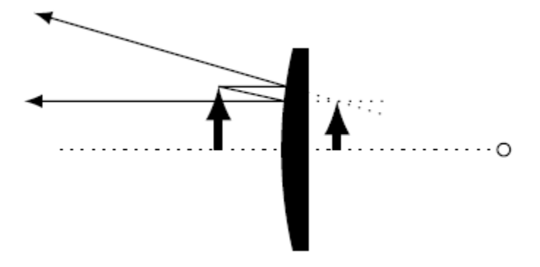
In a ray diagram, we only need a few key rays to identify the image location
Notes:
http://en.wikipedia.org/wiki/Curved_mirror

Slide 5
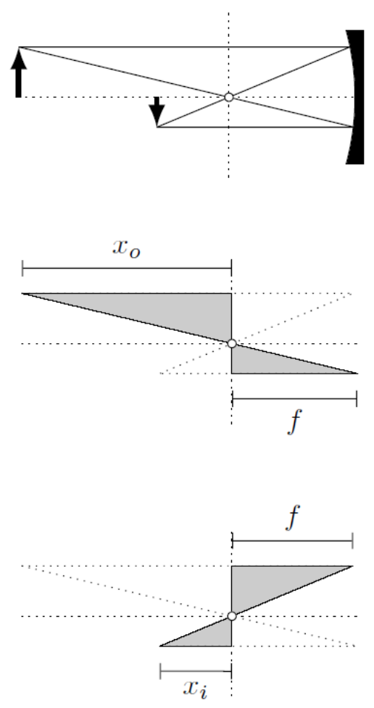

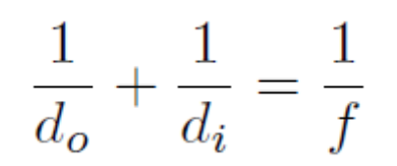


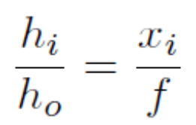
Image distance and magnification is related to object distance and lens focal length

Slide 6
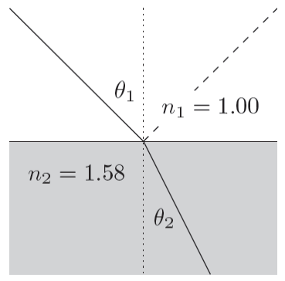



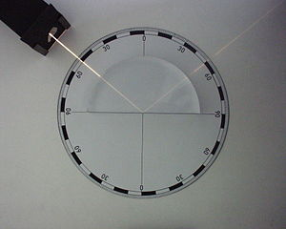
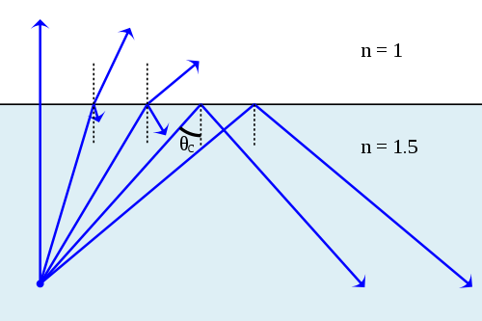
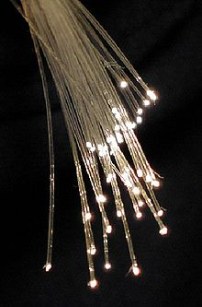
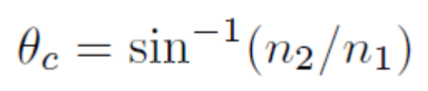
Snell’s law governs the angles involved in refraction and is related to the speed of light
Notes:
http://en.wikipedia.org/wiki/Refraction
http://en.wikipedia.org/wiki/Total_internal_reflection
http://en.wikipedia.org/wiki/Optical_fiber

Slide 7
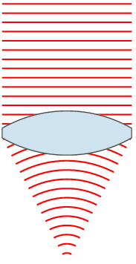
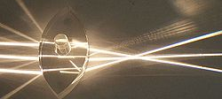
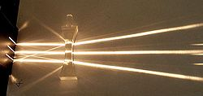
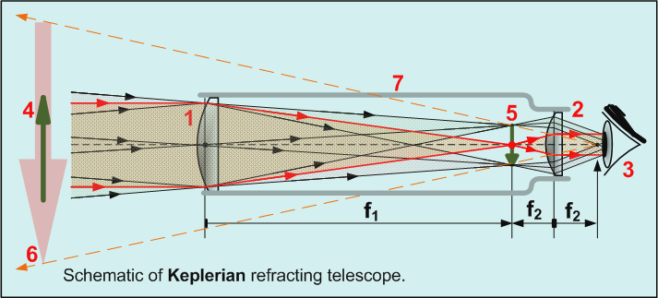

Transparent lenses obey same geometric formulas with a different sign convention
Notes:
http://en.wikipedia.org/wiki/Lens_(optics)
http://en.wikipedia.org/wiki/Optical_telescope

Slide 8
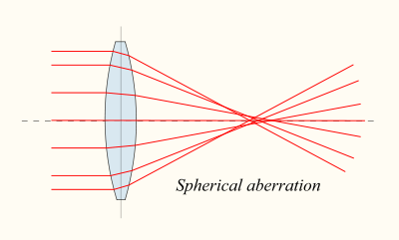
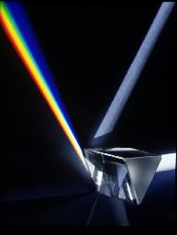
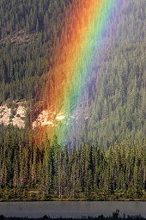
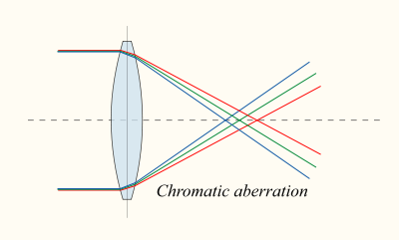
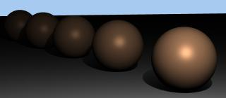
Most transparent materials are dispersive which explains prisms and rainbows
Notes:
http://en.wikipedia.org/wiki/Lens_(optics)
http://mirror-sg-wv1.gallery.hd.org/_tn/std/natural-science/prism-and-refraction-of-light-into-rainbow-2-AJHD.jpg
http://en.wikipedia.org/wiki/Rainbow
http://www.hash.com/am2004/Choreoraphy/Attenuation/Light%20Attenuation.htm

Slide 9
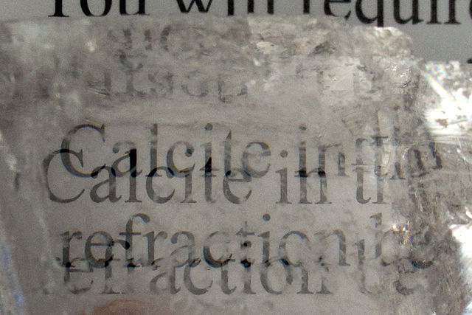
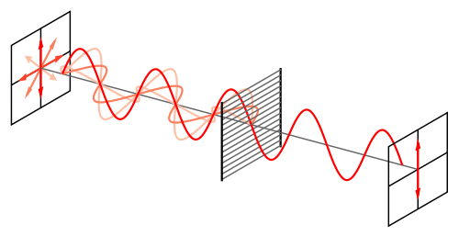
Double refraction and the problem of polarization
Notes:
http://eo.wikipedia.org/wiki/Dosiero:3310.calcite_(Iceland_Spar)_birefringence.jpg
http://en.wikipedia.org/wiki/File:Wire-grid-polarizer.svg

