Slide 1
Limits of Classical Mechanics
Physics 202 Lecture 11

Slide 2
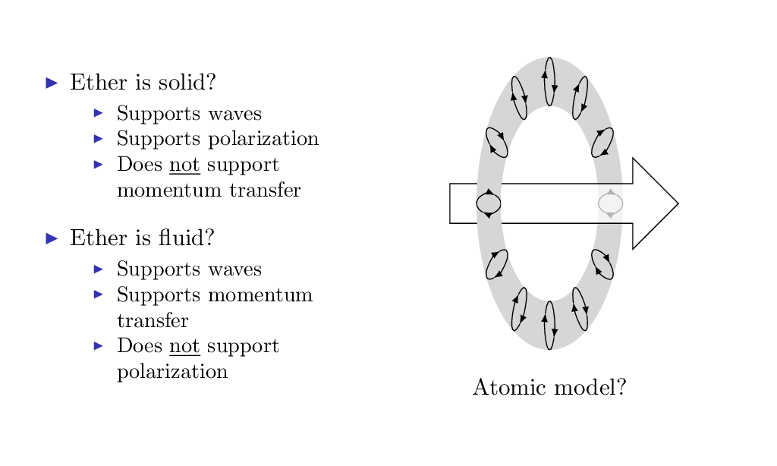
EM theory predicts that light will carry momentum—perhaps the ether is a fluid?

Slide 3
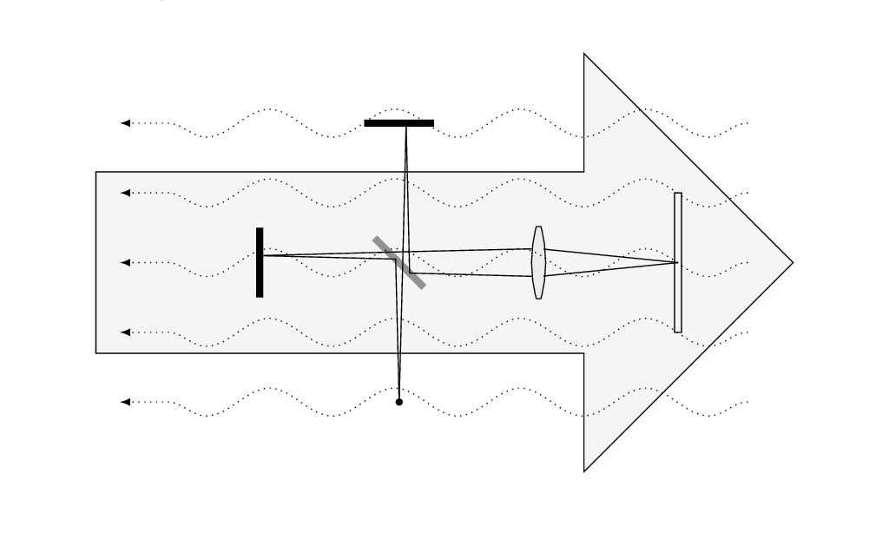
Michelson and Morley experiment should but does not detect any “ether wind”

Slide 4
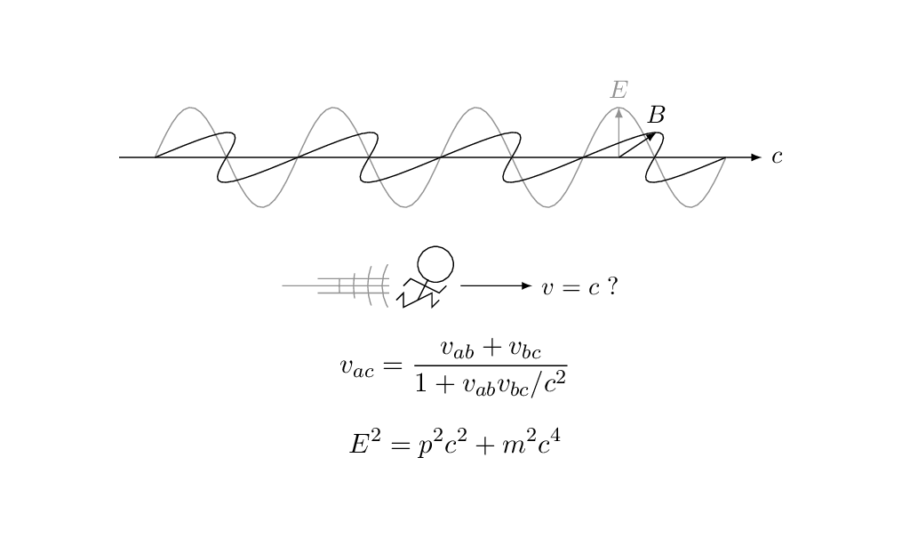
Special relativity: the ether is dead—but must rethink space-time mechanics

Slide 5
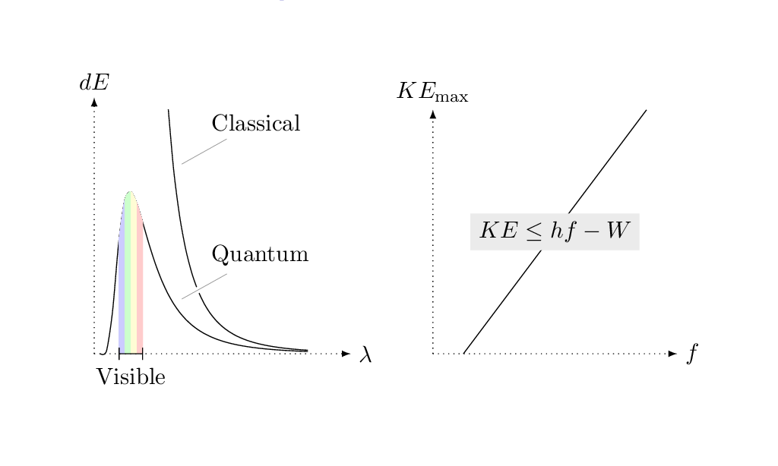
Quantum mechanics discovered at the same time as relativity but for different reasons

Slide 6
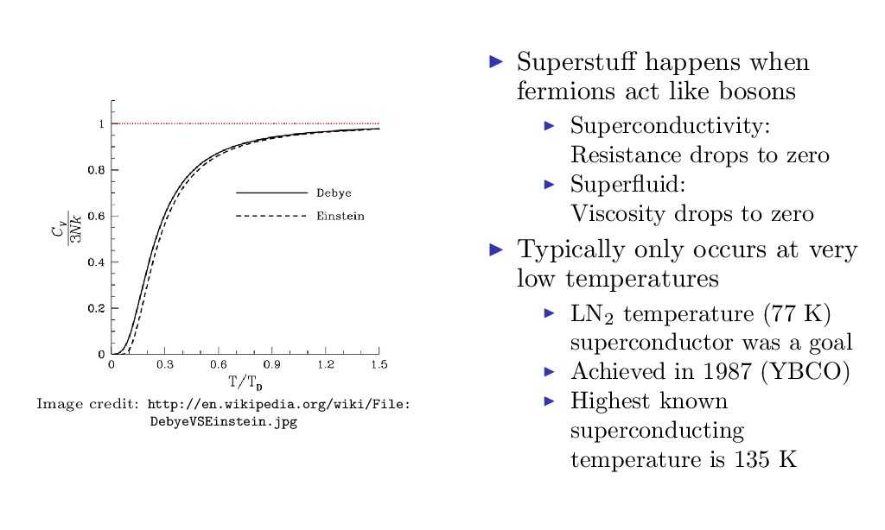
Problems in low temperature kinetic theory: specific heats of solids, also “”superstuff”

Slide 7
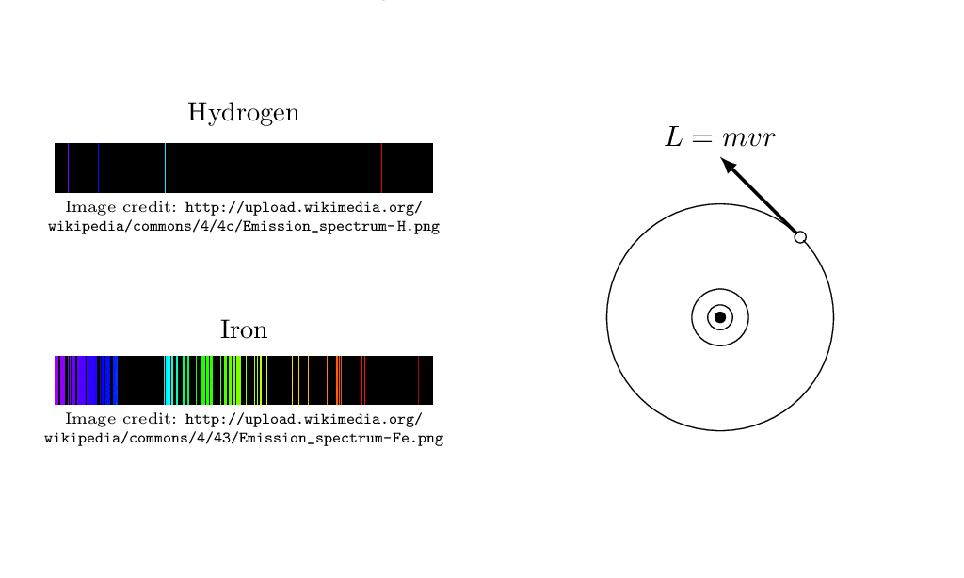
Problems in atomic theory: atom should be unstable, spectroscopy inexplicable

Slide 8
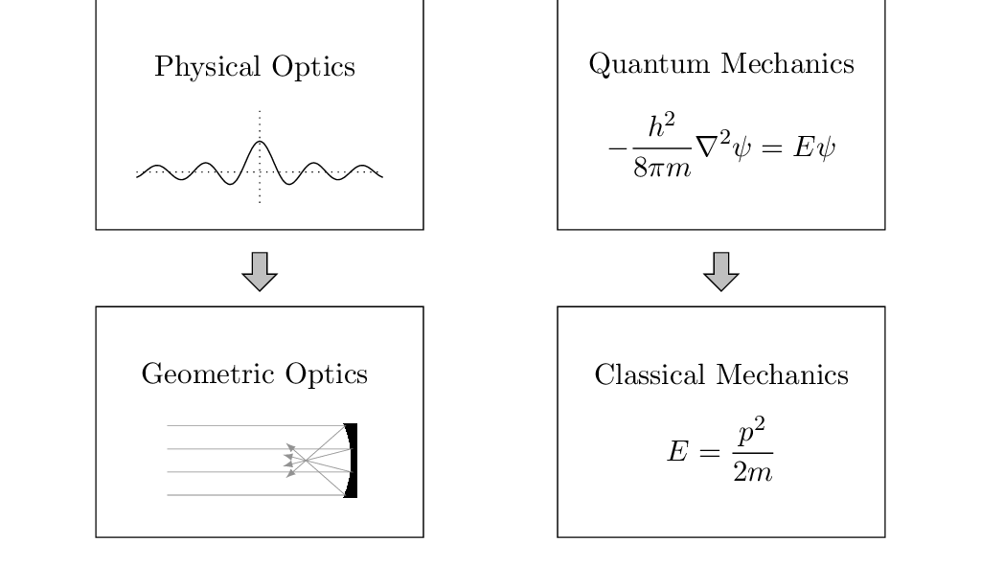
Quantum mechanics has wave-particle duality in a way similar to optics

Slide 9
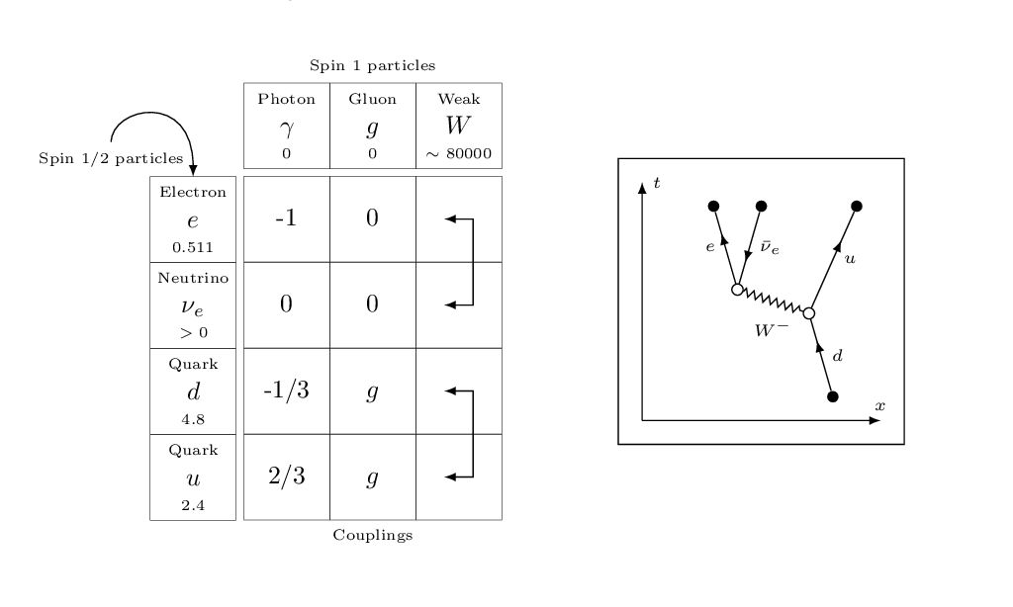
Quantum field theory is the “natural” combination of special relativity with QM

