Slide 1
Introduction and Kinematics
Physics 201 Lecture 1

Slide 2
Democritus was right – ultimately, it is all mechanics
Large
Classical
Mechanics
Classical
Field Theory
Newton
Maxwell
Einstein
Slow
Fast
Schrodinger
Dirac
Feynman
Quantum
Mechanics
Quantum
Field Theory
Small

Slide 3
What we know now
Cosmology
What it looks like | What it is
Planetary motion | Motion under gravitational force
Magnetism | Electric charge in motion
Sound | Wave motion of air
Heat | Random motion of molecules
Phase change | Rearrangement of molecular structure
Light | Flood of quantum photons
Elasticity | Static electric force between molecules
Solar system
Earth science
Our everyday world of
solids, liquids, gases
92 elements
Proton, neutron, electron, photon
Particle zoo?

Slide 4
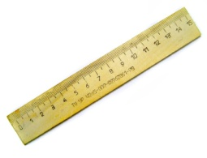
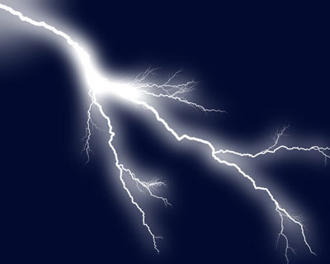
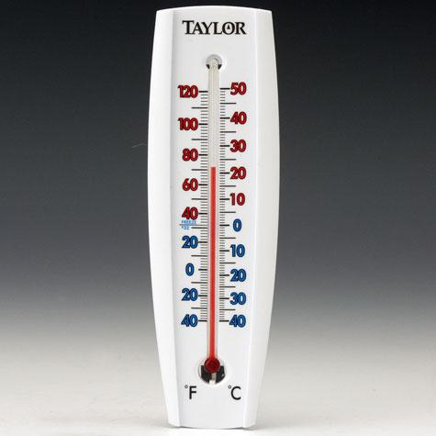
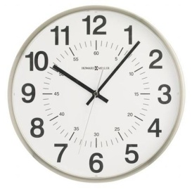

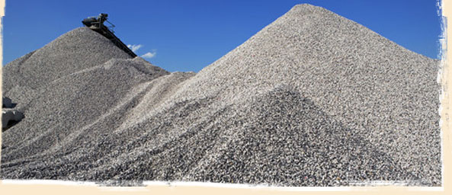
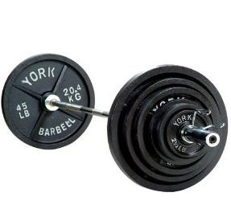
Units and measurement
Electric current
Temperature
Distance
Duration
Weight / Mass
Luminosity
Molecular count
Notes:
http://photo-dictionary.com/photofiles/list/620/4139ruler.jpg
http://remodelista.com/img/sub/uimg/janet/12-2010/Howard-miller-clock.jpg
http://www.weightliftingequipment.co/img/upload/barbell-weights.JPG
http://static.ddmcdn.com/gif/lightning-gallery-18.jpg
http://www.taylorusa.com/media/catalog/product/cache/1/image/5e06319eda06f020e43594a9c230972d/5/1/5154_2-detail.jpg
http://reddogreport.com/wp-content/uploads/2011/02/Light-Bulb-600x719.jpg
http://www.dualmfg.com/images/cycle/gravel-pile-spot.jpg

Slide 5
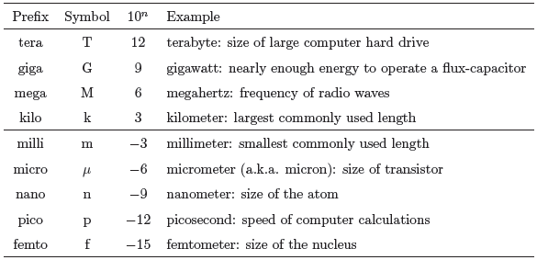
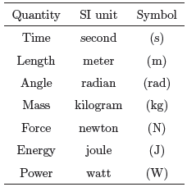
SI units and the metric system

Slide 6
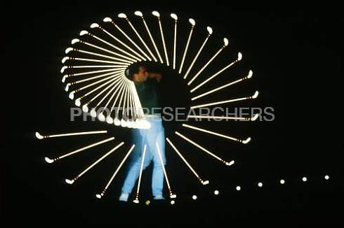

Velocity is change in position over time
Notes:
http://images.photoresearchers.com/photos/preview/7w/7w5841.jpg

Slide 7
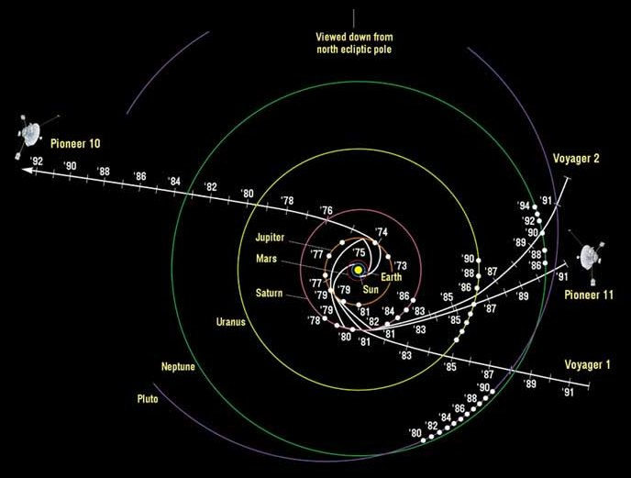
Acceleration is the rate at which velocity changes: speed or direction
Notes:
http://www.daviddarling.info/images/Pioneer_Voyager_trajectories.jpg

Slide 8

Constant acceleration yields time-squared motion
1 | 2 | 3 | 4 | 5 | 6 | 7 | 8 | 9 | 10 |  |  | 1
 |  |  |  |  |  |  |  |  |  |  |  |  |  | 3
2 | 4 | 6 | 8 | 10 | 12 | 14 | 16 | 18 | 20 |  |  | 4 |  |  |  |  | 2
 |  |  |  |  |  |  |  |  |  |  |  |  |  | 5
3 | 6 | 9 | 12 | 15 | 18 | 21 | 24 | 27 | 30 |  |  | 9 |  |  |  |  | 2
 |  |  |  |  |  |  |  |  |  |  |  |  |  | 7
4 | 8 | 12 | 16 | 20 | 24 | 28 | 32 | 36 | 40 |  |  | 16 |  |  |  |  | 2
 |  |  |  |  |  |  |  |  |  |  |  |  |  | 9
5 | 10 | 15 | 20 | 25 | 30 | 35 | 40 | 45 | 50 |  |  | 25 |  |  |  |  | 2
 |  |  |  |  |  |  |  |  |  |  |  |  |  | 11
6 | 12 | 18 | 24 | 30 | 36 | 42 | 48 | 54 | 60 |  |  | 36 |  |  |  |  | 2
 |  |  |  |  |  |  |  |  |  |  |  |  |  | 13
7 | 14 | 21 | 28 | 35 | 42 | 49 | 56 | 63 | 70 |  |  | 49 |  |  |  |  | 2
 |  |  |  |  |  |  |  |  |  |  |  |  |  | 15
8 | 16 | 24 | 32 | 40 | 48 | 56 | 64 | 72 | 80 |  |  | 64 |  |  |  |  | 2
 |  |  |  |  |  |  |  |  |  |  |  |  |  | 17
9 | 18 | 27 | 36 | 45 | 54 | 63 | 72 | 81 | 90 |  |  | 81 |  |  |  |  | 2
 |  |  |  |  |  |  |  |  |  |  |  |  |  | 19
10 | 20 | 30 | 40 | 50 | 60 | 70 | 80 | 90 | 100 |  |  | 100

Slide 9

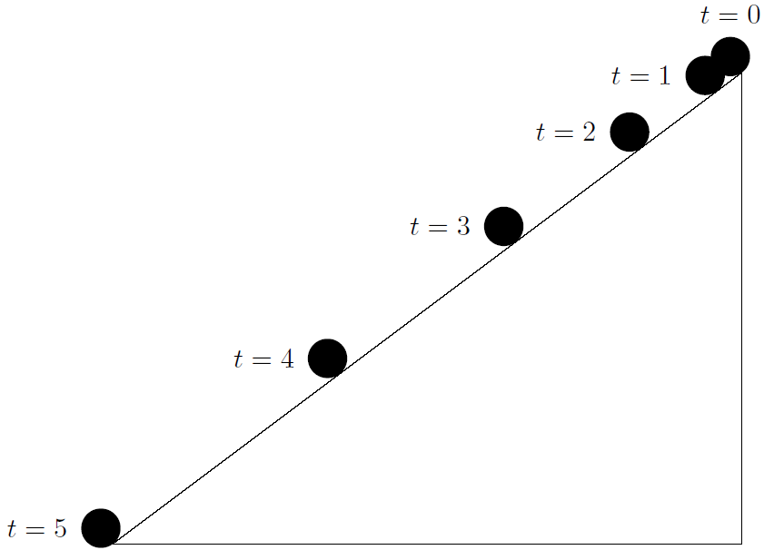

Objects in “free-fall” experience constant acceleration
Aside: What about terminal velocity?
Notes:
http://farm4.staticflickr.com/3609/3383701804_eb59c05e83_z.jpg?zz=1

