Slide 1
Acceleration Due to Gravity
Physics 201 Lecture 2

Slide 2


Equations of motion (so far)
Constant velocity
Constant acceleration
If the accelerated motion starts with some initial velocity:

Slide 3




Five equations of constant acceleration
1
2
3
4
5

Slide 4
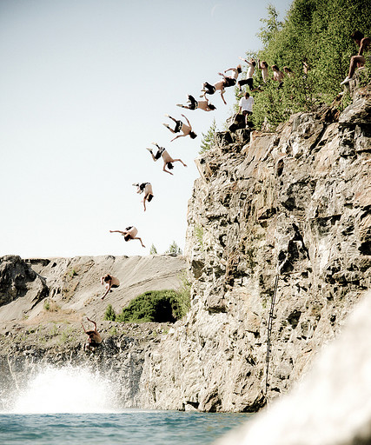
Projectile problems (2D free-fall)
Galileo cracked this type of problem by recognizing that projectile motion is two simultaneous types of motion:
Vertical free-fall
Constant acceleration
Horizontal motion
Constant velocity
The trick in solving these 2D questions is to split the problem into two simpler ones
Notes:
http://farm3.staticflickr.com/2476/3739164676_ec012ab04c_z.jpg

Slide 5

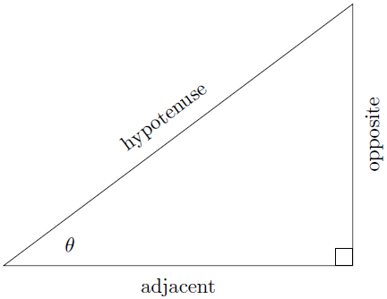



Trigonometry is required to split motion into these two components

Slide 6

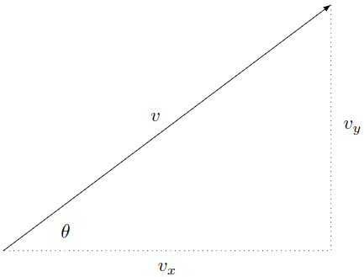


The horizontal and vertical components of velocity are related in the same way

Slide 7


Always start by using any given angle to split the problem into its two dimensions
Horizontal
Vertical
Controlling equation
Controlling equation
Time is the same for both

Slide 8
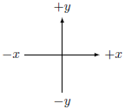

Tips for extracting info from the problem
Use proper sign conventions
Look for “implied data”
Up is positive
Keyword | Equation
Free-fall (often implied)
From rest
Comes to rest
Range
Maximum height
Down is negative
Right is positive
Left is negative
These are the same conventions used in a graph

Slide 9
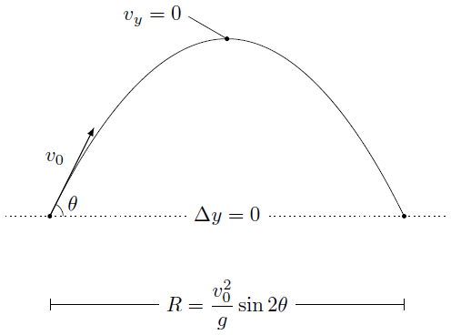
The trajectory of a projectile is a parabola
Fun facts
The trajectory is symmetric: the speed going up is the same as the speed going down
Maximum height is associated with zero vertical velocity
Time of flight is controlled by vertical speed, not horizontal
Maximum range at 45°

