Slide 1
Vectors and Equilibrium
Physics 201 Lecture 3

Slide 2
Physical systems are always subject to multiple forces
Dealing with forces is what vectors are for
  We will want to “break apart” a force into specific components
  We will want to “combine” forces to determine their net effect
This is a subject known as “vector algebra”
  We will speak of “adding” vectors, but this is a metaphor:
  vectors are not numbers!
  Behind every vector addition is a triangle – these are vector problems are all essentially geometry problems
  Trigonometry is the bridge between geometry and algebra – vectors help us to manage our use of trigonometry

Slide 3
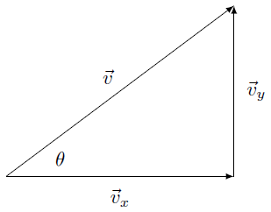

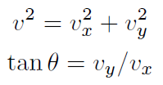
All you need to know about vectors: components
Components from vector
Vector from components
Some fine print…
The arrow represents a vector, a letter without an arrow represents its magnitude
What I have drawn as components ought to be vectors, not magnitudes

Slide 4
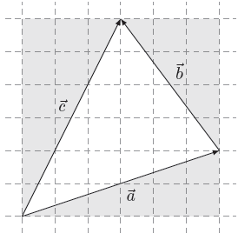
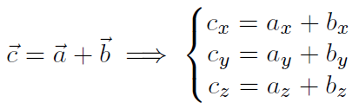
When you add vectors, add the components
Every vector formula actually represents two or three component equations
If this makes your head hurt, imagine doing this without components…

Slide 5
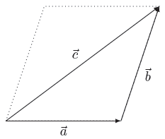
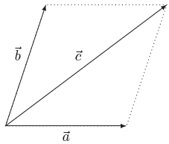
A subtle distinction…
Displacement
Force
Consecutive addition
Align head-to-tail
Simultaneous addition
Align tail-to-tail

Slide 6
Physical systems are always subject to multiple forces
The main objective of mechanics is to determine the reaction of the system to these interactions
The different independent ways the system can respond are called its degrees of freedom
  A particle has three: the dimensions of space
  A rigid solid has six: translation and rotation
Equilibrium is balance along every degree of freedom
  This definition is worded to work in every case all year
  For a particle, only the net unbalanced force counts

Slide 7




Only the net unbalanced force counts
The system can only move in one direction – it will follow the vector sum of the forces
Typically, the initial step in these mechanical problems will be to calculate this net force
We have equilibrium when

Slide 8
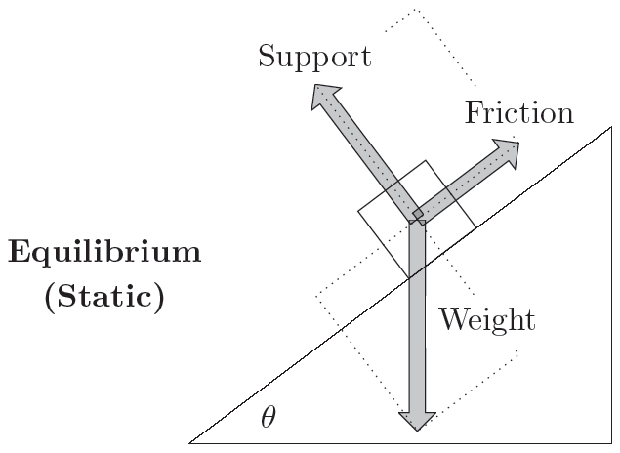
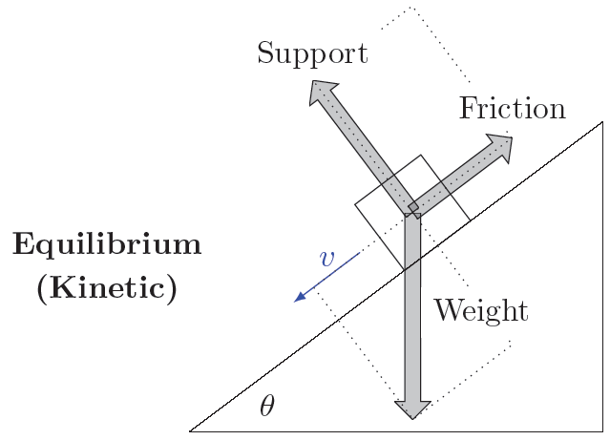

Potential “gotcha”: Equilibrium does not necessarily mean at rest

Slide 9
List of mechanical forces
Contact forces
Elastic force
Buoyancy
Kinetic friction
Air drag
Long range forces
Weight
Magnetism
Gravity
Static electricity
Reaction forces
Tension
Support
Static friction
Force | Symbol
Weight
Tension
Support
Static friction
Kinetic friction
These are whatever it takes to establish equilibrium

