Slide 1
Force and Acceleration
Physics 201 Lecture 4

Slide 2

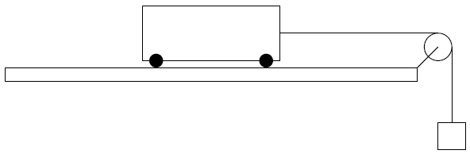
Unbalanced Force Causes Acceleration

Slide 3
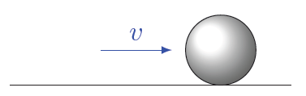
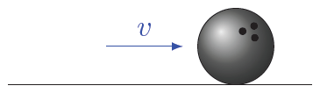
Mass Quantifies Inertia

Slide 4
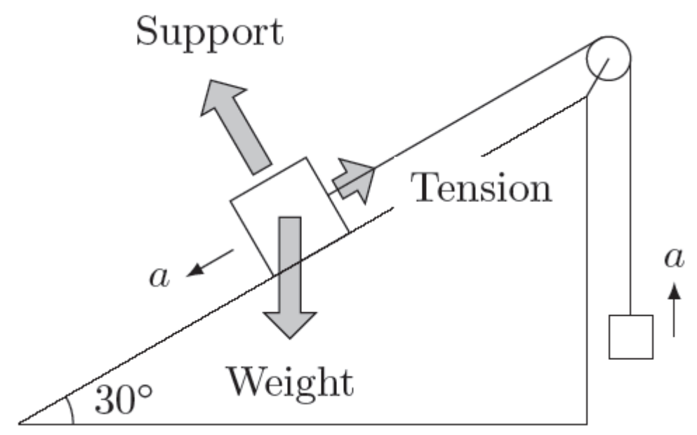
Only the Net Force Counts

Slide 5
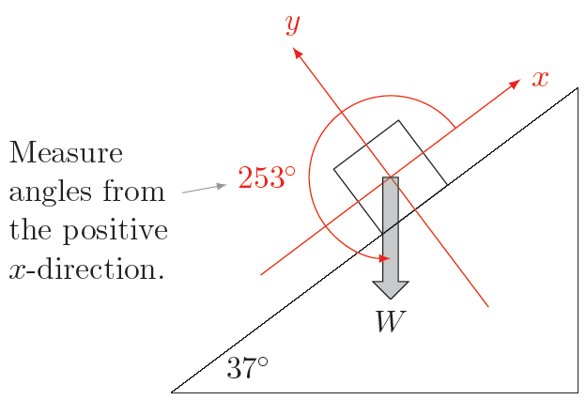
Align Your Coordinates

Slide 6
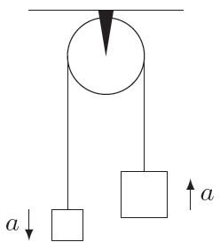
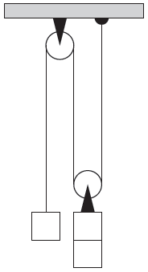
Weight, Tension, Strings, and Pulleys
Notes:
http://upload.wikimedia.org/wikipedia/commons/thumb/e/e1/Tackles.png/640px-Tackles.png

Slide 7
Support and Elastic Forces

Slide 8
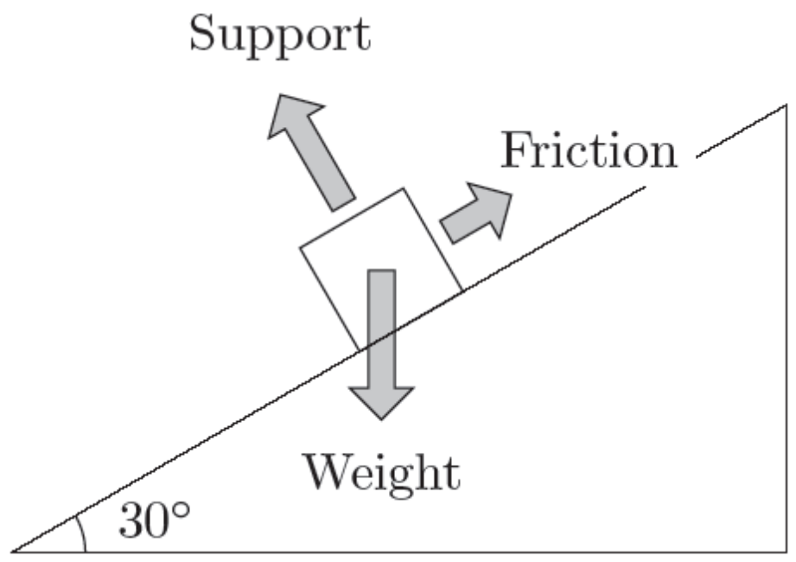


Friction: Kinetic or Static
Static Friction
(no motion)
Kinetic Friction
(with motion)

Slide 9
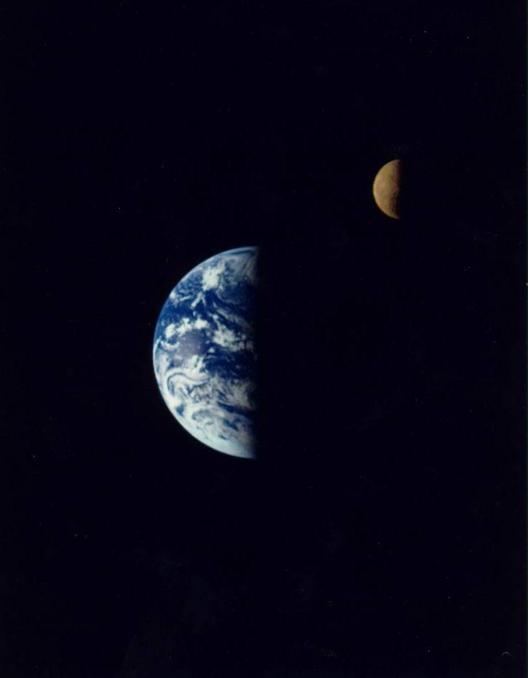

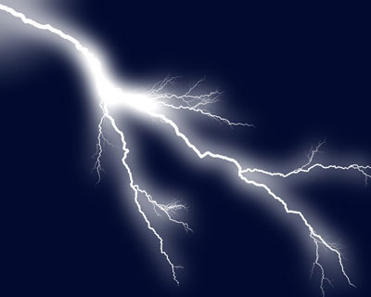
The Long-Range Forces
Magnetism
Gravity
Electricity
Notes:
http://photo-dictionary.com/photofiles/list/6171/8130horseshoe_magnet.jpg
http://nssdc.gsfc.nasa.gov/image/planetary/earth/gal_earth_moon.jpg
http://static.ddmcdn.com/gif/lightning-gallery-18.jpg

