Slide 1
Circular Motion and Gravity
Physics 201 Lecture 5

Slide 2
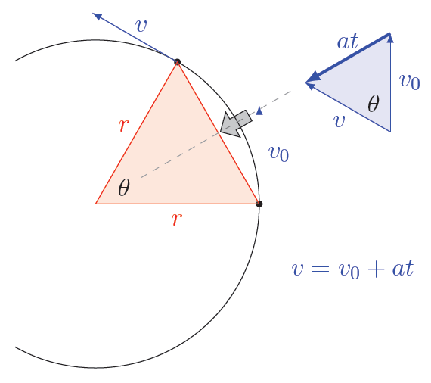


Acceleration for Uniform Circular Motion

Slide 3
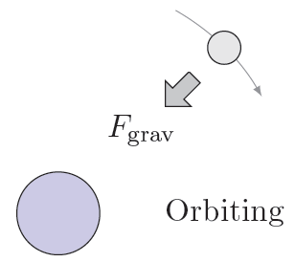
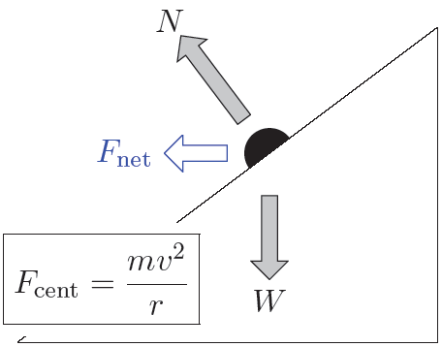
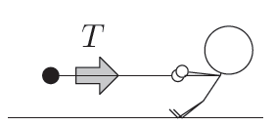
Centripetal Force is the Net Force

Slide 4
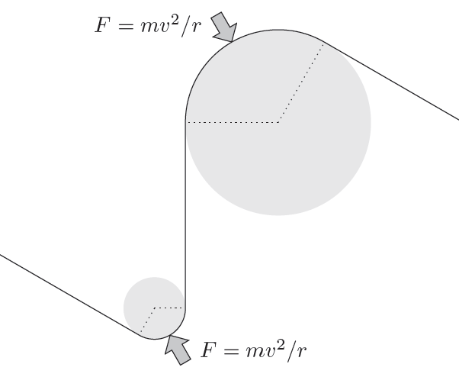
Radius of Curvature

Slide 5
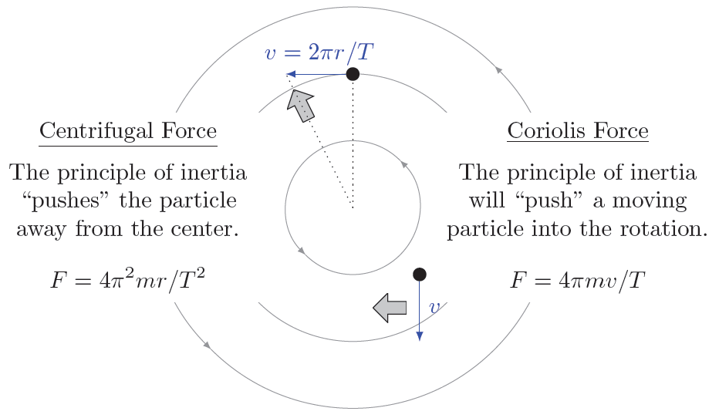
Rotating Frames and Inertial Forces

Slide 6

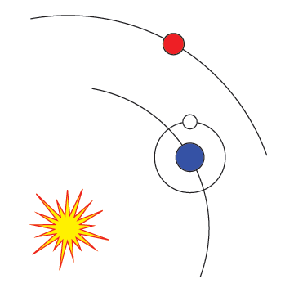
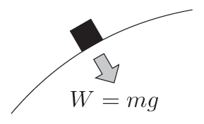

Newton’s Law of Gravity

Slide 7

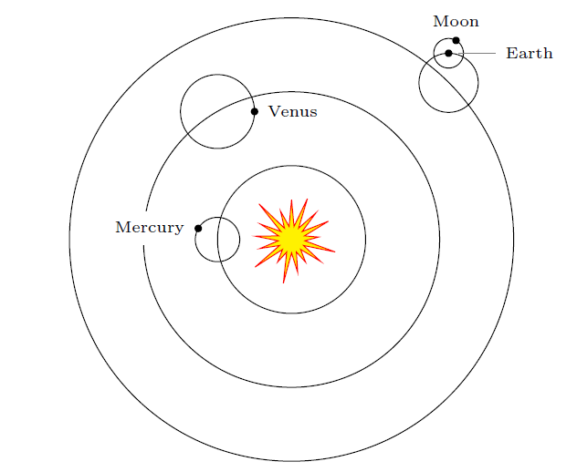


Kepler’s Third Law

Slide 8
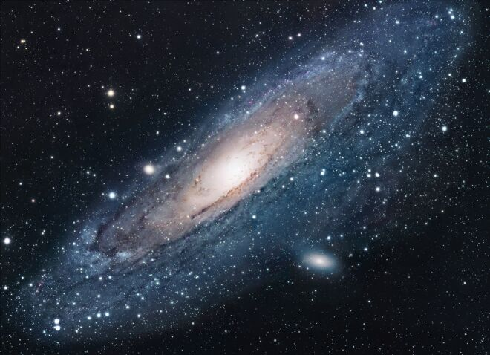
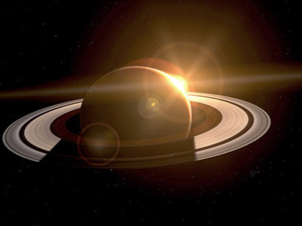
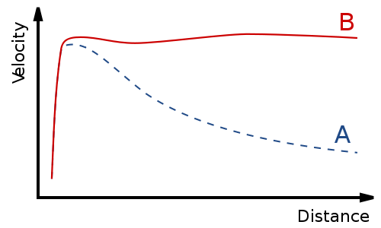
From Kepler: Saturn’s Rings, Dark Matter
Notes:
http://www.fileshome.com/images/scr/3414.jpg
http://www.solstation.com/x-objects/and2disk.jpg
http://upload.wikimedia.org/wikipedia/commons/thumb/b/b9/GalacticRotation2.svg/500px-GalacticRotation2.svg.png

Slide 9
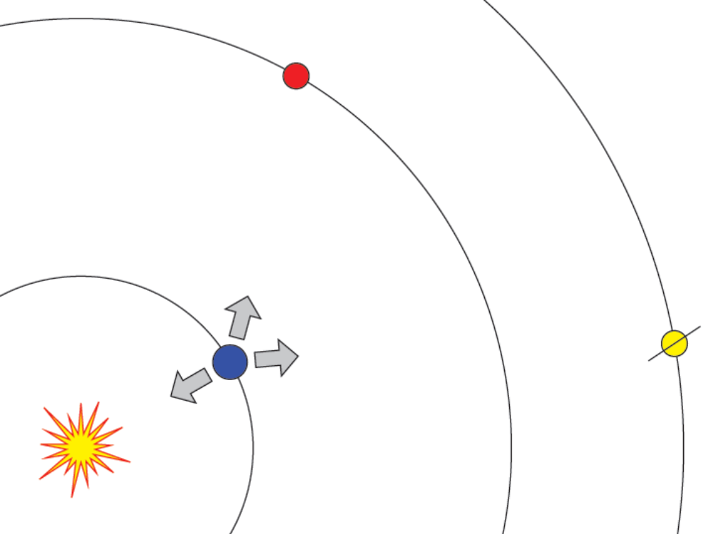
Perturbation Corrects Kepler

