Slide 1
Work, Power, and Energy
Physics 201 Lecture 6

Slide 2
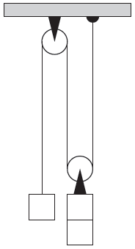
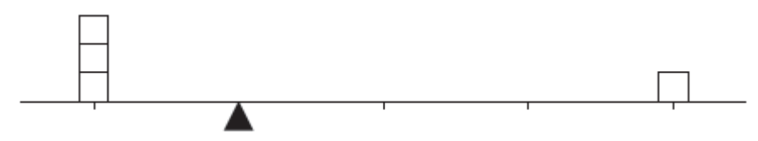
Machines and Mechanical Advantage

Slide 3
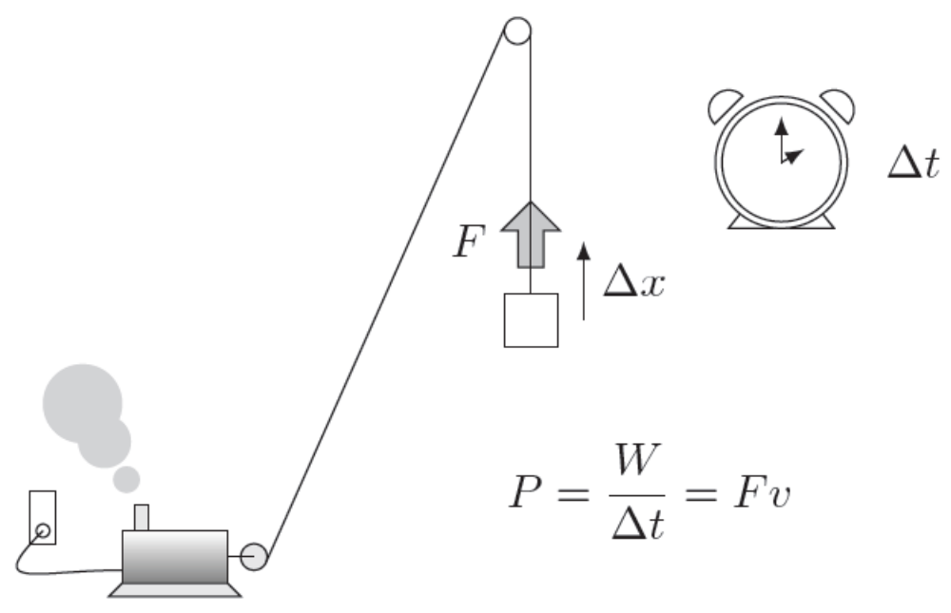
Work, Power, and Efficiency

Slide 4
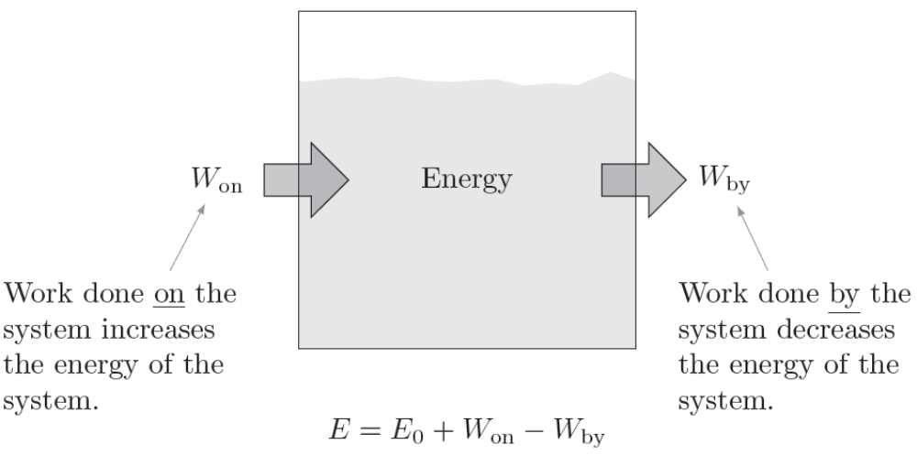
Energy is the Ability to Do Work

Slide 5
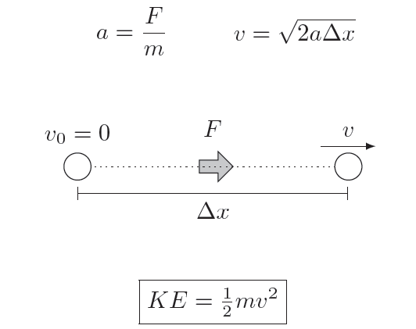
Kinetic Energy Defined

Slide 6
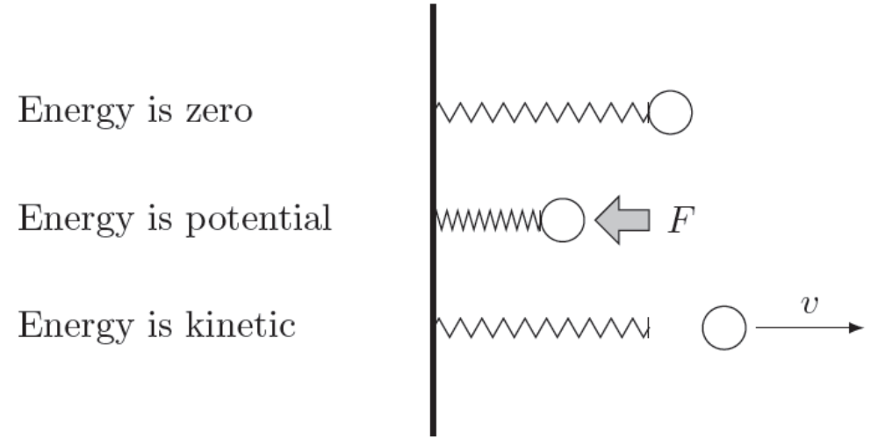
Potential Energy Defined

Slide 7
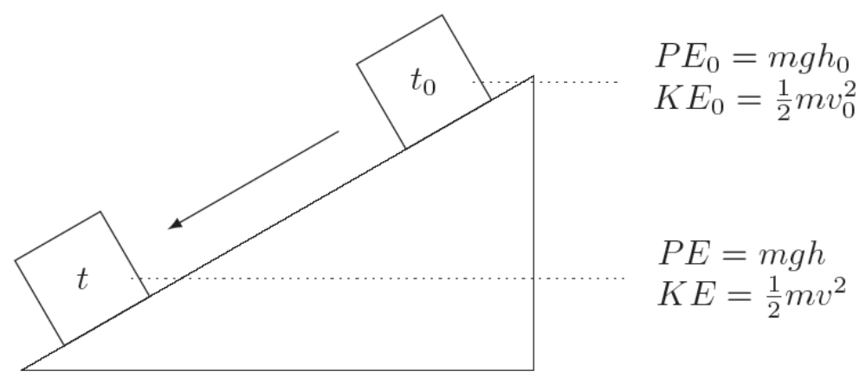
Conservation of Energy

Slide 8
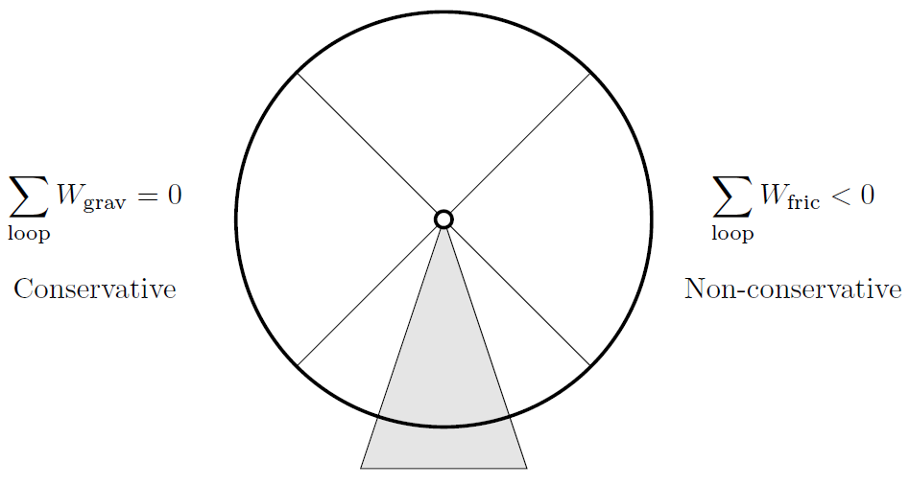
Non-Conservative Forces

Slide 9
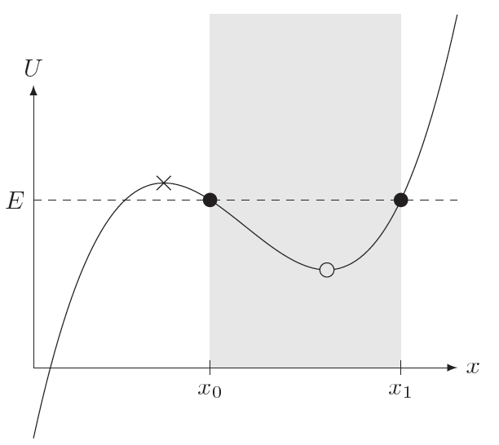
Energy Diagrams

