Slide 1
Interacting Systems
Physics 201 Lecture 7

Slide 2
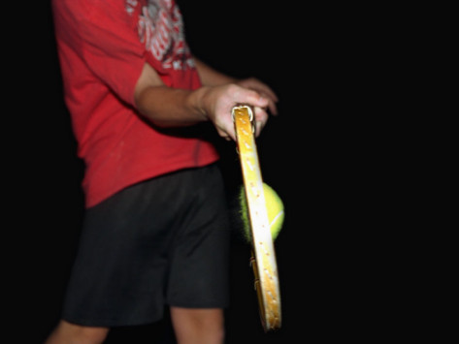
Impulse Changes Momentum
Notes:
http://imgc.allpostersimages.com/images/P-473-488-90/38/3814/YYRIF00Z/posters/amoz-eckerson-tennis-ball-impact-strobe.jpg

Slide 3
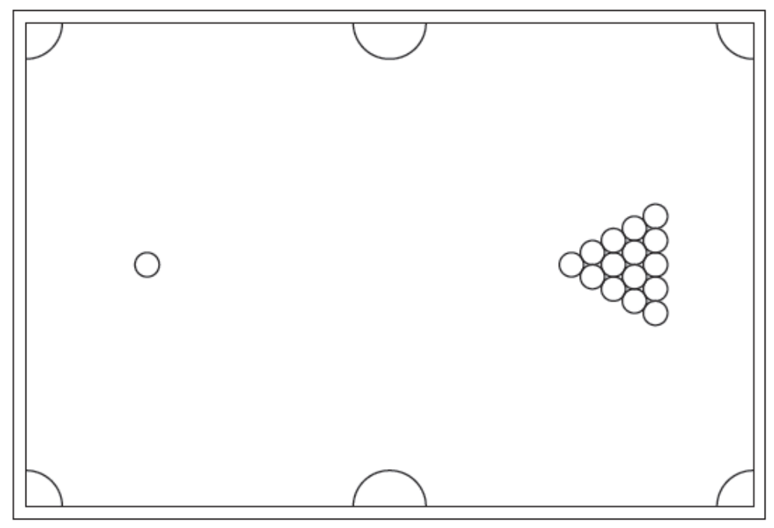
Collisions Conserve Momentum

Slide 4
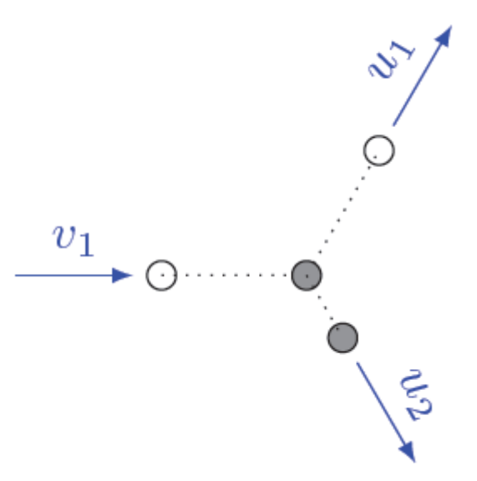
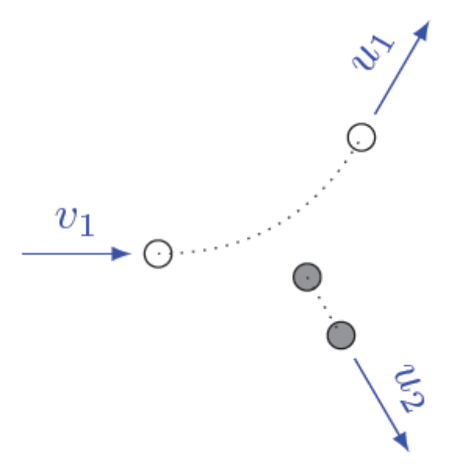
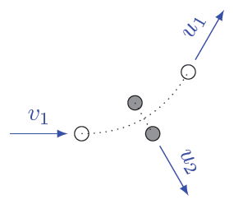
Elastic Collisions Conserve Energy
Billiards
Collision
Atomic
Scattering
Gravitational
Slingshot

Slide 5
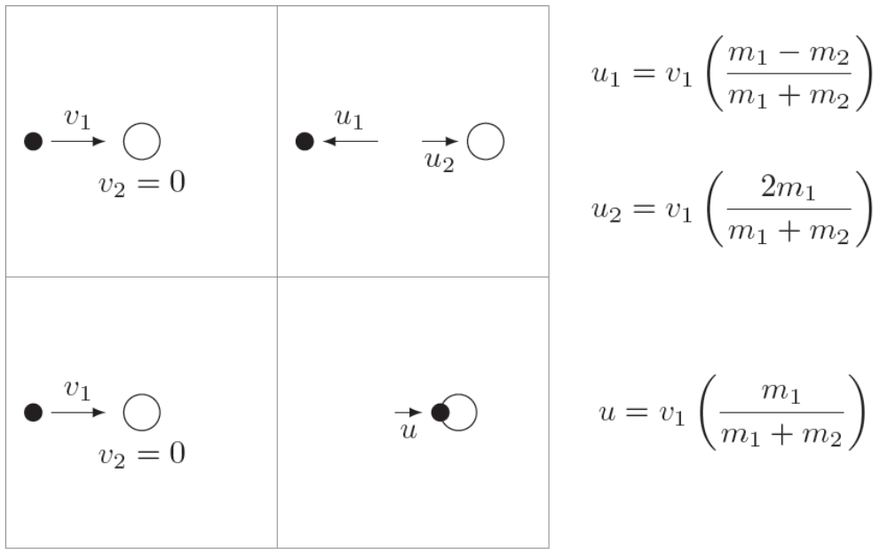
Lab and Center of Mass Frames

Slide 6
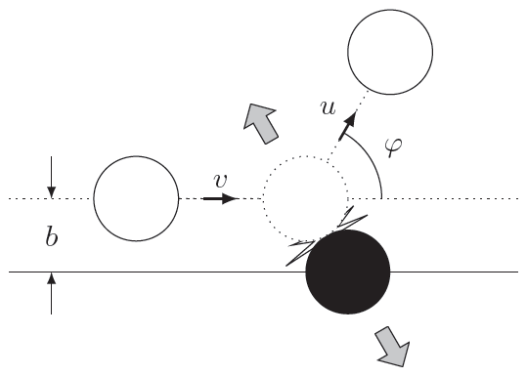
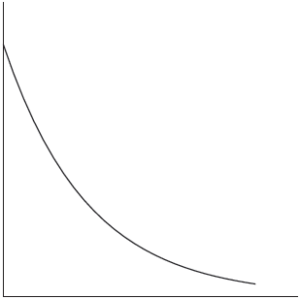
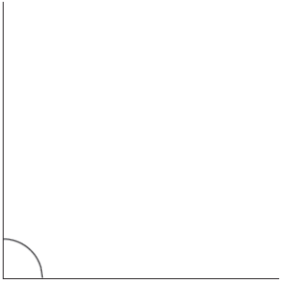
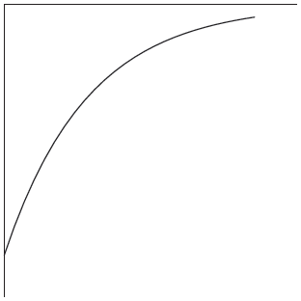
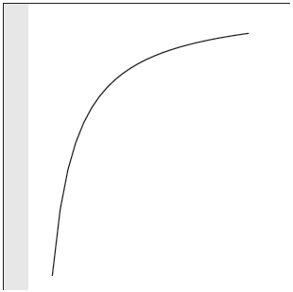
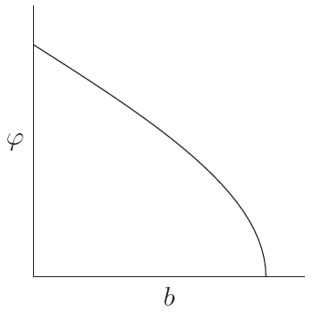

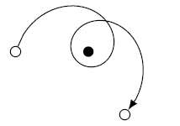

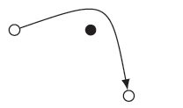
2D Interactions: Scattering
Rutherford
“Pudding”
Newton
Einstein

Slide 7
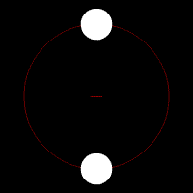
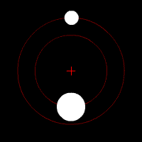
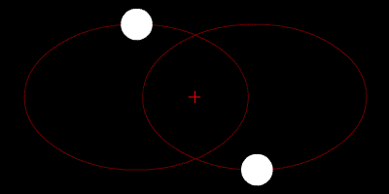
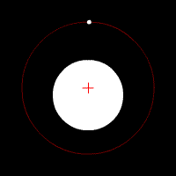
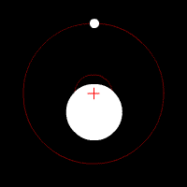
2D Interactions: Bound Orbits
Notes:
http://en.wikipedia.org/wiki/File:Orbit1.gif
http://en.wikipedia.org/wiki/File:Orbit2.gif
http://en.wikipedia.org/wiki/File:Orbit3.gif
http://en.wikipedia.org/wiki/File:Orbit4.gif
http://en.wikipedia.org/wiki/File:Orbit5.gif

Slide 8
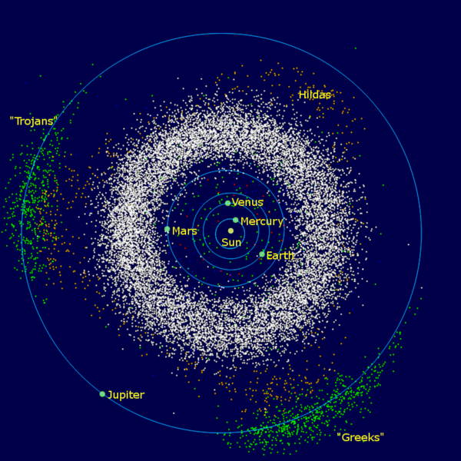
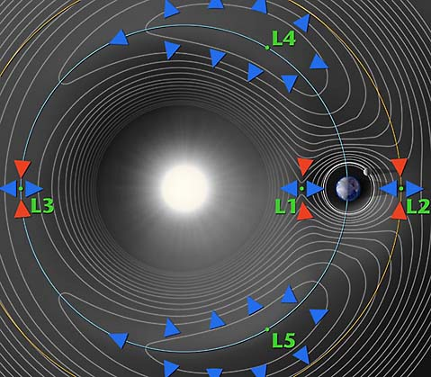
The Three-Body Problem is a Problem
Notes:
http://map.gsfc.nasa.gov/mission/observatory_l2.html
http://en.wikipedia.org/wiki/Solar_System

Slide 9
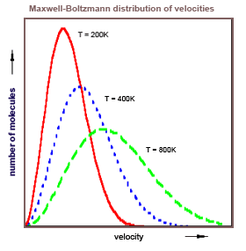
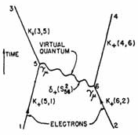
Statistical Mechanics and QFT
Notes:
http://www.informationphilosopher.com/introduction/physics/images/Maxwell_Boltzmann.gif
http://www.physicscentral.com/explore/action/images/first_feynman_diagram.jpg

