Slide 1
Equilibrium and Torque
Physics 201 Lecture 8

Slide 2
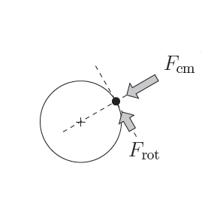
In general, a force has two significant components
Force in line with the center of mass – leads to acceleration
Force perpendicular to the center of mass – leads to rotation
This will make the puck move
This will make the puck spin

Slide 3
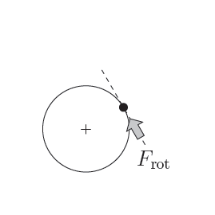
Torque is about leverage
Force perpendicular to the center of mass – leads to rotation
This will make the puck spin

Slide 4
The study of leverage goes back to Archimedes
Definition of Torque

Slide 5
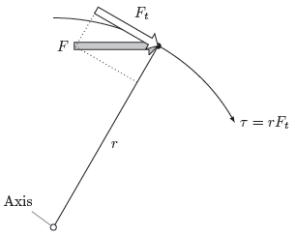
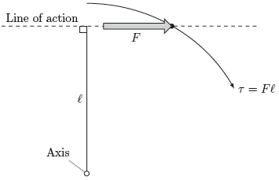
Two compatible ways to calculate torque
Tangential component
Lever arm

Slide 6



Equilibrium is balance along every degree of freedom
In general, a rigid object has six degrees of freedom, but we will only consider fixed rotation
For fixed rotation there are three equations of equilibrium:

Slide 7
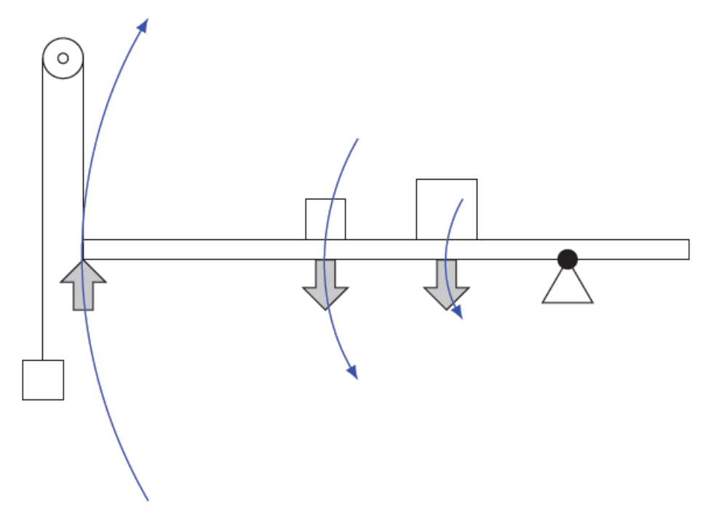
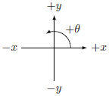
Sign of torque shows which way the rotation would occur if it could
Negative
This is the
same convention used in a graph
Positive

Slide 8
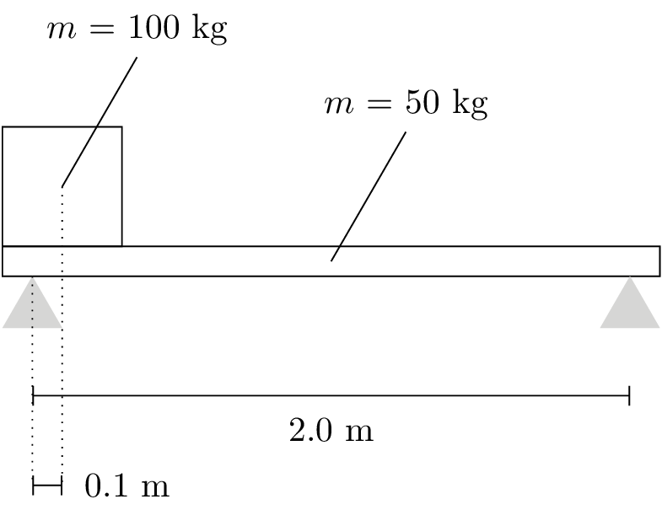
The center of gravity is generally in the center of the object

Slide 9
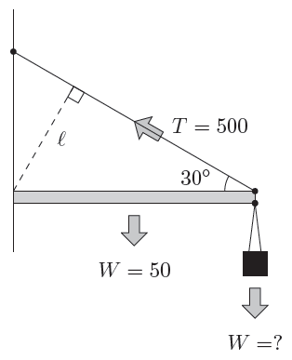
A harder problem…

