Slide 1
Torque and Rotation
Physics 201 Lecture 9

Slide 2

Radians are the “natural” way to measure angle
Arc-length is proportional to both the angle and the radius of the circle – in symbols:
We can simplify with a new unit for angle:
Using radians creates a cleaner expression for
arc-length:

Slide 3




There is an analogy between the definitions of linear and angular motion
Rotation is change in orientation

Slide 4
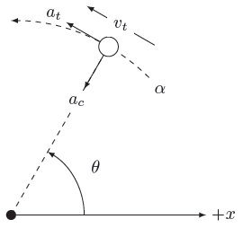

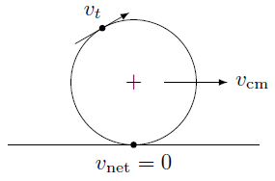
The parts of a rigid object rotate together
Tangential components
Radial components
Condition for things that are rolling
Slipping:
Sliding:

Slide 5
Torque drives angular acceleration
We seek a formula like Newton’s second law in the context of rotation – it will look like:
We have discussed torque and angular acceleration
The piece in the middle corresponds to mass for rotation and is called the moment of inertia
We must now discuss how to determine its value for various objects

Slide 6
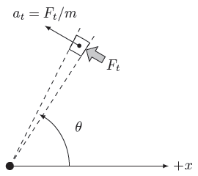


Moment of inertia depends on the distribution of mass
Each piece obeys Newton’s second law individually

Slide 7
That sum hides the calculus – we use a table
Object | Moment of Inertia
Circular ring
Circular plate
Hollow sphere
Solid sphere
Object | Moment of Inertia
Thin rod (center)
Thin rod (end)
Moment of inertia is smallest when mass is concentrated near the axis

Slide 8
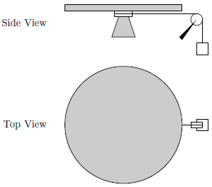
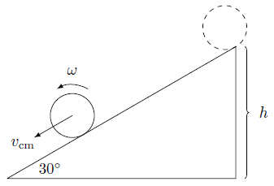

Some examples
Could use energy and/or momentum also…
Notes:
http://hyperphysics.phy-astr.gsu.edu/hbase/mi.html

Slide 9
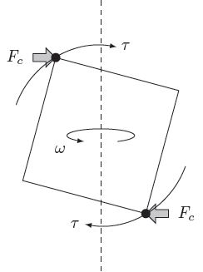
Free rotation – the moment of inertia is really a tensor
If rotation is not along a line of symmetry, extra torque is required to support the rotation
This causes a wobble in the rotation: precession and nutation
Every object has a wobble-free axis – dynamic balancing

