Slide 1
Celestial Mechanics
Physics 201 Lecture 10

Slide 2
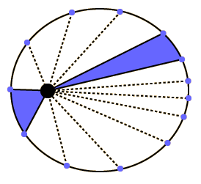
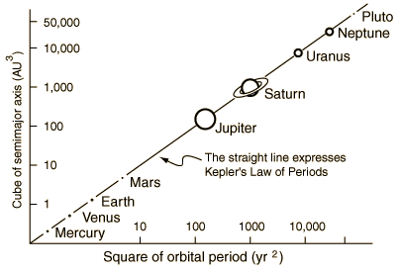
Kepler and Newton
Notes:
http://hyperphysics.phy-astr.gsu.edu/hbase/kepler.html

Slide 3
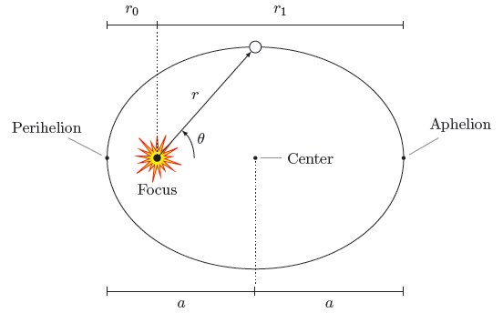
All Things Elliptical

Slide 4
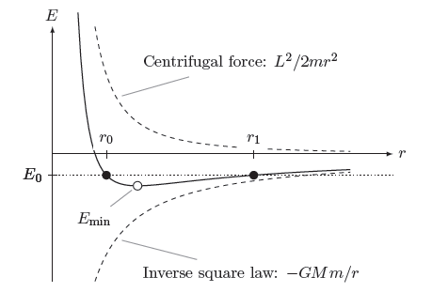
The Effective Potential

Slide 5
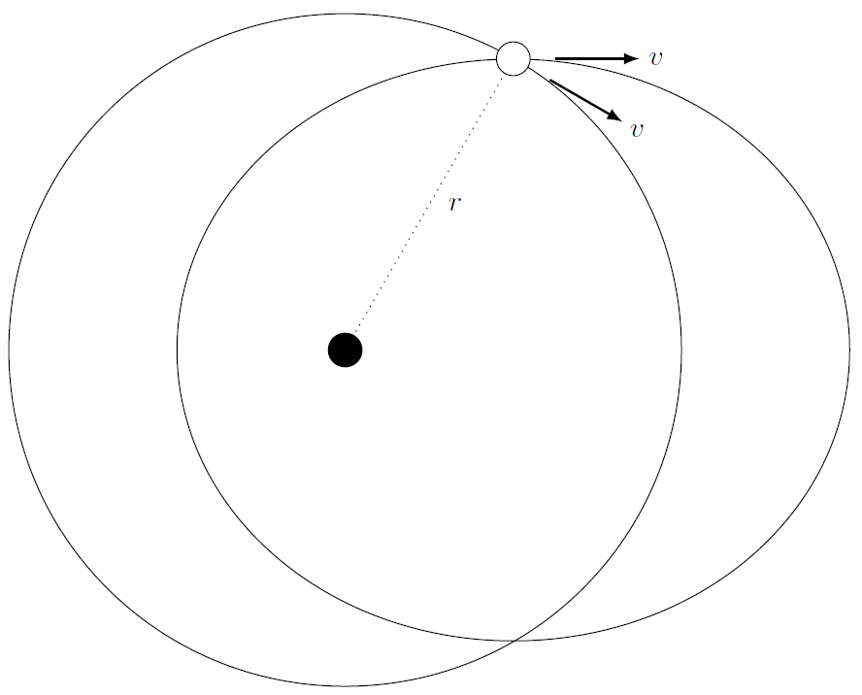


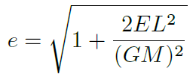
Connection Between Parameters

Slide 6
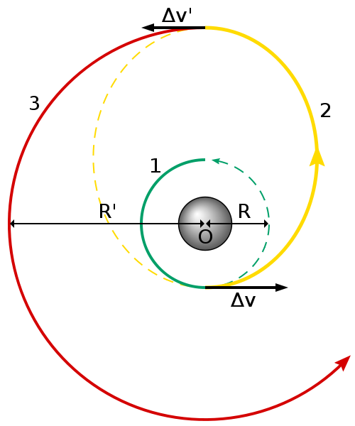


The Hohmann Transfer Orbit
Notes:
http://en.wikipedia.org/wiki/File:Hohmann_transfer_orbit.svg

Slide 7
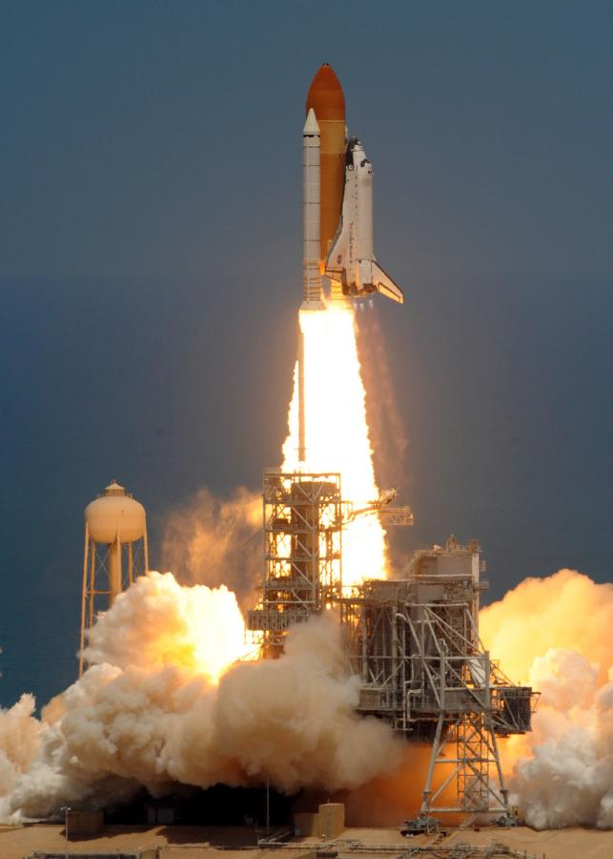
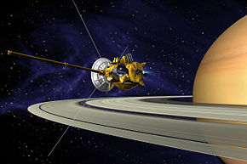
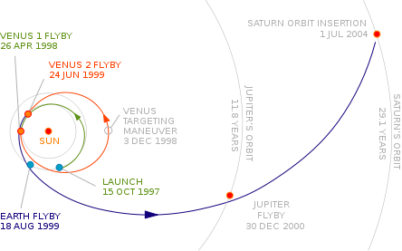
Delta-V: Rockets and Slingshots
Notes:
http://ph.cdn.photos.upi.com/slideshow/full/2f13f9e93adb5372a4d015f77fbbf51f/Atlantis-shuttle-launch.jpg
http://en.wikipedia.org/wiki/Cassini%E2%80%93Huygens

Slide 8
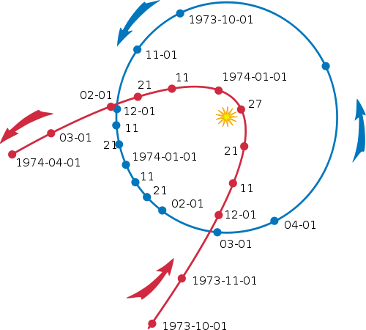
Unbound Orbits

Slide 9

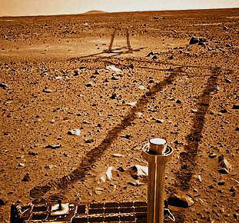
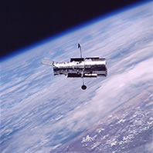
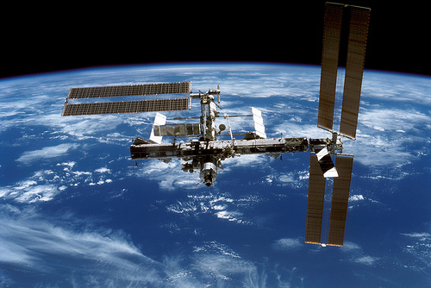
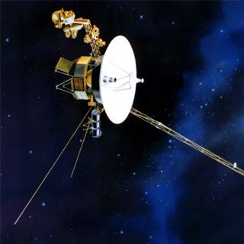
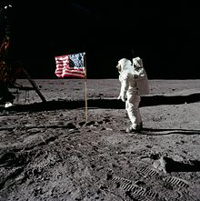

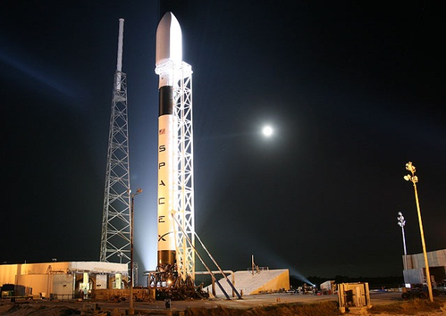
Some Space Flight History
Notes:
http://www.fastcompany.com/pics/sites/fastcompany.com.mba/linkedfiles/imagecache/slideshowlarge/slideshows/yuri-gagarin.jpg
http://www.nevadaspacegrant.com/wp-content/uploads/2010/01/Space-Station.jpg
http://images.mylot.com/userImages/images/postphotos/1186963.jpg
http://hubblesite.org/the_telescope/hubble_essentials/graphics/telescope_essentials_introduction1.jpg
http://www.scientificamerican.com/media/inline/salvaging-nasas-grand-tour_1.jpg
http://msnbcmedia2.msn.com/j/msnbc/Components/Photo_StoryLevel/080508/080508_Space_Rovers2.grid-6x2.jpg
http://upload.wikimedia.org/wikipedia/commons/thumb/d/dd/Buzz_salutes_the_U.S._Flag.jpg/220px-Buzz_salutes_the_U.S._Flag.jpg
http://www.spacex.com/falcon9.php

