Slide 1
Bending Time
Physics 201 Lecture 10

Slide 2


Einstein’s Elevator
=
=

Slide 3
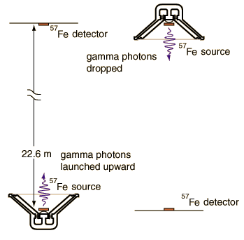
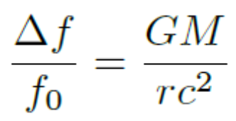
Gravitational Redshift
Notes:
http://hyperphysics.phy-astr.gsu.edu/hbase/relativ/gratim.html

Slide 4
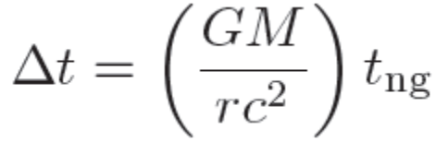
“Curved Time” and Weight

Slide 5
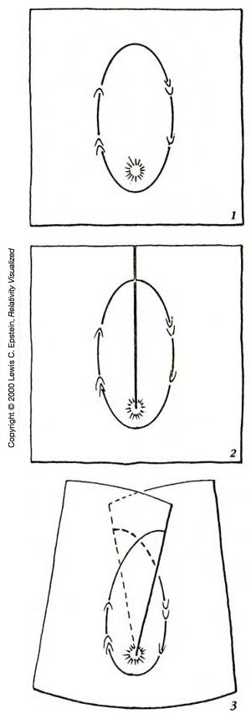
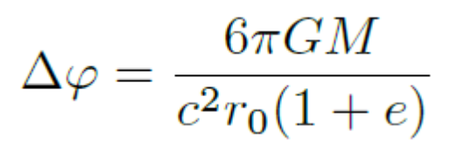

The Elevator is Limited: “Curved Space”
Notes:
http://www.relativity.li/en/epstein2/read/i0_en/i1_en/

Slide 6
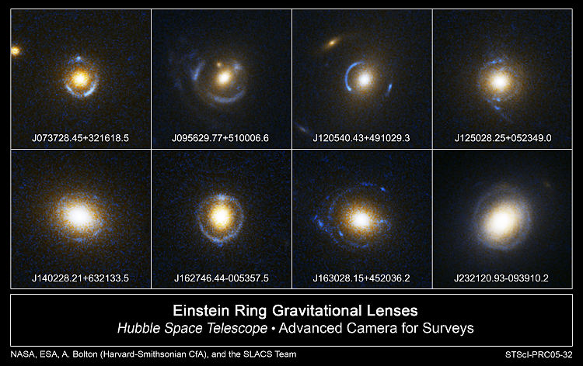
Einstein’s Field Equations
Notes:
http://en.wikipedia.org/wiki/File:Einstein_Rings.jpg

Slide 7
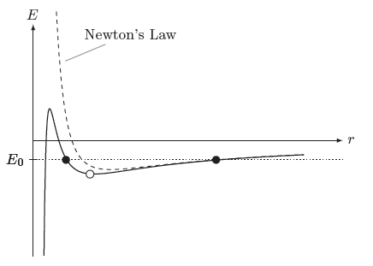
A New Effective Potential

Slide 8
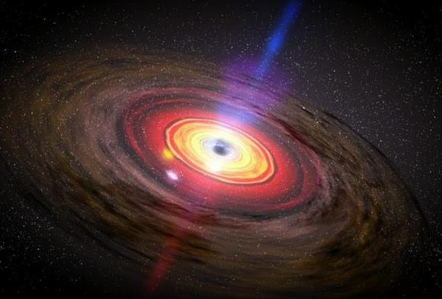
Black Holes: Event Horizon
Notes:
http://www.universetoday.com/wp-content/uploads/2011/02/467382main_dn12679-1_600.jpg

Slide 9
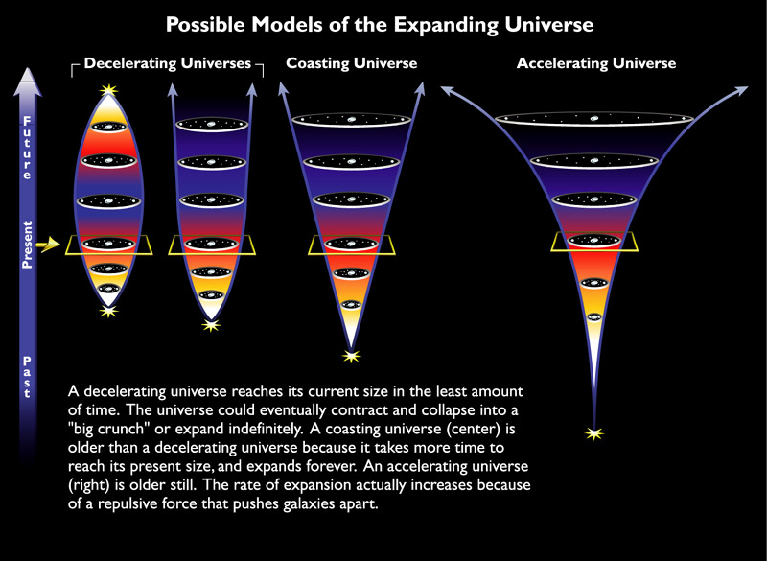
Einstein’s Biggest Blunder
Notes:
http://hubblesite.org/newscenter/archive/releases/1999/19/image/k/format/large_web/

