Slide 1
Electric Field and Potential
Physics 203 Lecture 1

Slide 2
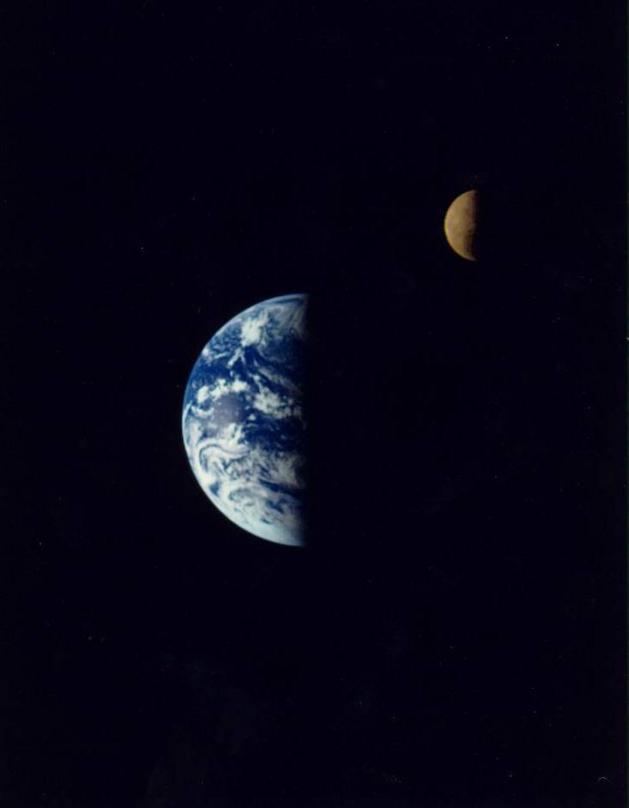

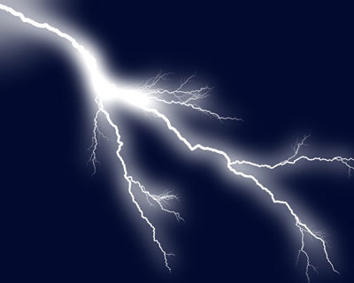
Long Range Forces And Fields
Magnetism
Gravity
Electricity
Notes:
http://photo-dictionary.com/photofiles/list/6171/8130horseshoe_magnet.jpg
http://nssdc.gsfc.nasa.gov/image/planetary/earth/gal_earth_moon.jpg
http://static.ddmcdn.com/gif/lightning-gallery-18.jpg

Slide 3
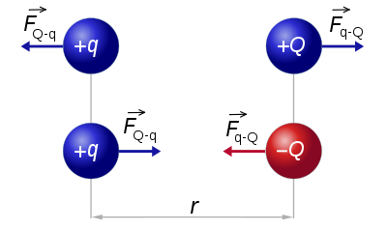
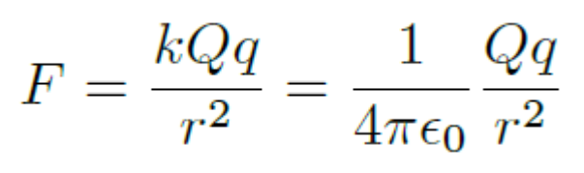

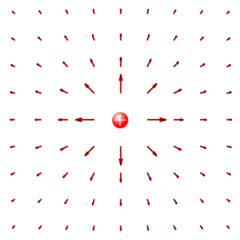
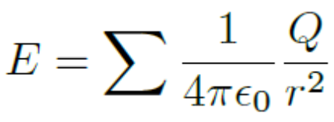
Coulomb’s Law for Electric Charge
Notes:
http://en.wikipedia.org/wiki/Coulomb’s_law
https://commons.wikimedia.org/wiki/File:E_FieldOnePointCharge.svg

Slide 4
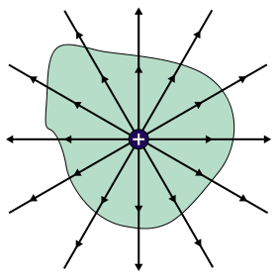


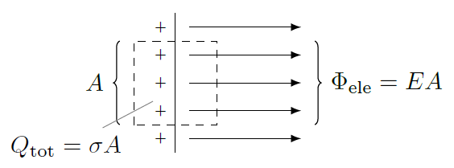
Gauss’ Law and Electric Flux
Notes:
https://commons.wikimedia.org/wiki/File:GaussLaw1.svg

Slide 5
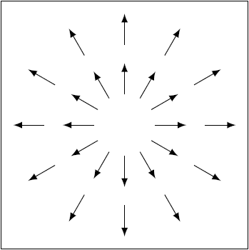
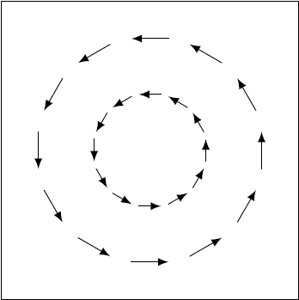


Divergence and Curl
Notes:
Cf.
http://software.intel.com/en-us/articles/fluid-simulation-for-video-games-part-1/

Slide 6
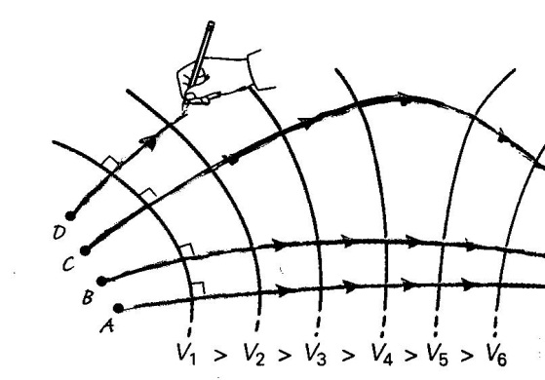
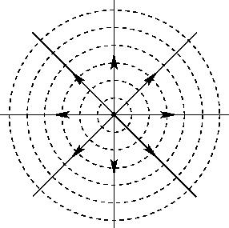



Electric Potential
Notes:
http://farside.ph.utexas.edu/teaching/316/lectures/node34.html
http://home.roadrunner.com/~enloephysics/potential.htm

Slide 7
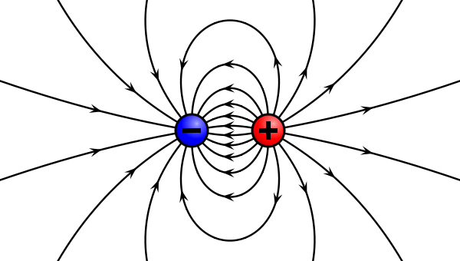



Neutral Atoms and Dipole Moments
Notes:
http://en.wikipedia.org/wiki/Dipole

Slide 8
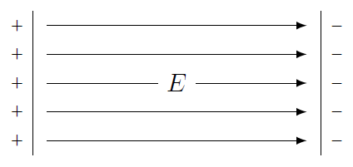
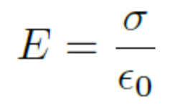
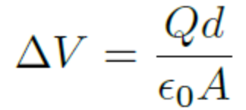
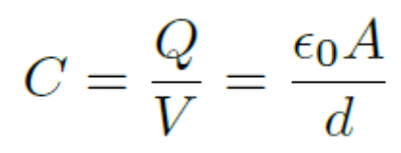
Conductors, Insulators, and Capacitors

Slide 9
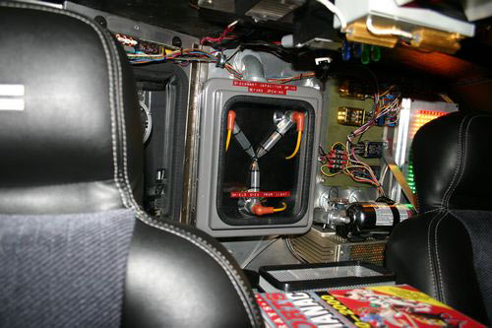

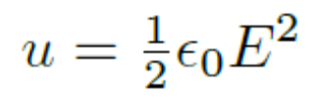
Electric Energy
Notes:
http://www.thegreenhead.com/2007/12/back-to-the-future-flux-capacitor-replica.php

