Slide 1
Cam UI

Slide 2
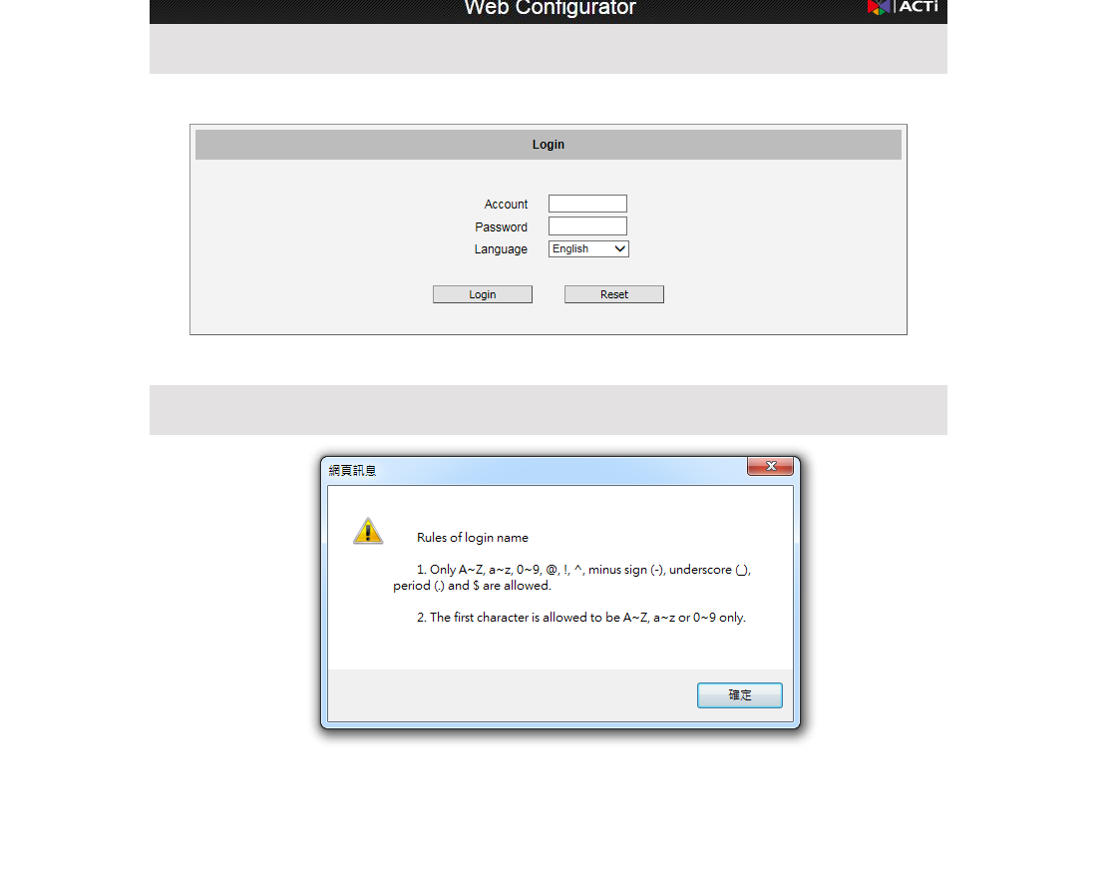
Log In

Slide 3
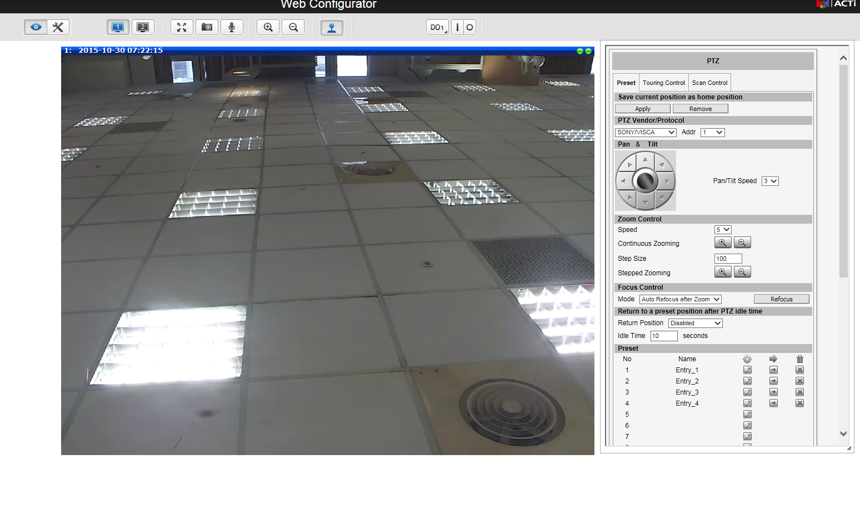
Live View- PTZ Control-Preset

Slide 4
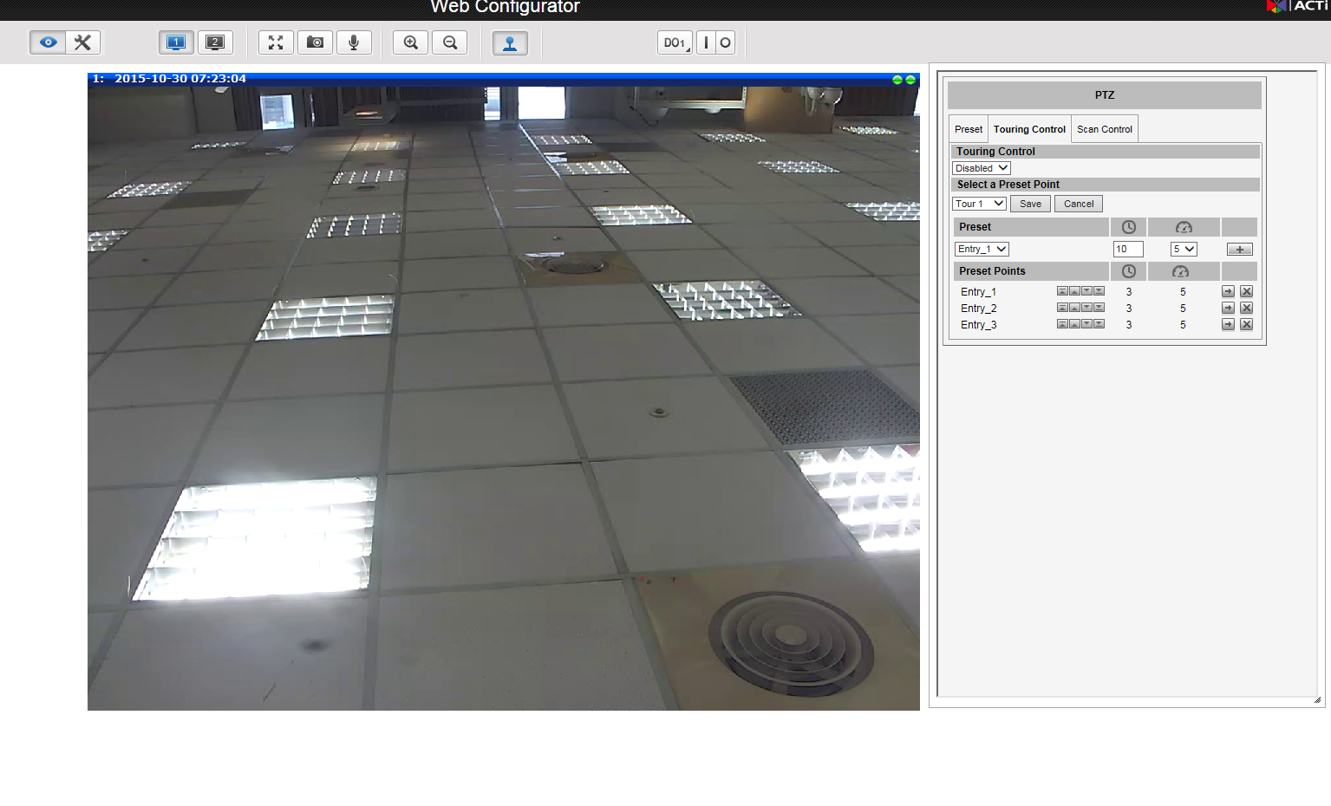
Live View- PTZ Control-Touring

Slide 5
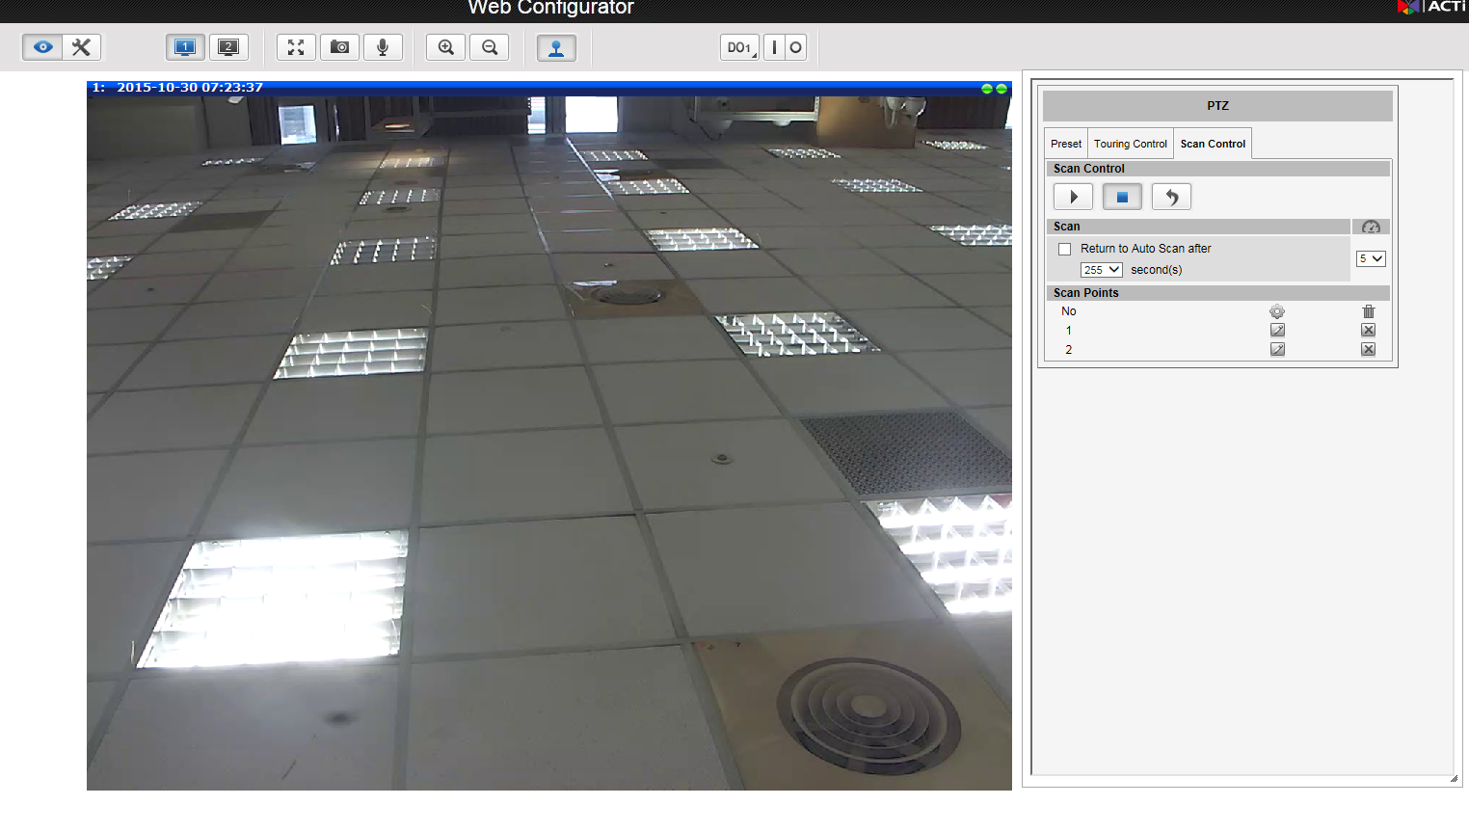
Live View-PTZ Control-Scan

Slide 6
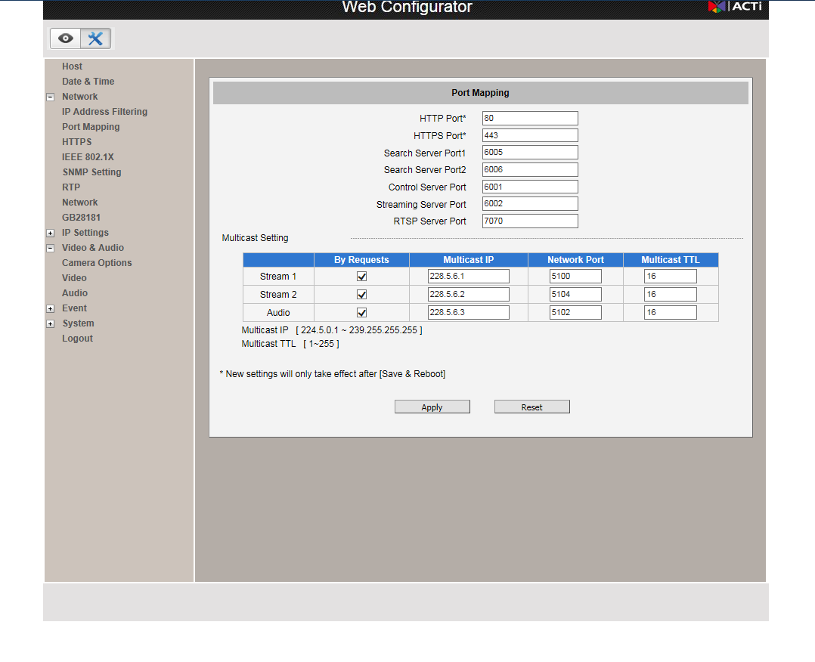
Setup – Port Mapping

Slide 7
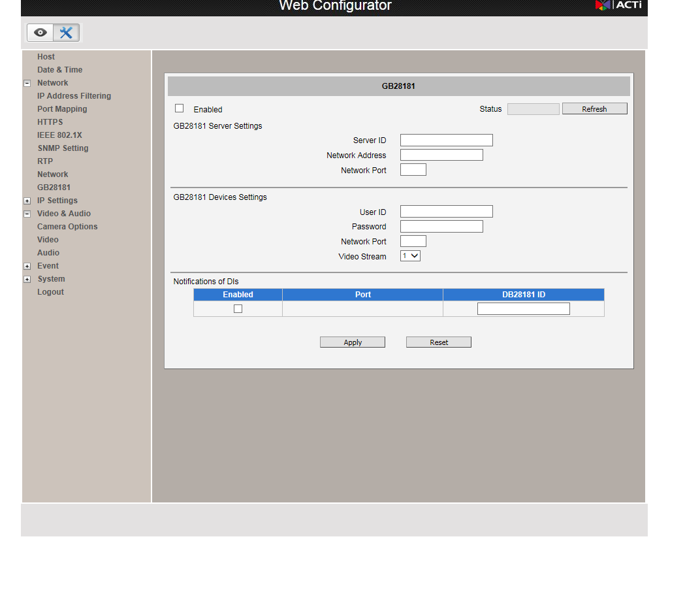
Setup - GB28181

Slide 8
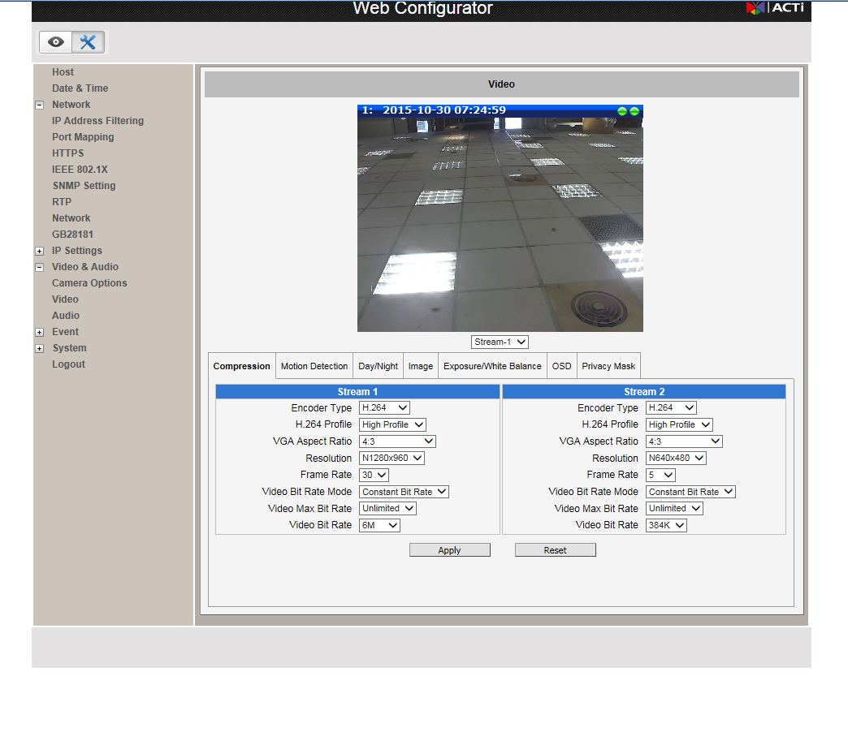
Setup – Video Compression

Slide 9
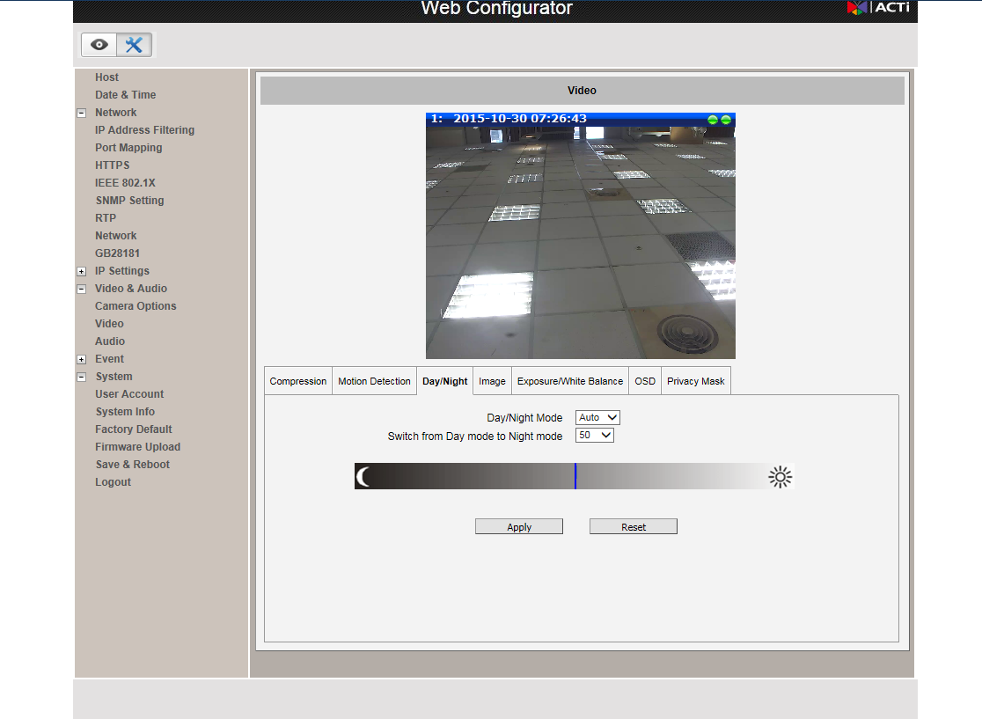
Setup – Video Day/Night Mode

Slide 10
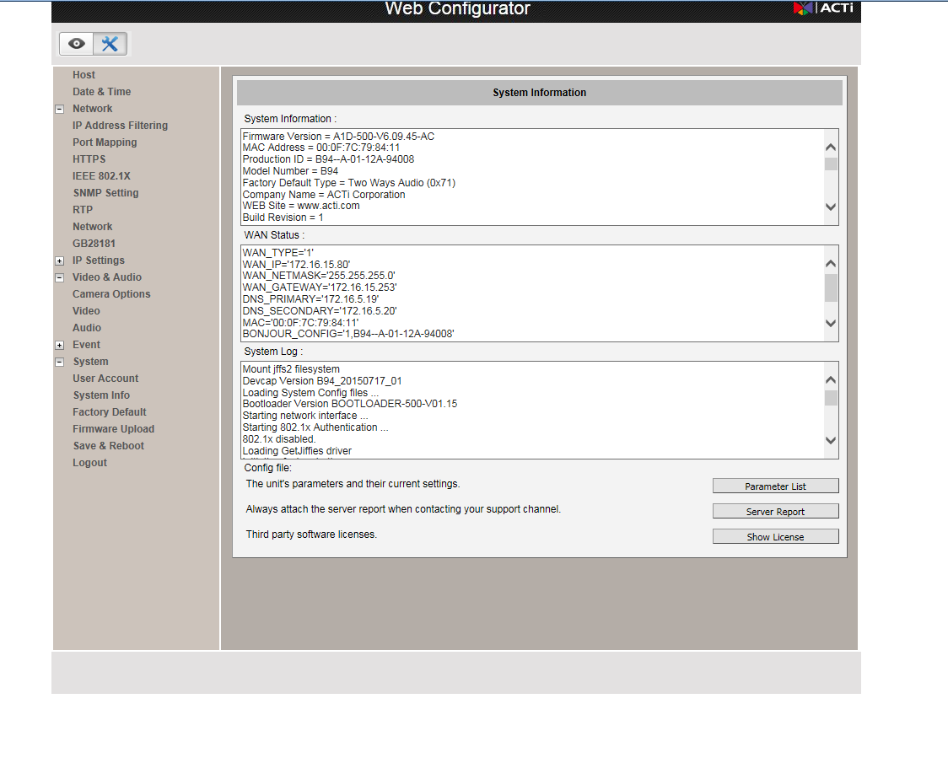
Setup – System Info

