Slide 1
Lean Enterprise Architecture
A lean, testable enterprise architecture with a modern client stack
By Shahed Chowdhuri, Sahil Talwar, Doguhan Uluca
Notes:
Lean Enterprise Architecture (title page)
A lean, testable enterprise architecture with a modern client stack

Slide 2








Thanks to our Sponsors for keeping the fires lit
Notes:
Sponsors

Slide 3

Introduction
Enterprise
Web
Application
Looking for Ways to Improve & Modernize
Motivation behind this design?
ASP.NET
MVC
Our desire to do the following:
TDD (Test Driven Development)
CI (Continuous Integration)
CD (Continuous Delivery)
BDD (Behavior Driven Development)
DB
Notes:
Introduction
* We are building an enterprise web application with ASP.NET MVC, following best practices for design, development, testability and deployment.
* We were looking for ways to improve and modernize
* The motivation behind this design was our desire to do TDD, BDD, CI, CD.

Slide 4
Data Access Layer
Shahed
Chowdhuri
Using Code-First Migrations

Slide 5
Tech Check
Are you familiar with…?
EF
Code-First Migrations
Entity
Framework
EF
Code-First Development
ASP
.NET
MVC
Notes:
Are you familiar with:
ASP.NET MVC?
Entity Framework?
Code First development?
Code First Migrations?
(slow-reveal diagram + ask the audience)

Slide 6
Options and Alternatives
Database-First
(EDMX)
Model-First
(Visual Designer)
Code-First (automatic migrations)
Code-First (manual migrations)
Notes:
Options and Alternatives
Database-First (EDMX)
Model-First (visual designer)
Code-First with automatic migrations
Code-First with manual migrations

Slide 7
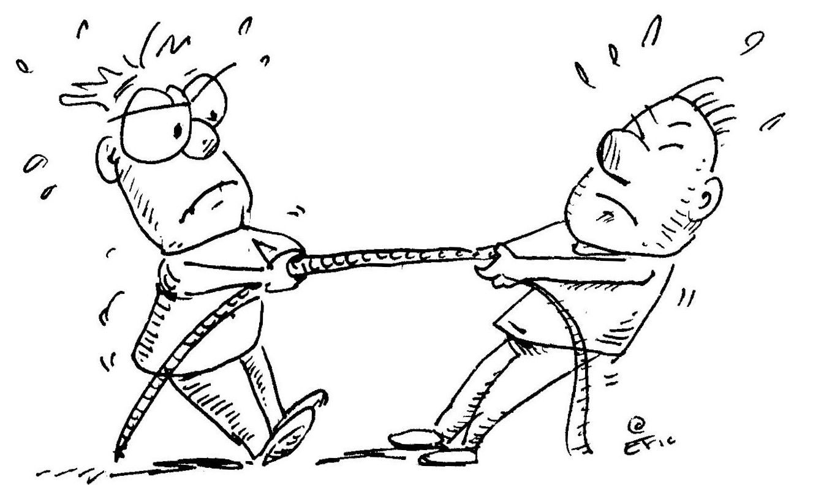
What are we trying to solve?

Slide 8
DAL: Agenda
1. Models & Mapping
2. Connection Strings
3. Enable Migrations
4. Update Database
5. Push Code + Migrate Server DB
6. Process Workflow
Notes:
Agenda
Add models and mapping in code
Connection String
Enable Migrations
Update Database
Push code + Migrate server DB
Process Workflow

Slide 9
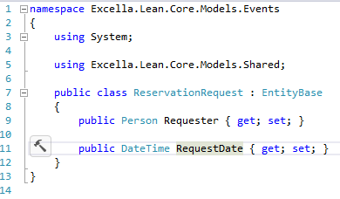

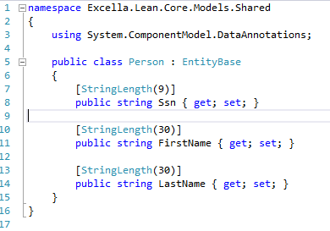
1. Models & Mapping
DBContext
.OnModelCreating()
Notes:
1. Models & Mapping

Slide 10

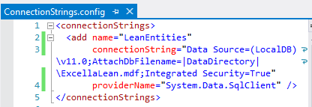
2. Connection Strings
Notes:
2. Connection Strings
Connection String
Web.config
configSource
Machine config

Slide 11
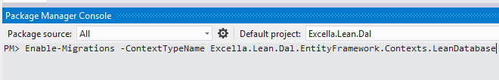
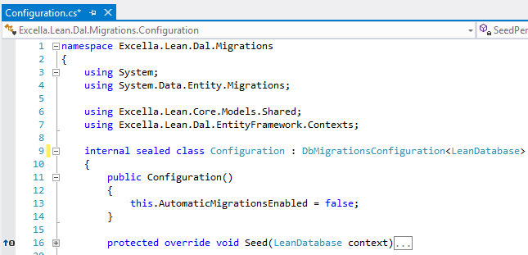
3. Enable Migrations
Notes:
3. Enable Migrations
Enable Migrations
Configuration.cs
Add Seed data

Slide 12


4. Update Database
model code
migration
code
migration code
+ seed
(sql)
dev
DB
Notes:
4. Update Database
Update Database
Run Seed Data
Verify SQL
Verify DB

Slide 13


5. Push Code + Migrate Server DB
code
push code
code
pull code
CI
Server
DB
migrate.exe
Notes:
5. Push Code + Migrate Server DB
Push code to source control
Other developers pull and Update Database
Migrate server DB via migrate.exe
Use TeamCity to automate this

Slide 14


6. Process Workflow
communication
DB
dev team
DB architects
Notes:
6. Process Workflow
Process Workflow
Handle existing database
Comply with enterprise requirements

Slide 15
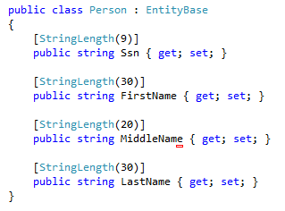
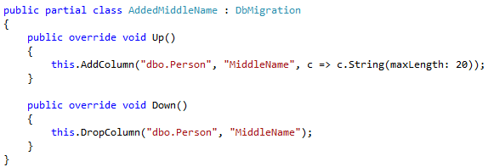
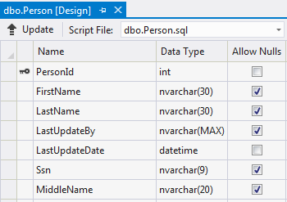
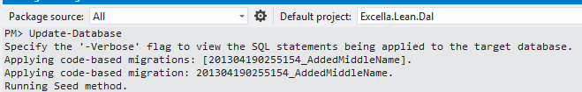
Code Walkthrough
Notes:
Code Walkthrough

Slide 16
DAL: Conclusion
Code-First Migrations
Dev Team Synchronized
Server Deployment
Database Versioning
Continuous Development
Notes:
Code First Migrations allows:
Continuous development
Synchronization among team members
Database versioning
Server deployment
(diagram with star pattern)

Slide 17
Resources
EF Code First Migrations on MSDN:
http://msdn.microsoft.com/en-US/data/jj591621
Web.config & configSource:
http://wakeupandcode.com/all-your-database-are-belong-to-us/
PluralSight EF Migrations video tutorial:
http://pluralsight.com/training/Courses/TableOfContents/efmigrations
Notes:
Resources

Slide 18
The Domain
Sahil Talwar
Simpler is better
Notes:
Intro
Shahed showed DAL, so I’ll run through Domain
Fair warning, though…

Slide 19

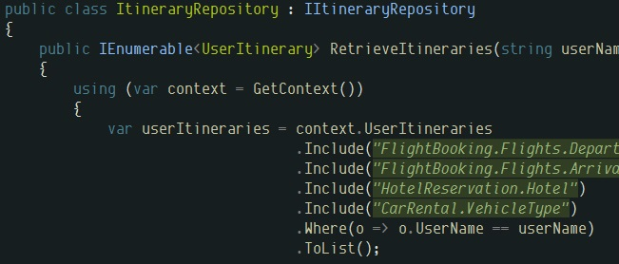

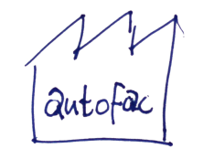

Notes:
This is not like the other two parts of the presentation!
I won’t show you code…
Or specific technologies…at all.
Instead, war stories and lesson learned

Slide 20
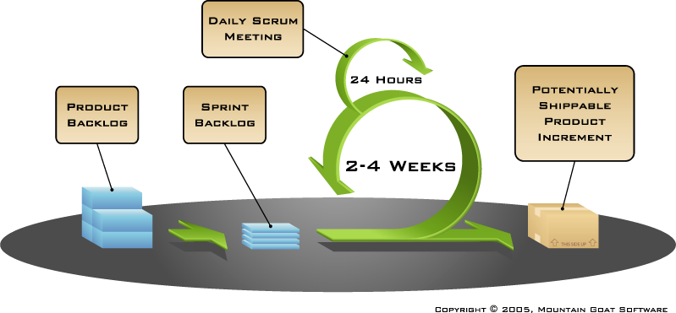
Notes:
Using Scrum,

Slide 21

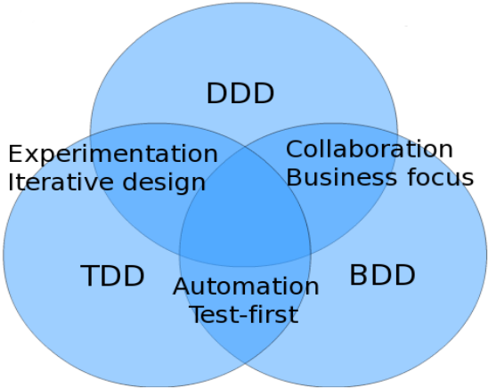
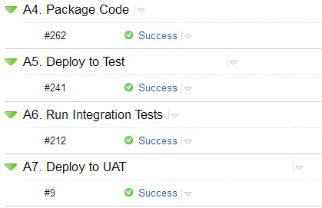
Notes:
CI, CD…TDD, BDD, and DDD…

Slide 22
Versus…
Notes:
But at the same time, some people involved with the project are proponents of…

Slide 23

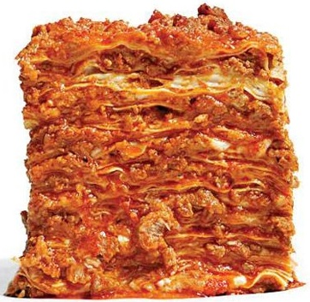
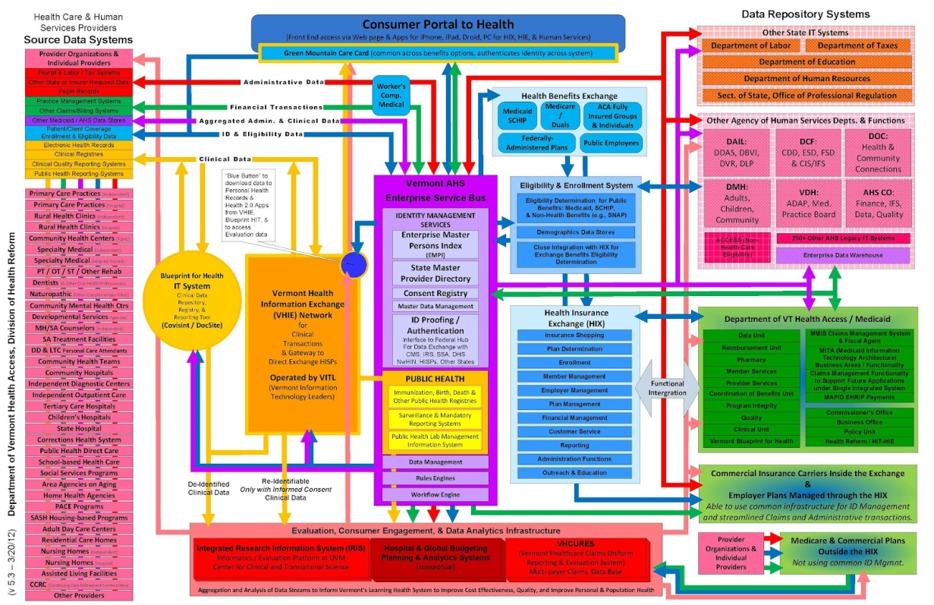
Heavyweight
Enterprise Architecture
Notes:
HEAVYWEIGHT enterprise architecture.
To see what I mean, compare layers
Jokes aside, 1 story of over-engineering causing problems:

Slide 24
Round
1

Slide 25
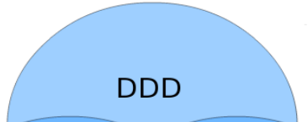
Entity Framework
Best Practices
Repositories
Unit of Work
Notes:
When using DDD…blogs
Dev tried to use best practices
Didn’t check if we had the problems

Slide 26
Web
Api
Domain
IUnitOfWork
IRepository
IRepository
IRepository
Dal
DbContext
DbSet
DbSet
DbSet
Notes:
3 problems:
Use of UoW optional
Redundant, as I said
To top it off: buggy, slow, redundant

Slide 27

Notes:
Now that’s what I call gold plating!

Slide 28
Round
2

Slide 29

Web Models
Api Models
Domain Models
Dal Models
Notes:
The second story of the day is about premature optimization.
Knuth: “premature optimization is the root of all evil”
Optimizing for unproven use case because app is complex, expensive, many dev teams
Automapper both ways
What does Bogard know? Wrote != knows domain!

Slide 30

Notes:
Eventually realized it was gold plating as much as the Repositories were

Slide 31
Web
Dal
Domain
Core
(Models)
…Except Api-Domain.
Notes:
After unreasonable time, came to our senses
Pulled out model into cross cutting layer
No more automapper!!
Api has Data Contracts that look nothing like models, so that is a valid exception.

Slide 32
Round
3
Notes:
Re: sharing a database context across objects.

Slide 33
Context Per Complex Object
Universities
Departments
Professors
Classes
Advisors
Students
UniversityContext
Student Context
Notes:
Service for every complex object
Injected new DbContext into every service
Problem with shared sub-objects being accessible in several contexts

Slide 34
Single Responsibility: Context Per Object
Universities
Departments
Professors
Classes
Advisors
Students
Professors
Classes
Students
Departments
Advisors
Universities
Notes:
Looked to SRP for guidance → one per object
Not only does not solve issue, makes it worse by making nearly all db objects shared
Also creates Repo explosion

Slide 35
ServiceStore
ServiceStore
Shared Context
Service
Service
Service
Service
Service
Service
Notes:
Made a store to manage # of services
Realized shared context problem, this fixes it
# of Services = pain to manage and test!
Came to realize
too many services & shared context problems
Store was messy, painful hack

Slide 36
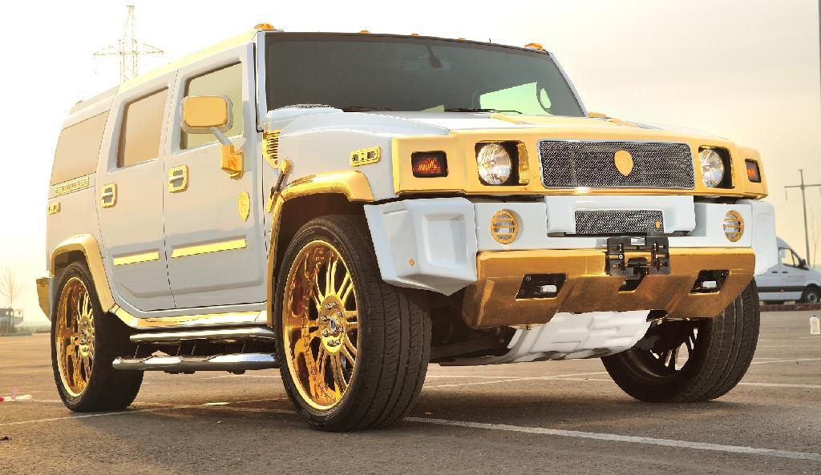
Solid gold.
Notes:
Basically, realized that this is a step beyond gold plating.
This is solid gold.

Slide 37
Web
Api
Services
Domain 1
Domain 2
Domain 3
Domain 4
Domain 5
Domain 6
Dal Models
Notes:
Solved problem by splitting up into non-overlapping domains.
Practically, this means 1 service per project team, & no overlapping objects.
Anyone heard of bounded contexts…?
Original solution proposed by DDD to begin with.
Anyway,

Slide 38
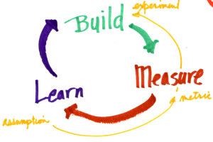
Notes:
We fought against over-engineering and gold plating by using lean startup principles:
Built
Measured pain; demonstrated to EA proponents
Learned from mistakes, built a solution closer to what we believed would alleviate the problems
Rinse & Repeat

Slide 39
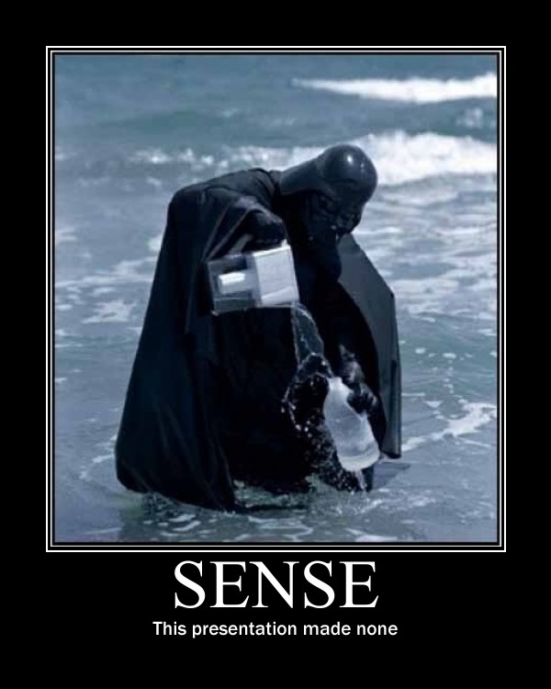

Slide 40
Image Credits
http://i-cdn.apartmenttherapy.com/uimages/kitchen/2010_05_17-Lasagna.jpg
http://www.callagold.com/wp-content/uploads/2012/02/gold-plated-porsche-1.jpg
http://img.diytrade.com/cdimg/1057186/11295732/0/1259756915/Gold_Plating_System.jpg
http://www.artisticplating.net/images/gold4.jpg
http://epf.thingml.org/wikis/inf5120/practice.mgmt.scrum.base-sintef/guidances/roadmaps/resources/ScrumLargeLabelled.png
http://1.bp.blogspot.com/-H0OeuWi6oXc/UG9BbClJF-I/AAAAAAAAAqY/6v4hZ5zGGXk/s1600/DDD_TDD_BDD_intersection.png
http://blogs.jetbrains.com/teamcity/wp-content/uploads/2008/09/teamcity512.png
http://www.regretfreelife.net/wp-content/uploads/2012/09/lscycle.jpg
http://automapper.org/img/black_logo.png
http://4.bp.blogspot.com/-1p7GSp6m_a8/UOrbvzLfwKI/AAAAAAAAAI4/oYULEv-jJWc/s1600/g3211.png
http://www.clker.com/cliparts/T/G/C/H/K/W/no-sign-hi.png
http://2.bp.blogspot.com/---z3-XY_a5M/T2uGslh4fYI/AAAAAAAAADY/PyqTk88n3Qo/s1600/Health+Services+Enterprise+Architecture+v5.3+(3-20-12).jpg
http://fc06.deviantart.net/fs71/f/2012/119/e/7/sumo_wrestler_by_maxxparis-d4xytyj.jpg
http://www.nerdpad.com/wp-content/uploads/2010/04/vs2010_full.jpg
https://secure.gravatar.com/avatar/cf4c53b37956b009d609caeacb171c40?s=420&d=https://a248.e.akamai.net/assets.github.com%2Fimages%2Fgravatars%2Fgravatar-org-420.png
http://nblumhardt.com/wp-content/uploads/2009/12/Autofac-2-Sketch1.png

