Slide 1
Lean Enterprise Architecture
A lean, testable enterprise architecture with a modern client stack
By Shahed Chowdhuri, Sahil Talwar, Doguhan Uluca
Notes:
Lean Enterprise Architecture (title page)
A lean, testable enterprise architecture with a modern client stack

Slide 2








Thanks to our Sponsors for keeping the fires lit
Notes:
Sponsors

Slide 3

Introduction
Enterprise
Web
Application
Looking for Ways to Improve & Modernize
Motivation behind this design?
ASP.NET
MVC
Our desire to do the following:
TDD (Test Driven Development)
CI (Continuous Integration)
CD (Continuous Delivery)
BDD (Behavior Driven Development)
DB
Notes:
Introduction
* We are building an enterprise web application with ASP.NET MVC, following best practices for design, development, testability and deployment.
* We were looking for ways to improve and modernize
* The motivation behind this design was our desire to do TDD, BDD, CI, CD.

Slide 4
DAL (Data Access Layer)
By Shahed Chowdhuri
Notes:
Part 1 of 3
DAL (Data Access Layer)
By Shahed Chowdhuri

Slide 5
Tech Check
Are you familiar with…?
EF
Code-First Migrations
Entity
Framework
EF
Code-First Development
ASP
.NET
MVC
Notes:
Are you familiar with:
ASP.NET MVC?
Entity Framework?
Code First development?
Code First Migrations?
(slow-reveal diagram + ask the audience)

Slide 6
Options and Alternatives
Database-First
(EDMX)
Model-First
(Visual Designer)
Code-First (automatic migrations)
Code-First (manual migrations)
Notes:
Options and Alternatives
Database-First (EDMX)
Model-First (visual designer)
Code-First with automatic migrations
Code-First with manual migrations

Slide 7
DAL: Agenda
1. Models & Mapping
2. Connection Strings
3. Enable Migrations
4. Update Database
5. Push Code + Migrate Server DB
6. Process Workflow
Notes:
Agenda
Add models and mapping in code
Connection String
Enable Migrations
Update Database
Push code + Migrate server DB
Process Workflow

Slide 8
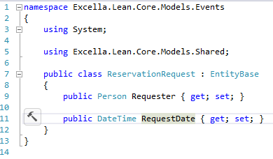

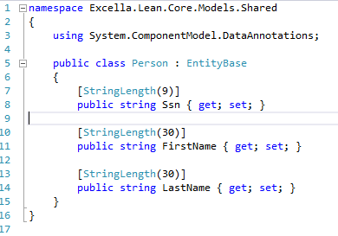
1. Models & Mapping
DBContext
.OnModelCreating()
Notes:
1. Models & Mapping

Slide 9

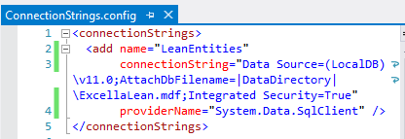
2. Connection Strings
Notes:
2. Connection Strings
Connection String
Web.config
configSource
Machine config

Slide 10
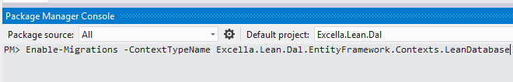
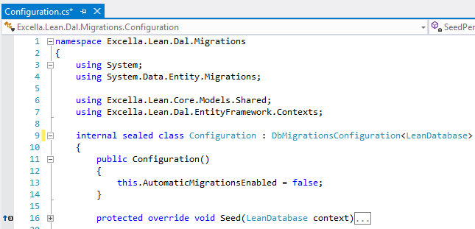
3. Enable Migrations
Notes:
3. Enable Migrations
Enable Migrations
Configuration.cs
Add Seed data

Slide 11


4. Update Database
model code
migration
code
migration code
+ seed
(sql)
dev
DB
Notes:
4. Update Database
Update Database
Run Seed Data
Verify SQL
Verify DB

Slide 12


5. Push Code + Migrate Server DB
code
push code
code
pull code
CI
Server
DB
migrate.exe
Notes:
5. Push Code + Migrate Server DB
Push code to source control
Other developers pull and Update Database
Migrate server DB via migrate.exe
Use TeamCity to automate this

Slide 13


6. Process Workflow
communication
DB
dev team
DB architects
Notes:
6. Process Workflow
Process Workflow
Handle existing database
Comply with enterprise requirements

Slide 14
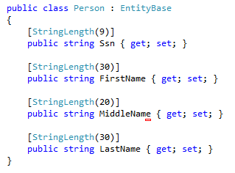
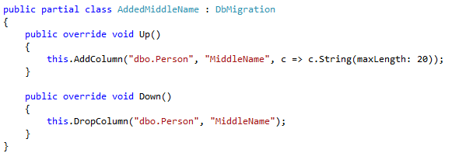
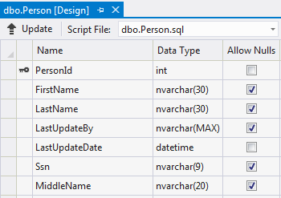
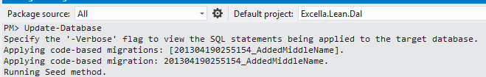
Code Walkthrough
Notes:
Code Walkthrough

Slide 15
DAL: Conclusion
Code-First Migrations
Dev Team Synchronized
Server Deployment
Database Versioning
Continuous Development
Notes:
Code First Migrations allows:
Continuous development
Synchronization among team members
Database versioning
Server deployment
(diagram with star pattern)

Slide 16
Domain Layer
By Sahil Talwar
Notes:
Part 2 of 3
Domain Layer
By Sahil Talwar

Slide 17
(placeholder)
Sahil’s slides go here
Notes:
Sahil’s slides go here

Slide 18
Presentation Layer
By Doguhan Uluca
Notes:
Part 3 of 3
Presentation Layer
By Doguhan Uluca

Slide 19
(placeholder)
Doguhan’s slides go here
Notes:
Doguhan’s slides go here

Slide 20
About Us
Shahed Chowdhuri
Email: shahed.chowdhuri@excella.com
Twitter: @shahedc
Web: http://WakeUpAndCode.com
Sahil Talwar
Email: sahil.talwar@excella.com
Twitter: @sahiltalwar88
Web: http://about.me/sahiltalwar
Doguhan Uluca
Email: doguhan.uluca@excella.com
Twitter: @duluca
Web: http://DeceivingArts.com/blog

Slide 21
Resources
Migrations:
Automapper:
Autofac:
Knockout:
Breeze:
Notes:
Resources

