Slide 1
Presentation Layer
Doguhan
Uluca
MVVM for the Web

Slide 2
ASP.NET MVC
Notes:
- In Mvc display logic can get mixed up with business logic
- There’s a need to clearly separate business logic from display logic

Slide 3
MVVM
Notes:
- Responsive and rich by default
- Server rendering vs client side rendering
- Less bandwidth
- Gracefully handle semi connected states
- Designers/BAs can design views ahead, while development catches up and hooks up binding

Slide 4

How

Slide 5
SPAJQueryKnockoutAngularBackboneNodeJsTwitterBootsrapMongoDBBreezeCSSThisPluginThatPluginJsonRequireQ(YeahThat’sAThing)CanYouReadThisAtTheBack?Yup, ALotOfStuff

Slide 6
JavaScript, really?
50 views?
Testing?

Slide 7
Is it ready?

Slide 8


Slide 9
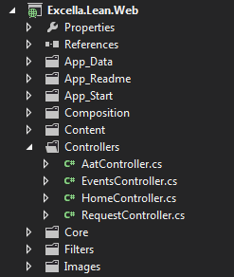
Project Structure

Slide 10
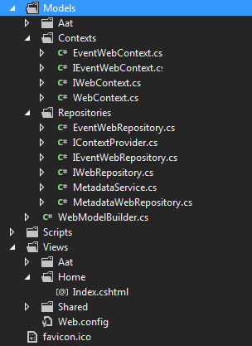
Project Structure

Slide 11
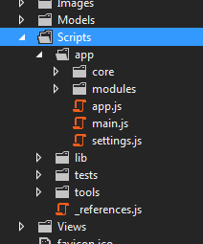
Project Structure

Slide 12
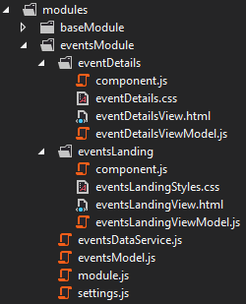
Scalable Framework
Separation of concerns
Lazy load resources
Based on Boilerplate.js
Thin
Full control
Configuration based
Takes over routing
Notes:
Durandal is alternative
Convention based
See HotTowel SPA

Slide 13
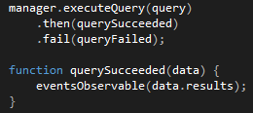
Taming JavaScript
“use strict”;
Q
Async promises
Require.js
Revealing Module Pattern

Slide 14
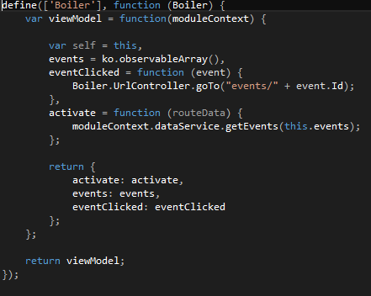

Slide 15

Binding
Knockout

Slide 16
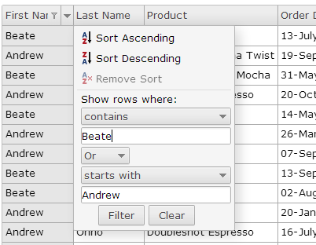
UI Toolkit
jQWidgets
Affordable
Tested with Knockout

Slide 17


Slide 18
We have the technology

Slide 19
Let’s tie this to the backend
Data
Security
Error Logging
Testing

Slide 20
Data In a Breeze
“1/4 the code, about 1/4 the time, and more value. Does that interest you?”
–John Papa

Slide 21
What about Breeze?
Notes:
Breeze: accelerator, delay decisions until the last possible moment (query)
OData behind it, don’t need Breeze to write Odata calls (show actual URLs) JSON data
If not: ko-lite
Manage risks: dataservice

Slide 22
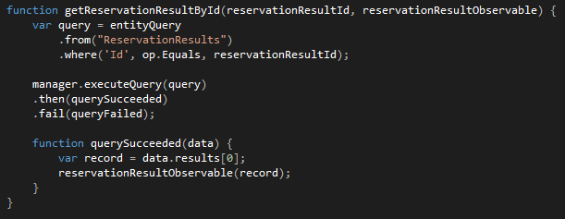

Slide 23
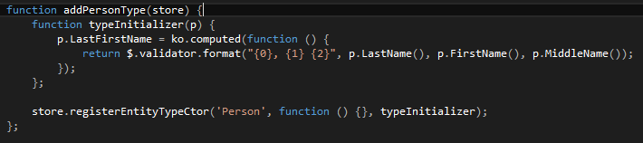

Slide 24
Security
Authenticate and Authorize
WebApi
Client
Anti-forgery token
Mvc
Breeze
Encryption? Go for it!

Slide 25

Error Logging
Server side
Elmah
Nlog
Client side
Basic
Full featured (with Toastr.js)

Slide 26
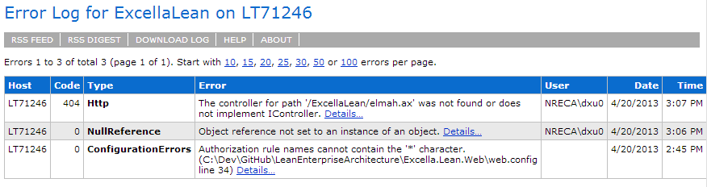
Error Logging

Slide 27
Testing
Unit testing
Qunit
PhantomJS (for TeamCity integration)
AAT
SpecFlow (gherkin)
Selenium (instrumentation) with Chrome Driver
Simpler Fake pipeline
Notes:
Majority of the client can be tested by just faking the JSON data

Slide 28
Resources
John Papa
http://www.johnpapa.net/spajs04/
http://www.johnpapa.net/howmanyistoomany/
http://www.johnpapa.net/kolite1-1/
Julie Lerman
Pain-Free Data Access in JavaScript--Yes, JavaScript
http://msdn.microsoft.com/en-us/magazine/jj863129.aspx
Boilerplate.js
http://boilerplatejs.org/
jQWidgets
http://jqwidgets.com/

Slide 29
About Us
Shahed Chowdhuri
Email: shahed.chowdhuri@excella.com
Twitter: @shahedc
Web: http://WakeUpAndCode.com
Sahil Talwar
Email: sahil.talwar@excella.com
Twitter: @sahiltalwar88
Web: http://about.me/sahiltalwar
Doguhan Uluca
Email: doguhan.uluca@excella.com
Twitter: @duluca
Web: http://DeceivingArts.com/blog

Slide 30
Get Lean
https://github.com/duluca/LeanEnterpriseArchitecture
or
goo.gl/xAii7
Work in progress
Will move to https://github.com/excellaco
It’s open source – feel free to submit pull requests

