Slide 1
Lean Enterprise Architecture
A lean, testable enterprise architecture with a modern client stack
By Shahed Chowdhuri, Sahil Talwar, Doguhan Uluca
Notes:
Lean Enterprise Architecture (title page)
A lean, testable enterprise architecture with a modern client stack

Slide 2








Thanks to our Sponsors for keeping the fires lit
Notes:
Sponsors

Slide 3

Introduction
Enterprise
Web
Application
Looking for Ways to Improve & Modernize
Motivation behind this design?
ASP.NET
MVC
Our desire to do the following:
TDD (Test Driven Development)
CI (Continuous Integration)
CD (Continuous Delivery)
BDD (Behavior Driven Development)
DB
Notes:
Introduction
* We are building an enterprise web application with ASP.NET MVC, following best practices for design, development, testability and deployment.
* We were looking for ways to improve and modernize
* The motivation behind this design was our desire to do TDD, BDD, CI, CD.

Slide 4
Data Access Layer
Shahed
Chowdhuri
Using Code-First Migrations

Slide 5
Tech Check
Are you familiar with…?
EF
Code-First Migrations
Entity
Framework
EF
Code-First Development
ASP
.NET
MVC
Notes:
Are you familiar with:
ASP.NET MVC?
Entity Framework?
Code First development?
Code First Migrations?
(slow-reveal diagram + ask the audience)

Slide 6
Options and Alternatives
Database-First
(EDMX)
Model-First
(Visual Designer)
Code-First (automatic migrations)
Code-First (manual migrations)
Notes:
Options and Alternatives
Database-First (EDMX)
Model-First (visual designer)
Code-First with automatic migrations
Code-First with manual migrations

Slide 7
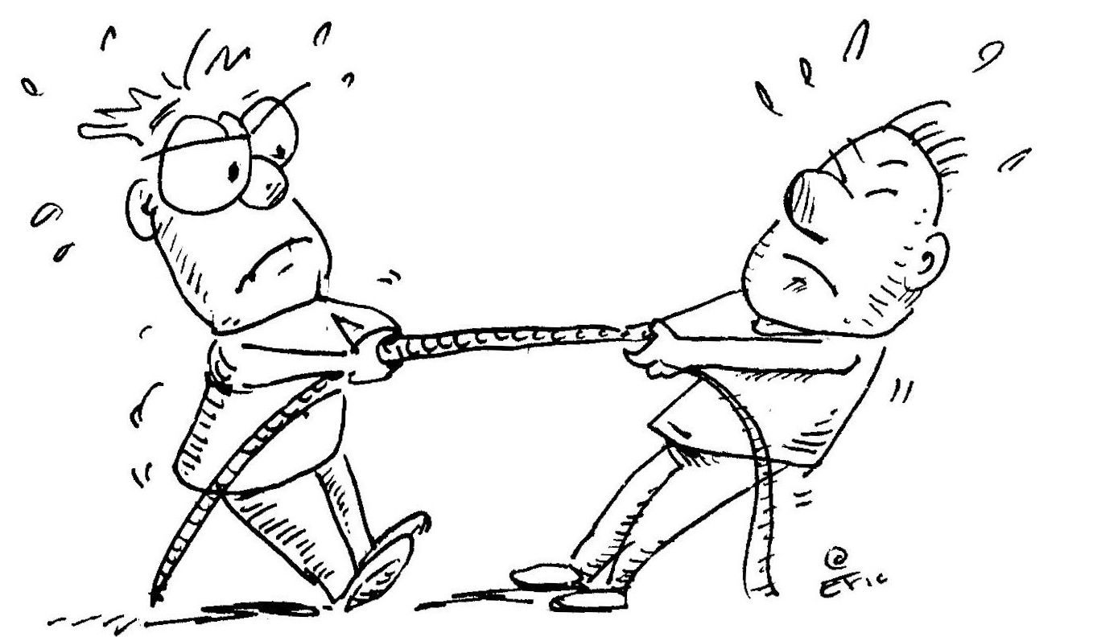
What are we trying to solve?

Slide 8
DAL: Agenda
1. Models & Mapping
2. Connection Strings
3. Enable Migrations
4. Update Database
5. Push Code + Migrate Server DB
6. Process Workflow
Notes:
Agenda
Add models and mapping in code
Connection String
Enable Migrations
Update Database
Push code + Migrate server DB
Process Workflow

Slide 9
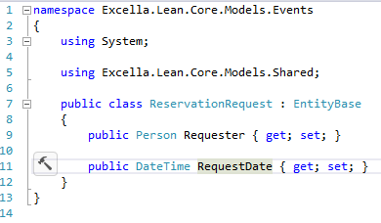

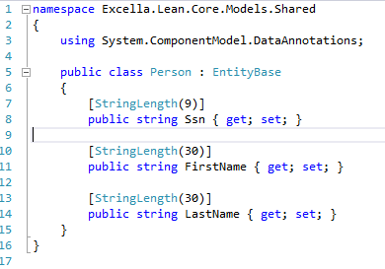
1. Models & Mapping
DBContext
.OnModelCreating()
Notes:
1. Models & Mapping

Slide 10

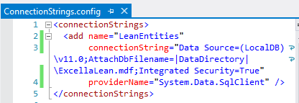
2. Connection Strings
Notes:
2. Connection Strings
Connection String
Web.config
configSource
Machine config

Slide 11
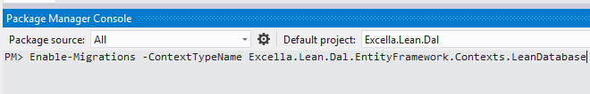
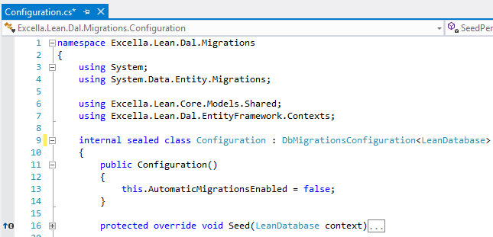
3. Enable Migrations
Notes:
3. Enable Migrations
Enable Migrations
Configuration.cs
Add Seed data

Slide 12


4. Update Database
model code
migration
code
migration code
+ seed
(sql)
dev
DB
Notes:
4. Update Database
Update Database
Run Seed Data
Verify SQL
Verify DB

Slide 13


5. Push Code + Migrate Server DB
code
push code
code
pull code
CI
Server
DB
migrate.exe
Notes:
5. Push Code + Migrate Server DB
Push code to source control
Other developers pull and Update Database
Migrate server DB via migrate.exe
Use TeamCity to automate this

Slide 14


6. Process Workflow
communication
DB
dev team
DB architects
Notes:
6. Process Workflow
Process Workflow
Handle existing database
Comply with enterprise requirements

Slide 15
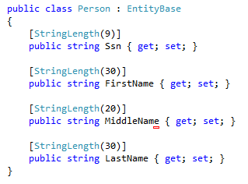
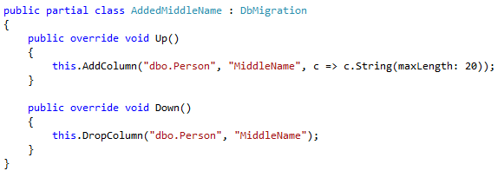
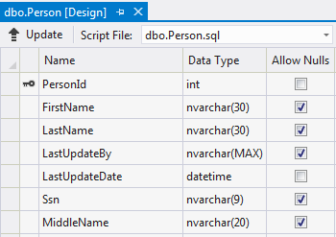
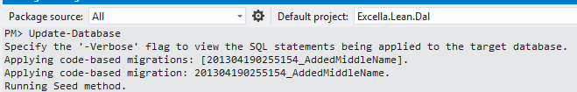
Code Walkthrough
Notes:
Code Walkthrough

Slide 16
DAL: Conclusion
Code-First Migrations
Dev Team Synchronized
Server Deployment
Database Versioning
Continuous Development
Notes:
Code First Migrations allows:
Continuous development
Synchronization among team members
Database versioning
Server deployment
(diagram with star pattern)

Slide 17
Resources
EF Code First Migrations on MSDN:
http://msdn.microsoft.com/en-US/data/jj591621
Web.config & configSource:
http://wakeupandcode.com/all-your-database-are-belong-to-us/
PluralSight EF Migrations video tutorial:
http://pluralsight.com/training/Courses/TableOfContents/efmigrations
Notes:
Resources

Slide 18
Domain
Sahil Talwar
Simpler is better

Slide 19
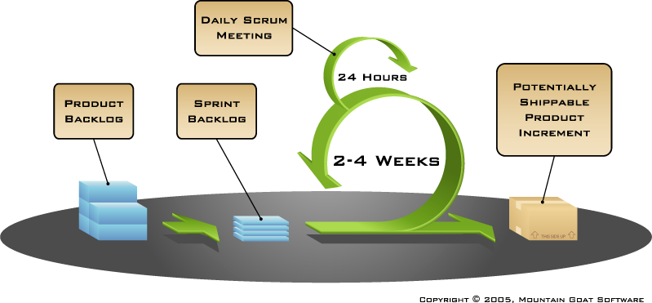
Notes:
Using Scrum,

Slide 20

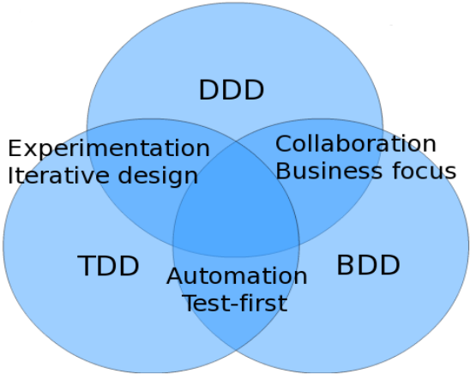
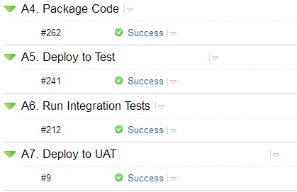
Notes:
CI, CD…TDD, BDD, and DDD…

Slide 21
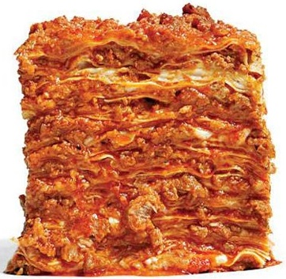

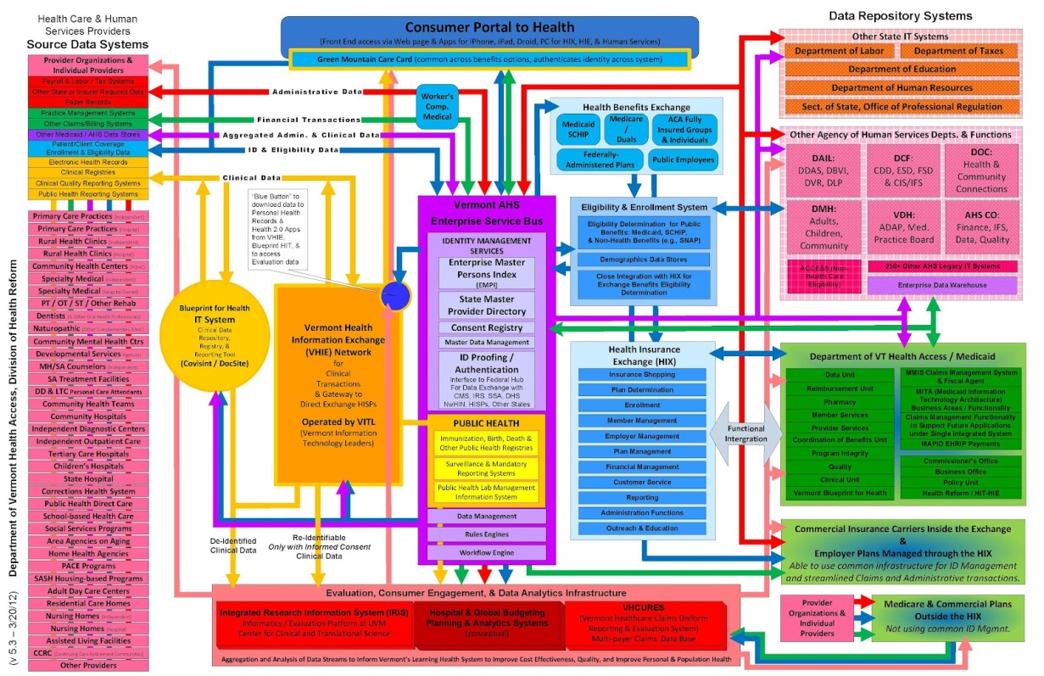
Heavyweight Enterprise Architecture
Notes:
…All while trying to appease proponents of unnecessarily heavyweight enterprise architecture.
Which has more layers?
Jokes aside, here’s an example of what I mean:

Slide 22
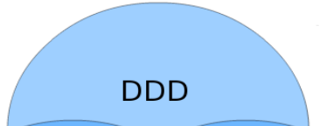
Entity Framework
Best Practices
Repositories
Unit of Work
Notes:
Blogs say best practice is to use IRepository & Unit of Work
Implemented without checking for the problems they solve - didn’t realize EF does them for you!

Slide 23
Web
Api
Domain
IUnitOfWork
IRepository
IRepository
IRepository
Dal
DbContext
DbSet
DbSet
DbSet
Notes:
2 problems:
Use of UoW optional
Custom implementation buggy, slow, redundant
= Massive amount of…

Slide 24


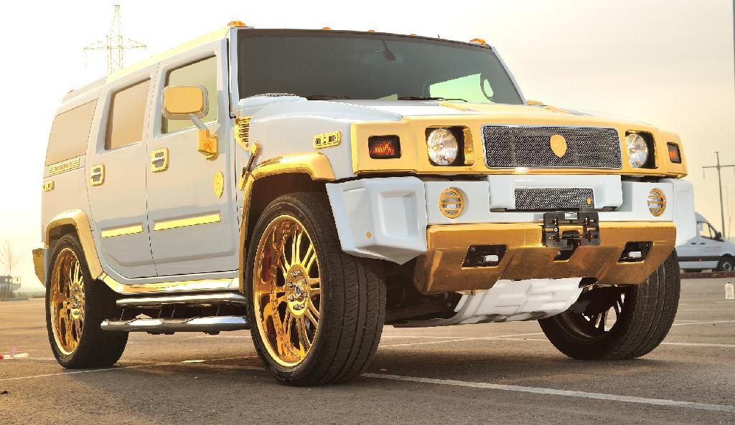
Notes:
All together now…Gold plating!(x3) …Sort of like those animations.
Topic: Our fight against gold plating & how we keep our enterprise level Domain simple

Slide 25
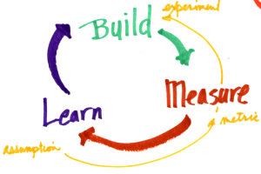
Notes:
We fought gold plating by using lean startup principles.

Slide 26

Web Models
Dal Models
Domain Models
Notes:
First example: Models
Built one set per layer

Slide 27


Web
Dal
Domain
Models
…Except Api-Domain.
Notes:
Measured amount of pain caused by mapping issues
Learned we don’t need separate models
Can use extension methods and partial classes IF we ever need layer-specific functionality. Have not yet run into it.

Slide 28
Context Per Complex Object
Universities
Departments
Professors
Classes
Advisors
Students
IUniversityRepository
Notes:
Problem with shared sub-objects being accessible in several contexts

Slide 29
Single Responsibility: Context Per Object
Universities
Departments
Professors
Classes
Advisors
Students
Professors
Classes
Students
Departments
Advisors
Universities
Notes:
…This worsened the issue.

Slide 30
RepositoryStore
RepositoryStore
Store Db
IRepository
IRepository
IRepository
IRepository
IRepository
IRepository
Notes:
Works, but is a pain to manage and test!

Slide 31
Web
Api
Repositories
Domain 1
Domain 2
Domain 3
Domain 1
Domain 2
Domain 3
Dal Models
Notes:
Solved problem by splitting up into non-overlapping domains.

Slide 32
Image Credits
http://i-cdn.apartmenttherapy.com/uimages/kitchen/2010_05_17-Lasagna.jpg
http://www.callagold.com/wp-content/uploads/2012/02/gold-plated-porsche-1.jpg
http://img.diytrade.com/cdimg/1057186/11295732/0/1259756915/Gold_Plating_System.jpg
http://www.artisticplating.net/images/gold4.jpg
http://epf.thingml.org/wikis/inf5120/practice.mgmt.scrum.base-sintef/guidances/roadmaps/resources/ScrumLargeLabelled.png
http://1.bp.blogspot.com/-H0OeuWi6oXc/UG9BbClJF-I/AAAAAAAAAqY/6v4hZ5zGGXk/s1600/DDD_TDD_BDD_intersection.png
http://blogs.jetbrains.com/teamcity/wp-content/uploads/2008/09/teamcity512.png
http://www.regretfreelife.net/wp-content/uploads/2012/09/lscycle.jpg
http://automapper.org/img/black_logo.png
http://4.bp.blogspot.com/-1p7GSp6m_a8/UOrbvzLfwKI/AAAAAAAAAI4/oYULEv-jJWc/s1600/g3211.png
http://www.clker.com/cliparts/T/G/C/H/K/W/no-sign-hi.png
http://2.bp.blogspot.com/---z3-XY_a5M/T2uGslh4fYI/AAAAAAAAADY/PyqTk88n3Qo/s1600/Health+Services+Enterprise+Architecture+v5.3+(3-20-12).jpg
http://fc06.deviantart.net/fs71/f/2012/119/e/7/sumo_wrestler_by_maxxparis-d4xytyj.jpg

