Slide 1
Presentation Layer
Doguhan
Uluca
MVVM for the Web

Slide 2
ASP.NET MVC
Notes:
- In Mvc display logic can get mixed up with business logic
- There’s a need to clearly separate business logic from display logic

Slide 3
MVVM
Notes:
- Responsive and rich by default
- Server rendering vs client side rendering
- Less bandwidth
- Gracefully handle semi connected states
- Designers/BAs can design views ahead, while development catches up and hooks up binding

Slide 4

How

Slide 5
SPAJQueryKnockoutAngularBackboneNodeJsTwitterBootsrapMongoDBBreezeCSSThisPluginThatPluginJsonRequireQ(YeahThat’sAThing)CanYouReadThisAtTheBack?Yup, ALotOfStuff

Slide 6
JavaScript, really?
50 views?
Testing?

Slide 7
Is it ready?

Slide 8


Slide 9
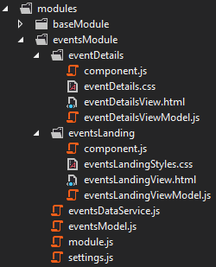
Scalable Framework
Separation of concerns
Lazy load resources
Based on Boilerplate.js
Thin
Full control
Configuration based
Takes over routing
Notes:
Durandal is alternative
Convention based
See HotTowel SPA

Slide 10
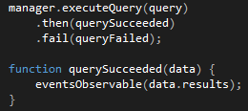
Taming JavaScript
“use strict”;
Q
Async promises
Require.js
Revealing Module Pattern

Slide 11
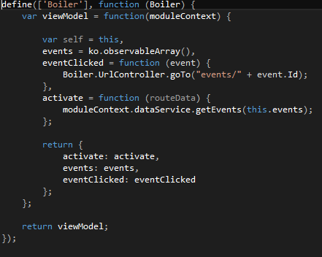

Slide 12

Binding
Knockout

Slide 13
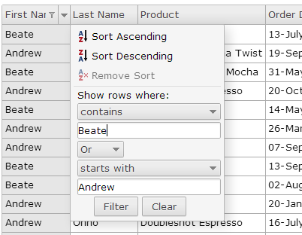
UI Toolkit
jQWidgets
Affordable
Tested with Knockout

Slide 14


Slide 15
We have the technology

Slide 16
Let’s tie this to the backend
Data
Security
Error Logging
Testing

Slide 17
Data In a Breeze
“1/4 the code, about 1/4 the time, and more value. Does that interest you?”
–John Papa

Slide 18
What about Breeze?
Notes:
Breeze: accelerator, delay decisions until the last possible moment (query)
OData behind it, don’t need Breeze to write Odata calls (show actual URLs) JSON data
If not: ko-lite
Manage risks: dataservice

Slide 19
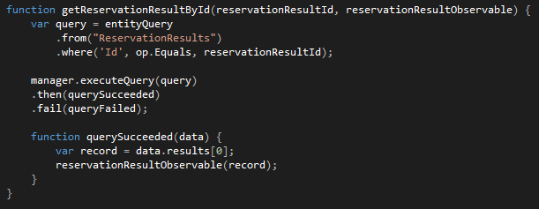

Slide 20
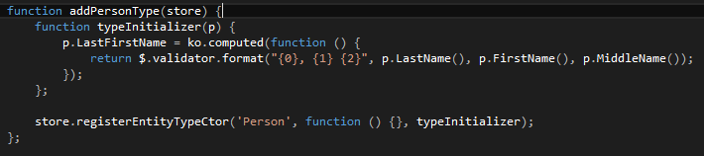

Slide 21
Security
Authenticate and Authorize
WebApi
Client
Anti-forgery token
Mvc
Breeze
Encryption? Go for it!

Slide 22

Error Logging
Server side
Elmah
Nlog
Client side
Basic
Full featured (with Toastr.js)

Slide 23
Testing
Unit testing
Qunit
PhantomJS (for TeamCity integration)
AAT
SpecFlow (gherkin)
Selenium (instrumentation) with Chrome Driver
Simpler Fake pipeline
Notes:
Majority of the client can be tested by just faking the JSON data

Slide 24
Resources
John Papa
http://www.johnpapa.net/spajs04/
http://www.johnpapa.net/howmanyistoomany/
http://www.johnpapa.net/kolite1-1/
Julie Lerman
Pain-Free Data Access in JavaScript--Yes, JavaScript
http://msdn.microsoft.com/en-us/magazine/jj863129.aspx
Boilerplate.js
http://boilerplatejs.org/
jQWidgets
http://jqwidgets.com/

Slide 25
About Us
Shahed Chowdhuri
Email: shahed.chowdhuri@excella.com
Twitter: @shahedc
Web: http://WakeUpAndCode.com
Sahil Talwar
Email: sahil.talwar@excella.com
Twitter: @sahiltalwar88
Web: http://about.me/sahiltalwar
Doguhan Uluca
Email: doguhan.uluca@excella.com
Twitter: @duluca
Web: http://DeceivingArts.com/blog

Slide 26
Get Lean
https://github.com/duluca/LeanEnterpriseArchitecture
or
goo.gl/xAii7
Work in progress
Will move to https://github.com/excellaco
It’s open source – feel free to submit pull requests

