Slide 1

DATA MINING · ASTHMA
Asthma Exacerbation Risk Prediction Using Categorical Naive Bayes
Exploring Asthma Exacerbation Patterns Through Predictive Classification
Durgesh Mishra · B.Sc Data Science
Notes:
This project uses Categorical Naive Bayes to classify observations associated with asthma exacerbation. I will show the data preparation, test results and Power BI reporting.
1

Slide 2

RESEARCH QUESTION
Can clinical and symptom variables help flag asthma exacerbations?
What we observe
What we classify
Asthma involves inflamed, narrowed airways. An exacerbation is a worsening of asthma symptoms.
Inputs include patient characteristics, asthma-control indicators, symptoms, lung-function categories and clinical history.
Exacerbation
or No Exacerbation
“Can the available clinical and symptom-related variables help identify observations associated with asthma exacerbation?”
PREDICTIVE CLASSIFICATION ONLY: NO CAUSATION, NO MEDICAL ADVICE
02 / 10
Notes:
The question is about observed associations, not what causes an exacerbation. These predictions are for an educational project and should not guide medical care.
2

Slide 3
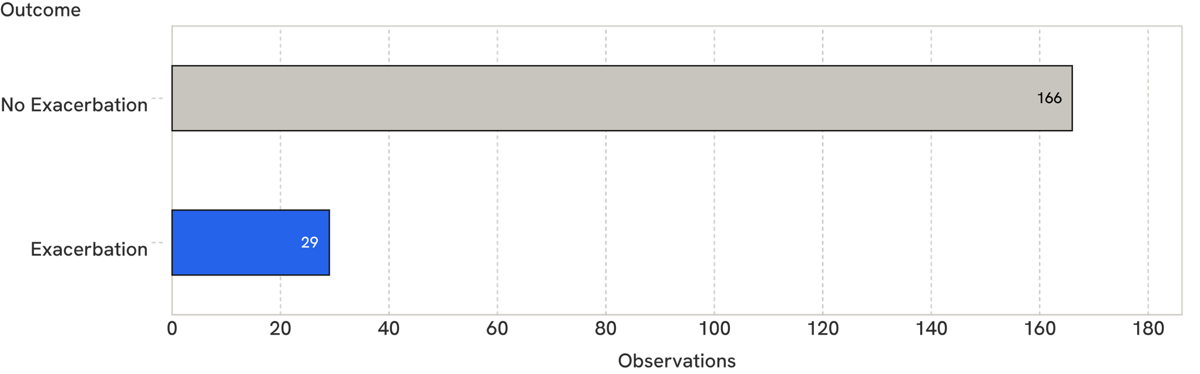
DATASET
195 observations from 65 patients, and exacerbations are rare
25 columns · no missing values · 2–4 repeated observations per patient
Exacerbation accounts for about 14.9%. These are not 195 independent patients.
Notebook source: data/asthma_exacerbation_dataset.xlsx
03 / 10
Notes:
The majority of observations have no exacerbation, which makes accuracy easy to overinterpret. Repeated observations belong to the same patients, so the split must keep patients separate.
3

Slide 4
PREPROCESSING
From raw columns to model-ready data
01
02
03
04
05
Dataset
Exploration
Feature selection
Encoding
Train/test split
195 observations
Types and balance
22 predictors
Category indices
By patient ID
Explore and exclude
Encode categories
Checked unique values, duplicates (none) and each variable against the outcome.
Excluded id, a patient identifier, and t, observation time. The 4th time point had only 12 observations and no exacerbations.
OrdinalEncoder for predictors; LabelEncoder for the target. Unseen test categories received a new valid category index.
Ath is a count variable (0–11).
04 / 10
Notes:
Exploration checked the structure and the relationship of each variable to the outcome. The exact encoding of Ath still needs verification against the notebook; the patient-level split is detailed next.
4

Slide 5
MODEL CHOICE
Why Categorical Naive Bayes?
A simple classifier for mostly categorical predictors.
01
02
03
Predictor categories
Estimated class probabilities
Predicted class
Symptoms + asthma-control category + clinical history
Estimate category likelihoods within each class and combine the evidence.
Choose the more likely class: Exacerbation or No Exacerbation.
Key assumption: predictors are independent given the class.
ILLUSTRATION, NOT A REAL PATIENT PREDICTION
05 / 10
Notes:
The model learns how common each predictor category is within each outcome class. Its independence assumption is a simplification, so we judge it by held-out performance rather than by the simplicity of its logic.
5

Slide 6
HELD-OUT RESULTS
The model found only 2 of 7 exacerbations
ROWS = ACTUAL · COLUMNS = PREDICTED
2
Actual outcome | Predicted Exacerbation | Predicted No Exacerbation
Exacerbation | 2 | 5
No Exacerbation | 4 | 27
caught
5
missed
Accuracy 76.3%
Exacerbation precision 33.3%
Recall 28.6% · F1 30.8%
38 test observations
07 / 10
Notes:
The important result is that five of the seven actual exacerbations were missed. The model also flagged four observations that actually had no exacerbation, so detection was limited in both recall and precision.
7

Slide 7
BASELINE COMPARISON
The baseline beat the model on accuracy
Naive Bayes | Majority-class baseline
 | ACCURACY 76.3% | ACCURACY 81.6%
 | EXACERBATION RECALL 28.6% | EXACERBATION RECALL 0%
 | Detects some exacerbations, but misses most. | Predicts No Exacerbation every time; imbalance inflates accuracy.
Setting both class priors to 0.5 changed no predictions or metrics.
No accuracy gain over the baseline, limited exacerbation detection.
08 / 10
Notes:
The baseline gets higher accuracy simply by choosing the majority class every time. Naive Bayes detects some exacerbations, but equal class priors did not improve the reported results.
8

Slide 8
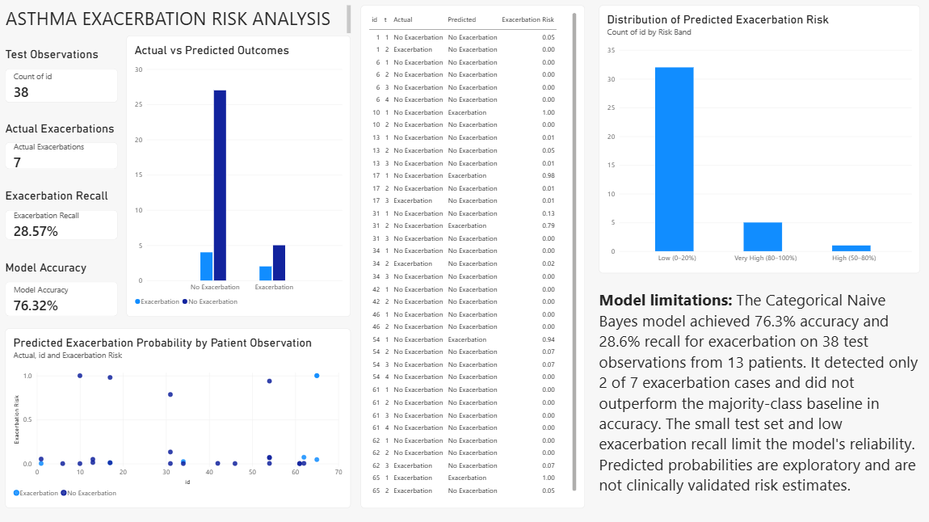
REPORTING
Power BI dashboard
38
7
28.6%
76.3%
TEST OBSERVATIONS
ACTUAL EXACERBATIONS
EXACERBATION RECALL
MODEL ACCURACY
Dashboard views
  Actual vs predicted outcomes
  Predicted-risk bands
  Probability by patient ID, coloured by actual outcome
  Prediction details table
09 / 10
Notes:
The dashboard uses the exported test predictions to make errors and outcome patterns easier to inspect. The screenshot still needs to be inserted, and the risk bands should be read as exploratory rather than clinical estimates.
9

Slide 9
CONCLUSION
Accuracy alone misleads on imbalanced data
Exploration → preprocessing → patient-level split → Categorical Naive Bayes → evaluation → Power BI reporting
Limited detection
Future work
Model: 76.3% accuracy, 28.6% recall on 38 test observations.
Baseline: 81.6% accuracy, 0% recall.
  Better minority-class detection
  Stronger validation
  Probability calibration
Educational research prototype only. Not validated for clinical decisions.
References and verification
Spyroglou et al. (2018), “Evaluation of Bayesian classifiers in asthma exacerbation prediction after medication discontinuation” supplied asthma exacerbation dataset
pandas documentation; scikit-learn documentation: CategoricalNB, OrdinalEncoder, LabelEncoder and metrics.
Notes:
This project covered the full workflow, but the held-out results show limited exacerbation detection. Future evaluation should focus on minority-class performance and stronger validation, with probability calibration before interpreting probabilities as risk. The reference details and original dataset source remain to be verified.
10

