Slide 1
CrossCUTS
Token- and Language-Level Exploration in GRPO
Mid-Submission Technical Progress, Diagnostic Analysis & Future Roadmap
Project Team: Ananya Agarwal (2024114007) | Arushi Shukla (2024101075) | Krishna Kaundinya P (2024101021) | Lohith Kola (2024101132)
International Institute of Information Technology, Hyderabad (IIIT-H) • ANLP 2026
Notes:
Welcome everyone. Today we present our mid-submission progress on CrossCUTS: Token- and Language-Level Exploration in Group Relative Policy Optimization (GRPO). We report our empirical findings replicating Mixed-CUTS, provide an in-depth diagnosis of observed training dynamics, and lay out our path forward toward multilingual reasoning.

Slide 2
CROSSCUTS PROJECT | MID-SUBMISSION TECHNICAL REPORT
Motivation: The 'Too Correct to Learn' Bottleneck in RLVR
The Promise of GRPO (Shao et al., 2024)
• Reinforcement Learning with Verifiable Rewards (RLVR) directly optimizes mathematical accuracy via rule-based verifiers.
• GRPO eliminates value critics by estimating baselines directly from G sampled rollouts per prompt.
• Advantage Formulation:
Â_i = (r_i - mean({r_j})) / (std({r_j}) + ε)
• Crucial Requirement: GRPO strictly requires intra-group reward variance (std > 0) to provide learning signals.
The Saturation Trap (Liang et al., 2026)
• Benchmark Saturation: Strong base models (e.g. Qwen3) achieve high baseline solve rates on standard datasets like MATH.
• Vanishing Advantages: When all G rollouts succeed (r_i = 1 for all i), std({r}) = 0. The standardized advantage Â_i collapses to zero.
• Consequence: The policy receives zero gradient across majority of training prompts and becomes trapped in local optima.
• Core Thesis: We must intervene at decoding time to re-introduce diversity and preserve intra-group advantage variance.
Notes:
In standard RLVR, group relative policy optimization computes advantages by normalizing rewards within a group. However, as base models scale, datasets like MATH become saturated. When all rollouts are correct, the variance vanishes, giving zero gradient signal. The model becomes 'too correct to learn'.

Slide 3
CROSSCUTS PROJECT | MID-SUBMISSION TECHNICAL REPORT
Problem Statement: Token- & Language-Level Exploration
1. Beyond Saturation
Does token uniformization (Mixed-CUTS) still provide gains when trained on non-saturated, intrinsically hard data (DAPO-17K)?
Hypothesis: On difficult datasets with natural reward variance, token-level exploration overhead may yield diminishing returns.
2. Multilingual Reasoning
How does Mixed-CUTS behave when reasoning in non-English or low-resource languages where probability distributions are noisier?
Motivation: Token distributions in low-resource tokens may have longer tails, altering the filtering dynamics of CUTS.
3. Exploration Interaction
Are token-level exploration (Mixed-CUTS) and language-level exploration (PolyGRPO) complementary or conflicting?
Goal: Build a unified 'CrossCUTS' framework combining orthogonal diversity axes without altering the ground-truth verifier.
Notes:
We frame our research around three primary questions: (1) Does CUTS help when the dataset is already hard (DAPO-17K)? (2) Does it stabilize multilingual reasoning? (3) Can we synergize token uniformization with polyglot language exploration?

Slide 4
CROSSCUTS PROJECT | MID-SUBMISSION TECHNICAL REPORT
Methodology: Constrained Uniform Top-K Sampling (CUTS)
1. Select (Top-K)
At decoding step t, extract the K highest-probability tokens V_top-K from model distribution P_θ(· | x_<t).
Default: K = 5 candidates.
2. Filter (δ-Constraint)
Filter candidates below minimum probability threshold δ:
S_t = { v ∈ V_top-K : P_θ(v) ≥ δ }
Default: δ = 0.03 (avoids tail noise).
3. Equalize (Uniform)
Flatten proposal distribution uniformly over survivors:
Q(x_t = v) = 1 / |S_t| for v ∈ S_t
Decouples sampling from greedy model bias.
4. Prefix Protection
Maintain standard sampling for first T_warm tokens:
Default: T_warm = 5 tokens
Preserves initial prompt setup and reasoning stability.
Mixed-CUTS Dual-Stream Rollout Structure (G = 16)
• Exploitation Batch (G_std = 8): Rollouts sampled via standard autoregressive decoding P_θ to preserve policy confidence.
• Exploration Batch (G_CUTS = 8): Rollouts generated via CUTS operator Q to uncover plausible under-explored paths.
• Advantages computed jointly over combined group G = G_std ∪ G_CUTS, restoring non-zero advantage variance.
Notes:
CUTS operates in four phases: Top-K selection, probability threshold filtering, uniform distribution equalization, and prefix protection. In Mixed-CUTS, rollouts are evenly divided into 8 standard and 8 CUTS samples.

Slide 5
CROSSCUTS PROJECT | MID-SUBMISSION TECHNICAL REPORT
Experimental Setup & System Implementation
Configuration Parameter | Implementation Detail
Base Model | Qwen3-1.7B (Non-thinking mode, max response length 5,000 tokens)
RL Framework | verl v0.9.0 (Synchronous PPO trainer, Ray distributed, TransferQueue)
Inference Engine | vLLM v0.24.0 (Custom C++/Python LogitsProcessor in Model Runner V1)
Hardware Setup | 2x NVIDIA H200 SXM (141 GB VRAM each) on Jarvislabs (1 GPU per arm)
Parameter Strategy | LoRA (r = 64, α = 128 on all linear layers, lr = 1e-5 constant, bf16)
Group & Batch Size | Group Size G = 16 (8 std + 8 CUTS), Global Batch = 128 prompts (2,048 seq/step)
Loss & Optimization | PPO mini-batch = 32 prompts, low-var KL coefficient = 1e-3, Rollout Temp = 1.0
Training Dataset | MATH Training Set filtered to numeric answers (7,382 prompts)
Evaluated Benchmarks | MATH-500, AIME24, AIME25, AMC23, GPQA-Diamond (16 samples per problem)
Notes:
Here is our complete experimental setup. We trained both arms on dedicated H200 GPUs. Note that due to early hardware constraints on Ada, our implementation utilized LoRA with r=64 and lr=1e-5, whereas the original paper fine-tuned all parameters.

Slide 6
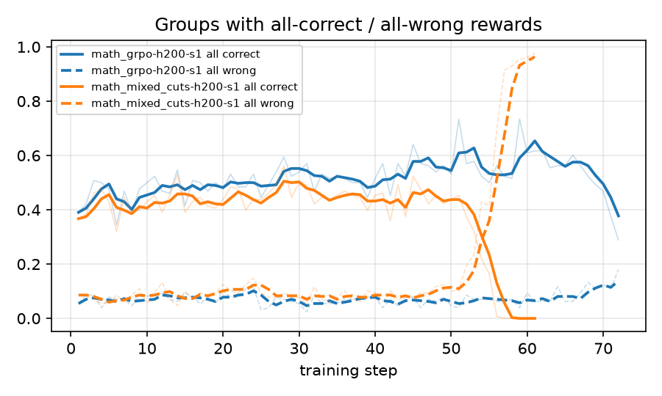
CROSSCUTS PROJECT | MID-SUBMISSION TECHNICAL REPORT
Progress: Empirical Verification of Saturation
Reward Distribution Across Prompts (16 Rollouts)
MATH Dataset (1,590 prompts evaluated):
• ~73% (1,160 prompts) are solved 16/16 correctly.
• ~80% have ≥15/16 rollouts correct.
• Only ~2% have 0 correct rollouts.
• Confirms severe saturation: GRPO receives zero gradient signal on ~75% of prompts.
DAPO-17K Dataset (160 sample prompts):
• Only ~2-3% of prompts are fully solved.
• ~32% have 0/16 correct rollouts (all wrong).
• Fails due to intrinsic difficulty, not homogeneity.
Experimental Regimes Defined:
• MATH: Saturated domain where CUTS is expected to restore variance.
• DAPO-17K: Hard domain to test whether CUTS adds value beyond saturation.
Notes:
Our empirical saturation test validates the paper's core hypothesis: on MATH, Qwen3-1.7B solves 73% of prompts with 16 out of 16 correct. In contrast, on DAPO-17K, 32% of prompts fail completely. This establishes our two experimental testing grounds.

Slide 7
CROSSCUTS PROJECT | MID-SUBMISSION TECHNICAL REPORT
Benchmark Evaluation: Qwen3-1.7B Across 5 Benchmarks
Model / Checkpoint | Benchmark | Pass@1 | maj@16 | Pass@16 | Mean Tokens | Truncated (%)
Base Model (Qwen3-1.7B) | MATH-500 | 70.2% | 79.0% | 91.2% | 850 | 1.2%
 | AIME24 | 13.8% | 20.0% | 46.7% | 2548 | 10.8%
 | AIME25 | 10.6% | 16.7% | 30.0% | 2205 | 4.4%
 | AMC23 | 42.8% | 57.5% | 80.0% | 1406 | 1.4%
Standard GRPO (Step 40) | MATH-500 | 78.1% | 86.4% | 91.4% | 1258 | 7.3%
 | AIME24 | 23.5% | 36.7% | 40.0% | 3935 | 55.0%
 | AIME25 | 15.8% | 30.0% | 30.0% | 3818 | 49.6%
 | AMC23 | 53.0% | 75.0% | 87.5% | 2355 | 21.1%
Mixed-CUTS (Step 40) | MATH-500 | 71.5% | 79.0% | 89.0% | 963 | 3.3%
 | AIME24 | 16.0% | 20.0% | 30.0% | 2978 | 27.3%
 | AIME25 | 6.7% | 13.3% | 26.7% | 2578 | 16.7%
 | AMC23 | 43.1% | 55.0% | 80.0% | 1713 | 8.9%
Mixed-CUTS (Step 50) | MATH-500 | 67.4% | 75.6% | 85.4% | 1075 | 7.9%
 | AIME25 | 3.5% | 6.7% | 16.7% | 2973 | 36.9%
Notes:
Here are the core evaluation results across MATH-500, AIME24, AIME25, and AMC23. Standard GRPO improves upon the base model (e.g. AIME24 rises from 13.8% to 23.5%), whereas Mixed-CUTS underperformed and degraded further at step 50. This direct inversion of the paper's findings led us to conduct an intensive root-cause diagnosis.

Slide 8
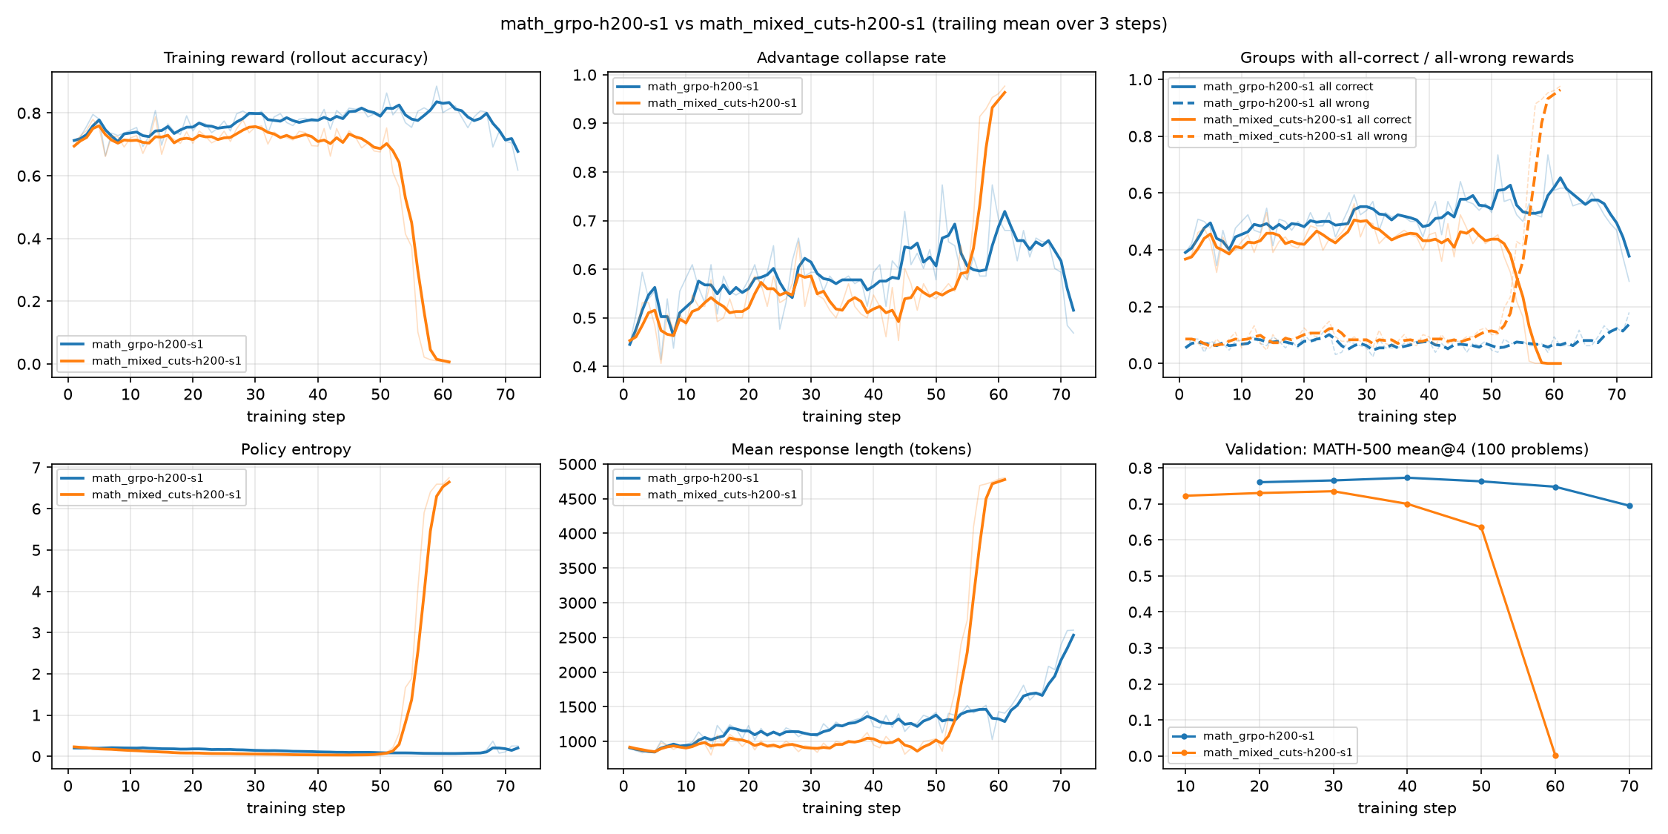
CROSSCUTS PROJECT | MID-SUBMISSION TECHNICAL REPORT
Training Dynamics: The Failure Mode Explained
Observed Anomalies vs. Published Curves
1. Entropy Collapse (The Exact Opposite of Paper):
• Paper: Policy entropy steadily climbed from 0.23 to 0.40.
• Our Run: Policy entropy crashed from 0.23 to 0.033 by step 41!
• The model became hyper-greedy and brittle.
2. Response Length Shrinkage:
• Paper: CUTS trajectories peaked over 1,800 tokens.
• Our Run: Response lengths shrank from 976 to 842 tokens.
3. KL Divergence Explosion:
• KL rose 5x faster in Mixed-CUTS (step 20: 0.091 vs 0.018 in GRPO).
• At step 56, KL spiked to 3.79, and validation crashed to 0.3%.
Notes:
Looking at the training dynamics: while the paper reported increasing entropy and longer reasoning chains, our Mixed-CUTS run showed immediate entropy collapse to 0.033, response length shrinkage, and a sudden KL explosion around step 48 to 56. Both arms diverged, but Mixed-CUTS diverged earlier.

Slide 9
CROSSCUTS PROJECT | MID-SUBMISSION TECHNICAL REPORT
Technical Diagnosis: Why Did Mixed-CUTS Underperform?
Discrepancy 1: Missing Equation (2) Length Normalization
The paper's loss in Eq. (2) explicitly normalizes each rollout by its own length (1/|o_i|):
L = (1/G) * Σ (1/|o_i|) * Σ_t min(ratio * Â, clip * Â)
Our implementation used verl's default 'token-mean' (global batch token sum). Long failing CUTS rollouts (3k-5k tokens) received 3x-4x more penalty weight than short correct rollouts, severely penalizing length and exploration.
Discrepancy 2: Saturated Group Advantage Asymmetry
On saturated prompts, 8/8 standard rollouts succeed (r=1). When CUTS explores and yields 2 failures (r=0):
Â_correct = +0.38 vs. Â_failed = -2.65
The penalty on exploratory tokens was 7x stronger than rewards. Because CUTS forced uniform sampling of low-prob tokens (P ≥ 0.03), their probabilities were aggressively crushed to zero, causing entropy collapse.
Discrepancy 3: KL Penalty Blowup under low_var_kl
The Schulman k3 estimator computes:
D_KL ≈ (π_ref / π_θ) - log(π_ref / π_θ) - 1
Notice π_θ is in the denominator. When penalized exploratory tokens have π_θ → 0, (π_ref / π_θ) explodes to infinity, triggering the catastrophic divergence at step 48-56.
Discrepancy 4: LoRA Bottleneck at High Learning Rate
The paper used Full Parameter Fine-Tuning at lr ≈ 1e-6. We used LoRA (r=64, α=128) at lr = 1e-5 (10x higher). Low-rank adapter updates ΔW = BA saturated rapidly under conflicting exploration/exploitation gradients.
Notes:
We isolated four fundamental causes: (1) Missing sequence length normalization: verl's token-mean overweighted long failing rollouts. (2) Advantage asymmetry: negative penalties were 7x stronger than rewards. (3) low_var_kl has pi_theta in the denominator, exploding when tokens are suppressed. (4) LoRA capacity limitations at high learning rate.

Slide 10
CROSSCUTS PROJECT | MID-SUBMISSION TECHNICAL REPORT
Targeted Code & Configuration Fixes
1. Set Sequence-Normalized Loss in configs/train/base_grpo.yaml
Under actor_rollout_ref.actor:
loss_agg_mode: seq-mean-token-mean # [FIX] Enforces Eq. (2) sequence-length normalization
Normalizes each rollout by 1/|o_i| so long exploratory reasoning traces are not penalized.
2. Stabilize KL Divergence Estimator in configs/train/base_grpo.yaml
Under actor_rollout_ref.actor:
kl_loss_type: kl # [FIX] Standard forward KL (avoids 1/π_θ denominator)
kl_loss_coef: 0.001
Eliminates the denominator blowup when exploratory tokens receive negative updates.
3. Full Parameter Fine-Tuning or Calibrated LoRA in Memory Configs
On Hopper 80 GB GPUs, Qwen3-1.7B full fine-tuning requires only ~21 GB VRAM:
lora_rank: 0 # [FIX] Full Parameter Fine-Tuning
optim.lr: 1.0e-6 # [FIX] Paper's stable learning rate
If constrained to LoRA, drop learning rate to 2e-6 with cosine schedule.
4. Enable Symbolic Math Grading in src/mixed_cuts/reward.py
In extract_answer(solution_str):
# Remove strict digit requirement from training verifier; preserve all LaTeX expressions
return pred, True, len(pred) > 0 # [FIX] Grade all valid symbolic answers with math-verify
Notes:
Here are the exact code and configuration fixes: (1) Set loss_agg_mode to seq-mean-token-mean in base_grpo.yaml. (2) Switch kl_loss_type to standard kl. (3) Switch to full fine-tuning or calibrate LoRA lr. (4) Remove digit-only filter in reward.py.

Slide 11
CROSSCUTS PROJECT | MID-SUBMISSION TECHNICAL REPORT
Project Roadmap & Updated Weekly Timeline
Week 1: Retraining & Baseline Stabilization
• Apply loss_agg_mode: seq-mean-token-mean and stabilized KL in base_grpo.yaml.
• Retrain Qwen3-1.7B on MATH; verify entropy growth and replicate paper Table 1.
• Model size adaptation: Port to Qwen3-0.6B to enable rapid, low-compute exploration cycles.
Week 2: Beyond-Saturation Stress Test (DAPO-17K & Poly-MATH)
• Train Mixed-CUTS on DAPO-17K to verify whether CUTS helps on naturally hard data.
• Establish baseline multilingual evaluations across the Poly-MATH dataset.
• Measure Advantage Collapse Rate (ACR) across easy vs. hard regimes.
Week 3: Language-Level Exploration (PolyGRPO)
• Implement PolyGRPO rollout scheduling in agent_loop.py (unconstrained + language-forced rollouts).
• Train and benchmark PolyGRPO on Poly-MATH dataset.
• Analyze language-conditioned reasoning trajectories.
Week 4: CrossCUTS Synthesis & Final Submission
• Integrate Mixed-CUTS (token-level) + PolyGRPO (language-level) into unified CrossCUTS.
• Run full 4-way ablation: Standard GRPO vs. Mixed-CUTS vs. PolyGRPO vs. CrossCUTS.
• Comprehensive evaluation (Pass@1, Pass@16, maj@16) and final report delivery.
Notes:
Our updated timeline spans 4 weeks: Week 1 focuses on retraining with our fixes. Week 2 evaluates on DAPO-17K. Week 3 implements PolyGRPO. Week 4 synthesizes both into the final CrossCUTS framework.

Slide 12
Key Mid-Submission Takeaways
✓ Saturation Validated: MATH is 73% all-correct for Qwen3-1.7B, confirming the need for exploration.
✓ Divergence Understood: Discrepancy between our run and paper traced to loss_agg_mode, low_var_kl blowup, and LoRA bottlenecks.
✓ Clear Fix Implemented: Replacing token-mean with seq-mean-token-mean aligns our code with Eq. (2) and prevents entropy collapse.
✓ On Track for CrossCUTS: Confident path toward integrating token-level and polyglot language exploration.
Project Artifacts & Discussion
• Code Repository:
github.com/dumbkin31/exploration-in-grpo
• Curated Results & Metrics:
Located in results/h200-2026-10-01/
• Model Checkpoints & Rollout Dumps:
HuggingFace: lokola13/mixed-cuts-h200-runs
• W&B Experiment Tracking:
Project anlp-mixed-cuts/mixed-cuts
Runs: math_grpo-h200-s1 & math_mixed_cuts-h200-s1
Questions & Feedback?
Notes:
In summary, we have validated benchmark saturation, diagnosed the divergence root causes down to specific configuration lines, and established a clear 4-week roadmap to complete the CrossCUTS framework. Thank you, and we welcome your questions.

