Slide 1

We choose the classic webpage structure
Flexible on different platforms (PC, Pad, Phone)

Slide 2
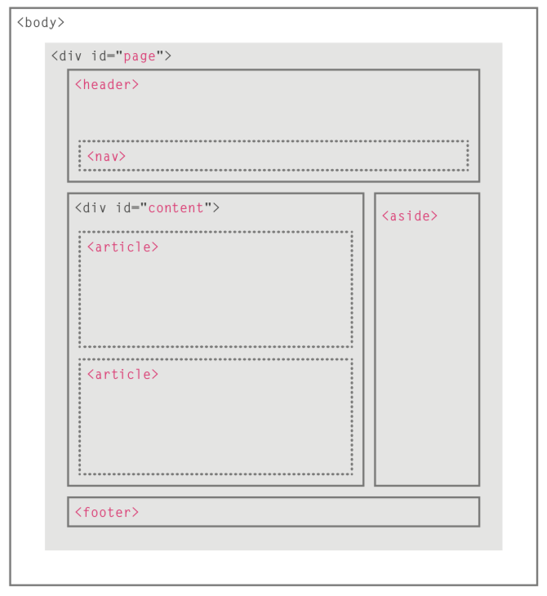
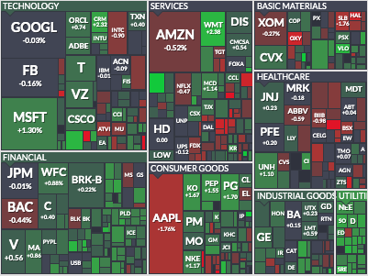

Home page
Market Outlook
• Daily outlook
• Weekly outlook
• Monthly outlook
• Market matrix
• Sector highlight
Ads
AphantI
Home | Outlooks | Blogs | Shows
- Show paper trading cases
Ads
Today’s Blog
Ads
Why AAPL becomes one of the top 5 must picked stocks?
Trade talks between
China and U.S. ended on
Friday without a deal…
Stock markets fell in
early morning trading,
with the S&P 500 down
more than 1 percent …
1day 5day 10day
Ads
About • Advertise • Contact • Privacy • Help
Apr 10 Apr 20 May 10

Slide 3
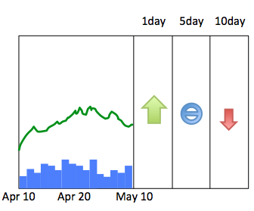

Apple Inc.
NASDAQ: AAPL
197.18 (+1.2%)
Volume: 231K
…

