Slide 1
XPMA
(eXtensive Process Modelling and Automation)

Slide 2
„Exchange tedious work for computer force!“

Slide 3
The Issue
IT industry today:
Hi-Tech organizations
Administrative organizations
Amateurs
missing:
SMEs
ill-funded or low-budget organizations (schools, manual workers, etc.)

Slide 4
Solution?
No silver bullet :(

Slide 5
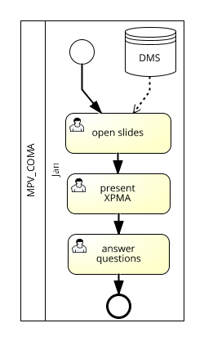
Processes
Everywhere
Intuitive
Enough precise
Transparency
Effectivity
Simplicity

Slide 6
Wait!?
Why are they uncommon?
People (end-users)
Implementation quality
Buzzword + prejudice
Missing data

Slide 7
XPMA
Modelling - both processes & data
Fully automated creation of the modelled system
    No human failure
    No cost
    No time
Power in hands of end-users
Open source
https://github.com/dumblob/XPMA

Slide 8
?

