Slide 1

Project Title:seamless online booking
Team Members:
Team Leader :kondapalli Dumdi Koteswararao
Team member : Yalavarthi Gopi Krishna
Team member : Puvvada Baby varshitha

Slide 2

Purpose:
Seamless booking in healthcare allows patients to easily schedule appointments online or through mobile apps, reducing wait times and administrative burdens. It improves patient experience, increases accessibility, and enables efficient resource allocation. This streamlined process also reduces no-show rates and enhances patient engagement.
Project Overview
Features:
Online Booking
Real-Time Availability
Automated Reminders
Easy Rescheduling and Cancellation
Integration with EMR/EHR

Slide 3

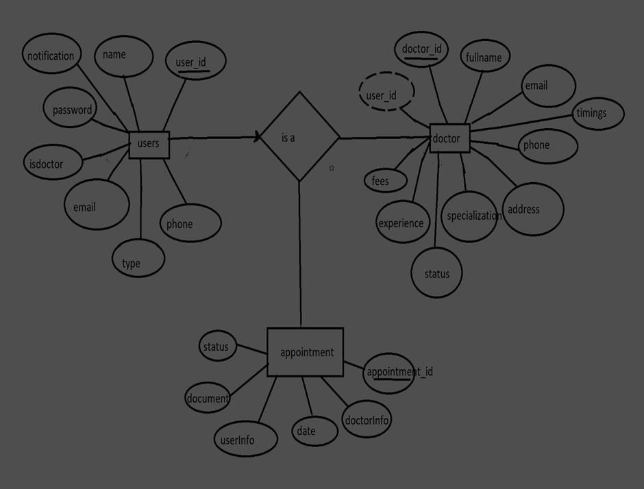


ER DIAGRAM
Users:
_id: (MongoDB creates by unique default) name
email notification password isdoctor type phone Doctor:
userID: (can be act as foreign key )
_id: (MongoDB creates by unique default) fullname
email timings phone address
specialization status experience

Slide 4
PRE-REQUISITES
Here are the key prerequisites for developing a full-stack application using Node.js, Express.js, MongoDB, React.js:
Node.js and npm:
Node.js is a powerful JavaScript runtime environment that allows you to run JavaScript code on the server-side. It provides a scalable and efficient platform for building network applications.
Install Node.js and npm on your development machine, as they are required to run JavaScript on the server-side.
Download: https://nodejs.org/en/download/
Installation instructions: https://nodejs.org/en/download/package-manager/
Express.js:
Express.js is a fast and minimalist web application framework for Node.js. It simplifies the process of creating robust APIs and web
applications, offering features like routing, middleware support, and modular architecture.
Install Express.js, a web application framework for Node.js, which handles server-side routing, middleware, and API development. Installation: Open your command prompt or terminal and run the following command:
npm install express MongoDB:
MongoDB is a flexible and scalable NoSQL database that stores data in a JSON-like format. It provides high performance, horizontal scalability, and seamless integration with Node.js, making it ideal for handling large amounts of structured and unstructured data.

Slide 5
React.js:
React.js is a popular JavaScript library for building user interfaces. It enables developers to create interactive and reusable UI components, making it easier to build dynamic and responsive web applications.
Install React.js, a JavaScript library for building user interfaces.
Follow the installation guide: https://reactjs.org/docs/create-a-new-react-app.html
HTML, CSS, and JavaScript: Basic knowledge of HTML for creating the structure of your app, CSS for styling, and JavaScript for client- side interactivity is essential.
Database Connectivity: Use a MongoDB driver or an Object-Document Mapping (ODM) library like Mongoose to connect your Node.js server with the MongoDB database and perform CRUD (Create, Read, Update, Delete) operations. To Connect the Database with Node JS go through the below provided link:
https://www.section.io/engineering-education/nodejs- mongoosejs-mongodb/
Front-end Framework: Utilize Reactjs to build the user-facing part of the application, including entering complaints, status of the complaints, and user interfaces for the admin dashboard.
For making better UI we have also used some libraries like material UI and boostrap.
Version Control: Use Git for version control, enabling collaboration and tracking changes throughout the development process. Platforms like GitHub or Bitbucket can host your repository.
Git: Download and installation instructions can be found at: https://git-scm.com/downloads
5

Slide 6
Development Environment: Choose a code editor or Integrated Development Environment (IDE) that suits your preferences, such as Visual Studio Code, Sublime Text, or WebStorm.
Visual Studio Code: Download from https://code.visualstudio.com/download
To run the existing Video Conference App project downloaded from GitHub: Follow below steps:
Clone the Repository:
Open your terminal or command prompt.
Navigate to the directory where you want to store the e-commerce app. Execute the following command to clone the repository:
git clone: https://github.com/awdhesh-student/complaint-registery.git
Install Dependencies:
Navigate into the cloned repository directory:
cd complaint-registery
Install the required dependencies by running the following commands:
cd frontend npm install cd ../backend npm install
Start the Development Server:
The online complaint registration and management app will be accessible at http://localhost:3000

Slide 7
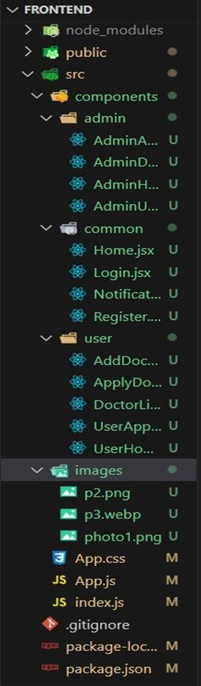
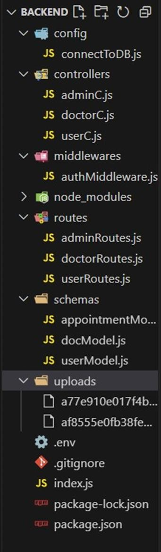
PROJECT STRUCTURE:
Application Flow: The project has 2 type of user – Customer and Doctor and other will be Admin which takes care to all the user. The roles and responsibilities of these two types of users can be inferred from the API endpoints defined in the code. Here is a summary:
Customer/Ordinary:
Create an account and log in to the system using their email and password.
They will be shown automatically all the doctors in their dashboard.
After clicking on the Book Now, a form will generate in which date of appointment and documents need to send.
They can sees the status of their appointment and can get a notification if the appointment is schedule or not.
The user can also cancel it`s booking in booking history page and can change the status of booking.
Admin:
Manage and monitor the overall operation of the appointment and the type of users
and doctors to the application.
He monitors the applicant of all doctors and approve them and then doctors are registered in the app.
Implement and enforce platform policies, terms of service, and privacy regulations. Doctor:
Gets the approval from the admin for his doctor account.

Slide 8
Folder setup
Folder setup:
Create frontend and
Backend folders
Open the backend folder to install necessary tools
For backend, we use:
cors
bcryptjs
express
dotenv
mongoose
Multer
Nodemon
jsonwebtoken

Slide 9
Setup express server
Setup express server
Create index.js file in the server (backend folder).
define port number, mongodb connection string and JWT key in env file to access it. Configure the server by adding cors, body-parser.
Add authentication: for this,
You need to make a middleware folder and in that make an authMiddleware.js file for the authentication of the projects and can use in.
9

Slide 10
Configure MongoDB
Configure MongoDB
Import mongoose.
Add database connection from config.js file present in config folder
Create a model folder to store all the DB schemas like renter, owner and booking, properties schemas.
Installation of required tools
Installation of required tools:
For frontend, we use:
React
Bootstrap
Material UI
Axios
Antd
mdb-react-ui-kit
react-bootstrap

Slide 11
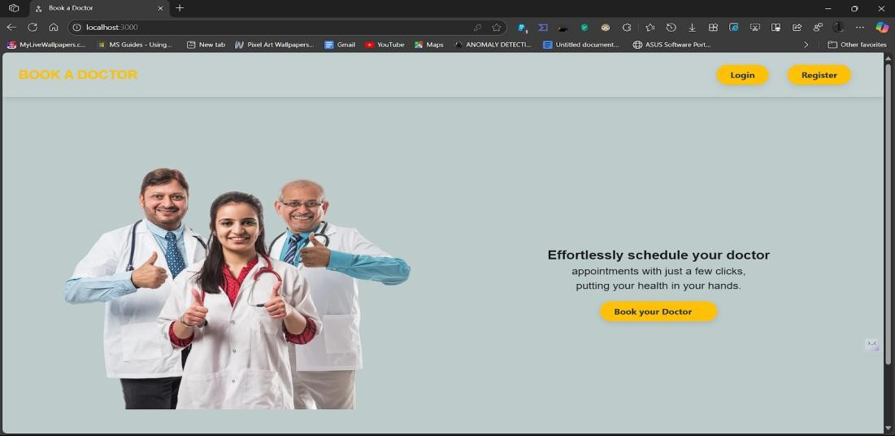
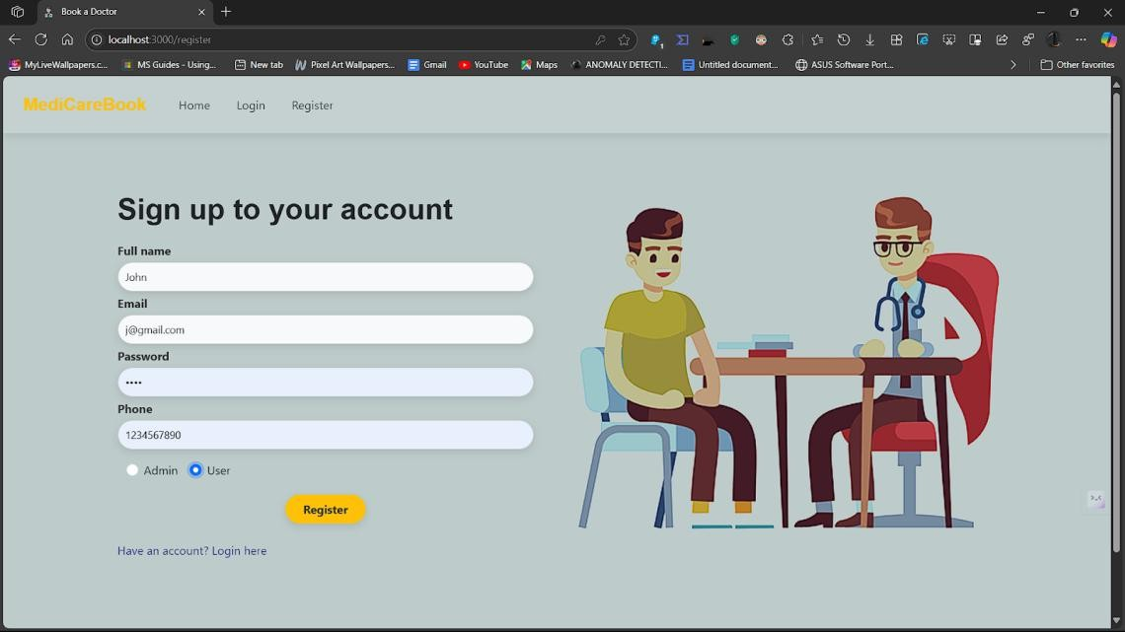
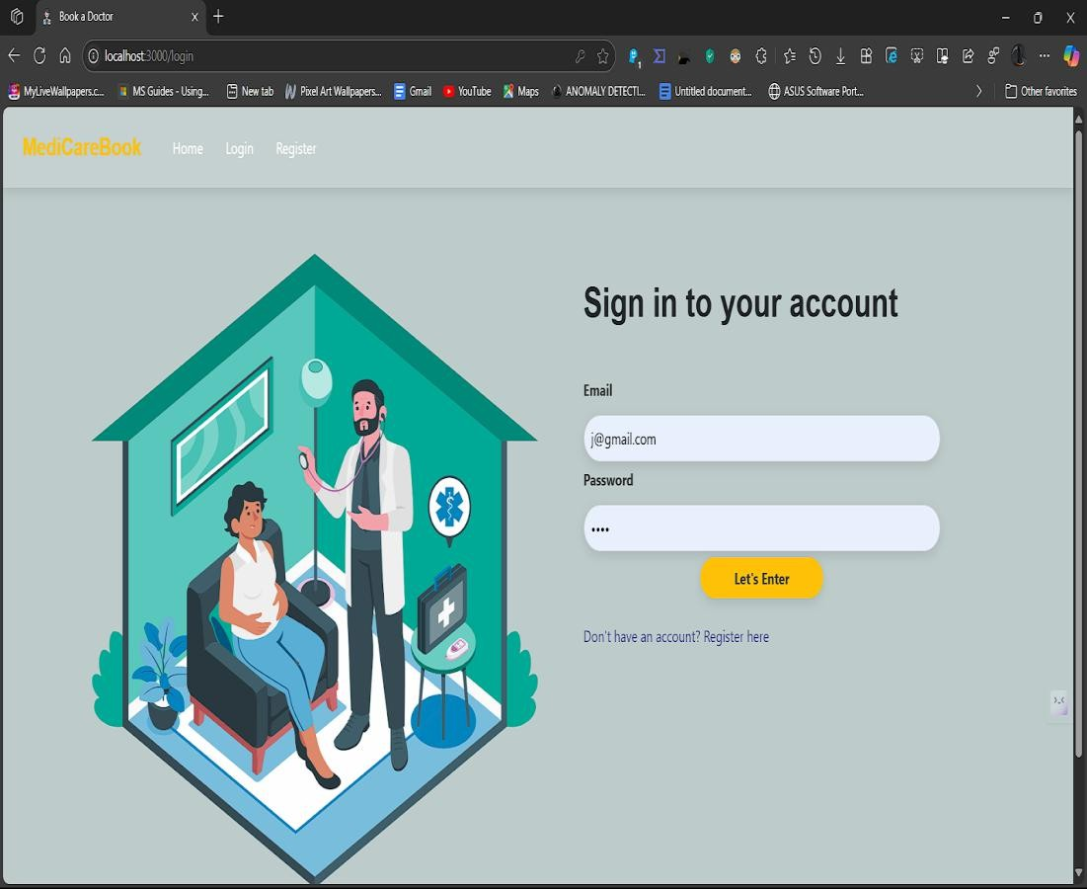
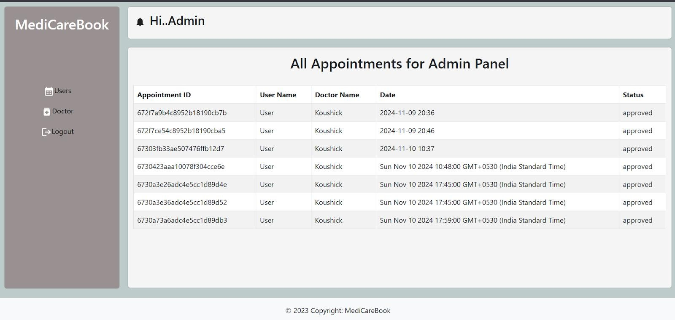
Landing page
Register page
Login page
Admin page:

Slide 12
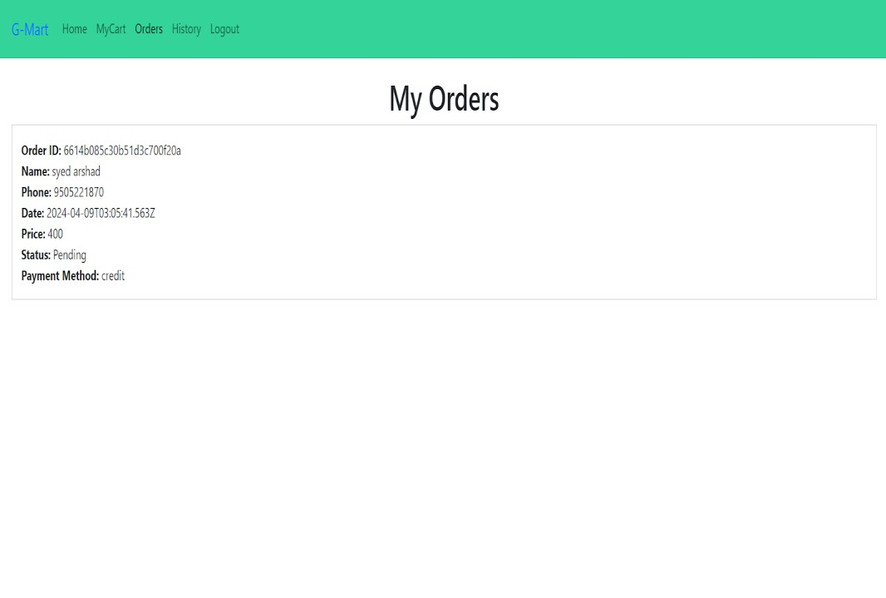
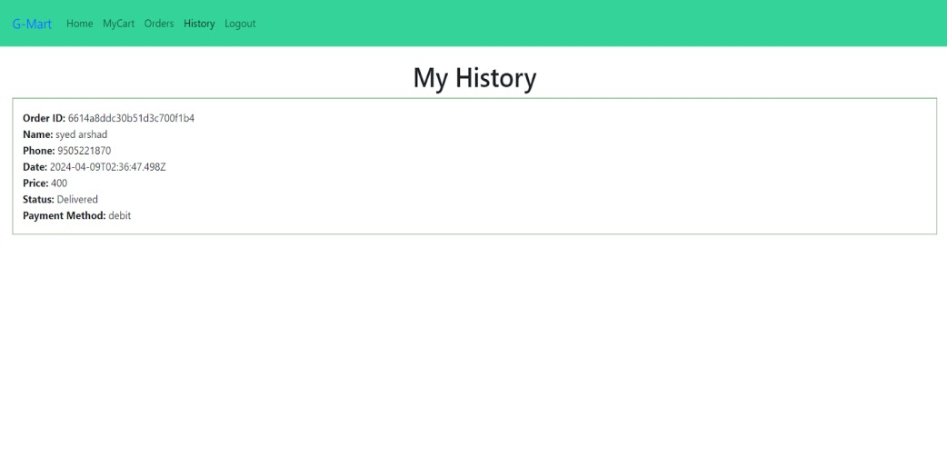
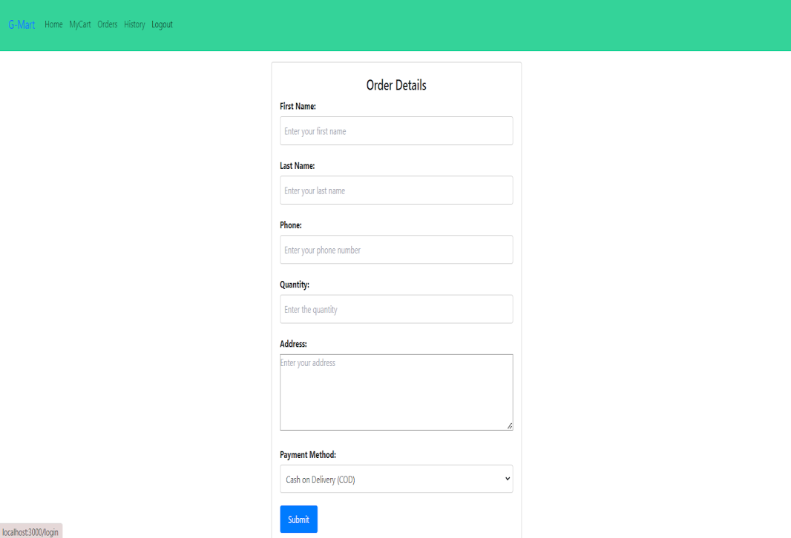
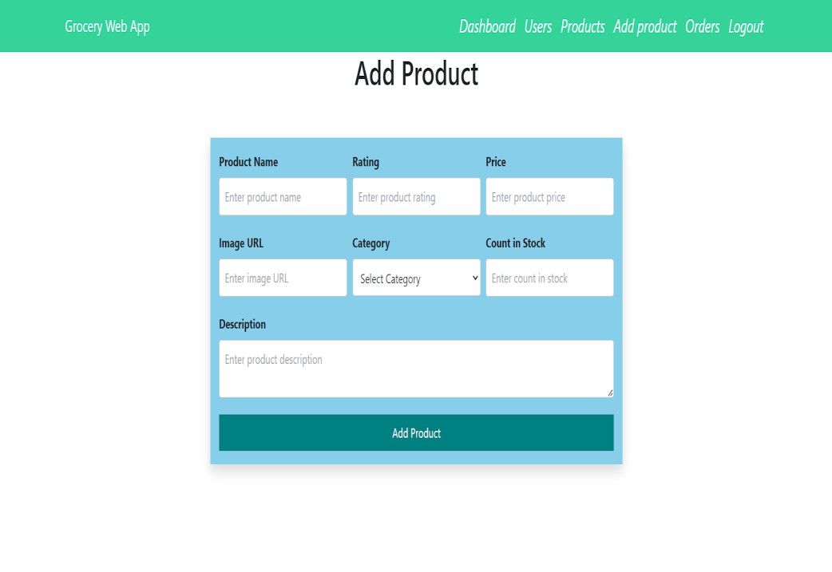

My History Page:
Place Order Page:-
Users Page:-
Add Product page:-

Slide 13
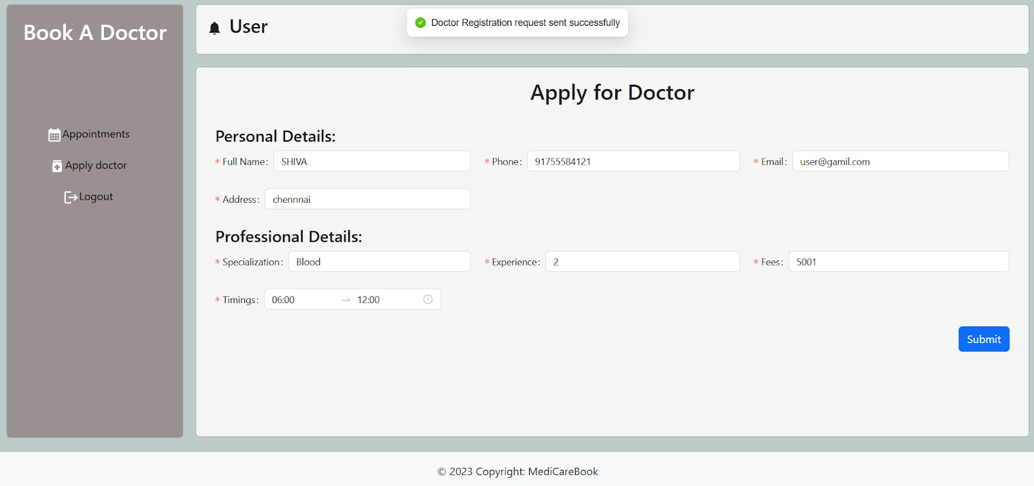
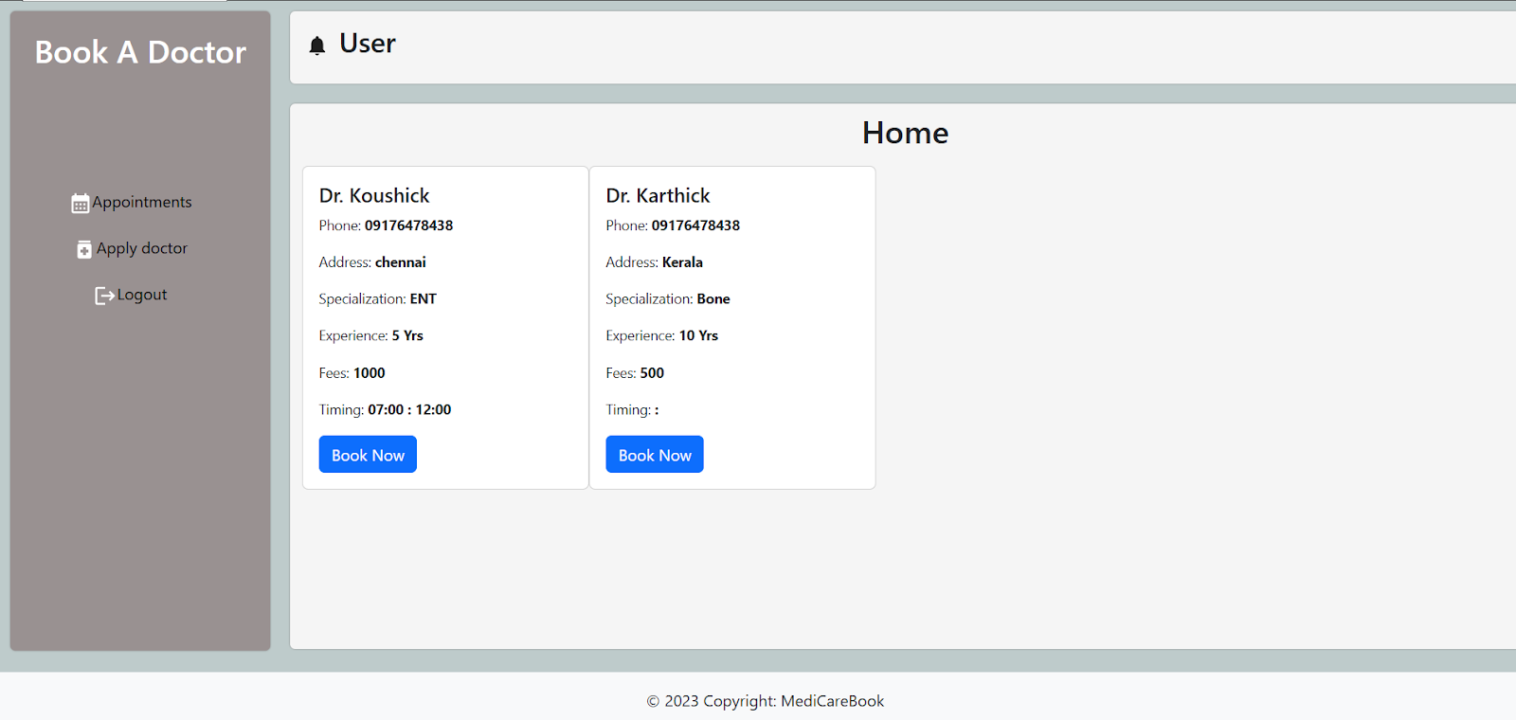
Doctor dashboard
User dashboard

Slide 14
Thank You
14

