Slide 1
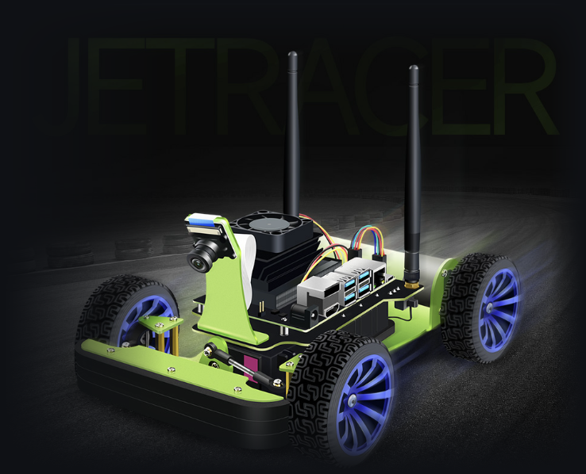
JetRacer Autonomous Driving and Delivery
RUSHHOUR3 · PROJECT 75
Teaching a real car to drive itself
with reinforcement learning
Augustus Amedume 24983037
SAC-VAE on the real car · VAE · dashboard
Seth Yap Wing Shen 25965486
Imitation learning · 2D-sim DQN · OpenCV
Jia Lu 25404498
Image-based DQN in DonkeySim
43008 Reinforcement Learning · Assessment 3 · Part F
Notes:
SPEAKERS: all three, each says name + student ID | TARGET: 0:45 | ~83 words
AUGUSTUS: Hello, everyone. We're team RushHour3, project 75. I'm Augustus Amedume, student ID 24983037.
SETH: I'm Seth Yap Wing Shen, student ID 25965486.
JIA: And I'm Jia Lu, student ID 25404498.
AUGUSTUS: Our project is JetRacer Autonomous Driving and Delivery. We set out to teach a real NVIDIA JetRacer to drive itself around a track with reinforcement learning, as a small-scale autonomous delivery vehicle. We'll cover the problem, our environment, the four approaches we tried, our final SAC-VAE system with a recorded demo, and what we learned.

Slide 2
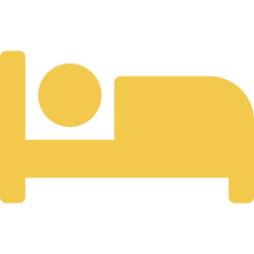





Delivery still depends on human drivers
Augustus Amedume
THE PROBLEM TODAY
OUR PROOF OF CONCEPT
A JetRacer as a small autonomous delivery vehicle
Driver fatigue
Long shifts reduce alertness
Follows its lane using only the onboard camera
Operating costs
Every vehicle needs a paid driver
Steers through the corners on its own
Inconsistent performance
Timing and quality vary between drivers
Stops at pickup and drop-off zones (final goal)
Our question: can a real car learn reliable lane following from camera images with reinforcement learning?
Notes:
SPEAKER: Augustus Amedume | TARGET: 1:00 | ~137 words
Delivery services still rely on human drivers to pick up and drop off goods on time. That brings three problems: driver fatigue, high operating costs, and performance that varies from driver to driver. Autonomous delivery vehicles are one of the most promising applications of machine learning for this.
Our project is a small-scale proof of concept: a JetRacer acting as a delivery vehicle. It has to follow its lane using only the onboard camera, steer through the corners on its own, and, as the final goal, stop at pickup and drop-off zones.
We also had a learning goal. Almost everything we trained in this subject lived in a simulator, and we wanted to see what changes when a policy has to drive real hardware, with camera noise, changing light and imperfect steering.
Seth will introduce the environment.

Slide 3
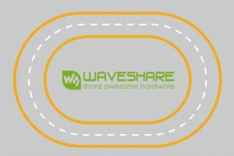
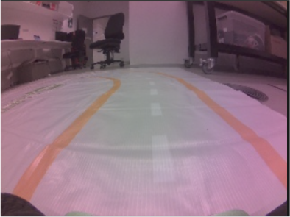
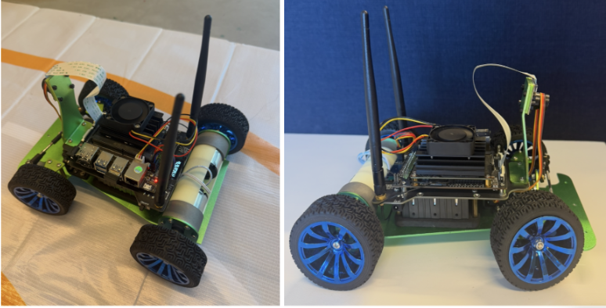
A real track, a real car, a noisy camera
Seth Yap Wing Shen
TRACK
JETRACER
CAMERA VIEW
Oval, about 2.65 m × 1.70 m
Lane 0.26 m wide between orange lines
Dashed white centre line
Jetson Nano runs it all on board
Front camera, 320 × 240 colour
Steering servo + drive motor
Pink colour cast at the edges
Room and people above the track
Datasets: 849 frames (imitation), 6,432 + 15,809 (VAE)
We also built two simulators: a 2D Gymnasium track (slide 6) and a DonkeySim copy of the lab track (slide 7).
Notes:
SPEAKER: Seth Yap Wing Shen | TARGET: 1:00 | ~150 words
Thanks, Augustus. Our environment is physical. The track is the Waveshare JetRacer mat: an oval about 2.65 by 1.7 metres, with a lane only 26 centimetres wide between two orange boundaries and a dashed white centre line. The lane is narrow and the curves are tight, so the car has to keep correcting its steering.
The car is an NVIDIA JetRacer. A Jetson Nano on board runs the camera, the model and the control loop. The front camera gives 320 by 240 colour frames. As you can see on the right, they have a pink colour cast towards the edges, and the top of each frame shows the lab and people rather than the track. Both of those caused problems later.
Alongside the real track, we built two simulators: a simple 2D one, and a DonkeySim copy of the track. Augustus will give a quick overview of our four approaches.

Slide 4



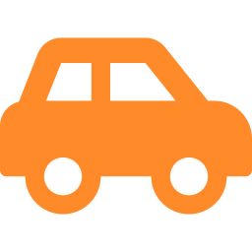
Four approaches, one goal
Augustus Amedume
SELECTED
APPROACH 1
APPROACH 2
APPROACH 3
APPROACH 4
Imitation learning
DQN + OpenCV
Image-based DQN
SAC + VAE
ResNet18 copies a human driver
Trained in a 2D simulator, run through lane detection
Trained on camera images in DonkeySim
Learns online on the real car
Owner: Seth
Owner: Seth
Owner: Jia
Owner: Augustus
RESULT
RESULT
RESULT
RESULT
Val. MAE 0.086, but missed corners on the car
4.6 laps in sim, unreliable on the car
11/12 sim runs, not tested on the real track
≈4.5 laps on the real track
Notes:
SPEAKER: Augustus Amedume | TARGET: 0:30 | ~58 words
Here are our four approaches side by side. Seth built imitation learning and a DQN trained in a 2D simulator. Jia built an image-based DQN in DonkeySim. I built SAC with a variational autoencoder, which learns directly on the car. Only SAC-VAE completed laps on the real track, so it became our final system. Seth, over to you.

Slide 5
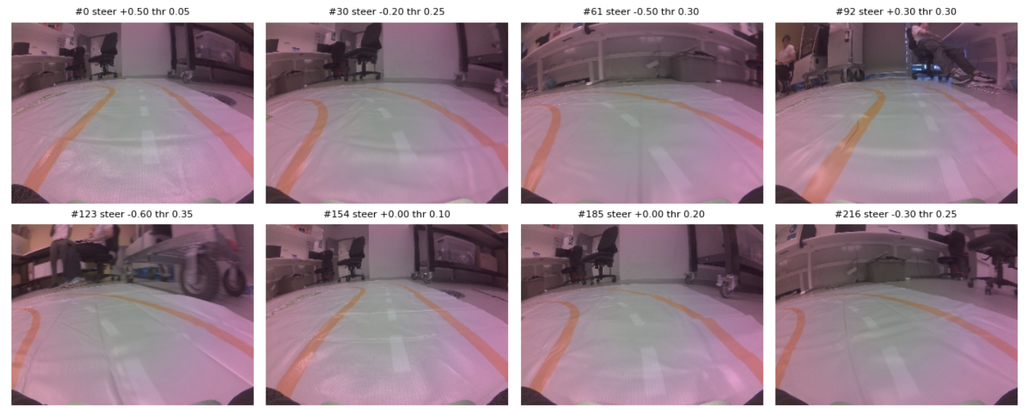

Imitation learning: copy a human driver
Seth Yap Wing Shen
Drive by keyboard
teleoperation, 4 sessions
Record pairs
camera frame + steering label
Train ResNet18
ImageNet weights, 1 steering output
Steer live
predicted steering, fixed throttle
TRAINING PAIRS: CAMERA FRAME + STEERING LABEL
0.086
validation MAE (steering)
756 of 849 frames kept
608 train / 148 val, split by time
L1 loss · AdamW · 20 epochs
On the car: fine on straights, missed corners
Notes:
SPEAKER: Seth Yap Wing Shen | TARGET: 1:00 | ~137 words
Our first approach was imitation learning: if a person can drive the track, can a network copy them? We used a keyboard teleoperation controller to drive the car around the track while recording every camera frame with its steering command. That gave 849 frames over four sessions. We kept 756 after cleaning, split by time into 608 for training and 148 for validation.
We fine-tuned a ResNet18, pretrained on ImageNet, with a single steering output, for 20 epochs with an L1 loss. Each image had its top 35 percent cropped off and was resized to 160 by 120.
Offline it looked good: a validation error of 0.086. On the car, it handled the straights but struggled with the corners. Once it drifted into a position we had never demonstrated, it had no examples of how to recover.

Slide 6
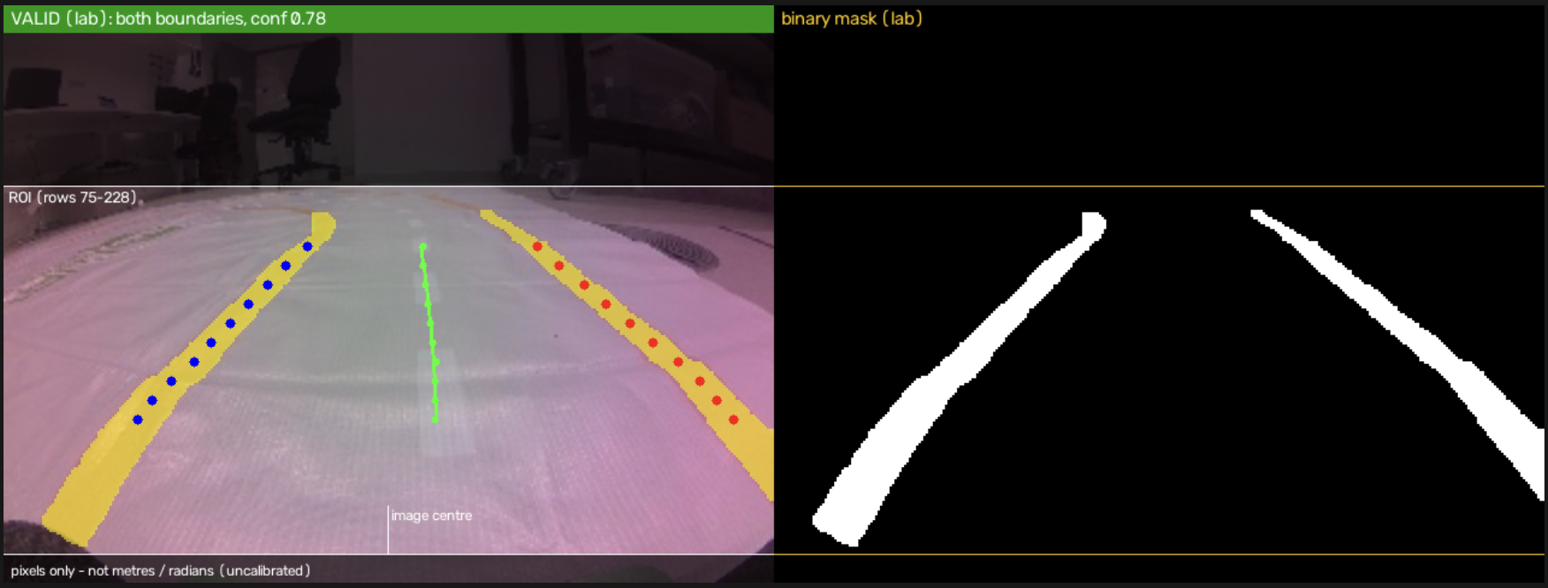
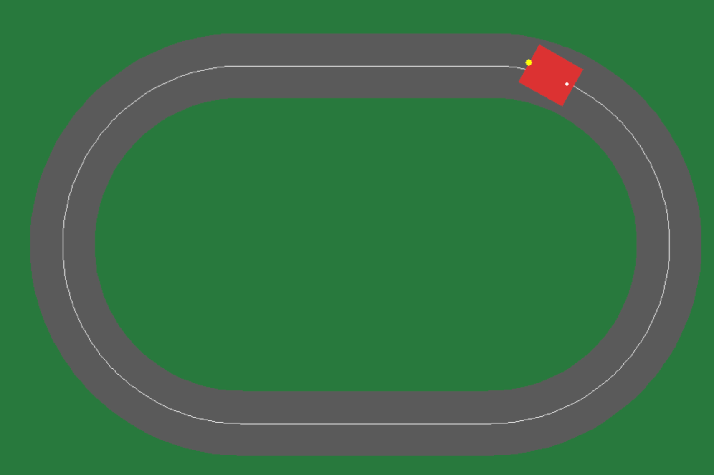
2D-sim DQN, deployed through OpenCV
Seth Yap Wing Shen
1 · TRAIN IN A 2D GYMNASIUM SIMULATOR
2 · DEPLOY WITH OPENCV LANE DETECTION
State
lane offset, heading error, last steering
Actions
left · straight · right
Reward
+ progress near the centre
− leaving the lane
Training
SB3 DQN, 20 min (5.68 M steps)
Orange boundaries → lane offset + heading → DQN → steering
4.6
laps on average in simulation
0%
crashes over 100 greedy test episodes
Unreliable on the car
Lost a boundary on corners; sensitive to noise and delays
Notes:
SPEAKER: Seth Yap Wing Shen | TARGET: 1:15 | ~169 words
Next, I tried reinforcement learning in simulation. I built a 2D Gymnasium environment with the real track's dimensions and a simple bicycle model of the car. The state is three numbers: the offset from the lane centre, the heading error, and the previous steering action. The DQN chooses left, straight or right. It is rewarded for progress near the centre, and leaving the lane ends the episode with a penalty.
After about 20 minutes of training, or 5.7 million steps, it averaged 4.6 laps with zero crashes over 100 greedy test episodes.
The car can't measure its lane offset directly, so I built the OpenCV pipeline on the right. It finds the orange boundaries and estimates the offset and heading from each camera frame.
That's where the transfer broke down. On corners the detector often lost one boundary, so the DQN received wrong states, and our robustness tests showed it was very sensitive to noise and control delays. Jia tried to close that gap by learning from images directly.

Slide 7
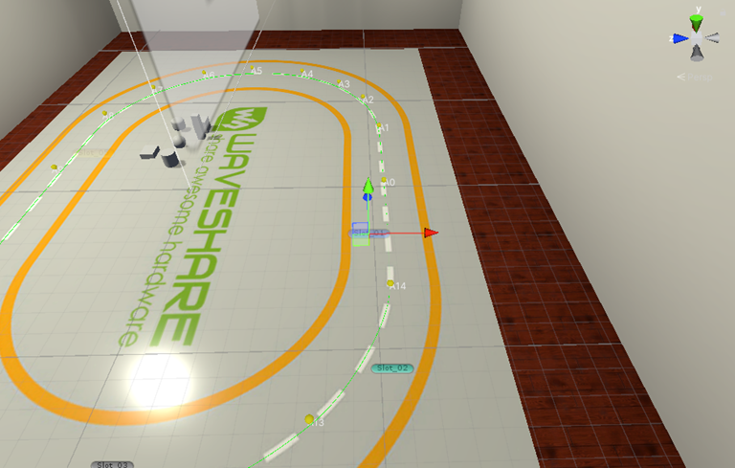
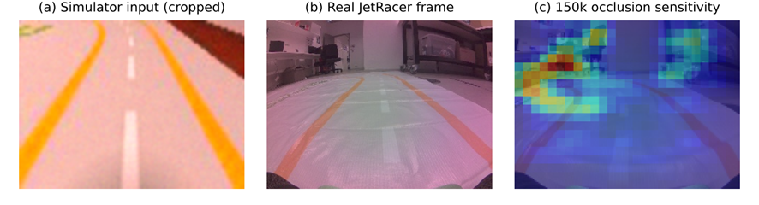
Image-based DQN in DonkeySim
Jia Lu
UNITY COPY OF THE LAB TRACK
1
2
3
Lane following
Crop + random colours
Mirrored runs
from scratch · 150k steps
top 45% removed · 125k
resized track · 750k
Model | CCW | CCW + rand. | CW (mirror) | CW + rand. | Total
Start* | 2/2 | – | 0/2 | – | 2/4
Round 1 | 3/3 | 3/3 | 0/3 | 0/3 | 6/12
Round 2 | 3/3 | 3/3 | 3/3 | 1/3 | 10/12
Round 3 (final) | 3/3 | 3/3 | 3/3 | 2/3 | 11/12
SIMULATOR VS REAL CAMERA
Runs reaching 1,000 steps on the resized track. *Start model: 2 runs per condition, 500-step limit.
On real frames its steering agreed better with the human after cropping + colours, but it never drove the real track (servo off-centre, power loss).
(c) shows the first model looked mostly at the room (red)
Notes:
SPEAKER: Jia Lu | TARGET: 1:30 | ~217 words
Thanks, Seth. Working cars and lab time were limited, so as a backup I built a copy of the lab track in DonkeySim, a Unity simulator. The first version, built from memory, was about 30 percent too wide, so I resized it.
My DQN looks at the camera image instead of three numbers. A small convolutional network scores five actions, from hard left to hard right.
I trained it in stages. First, plain lane following. Then I cropped off the top 45 percent of each image and randomised the colours, so it would look at the road and not the room. Then half of the runs were mirrored, flipping the image and the steering, so it learned clockwise driving without a second track.
The table shows why mirroring mattered: clockwise went from zero out of three to three out of three, and the final model passed 11 of 12 test runs.
On real camera frames, its steering agreed more with the human driver after these changes. But real frames still look very different from the simulator, as the bottom image shows, and we couldn't test it on the real track: the second car's servo was far off-centre and the Jetson lost power when it steered hard. Augustus will now show the approach that worked on the car.

Slide 8
SAC-VAE: separate seeing from deciding
Augustus Amedume
DRIVING LOOP · EVERY STEP (≈22–35 Hz)
next camera frame
Camera
320×240 RGB frame
Pre-process
resize to 160×120, keep bottom 160×80
VAE encoder
frozen · 32 latent values
State
32 latent + last 20 actions = 72
SAC actor
2×32 ReLU → steering, throttle
JetRacer
steering servo + drive motor
store (s, a, r, s′)
update weights
LEARNING LOOP
AFTER EVERY EPISODE
Operator
START, then STOP at the track edge
Reward
+1 per step · −10 on STOP
Replay buffer
30,000 transitions
SAC update
twin critics + actor, 200 gradient steps
Seeing: VAE, trained offline, frozen
Deciding: SAC actor, learned on the car
Learning: after every episode
Notes:
SPEAKER: Augustus Amedume | TARGET: 1:30 | ~182 words
Our final system separates seeing from deciding. Learning to steer from raw pixels would need far more driving than one real car can collect. So we followed the 'learning to drive in minutes' method, using the open-source airc-rl-agent code, and adapted it to our car, track and steering.
The top row runs at every control step, about 22 to 35 times a second. The camera frame is resized and cropped to the bottom 160 by 80 pixels, which is the track ahead. A variational autoencoder, trained offline on our own track images and then frozen, compresses that crop into 32 numbers. We add the last 20 actions, so the agent knows how it has been moving, which gives a 72-number state. The SAC actor turns that state into a steering and throttle command.
The bottom row is learning. Every transition is stored in a replay buffer. After each episode, the twin critics and the actor are updated with 200 gradient steps. We chose SAC because it handles continuous steering directly, and because it's off-policy: every expensive real-world sample gets reused many times.

Slide 9



Human-in-the-loop training on the car
Augustus Amedume
State | 72 values: VAE latent (32) + last 20 actions (40)
Action | Steering in [−0.8, 0.8]; throttle 0.3–0.4 forward; steering change ≤ 0.56 per step
Reward | 1 + 0.1 · throttle / 0.4 per step; −10 − 5 · throttle (normalised) on STOP
Discount | γ = 0.99
Networks | Actor + twin critics, 2 × 32 ReLU · lr 3×10⁻⁴ · batch 64 · buffer 30,000
EACH EPISODE
1 START
2 DRIVE
Operator starts an episode with a key press
The car drives itself: about +1 reward per step
4 LEARN
3 STOP
200 SAC updates while the car is reset
Operator stops it at the track edge: −10 or worse
Each session starts with 300 random warm-up steps. No simulator: all learning ran on the Jetson Nano.
Notes:
SPEAKER: Augustus Amedume | TARGET: 1:00 | ~137 words
Here's the MDP. The state is that 72-number vector. The action is a continuous steering value between minus and plus 0.8, plus a throttle rescaled to a forward command between 0.3 and 0.4, and steering changes are limited each step to avoid jerks.
The reward is about survival: roughly plus one for every step on the track, with a small bonus for speed, and minus 10 or more when the car has to be stopped, larger at higher throttle so it doesn't learn to speed into crashes. Since the throttle never drops below 0.3, a longer episode really means more track driven.
There's no simulator here. We acted as the referee: we pressed start, the car drove, we pressed stop the moment it left the track, and while we put it back, SAC trained on the Jetson.

Slide 10
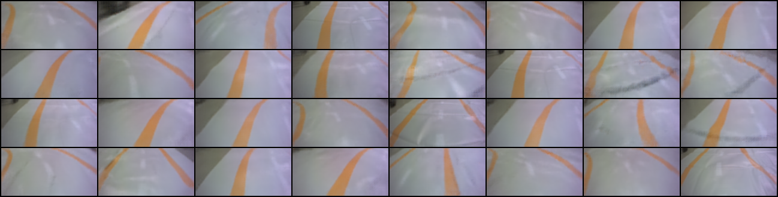
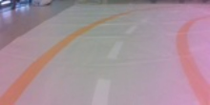
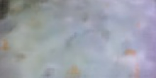
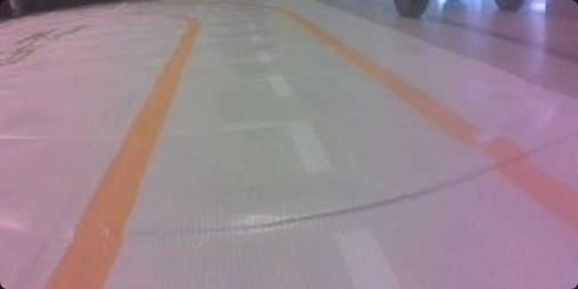
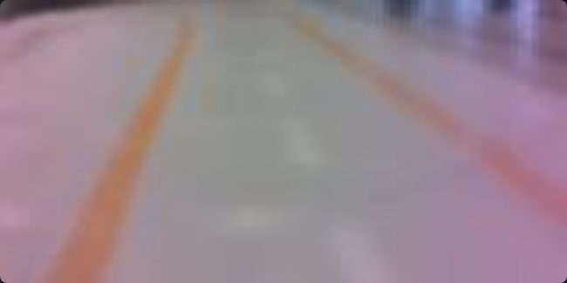
Seeing the track: VAE v1 vs v2
Augustus Amedume
VAE V1 · 6,432 IMAGES · ANTI-CLOCKWISE ONLY
VAE V2 · 15,809 IMAGES · BOTH DIRECTIONS + GLARE
In the training notebook: looks fine
Recorded clockwise and anti-clockwise
Different light and glare conditions
Same 160 × 80 crop; trained for 62 epochs
Live, on a right turn: noise
Live frame (dashboard): track recovered
Input crop
Reconstruction · error 485,386
Input crop
Reconstruction
The driving results we report used VAE v1. VAE v2 and a corrected steering configuration were ready, but hardware faults stopped retraining.
Notes:
SPEAKER: Augustus Amedume | TARGET: 1:00 | ~138 words
The VAE is the agent's eyes, so its quality limits everything. Our first VAE was trained on 6,432 images, all recorded driving anti-clockwise. In the training notebook its reconstructions looked good, as on the left. But when we checked it live, it failed on right turns: the reconstruction is just noise, with an error of about 485,000. If the VAE can't see a right turn, SAC can't learn one.
So I collected 15,809 more images, in both directions and with different light and glare, and trained a second VAE. On a live frame it recovers the boundaries and the direction of the curve, as on the right.
One honest caveat: the driving results we report come from the first VAE. The second VAE and a corrected steering configuration were ready, but hardware faults stopped us retraining with them.

Slide 11
Results: 87 → 343 steps per episode
Augustus Amedume
3,130
longest episode: over 2 minutes driving alone
≈26,500
steps · 200 episodes · 6 sessions
≈4.5 laps
deterministic test runs: 37.9 s and 30.9 s
anti-clockwise
Clockwise: failed on right-hand curves
Notes:
SPEAKER: Augustus Amedume | TARGET: 0:45 | ~100 words
We trained the final policy over six sessions, each continuing from the previous checkpoint: about 26,500 steps and 200 episodes in total. Mean episode length rose from 87 steps in the first session to 343 in the last. The dips in sessions three to five are partly because each resumed session starts with an empty replay buffer and random steps. The longest episode was 3,130 steps, over two minutes of driving on its own.
With its deterministic policy, the final model drove for 37.9 and 30.9 seconds, about 4.5 laps on average, anti-clockwise. Clockwise, it failed on the right-hand curves.

Slide 12
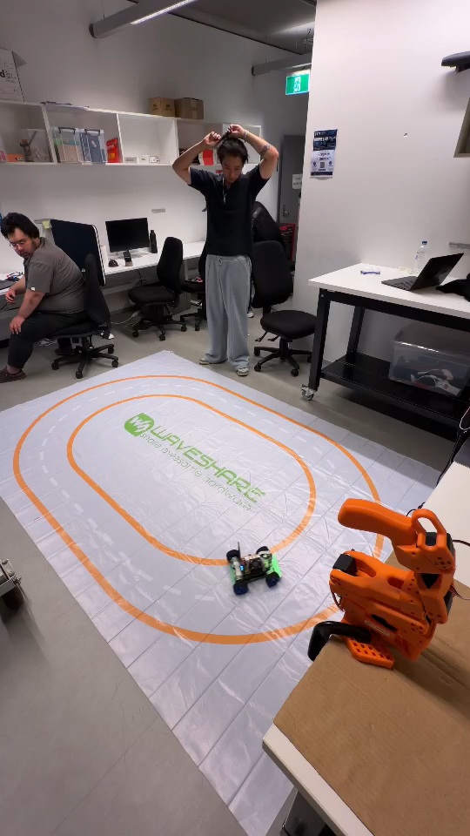



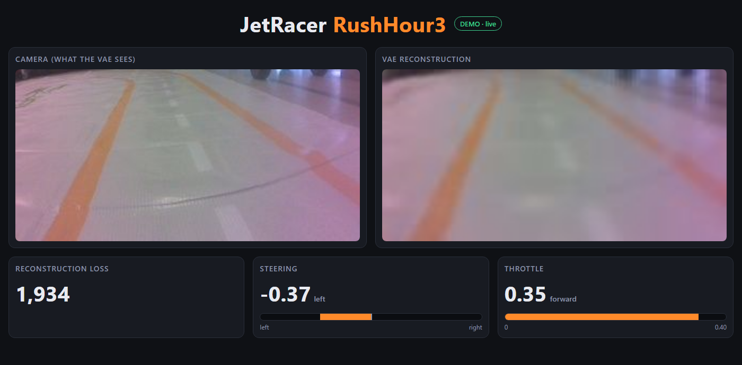
Demo: the policy driving on its own
Augustus Amedume
No human steering
5+ laps in 83 s
Anti-clockwise
LIVE DASHBOARD · SERVED FROM THE CAR, VIEWED IN ANY BROWSER
Notes:
SPEAKER: Augustus Amedume | TARGET: 1:45 (the 83 s clip plays automatically and is muted; talk over it) | ~151 words
[If the video doesn't start by itself, click it.] Here's our recorded demo. This is our trained SAC-VAE policy driving the lab track by itself. Nobody is steering; the operator only watches, ready to press stop.
Watch the corners: the car keeps making small steering corrections all the way round, at a steady speed. In this 83-second clip it completes more than five laps, anti-clockwise, without leaving the lane.
On the right is the dashboard I built for training and demos. It runs on the car and opens in any browser. On its left is what the VAE sees, the cropped camera frame, and next to it the VAE's reconstruction. Below are the reconstruction loss and the steering and throttle the agent is sending. If the reconstruction stops looking like the track, the loss jumps, and you know the agent is effectively driving blind. That's exactly how the right-turn problem shows up.
Seth will now take us through the limitations.

Slide 13






Limitations and lessons
Seth Yap Wing Shen
Sim-to-real gap
Perception
Steering hardware
Both DQNs were reliable in simulation, where states are perfect; the car must estimate them from a noisy camera.
OpenCV lost a boundary on corners; the camera has a pink colour cast; VAE v1 failed on unseen right turns.
Servo centre at +0.3: the car turned further left (1.1) than right (0.5). A failing servo later cut the power.
One direction only
Survival-only reward
Delivery unfinished
SAC was trained anti-clockwise only, so it never learned to drive clockwise.
The reward pays for staying on the track, not for staying centred in the lane.
Pickup and drop-off detection and automatic stopping were not completed.
Notes:
SPEAKER: Seth Yap Wing Shen | TARGET: 1:00 | ~141 words
Thanks. These are the main things that held us back.
First, the sim-to-real gap. Both DQNs were reliable in simulation, where the state is perfect, but on the car it had to be estimated from a noisy camera.
Second, perception. The OpenCV detector lost boundaries on corners, the camera has a pink colour cast, and the first VAE failed on views it hadn't seen.
Third, the steering hardware. Calibration showed the servo's straight-ahead position was at plus 0.3 instead of zero, so the car could turn much further left than right. Later, a failing servo caused power cut-outs.
Fourth, SAC was only trained anti-clockwise, so it never learned to drive clockwise. Fifth, the reward only pays for survival, not for staying centred. And finally, the delivery part, detecting pickup and drop-off zones and stopping there, wasn't finished.
Jia will wrap up.

Slide 14


Conclusion and next steps
Jia Lu
WHAT WE FOUND
NEXT STEPS
SAC-VAE gave the best real-world result: multiple laps after learning directly on the car
1
Retrain SAC in both directions with VAE v2 and the corrected steering
Simulation-trained DQNs did well in simulation but did not transfer reliably
2
Evaluate over repeated trials, not single runs
Perception, calibration and training conditions matter as much as the algorithm
3
Add pickup and drop-off detection and stopping
Thank you. Questions?
Augustus Amedume 24983037 · Seth Yap Wing Shen 25965486 · Jia Lu 25404498
github.com/dumes21/AutonomousDriving-
Notes:
SPEAKER: Jia Lu | TARGET: 0:30 (then Q&A, all three) | ~68 words
To conclude: of our four approaches, SAC-VAE gave the best real-world result, completing multiple laps after learning directly on the car. Our biggest lesson is that perception, calibration and training conditions matter as much as the algorithm. Next, we would retrain in both directions with the new VAE and corrected steering, evaluate over repeated trials, and add pickup and drop-off stops. Thank you, we're happy to take questions.

