Slide 1
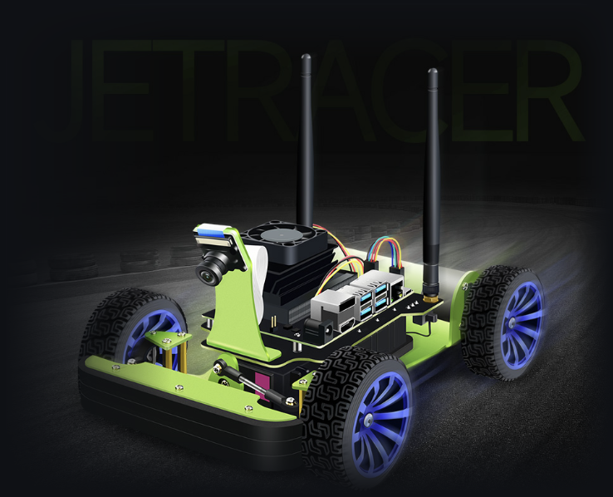
JetRacer Autonomous Driving and Delivery
RUSHHOUR3 · PROJECT 75 · PROJECT VIDEO
Teaching a real car to drive itself
with reinforcement learning
Augustus Amedume 24983037
SAC-VAE on the real car · VAE · dashboard
Seth Yap Wing Shen 25965486
Imitation learning · 2D-sim DQN · OpenCV
Jia Lu 25404498
Image-based DQN in DonkeySim
43008 Reinforcement Learning · Assessment 3 · Part F
Notes:
VOICES: all three | TITLE | 0:00–0:20 (20 s) | ~27 words
AUGUSTUS: Hi, we're team RushHour3, project 75. I'm Augustus Amedume, student ID 24983037.
SETH: I'm Seth Yap Wing Shen, student ID 25965486.
JIA: And I'm Jia Lu, student ID 25404498.

Slide 2
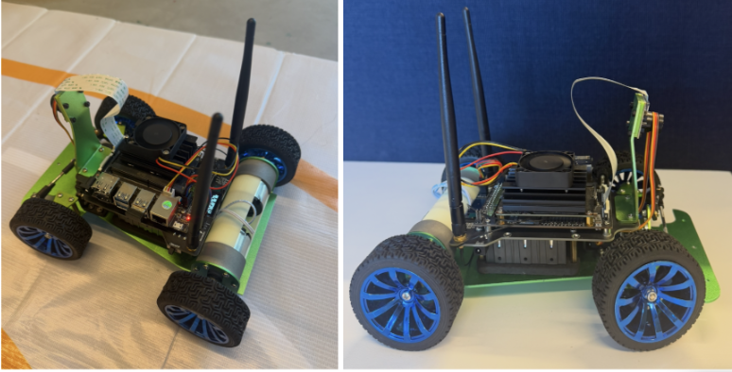







Taking RL beyond the simulator
Augustus · Seth · Jia
OUR PLATFORM
FOUR APPROACHES WE TRIED
Imitation learning
Val. MAE 0.086, but missed corners on the car
Seth · ResNet18 copies a human driver
DQN + OpenCV
4.6 laps in sim, unreliable on the car
Seth · Trained in a 2D simulator, run through lane detection
Image-based DQN
11/12 sim runs, not tested on the real track
NVIDIA JetRacer with a Jetson Nano
Jia · Trained on camera images in DonkeySim
Front camera, 320 × 240 colour frames
SAC + VAE
≈4.5 laps on the real track
Oval track, lane only 26 cm wide
Augustus · Learns online on the real car
Notes:
VOICES: Augustus, Seth, Jia | INTRODUCTION & BACKGROUND | 0:20–1:20 (60 s) | ~136 words
AUGUSTUS: In this subject, almost everything we trained lived in a simulator. We wanted to know what happens when reinforcement learning has to drive real hardware. Our platform is the NVIDIA JetRacer, a small car with a Jetson Nano computer and a front camera, on an oval track with a lane just 26 centimetres wide. We tried four approaches.
SETH: I built imitation learning, which copies a human driver, and a DQN trained in a 2D simulator and run through OpenCV lane detection. Both looked good offline but struggled on the real car.
JIA: I trained an image-based DQN in a DonkeySim copy of our track. It passed 11 of 12 simulator tests, but real camera images looked too different.
AUGUSTUS: Our fourth approach, SAC with a variational autoencoder, learned on the car itself. That's the one we'll show you.

Slide 3





Delivery still depends on human drivers
Augustus Amedume
THE PROBLEM TODAY
OUR PROOF OF CONCEPT
A JetRacer as a small autonomous delivery vehicle
Driver fatigue
Long shifts reduce alertness
Follows its lane using only the onboard camera
Operating costs
Every vehicle needs a paid driver
Steers through the corners on its own
Inconsistent performance
Timing and quality vary between drivers
Stops at pickup and drop-off zones (final goal)
Our question: can a real car learn reliable lane following from camera images with reinforcement learning?
Notes:
VOICE: Augustus | BUSINESS PROBLEM | 1:20–2:20 (60 s) | ~128 words
Why does this matter? Delivery services still depend on human drivers to pick up and drop off goods on time. That brings driver fatigue, high operating costs and inconsistent performance. Autonomous delivery vehicles could take over the repetitive driving.
But a delivery vehicle has to cope with the real world, not a simulator: its camera is noisy, the light changes, and its steering is never perfect. Our project is a small-scale proof of concept of that problem: a JetRacer acting as a delivery vehicle. It must follow its lane using only its camera, take the corners on its own, and, as the final goal, stop at pickup and drop-off zones.
So our question was: can a real car learn reliable lane following from camera images using reinforcement learning?

Slide 4
Our solution: separate seeing from deciding
Augustus Amedume
DRIVING LOOP · EVERY STEP (≈22–35 Hz)
next camera frame
Camera
320×240 RGB frame
Pre-process
resize to 160×120, keep bottom 160×80
VAE encoder
frozen · 32 latent values
State
32 latent + last 20 actions = 72
SAC actor
2×32 ReLU → steering, throttle
JetRacer
steering servo + drive motor
store (s, a, r, s′)
update weights
LEARNING LOOP
AFTER EVERY EPISODE
Operator
START, then STOP at the track edge
Reward
+1 per step · −10 on STOP
Replay buffer
30,000 transitions
SAC update
twin critics + actor, 200 gradient steps
Seeing: VAE, trained offline, frozen
Deciding: SAC actor, learned on the car
Learning: after every episode
Notes:
VOICE: Augustus | SOLUTION | 2:20–2:50 (30 s) | ~61 words
Our solution separates seeing from deciding. A variational autoencoder, trained offline on our own track images, compresses each camera frame into 32 numbers. Together with the last 20 actions, that's the state. Soft Actor-Critic then learns which steering and throttle to send. Because SAC is off-policy, every real-world sample is reused many times, which makes learning on a physical car practical.

Slide 5



It learned on the real car
Augustus Amedume
1 START
2 DRIVE
6
Operator starts an episode with a key press
The car drives itself: about +1 reward per step
training sessions
≈26,500
control steps
4 LEARN
3 STOP
200 SAC updates while the car is reset
Operator stops it at the track edge: −10 or worse
200
episodes, all on the Jetson Nano
Notes:
VOICE: Augustus | HOW IT LEARNED | 2:50–3:10 (20 s) | ~45 words
All the learning happened on the real car. We start an episode, the car drives itself, and we press stop when it leaves the track. That step is penalised, and SAC trains while we reset the car. In total: six sessions and about 26,500 steps.

Slide 6
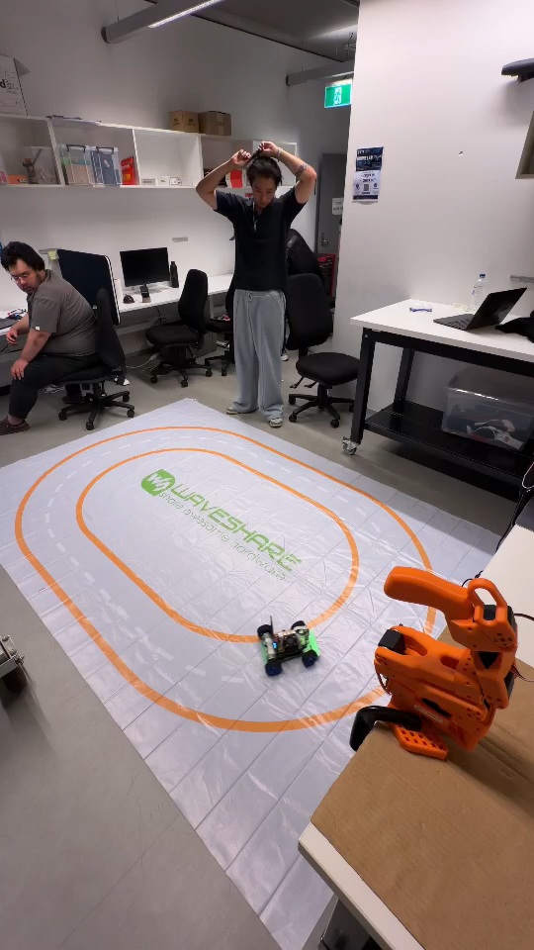



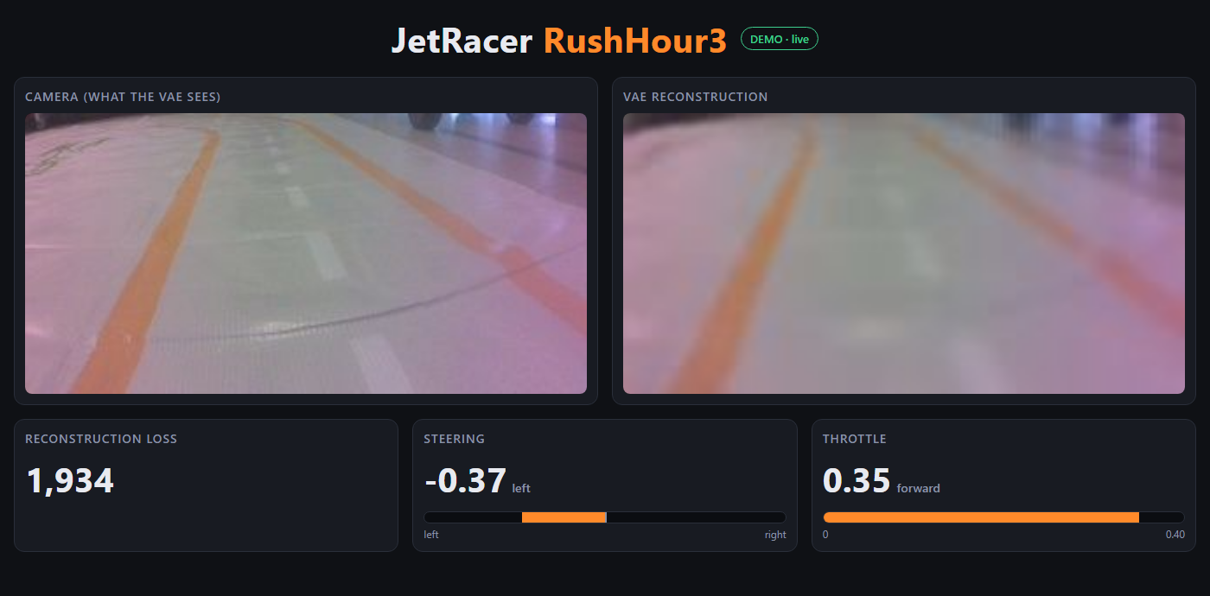
Demo: the policy driving on its own
Augustus Amedume
No human steering
Recorded in our lab
Anti-clockwise
LIVE DASHBOARD · SERVED FROM THE CAR, VIEWED IN ANY BROWSER
Notes:
VOICE: Augustus | DEMO | 3:10–3:55 (45 s; the clip plays muted, trimmed to 0:00–0:45) | ~74 words
Here's the trained policy driving by itself. Nobody is steering; the operator only watches, ready to press stop. Notice the small corrections through each corner. The car keeps going, lap after lap, anti-clockwise, without leaving the lane.
Behind the scenes, the car only sees the bottom of each camera frame, squeezed into 32 numbers by the VAE, and the policy answers with a new steering and throttle command more than twenty times a second.

Slide 7

Results: 87 → 343 steps per episode
Augustus Amedume
3,130
longest episode: over 2 minutes driving alone
≈26,500
steps · 200 episodes · 6 sessions
≈4.5 laps
deterministic test runs: 37.9 s and 30.9 s
anti-clockwise
Clockwise: failed on right-hand curves
Notes:
VOICE: Augustus | RESULTS | 3:55–4:10 (15 s) | ~28 words
During training, mean episode length grew from 87 to 343 steps. In evaluation, the final policy averaged about 4.5 laps anti-clockwise. Clockwise, it still failed on right-hand curves.

Slide 8



Limitations and next steps
Jia Lu
WHAT HELD US BACK
NEXT
Sim-to-real gap for the simulation-trained DQNs
1
Train both directions with VAE v2 and corrected steering
Off-centre steering servo (+0.3) and power cut-outs
2
Evaluate over repeated trials
SAC trained in one direction only (anti-clockwise)
3
Add pickup and drop-off stops
Thanks for watching!
Augustus Amedume 24983037 · Seth Yap Wing Shen 25965486 · Jia Lu 25404498
github.com/dumes21/AutonomousDriving-
Notes:
VOICE: Jia | CLOSE | 4:10–4:30 (20 s) | ~35 words
Our main limits were the sim-to-real gap, an off-centre steering servo, and training in one direction only. Next, we'd train both directions with our improved VAE and add pickup and drop-off stops. Thanks for watching!

