Slide 1
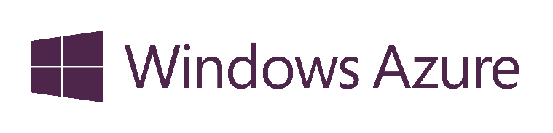



What is Cloud?
Public Cloud
On-Premises
( Private Cloud )
Packaged Software
Infrastructure
( as a Service )
Platform
( as a Service )
Software
( as a Service )
You Manage
Data & Access
Data & Access
You Manage
Data & Access
Data & Access
You Provision & Manage
Applications
Applications
Applications
Applications
You Provision & Manage
Provisioned & Managed by Vendor
Runtime
Runtime
Runtime
Provisioned & Managed by Vendor
Runtime
Operating System
Operating System
Operating System
Operating System
Virtual Machine
Virtual Machine
Physical Fabric Managed by Vendor
Virtual Machine
Virtual Machine
Compute
You Provision Cloud Services
Compute
Compute
Compute
Networking
Networking
Networking
Networking
Storage
Storage
Storage
Storage
Host
Develop
Consume
Notes:
Slide Objectives:
Explain the differences and relationship between IaaS, PaaS, and SaaS in more detail.
Speaking Points:
Here’s another way to look at the cloud services taxonomy and how this taxonomy maps to the components in an IT infrastructure.
Packaged Software
With packaged software a customer would be responsible for managing the entire stack – ranging from the network connectivity to the applications.
IaaS
With Infrastructure as a Service, the lower levels of the stack are managed by a vendor. Some of these components can be provided by traditional hosters – in fact most of them have moved to having a virtualized offering.
Very few actually provide an OS
The customer is still responsible for managing the OS through the Applications.
For the developer, an obvious benefit with IaaS is that it frees the developer from many concerns when provisioning physical or virtual machines.
This was one of the earliest and primary use cases for Amazon Web Services Elastic Cloud Compute (EC2).
Developers were able to readily provision virtual machines (AMIs) on EC2, develop and test solutions and, often, run the results ‘in production’.
The only requirement was a credit card to pay for the services.
PaaS
With Platform as a Service, everything from the network connectivity through the runtime is provided and managed by the platform vendor.
The Windows Azure best fits in this category today.
In fact because we don’t provide access to the underlying virtualization or operating system today, we’re often referred to as not providing IaaS.
PaaS offerings further reduce the developer burden by additionally supporting the platform runtime and related application services.
With PaaS, the developer can, almost immediately, begin creating the business logic for an application.
Potentially, the increases in productivity are considerable and, because the hardware and operational aspects of the cloud platform are also managed by the cloud platform provider, applications can quickly be taken from an idea to reality very quickly.
SaaS
Finally, with SaaS, a vendor provides the application and abstracts you from all of the underlying components.

Slide 2
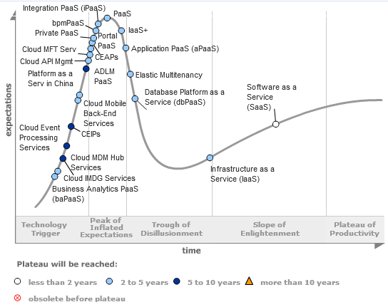
Cloud Hype Cycle
Source: Gartner, July 2013
Notes:
http://www.gartner.com/newsroom/id/2819918

Slide 3
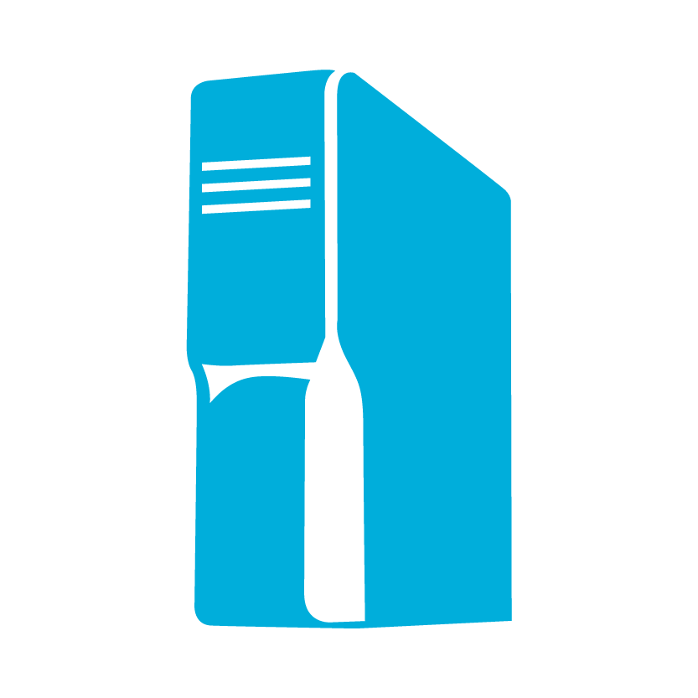
Think AND not OR
Enterprise needs
Virtualization
Integration
Identity
Data
Platform
On-premises
Cloud
Microsoft Azure fundamentals
On-premises AND Cloud
Development
DevOps and mgmt
Notes:
On-premises AND Cloud: We believe in a world where you’re integrating public cloud with your on-premises infrastructure, and using each where it makes sense, in conjunction with each other. Think and, not or. It’s not an on-premises OR cloud proposition – it’s an AND proposition. And when we say integration, we mean true integration – across infrastructure, apps, identity, and databases. This is what we call hybrid.
Microsoft is the only company which has the necessary assets across virtualization, identity, data platform , development and management to provide a consistent experiences across on-premises, our cloud and 3rd party service providers. This vision and strategy - called “Cloud OS” – is what we aim to deliver for our customers. If you choose look at other Cloud vendors that provide public OR private cloud offerings (Amazon, VMware, or Google), you have to cobble together disparate offerings and you will not get a seamless experience.

Slide 4
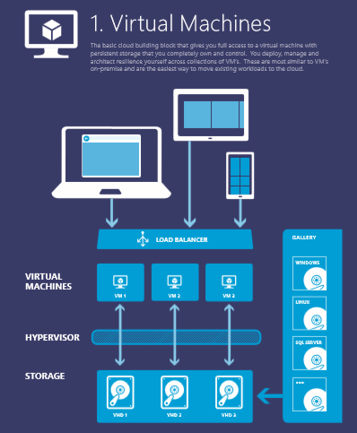
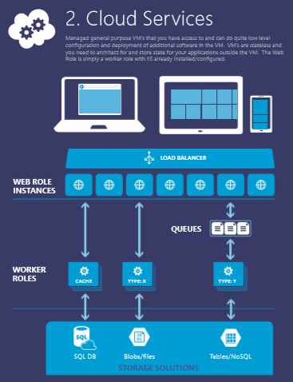
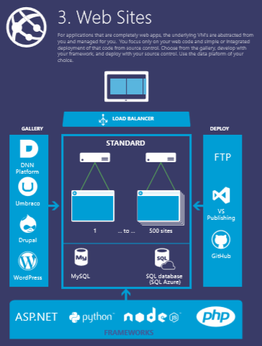
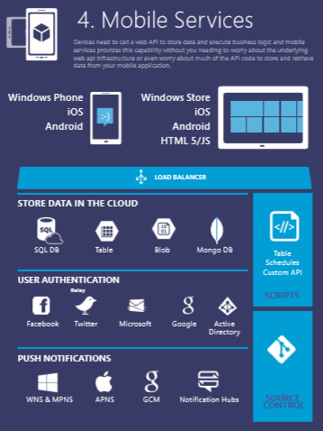
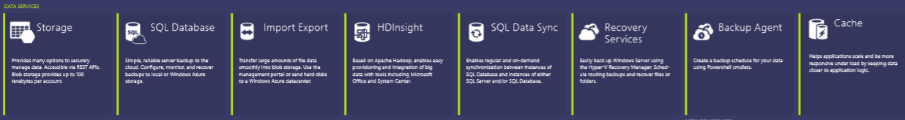




Azure = Building Blocks to Technology Solutions
Notes:
You can use this to explain all the Azure building blocks – the compute services at the top and then the other blocks of services – data, networking, Apps…. YOUR CHOICE… We want to articulate that Azure is a bunch of services that can be used as “Building Blocks” to technology solutions. If you would like to do that without this eye chart, Your Choice ☺

Slide 5





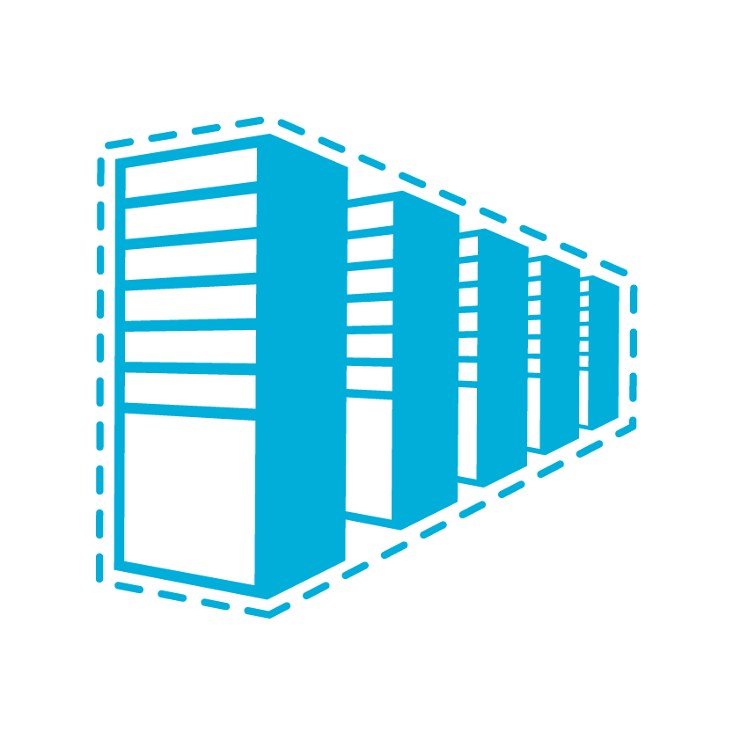

















^{app} ^{services}
cloud services
caching
identity
service bus
media
mobile services
web sites
integration
hpc
analytics
^{data} ^{services}
SQL database
HDInsight
table
blob storage
^{infrastructure} ^{services}
virtual machines
virtual network
vpn
traffic manager
cdn
Notes:
Windows Azure is a broad stack of services that runs in our datacenters globally.
Think of the different services as building blocks. These services can be categorized into three classes –
Infrastructure services which are lower level building blocks,
Data services that provide storage and data management capabilities to apps, and
App services which provide different capabilities to rapidly develop apps, scale and run apps at a global scale.

Slide 6
^{app} ^{services}
cloud services
caching
identity
service bus
media
Apps
mobile services
web sites
integration
hpc
analytics
^{data} ^{services}
SQL database
HDInsight
table
blob storage
caching
identity
cloud services
table
^{infrastructure} ^{services}
virtual network
virtual machines
virtual network
vpn
traffic manager
cdn
Notes:
You can use these blocks or puzzle pieces to rapidly build apps, and then choose an Azure datacenter to run the app. Windows Azure takes care of the underlying management, and provides your app the scale it needs.
This approach is what industry experts call a Platform as a Service.

Slide 7

Azure datacenters,
your datacenters.
^{app} ^{services}
cloud services
caching
identity
service bus
media
web sites
integration
hpc
analytics
virtual machines
virtual network
mobile services
vpn
^{data} ^{services}
SQL database
HDInsight
table
blob storage
^{infrastructure} ^{services}
virtual network
virtual machines
virtual network
vpn
traffic manager
cdn
vpn
Notes:
But that is not all that you can do with Azure. Windows Azure also provides infrastructure services which allow for more hands on configuration and management similar the servers you have today. However, they’re hosted in Microsoft datacenters letting you use Azure as if you were operating your own datacenter in the Cloud. For example, you can provision VMs, give them private IP addresses, and connect to them using a VPN from your on-premises environment. Most importantly, this lets Windows Azure mimic your on-premises datacenter and run your current apps with little or no change without the expense of having to own servers of racks, cooling and building costs. Furthermore, you can connect the “datacenter” you build in the Cloud to your on-premises datacenter so the datacenter in the Cloud becomes an extension to your on-premises infrastructure.
These “building blocks” lets Windows Azure to be used as an Infrastructure-a- a-service.
So, you see Windows Azure offers IaaS +PaaS in one platform. IaaS provides flexibility, PaaS eliminates complexity. Use PaaS where you can, use IaaS where you need. With Azure, you can use both together or independently, and build apps of the future. That uniquely differentiates us.

Slide 8
Cloud Computing Patterns
On and Off
Inactivity
Period
On & off workloads (e.g. batch job)
Over provisioned capacity is wasted
Time to market can be cumbersome
Compute
t
Growing Fast
Compute
Successful services needs to grow/scale
Keeping up w/ growth is big IT challenge
Cannot provision hardware fast enough
t
Unpredictable Bursting
Compute
Unexpected/unplanned peak in demand
Sudden spike impacts performance
Can’t over provision for extreme cases
t
Predictable Bursting
Compute
Services with micro seasonality trends
Peaks due to periodic increased demand
IT complexity and wasted capacity
t
Notes:
Slide Objectives:
Describe the various computing patterns that are good for Cloud Computing
Speaking Points:
There are numerous terms and definitions floating around in the industry for “the cloud”, “cloud computing”, “cloud services”, etc.
Microsoft thinks of the cloud as simply an approach to computing that enables applications to be delivered at scale for a variety of workloads and client devices.
The cloud can help deliver IT as a standardized service…freeing you up to focus on your business
Cover the workloads in the slide

Slide 9



Manage using existing Tools
Windows Intune
Macs
X86/x64
AD
Windows Server 2008 R2
Windows RT
VPN Tunnel
Windows Phone 8
iOS
Windows Server 2012
Windows Server 2008
Windows Server 2003
Windows Server 2012
Windows Server 2012
Android
On Premises
Azure
Internet

Slide 10
Storage Scale
Microsoft Azure Storage
35 Trillion Objects
“Azure Blob storage has taken a significant step ahead of last year’s leader Amazon S3, to take the top spot”
– Nasuni 2013 Cloud Storage Report
Notes:
Let us now understand the Windows Azure storage system and some of its salient features.
Treat Windows Azure as a giant “hard drive”. Why do we call it a giant? Windows Azure Storage has over 4 trillion objects, processes an average of 270,000 requests per second, and reaches peaks of 880k requests per second!
Windows Azure Blob storage is actually the top most rated by Nasuni Cloud storage report. This ranking is based on a number of factors like read/write speeds, availability and performance metrics.

Slide 11
How Microsoft Azure Drives Works
VM
Drive is a formatted page blob stored in blob service
Mount obtains a blob lease
Mount specifies amount of local storage for cache
NTFS flushed/unbuffered writes commit to blob store before returning to app
NTFS reads can be served from local cache or from blob store (cache miss)
Application
Drive X:
OS
Windows Azure Blob Service
Local Cache
DemoBlob
Notes:
Slide Objectives
Understand Drives Mounting and Caching
Speaker Notes
A Windows Azure drive acts as a local drive mounted on the file system and is accessible to code running in a role.
The data written to a Windows Azure drive is stored in a page blob defined within the Windows Azure Blob service, and cached on the local file system.
Because data written to the drive is stored in a page blob, the data is Durable.
Notes
http://blogs.msdn.com/b/windowsazure/archive/2009/11/05/introducing-the-windows-azure-content-delivery-network.aspx

Slide 12
DNS Scenarios
Azure DNS Resolution of INTERNAL resources are defined per Cloud Service …
One cloud service cannot resolve a different cloud service by internal host names
Windows Azure DNS Scenarios
A. Client-server applications using VMs
VM
VM
VM
SQL Reporting Service
SQL Analysis Service
SQL Service
Use your own DNS Scenarios
B. Hybrid connectivity with on-premise (DNS on-premise)
C. SharePoint with custom DNS (VM)
VM Role
Local DNS
On-Premises Machine
On-Premises Machine
DC
DNS
Active Directory
Web Tier
Open User Access (Website)
UI Process Components
VM Role
SharePoint FrontEnd
VM Role
VM Role
SQL
Active Directory
On-Premises Machine
LB
Business Components & Entities
SQL Mirroring
VM Role
SQL Service
Active Directory
SharePoint FrontEnd
VM Role
VM Role
SQL
Search and Indes
Domain joined to On-Premises Network
SQL Service
Internet
Notes:
Just like on premises infrastructure, your cloud infrastructure will need name resolution. You can use Azure DNS for name resolution which is particularly helpful when you are running Platform as a service or applications on Azure. Name resolution is easy in Azure since it is built into the platform. However, you need to consider that there are two types of resolution. There is resolution for “internal servers” (your 192.168. or 10.10 addresses) and external name resolution www.xxxx.com. For Internal Host Name resolution, the boundary for a network is a cloud service. This means that if you have multiple cloud services, even if they are on the same network, Azure internal host name resolution will not work using Azure DNS. Often when you configure servers that need to communicate with each other using host names, they will be on the same cloud service anyway. If you do need to have name resolution across cloud services, you can simply stand up your own DNS servers. You can integrate with your on premises DNS, stand up a dedicated DNS for your cloud network or even use a hybrid approach. In any case, you can make sure you have redundancy and reliability throughout.

Slide 13
Virtual Machine Availability Sets Update Domains are honored by host OS updates
Fault Domain
Fault Domain
Rack
Rack
Virtual Machine
Virtual Machine
Availability Set
IIS1
IIS2
UD #1
UD #2
Availability Set
Virtual Machine
Virtual Machine
SQL1
SQL2
UD #1
UD #2
Notes:
Slide Objective: Explain availability sets
Key Talking Points:
Availability sets tell the Fabric Controller to place VMs in the same set on different racks for faults and in separate upgrade domains for updates.
This essentially tells the FC not to take the guest OS down of all VMs in the same set for host updates.

Slide 14

Availability & Service Level Agreements
Availability set
99.95% Monthly SLA for VM’s
4.38 hours of downtime per year for VM’s in an availability set
VM 1
VM 2
What’s included
Compute Hardware failure (disk, cpu, memory)
Datacenter failures - Network failure, power failure
Hardware upgrades, Software maintenance – Host OS Updates
What is not included
VM Guest OS & Applications, VM Guest OS Updates
Customer on-premises network connectivity and intermediary Internet connectivity
SLA 99.95
Notes:
Slide Objective: Discuss how to achieve an SLA of 99.95% for VMs
Key Talking Points:
Configuring at least two VMs performing the same workload in the same availability set provides a 99.95% SLA
Virtual Network SLA = 99.9%
VMs in same availability set are automatically placed in separate upgrade and failure domains ( racks ) within a datacenter.
Azure SLA is more granular than competition – mapped to availability of specific infrastructure components that are hosting VMs, instead of generically mapped to edge of a datacenter region
SLA for VM’s based on monthly availability instead of annual availability ( most of competition ).
Complete SLA for VMs available at http://www.microsoft.com/en-us/download/details.aspx?id=38427

Slide 15
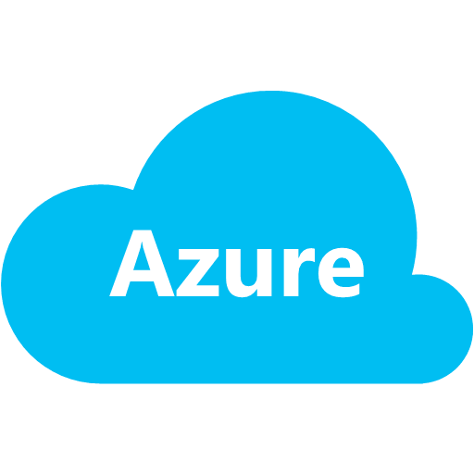
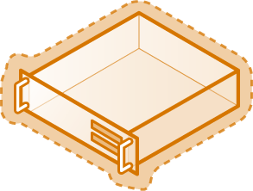

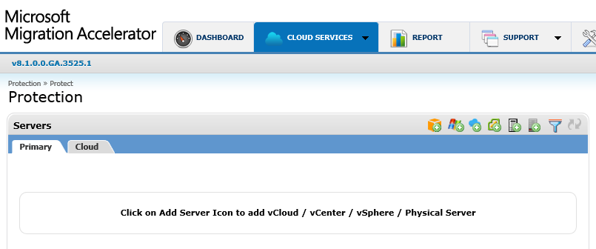
Microsoft Migration Accelerator for Azure
Source Network
Encrypted HTTPS communication
Target Cloud
Mobility Service Scout Agents
WMI for agent push installation
Data Channel
Master Target (MT)
tcp/9443
Control Channel
Source Servers / VMs
Process Server (PS)
Config Server (CS)
Target VMs
Azure Virtual Network
Orchestration
Microsoft
Migration Accelerator Portal
Migration Accelerator Portal UI Access
Administrator

Slide 16
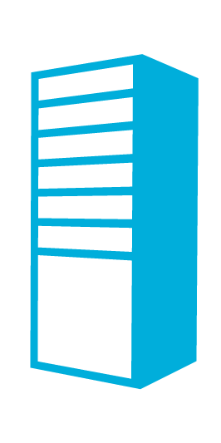
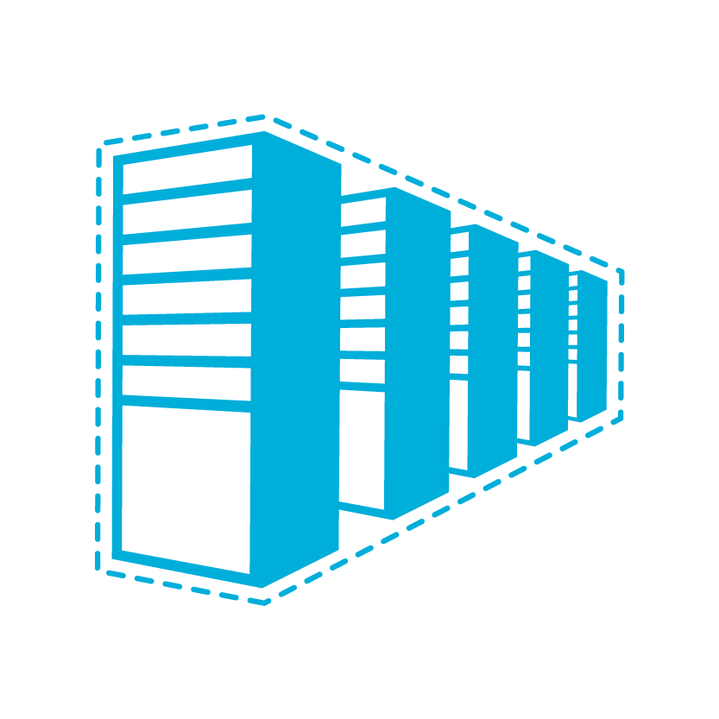


Hybrid Cloud Connectivity
OnPremNet
Microsoft Azure
CloudNet
On-Premises Network
Subnet 10.2.1.0 / 24 - Web
Site-to-Site IPSec VPN tunnel
System Center
SQL
IIS
IIS
SharePoint
IPv4 Public Address
Subnet 10.2.0.0 / 24 - Gateway
Highly Available Active / Passive
AD / DNS
VPN Gateway
VPN Gateways
Site-to-Site Express Route tunnel
Subnet 10.2.2.0 / 24 - Core
Exchange
BranchCache
File
AD / DNS
SQL
IP Address Space: 10.1.0.0/16
IP Address Space: 10.2.0.0/16
Notes:
Slide Objective: Introduce Hybrid Cross-Premises Scenario with Site-to-Site VPN support.
Limit: Only 1 Site-to-Site VPN Tunnel per Virtual Network
Availability: HSRP or VRRP can be used for a redundant pair of on-premises VPN devices.
List of compatible ( tested ) on-premises VPN Gateways: http://msdn.microsoft.com/en-us/library/windowsazure/jj156075.aspx

Slide 17
What is Identity?

Slide 18
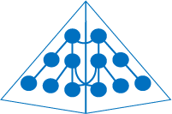


Corporate Identity Comes from Many Sources
HR System
givenName
Samantha
Forefront Identity Manager creates a compilation of these attributes with validation and keeps this in sync with all identity realms
surname
Dearing
employeeID
007
Database
title
Coordinator
givenName
Samantha
Active Directory
surname
Dearing
title
Coordinator
E-mail
samd@contoso.com
employeeID
007
telephone
555-123-4567
Exchange
e-mail
samd@contoso.com
Active Directory
LDAP
telephone
555-123-4567
Identity attributes are often located in multiple repositories
SQL
PowerShell
Web Services
(ODBC)
(SOAP, JAVA, REST)
LDAP v3
Notes:
One of the biggest challenges to creating a single user identity for each user is to get all the various identity attributes together and consistent across an environment.
[BUILD]
Many items maintain some aspect of who we are, and require some knowledge of who we are to determine what kind of access we will have.
[BUILD]
One option to manage identities locally for all of your users and their needs is Forefront Identity Manager. FIM provides an extensible sync engine that can bring together all the attributes from the various locations into a single view of the user and keep them up to date as they change across a number of identity directories.

Slide 19








Users need common on-premises and cloud identity
Notes:
The main point is…

Slide 20

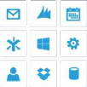

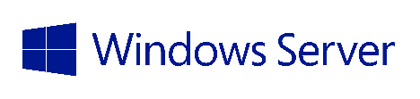
Identity: Cloud, Sync or Federated?
SaaS Apps
Cloud identity provides a solution where all identity resides in the cloud


Active Directory
Identity sync enables customers to bridge their existing identity into the cloud
Resources in other businesses or identity realms
Federated identity allows customers to retain all authentication on-premises

B2B federated identity allows customers to securely share and collaborate with each other

Active Directory
Notes:
Here is a little more of a deeper drill-down of those options, plus one other.
There are 3 primary scenarios for user identities across on-premises and in the cloud, plus B2B.
Cloud identity provides a solution where all identity including passwords reside in the cloud. In this scenario, authentication happens in the cloud.
Identity sync enables customers to bridge their existing identity into the cloud, passwords are in sync between on-premises and in the cloud, and therefore authentication can occur in either location (depending on what resource is accessed)
Federated identity allows customers to retain all authentication on-premises, passwords are only stored on-premises and all authentication is passed back through AD FS to AD.
B2B federated identity allows customers to securely share and collaborate with each other, with each side delegating access to the others resources.

Slide 21
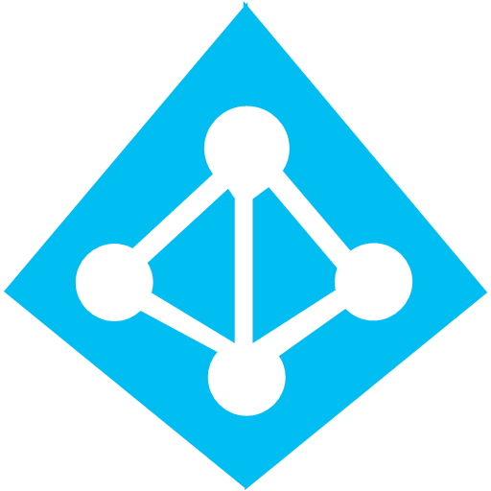
What is Azure Active Directory?
A comprehensive identity and access management cloud solution.
It combines directory services, advanced identity governance, application access management and a rich standards-based platform for developers
Azure Active Directory Premium is an advanced offering that includes IAM capabilities for on-premises, hybrid and cloud environments
Notes:
Azure Active Directory is many more things than just a directory.
Of course it offers directory services. Office 365 is the most visible example of a cloud app based on Azure AD for directory services.
Basically because of Office 365 we are processing more than 12 Billion authentications/week . This is a real testament to the level of scale we can handle! You might also be interested to learn that more than 1.4 million business, schools, government agencies and non-profits are now using Azure AD in conjunction with their Microsoft cloud service subscriptions.
And maybe even more amazing is that we now have over 290 million user accounts in Azure AD from companies and organizations in 127 countries around the world. It is a good thing we're building so many data centers world wide – it looks like we're going to need them!
Azure AD Premium includes every feature of the free tier plus a very reach set of features we are going to present in this session.

Slide 22
Common Identity with Sync and Federation
Synchronization
Active Directory
Active Directory
Identity Sync with password hash sync
User attributes are synchronized including the password hash, Authentication can be completed against either Azure or Windows Server Active Directory
*Write back of attributes to support cloud first and co-existence
Federation
Identity Sync
Active Directory
Active Directory
User attributes are synchronized, Authentication is passed back through federation and completed against Windows Server Active Directory
AD FS provides conditional access to resources, Work Place Join for device registration and integrated Multi-Factor Authentication
AD FS
*Coming Soon
Notes:
<understanding Sync and Federation>
When it comes to creating that single identity across on-premises and in the cloud you have options around sync and federation. The key question here is, where do you want passwords stored?
[BUILD]
In the Sync model, identity information is kept in sync between the 2 locations, including passwords. Authentication can occur against either directory.
[BUILD]
In the Federation model, identity information is kept in sync, but passwords are not. All authentication is passed back to on-premises AD to validation.

Slide 23
Direct to cloud identity sync
LDAP v3
Web Services
(SOAP, JAVA, REST)
Active Directory
Active Directory
Azure Active Directory Sync provides the ability to sync disparate on-premises identity repositories directly to Azure Active Directory
PowerShell
SQL
(ODBC)
Notes:
New with Azure AD Premium is the ability to sync disparate on-premises directories direct to Azure AD. We have a new sync engine, Azure Active Directory Sync Services (Azure AD Sync) that is available in April 2014 as a Preview with a GA later in Summer 2014.
NOTE FROM KEVIN: the most recent FAQ states that GA will happen “Q3CY14”, so it may be GA before we do the first of these Camps.
FAQ: http://social.technet.microsoft.com/wiki/contents/articles/24053.aadsync-frequently-asked-questions.aspx

Slide 24



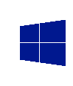
Hybrid Identity
Virtual Machines
Virtual Network
Connect hybrid infrastructure services with a single identity
Authenticate apps in virtual machines using on-premises identities
Bring mature, enterprise adopted AD to apps in cloud
Enable hybrid scenarios through Virtual Network private secure connection to on-premises
Connect Office 365 and other SaaS Apps to on-premises identities
Windows Server Active Directory DS
Windows Server Active Directory ADFS
Windows Azure Active Directory
LOB & custom apps
Windows Server Active Directory
Internet
End Users
On-premises
Windows Azure
SaaS Apps
Notes:
Extend and Synch. – Connect Hybrid Infrastructure Services with a Single Identity
The next scenario we’ll discuss is in the context of Office 365 and Windows Server Active Directory, which is used by 90% of enterprises worldwide. You’ll see how Active Directory in Virtual Machines can bring hybrid scenarios to life. This is possible not only when you run Active Directory and its components – such as federation services and DirSync - in Windows Azure Virtual Machines. For your SharePoint farms, with SQL Server apps talking back to on-premises, you’ll also want to connect back to your corporate identity store this way.
When you sign up for Office 365, you get virtually anywhere access to familiar Office tools, plus enterprise-grade email, conferencing, and a lot more. If you’re like most customers, you might want to synch on-premises identity with Office 365. By simply running Active Directory in Virtual Machines, synching with ADFS on-premises and connecting through Virtual Network, you can set up single sign-on capabilities.
This model also applies for applications running in Windows Azure Virtual Machines. When those applications need to authenticate with on-premises identities, you just connect to on-premises Active Directory to federate identities. With Windows Azure Infrastructure Services, it’s easy to build hybrid environments that take advantage of what you already have, while enabling new capabilities in the cloud.

Slide 25
Azure Active Directory free and premium offerings feature comparison
 | Azure AD Free | Azure AD Basic | Azure AD Premium
Directory as a Service | up to 500K Objects | No Limit | No Limit
User/Group Management
SSO to pre-integrated SAAS Applications /Custom Apps | 10 apps per user | 10 apps per user | No Limit
Directory Synchronization Tool (WSAD Extension)
User-Based access management/provisioning
Group-based access management/provisioning
Self-Service Group Management for cloud users
Self-Service Change Password for cloud users
Self-Service Reset Password for cloud users
Security Reports
Advanced Security Reporting (machine learning-based)
Usage Reporting
Company Branding (Logon Pages/Access Panel customization)
MFA (All available features on Windows Azure and on premises)
SLA (99.9%)
FIM CAL + FIM Server
http://msdn.microsoft.com/library/azure/dn532272.aspx
Notes:
In this slide you can see all the available features in the free and premium Azure AD Offerings.
In the free offering each user can have up to 10 SaaS apps in his access panel
The Free Azure AD tenant can go up to 500,000 user accounts
FIM server user rights : Unlimited number of FIM servers and a FIM CAL for every Azure AD Premium subscriber/user

Slide 26

What is Azure Multi-Factor Authentication?
A stand-alone Azure Identity and Access management service also included in Azure Active Directory Premium
Prevents unauthorized access to both on-premises and cloud applications by providing an additional level of authentication
Trusted by thousands of enterprises to authenticate employee, customer, and partner access.
Notes:
Azure Multi-Factor Authentication is trusted by thousands of enterprise customers, healthcare organizations, banking and financial services companies, as well as government agencies at the state, local and federal level.
The service authenticates millions of logins and financial transactions around the globe each month. It is battle tested and enterprise-ready.
While Multi-Factor Authentication is part of the Azure family and is powered by a cloud service, it is often deployed to secure on-premises applications in conjunction with an on-premises directory like Windows Server Active Directory.
It supports on-premises, cloud, and hybrid scenarios.

Slide 27
What is multi-factor authentication?
Any two or more of the following factors:
Something you know: a password or PIN.
Something you have: a phone, credit card or hardware token.
Something you are: a fingerprint, retinal scan or other biometric.
Stronger when using two different channels (out-of-band).
01234
Hardware token
Certificates
Smartcard
Phone

Slide 28
Benefits of multi-factor authentication
Employees
Convenience
Scale
Security
Partners
Customers

Slide 29
01234
No devices or certificates to purchase, provision, and maintain
No end user training is required
Users replace their own lost or broken phones
Convenience
Users manage their own authentication methods and phone numbers
Integrates with existing directory for centralized user management and automated enrollment

Slide 30
Works with all leading on-premises applications
Supports ADFS and SAML-based apps for federation to the cloud
Built into Microsoft Azure Active Directory for use with cloud apps
Scale
SDK for integration with custom apps and directories
Reliable, scalable service supports high-volume, mission-critical scenarios

Slide 31
Strong multi-factor authentication
Real-Time Fraud Alert
PIN option
Security
Reporting and logging for auditing
Enables compliance with NIST 800-63 Level 3, HIPAA, PCI DSS, and other regulatory requirements

Slide 32
How It Works
Mobile apps
Phone calls
Text messages
1 4 5 6 7 6
ALERT
Notes:
Multi-Factor Authentication offers the additional security you demand using the phones your users already carry. Multiple phone-based authentication methods are available, allowing users to choose the one that works best for them. And, support for multiple methods ensures additional authentication is always available.
Multi-Factor Authentication apps are available for Windows Phone, iOS phones and tablets, and Android devices. Users download the free app from the device store and activate it using a code provided during set up. When the user signs in, a notification is pushed to the app on their mobile device. The user taps to approve or deny the authentication request. Cell or Wi-Fi access is required. For offline authentication, the app works like a software token to generate a one-time passcode that is entered during sign in. The one-time-passcode method is comparable to software or soft tokens solutions offered by vendors like RSA and Gemalto.
Automated phone calls are placed by the Multi-Factor Authentication service to any phone, landline or mobile. The user simply answers the call and presses # on the phone keypad to complete their sign in.
Text messages are sent by the Multi-Factor Authentication service to any mobile phone. The text message contains a one-time passcode. The user is prompted to either reply to the text message with the passcode or enter the passcode into the sign in screen.

Slide 33




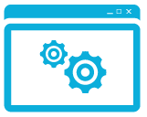


1
Users sign in from any device using their existing username/password.
2
Users must also authenticate using their phone or mobile device before access is granted.
On-Premises Apps
RADIUS
LDAP IIS
RDS/VDI
Cloud Apps
SAML
.NET, Java, PHP…
Multi-Factor
Authentication
Service
Multi-Factor
Authentication Server
Active Directory
Windows Server AD or Other LDAP
Notes:
The user signs in from any device using their existing account credentials. If the user is signing into an on-premises application, the Multi-Factor Server that is installed at the customer’s site intercepts the authentication request.
First it checks the username and password against the user directory.
If the correct credentials are entered, a request is sent to the Multi-Factor Authentication cloud service.
The service sends the authentication request to the user’s phone.
[click] Once the user has authenticated, they are instantly signed into the application.
[click] The are a number of ways to configure the service to secure cloud apps.
First, the on-premises multi-factor server can be used with Active Directory Federation Services or another SAML application for single sign-on to cloud applications.
[click] For apps that use Azure Active Directory, the directory can call the Multi-Factor Authentication cloud service directly.
[click] Or developers can build multi-factor into their custom apps using one of the Software Development Kits.

Slide 34





Authentication In Motion

Slide 35
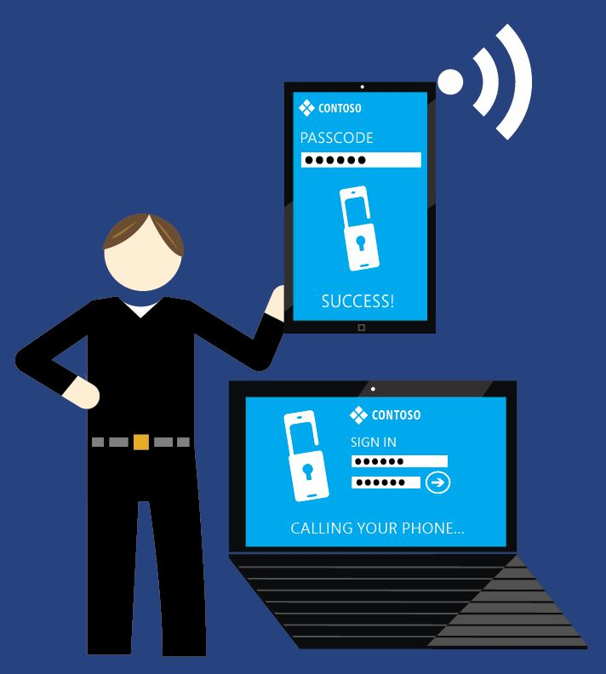
Microsoft Azure Multi-Factor Authentication flavors
Azure Multi-Factor Authentication stand-alone
Included in Azure Active Directory Premium
Free for Azure administrators
A subset of Azure MFA functionality included in Office 365

Slide 36
Azure MFA vs MFA for Office 365
 | MFA for Office 365 | Azure Multi-Factor Authentication
Administrators can Enable/Enforce MFA to end-users | Yes | Yes
Use Mobile app (online and OTP) as second authentication factor | Yes | Yes
Use Phone call as second authentication factor | Yes | Yes
Use SMS as second authentication factor | Yes | Yes
Application passwords for non-browser clients (e.g. Outlook, Lync) | Yes | Yes
Default Microsoft greetings during authentication phone calls | Yes | Yes
Remember Me (Public Preview coming in Q2)* | Yes | Yes
Custom greetings during authentication phone calls |  | Yes
Fraud alert |  | Yes
MFA SDK |  | Yes
Security Reports |  | Yes
MFA for on-premises applications/ MFA Server. |  | Yes
One-Time Bypass |  | Yes
Block/Unblock Users |  | Yes
Customizable caller ID for authentication phone calls |  | Yes
Event Confirmation |  | Yes
IP Whitelist |  | Yes

Slide 37
Azure Multi-Factor Authentication Server
Provide Azure multi-factor authentication to on-premises applications.
Install locally and link to Azure subscription
Supports extending
IIS
RADIUS
Windows Authentication
LDAP Authentication

Slide 38
RADIUS
Add multi-factor to any RADIUS authentication system including
VPN
RD Gateway
Hardware/Management

Slide 39
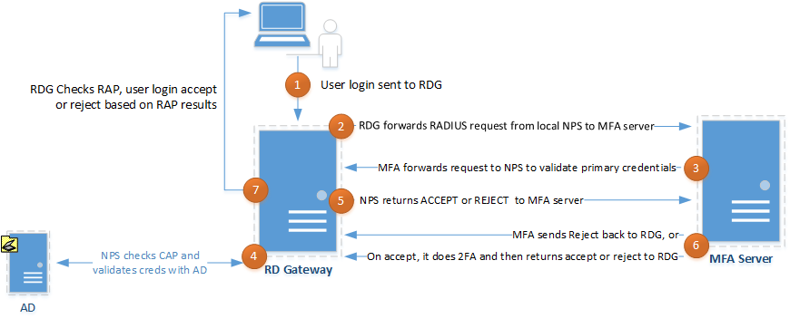
Multi-factor and RD Gateway
Notes:
To explain this diagram.
User logs on normally, but experiences a delay in authentication.
Request is bounced to the MFA server which actually sends it back to the NPS server to validate the user credentials. MFA orchestrates both username/password and token/pin.
Username/password is forwarded to NPS for AD authentication.
AD authentication takes place.
Authentication = valid is returned to MFA server. MFA server then send request to Azure to validate token/pin. This is outside this diagram, but the user will receive whatever secondary authentication method is configured, such as text or voice.
Result returned to RD Gateway
User logon rejected or allowed to proceed.

