Slide 1
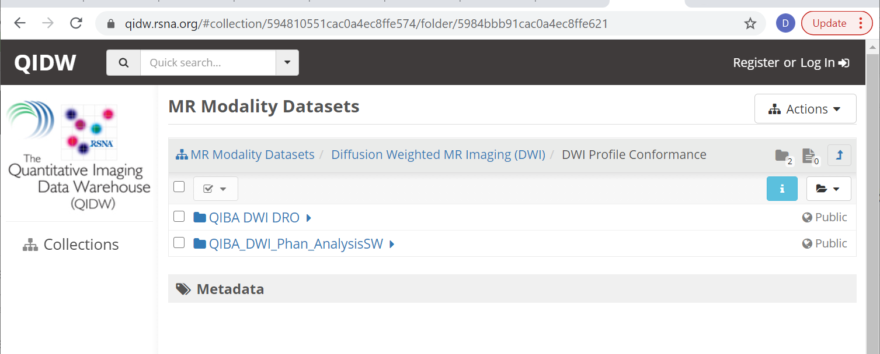
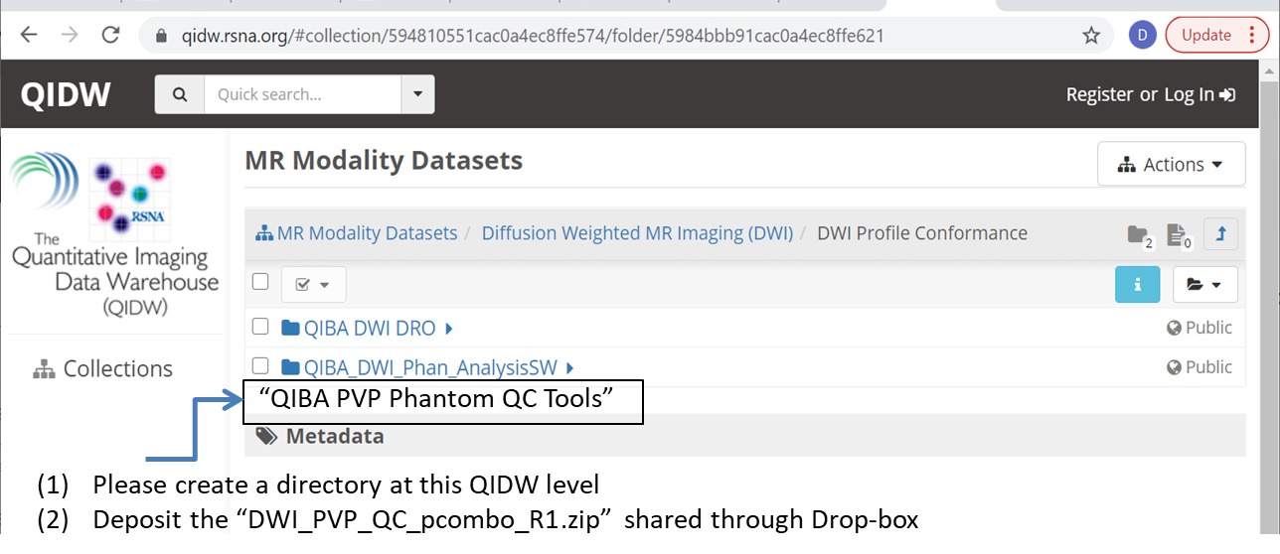
“QIBA PVP Phantom QC Tools”
Please create a directory at this QIDW level
Deposit the “DWI_PVP_QC_pcombo_R1.zip” shared through Drop-box

