Slide 1







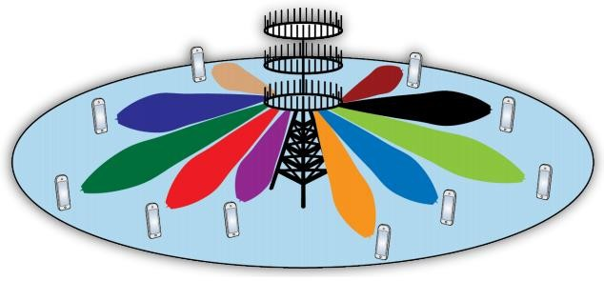
By/ Eng. Ahmed Nasser Ahmed

1


Slide 2



Massive MIMO Definition
Multiuser VS Single user
Massive MIMO Potential
TDD or FDD
Massive MIMO Limitation
Massive MIMO Research Problem
Massive MIMO channel
Massive MIMO Coding
1
2
3
4
5
6
7
8

Slide 3


 Massive MIMO (also known as “Large-Scale Antenna Systems”, “Very Large MIMO”, “Hyper MIMO”, “Full- Dimension MIMO” and “ARGOS”) [1]
 is a new research field, where base stations are equipped with a very large number of antennas as compared to previously considered systems[2].

Slide 4
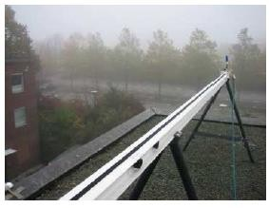
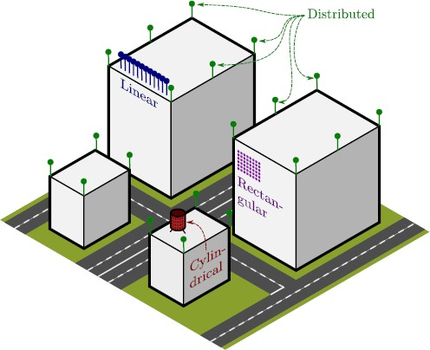
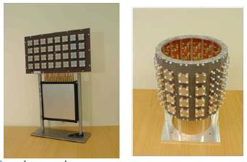

Slide 5
Massive MIMO Definition
Multiuser VS Single user
Massive MIMO Potential
TDD or FDD
Massive MIMO Limitation
Massive MIMO Research Problem
Massive MIMO channel
Massive MIMO Coding
1
2
3
4
5
6
7
8

Slide 6
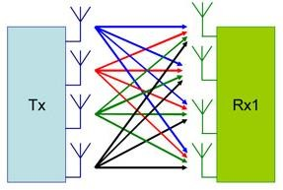
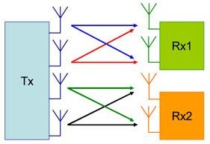
SU-MIMO
MU-MIMO
 the multiplexing gain may disappear when the signal power is low, relative to interference and noise, or in propagation
 environments with dominating line-of-sight or insufficient scatters.
 SU-MIMO systems also require complex and
expensive multiple-antenna terminals.
 Practical size limitations on terminals also limit the number of antennas that can be used and thereby the achievable multiplexing gains. [3]
 It is shown that all the effects of uncorrelated noise and fast fading disappear, as does the intra- cell interference.
 The only remaining impediment is the inter-cell
interference due to pilot contamination [3]

Slide 7
Massive MIMO Definition
Multiuser VS Single user
Massive MIMO Potential
TDD or FDD
Massive MIMO Limitation
Massive MIMO Research Problem
Massive MIMO channel
Massive MIMO Coding
1
2
3
4
5
6
7
8

Slide 8


1. Massive MIMO can increase the capacity 10 times or more:
 The capacity increase results from the aggressive spatial multiplexing
used in massive MIMO. [1]

Slide 9
2) Massive MIMO increases data rate[1]:
 because the more antennas, the more independent data streams can be sent out and the more terminals can be served simultaneously.
 Each terminal can be given the whole bandwidth

Slide 10
3) Massive MIMO can be built with inexpensive, low- power components [1]:
 With massive MIMO, expensive, ultra-linear 50 Watt amplifiers used in conventional systems are replaced by hundreds of low-cost amplifiers with output power in the milli-Watt range
 Massive MIMO reduces the constraints on accuracy and linearity of each
individual amplifier and RF chain

Slide 11
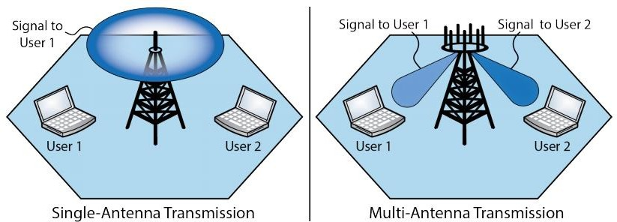
4) Improved energy efficiency[1]:
 because the base station can focus its emitted energy into the spatial directions where it knows that the terminals are located
5) Reduce interference:
 because the base station can purposely avoid transmitting into
directions where spreading interference would be harmful.

Slide 12
6) Massive MIMO enables a significant reduction of latency on the air interface[1]:
 Massive MIMO relies on the law of large numbers and beamforming in order
to avoid fading dips, so that fading no longer limits latency.
7) Massive MIMO simplifies the multiple-access layer[1]:
 the channel hardens so that frequency-domain, scheduling no longer pays off.
 Each terminal can be given the whole bandwidth, which renders most of the physical-layer control signaling redundant.

Slide 13
8) Massive MIMO increases the robustness to intentional jamming[1]:
 Massive MIMO offers many excess degrees of freedom that can be used to cancel signals from intentional jammers.
 If massive MIMO is implemented by using uplink pilots for channel estimation, then smart jammers could cause harmful interference with modest transmission power. However, more clever implementations using joint channel estimation and decoding should be able to substantially diminish that problem.
9) These degrees of freedom can be used for hardware- friendly signal shaping[1]:
 A massive MIMO system has a large surplus of degrees of freedom. For example, with 200 antennas serving 20 terminals, 180 degrees of freedom are unused.

Slide 14
Massive MIMO Definition
Multiuser VS Single user
Massive MIMO Potential
TDD or FDD
Massive MIMO Limitation
Massive MIMO Research Problem
Massive MIMO channel
Massive MIMO Coding
1
2
3
4
5
6
7
8

Slide 15


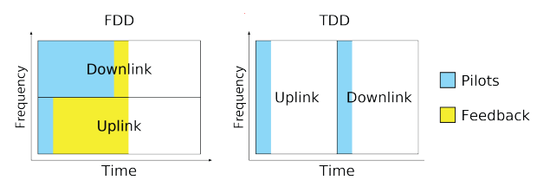
We need a pilot signal for Channel state information (CSI) estimation , but
there are two problems :
 First, optimal downlink pilots should be mutually orthogonal between the antennas. This means that the amount of time frequency resources needed for downlink pilots scales as the number of antennas, so a massive MIMO system would require up to a hundred times more such resources than a conventional system.
 Second, the number of channel responses that each terminal must estimate is also proportional to the number of base station antennas. Hence, the uplink resources needed to inform the base station about the channel responses would be up to a hundred times larger than in conventional systems [1] [4].
The solution is to operate in TDD mode, and rely on reciprocity between
the uplink and downlink channels [1]

Slide 16
Massive MIMO Definition
Multiuser VS Single user
Massive MIMO Potential
TDD or FDD
Massive MIMO Limitation
Massive MIMO Research Problem
Massive MIMO channel
Massive MIMO Coding
1
2
3
4
5
6
7
8

Slide 17




Main goals:
 Decrease of the multiuser interference.
 Increase in the achievable sum-rates.
Types:
 Linear precoding.
 Block diagonalization precoding.
 Tomlinson-Harashima precoding.
 Vector perturbation precoding.

Slide 18
Massive MIMO Definition
Multiuser VS Single user
Massive MIMO Potential
TDD or FDD
Massive MIMO Limitation
Massive MIMO Research Problem
Massive MIMO channel
Massive MIMO Coding
1
2
3
4
5
6
7
8

Slide 19


Main goal:
 Is to separate the data streams of the users at the receiver
Types:-
 Optimal Maximum Likelihood detector
 Linear detectors
 Decision feedback detectors

Slide 20
Massive MIMO Definition
Multiuser VS Single user
Massive MIMO Potential
TDD or FDD
Massive MIMO Limitation
Massive MIMO Research Problem
Massive MIMO channel
Massive MIMO Coding
1
2
3
4
5
6
7
8

Slide 21

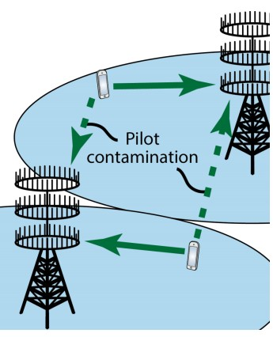
1) Channel Reciprocity
the hardware chains in the base station and terminal transceivers may not be reciprocal between the uplink and the downlink [1]
2) Pilot Contamination
Pilot contamination is encountered only when analyzing a multi-cell MIMO system with training, and is lost when narrowing focus to a single-cell setting. Pilot contamination occurs when the channel estimate at the base station in one cell ! The authors were supported in part by the DoD and the ARO Young Investigator Program (YIP). becomes polluted by users from other cells. The use of non orthogonal training sequences causes this contamination [4]

Slide 22
3) Non-CSI@TX operation
Before a link has been established with a terminal, the base station has no way of knowing the channel response to the terminal. This means that no array beamforming gain can be harnessed. In this case, probably some form of space-time block coding is optimal.
Once the terminal has been contacted and sent a pilot, the base station can learn the channel response and operate in coherent MU-MIMO beamforming mode, reaping the power gains offered by having a very large array [1].

Slide 23
4) Distance between users and base station [2]:
 closely located with line of-sight (LOS) conditions: it is implied that the spatial separation of the users is particularly difficult, The LOS condition may cause high correlation between the channels to different users.
 co-located with NLOS: we still have the users closely spaced but with NLOS to the base station antenna arrays. The NLOS condition with rich scattering should improve the situation by providing more “favorable” propagation and thus allowing better spatial separation of the users
 well separated with LOS: the increased separation of users should help to improve the performance, the spatial fingerprints of the four users are significantly different, which indicates a favorable user decorrelation situation for the large arrays [2].

Slide 24
Massive MIMO Definition
Multiuser VS Single user
Massive MIMO Potential
TDD or FDD
Massive MIMO Limitation
Massive MIMO Research Problem
Massive MIMO channel
Massive MIMO Coding
1
2
3
4
5
6
7
8

Slide 25
1) Fast and distributed, coherent signal processing:
- Massive MIMO arrays generate vast amounts of baseband data that need be processed in real time
The challenge of low-cost hardware:
Internal power consumption the total power consumed must be considered:
- that includes the cost of baseband signal processing. Much research must be invested into highly parallel
Cost of reciprocity calibration:
Pilot contamination:
Design of innovative training schemes
Design of precoders and resource allocation algorithms that can deal with pilot contamination.
6)Iterative detection and decoding
Reducing the number of iterations
Improving the exchange of soft information.
7) used multiple antenna at receivers

Slide 26


 [1] Larsson, Erik G., et al. "Massive MIMO for next generation wireless systems."arXiv preprint arXiv:1304.6690 (2013).
 [2] Gao, Xiang, et al. "Massive MIMO in real propagation
environments." arXiv preprint arXiv:1403.3376 (2014).
 [3] Gao, Xiang, et al. "Linear pre-coding performance in measured very-large MIMO channels." Vehicular Technology Conference (VTC Fall), 2011 IEEE. IEEE, 2011.
 [4] Jose, Jubin, et al. "Pilot contamination problem in multi- cell TDD systems."Information Theory, 2009. ISIT 2009.
IEEE International Symposium on. IEEE, 2009.

Slide 27
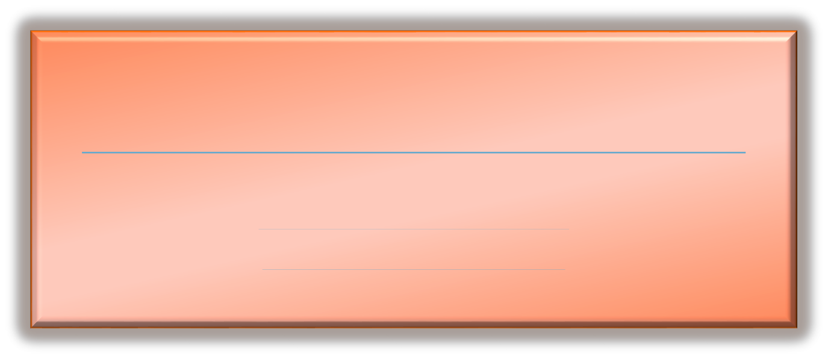
Thank You
Contact me:
Web site:
www.ahmed_nasser_eng.staff.scuegypt.edu.eg
Email:
ahmed.nasserahmed@gmail.com
Ahmed.nasser@eng.suez.edu.eg

