Slide 1
Introduction
Our proposal outlines a portal front end on the save the children website to allow reporting violations.
Our idea is to start with a small piece of functionality that can eb implemented quickly and evaluated by real users. If it is successful the portal can be extended to:
Inventory and distribution of donated stock
Mapping of available stock
Setting up a donation centre
View and download information

Slide 2
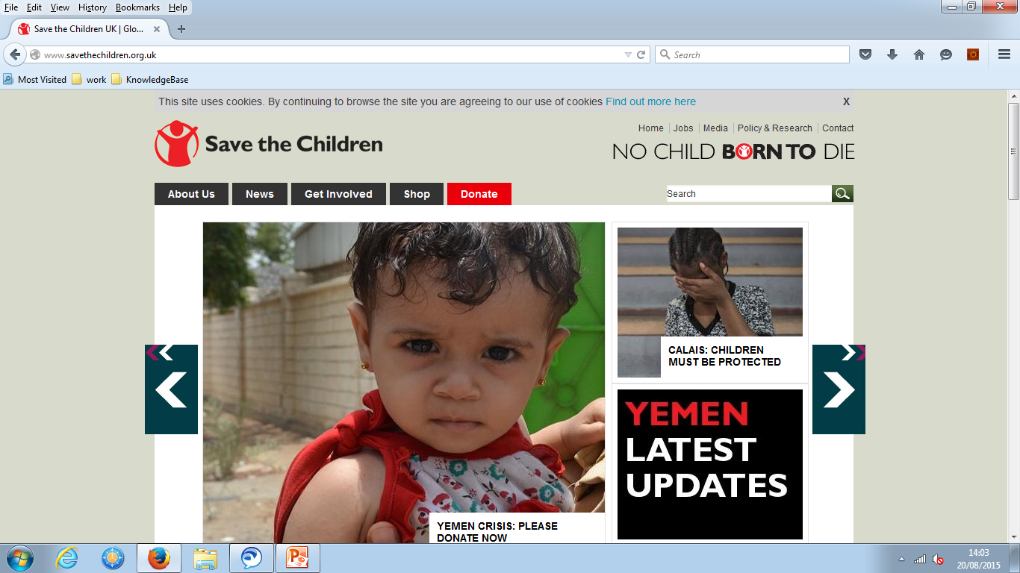
STC Portal

Slide 3
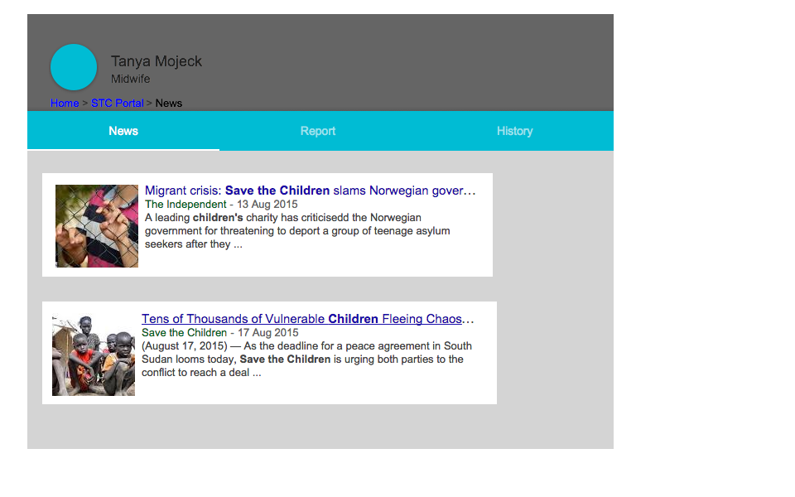
STC Portal User Home

Slide 4
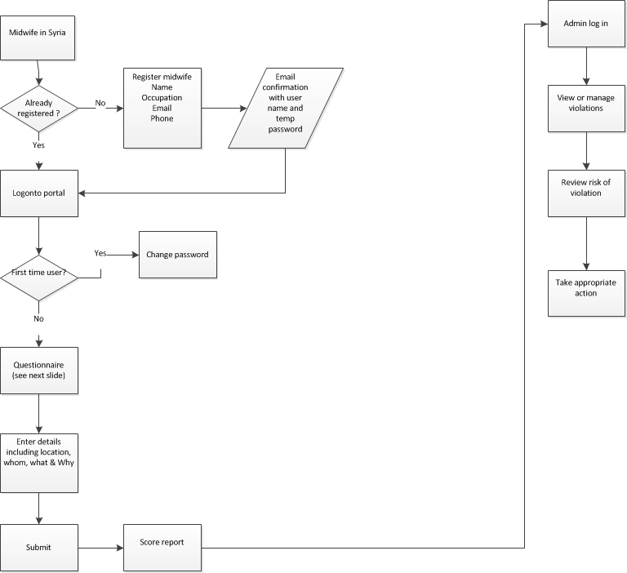
Flow chart on how to report a violation

Slide 5
Save the Children Portal Page
Report a violation questionnaire
Are free samples or feeding equipment being handed out?
Are company reps receiving bonuses related to sales?
Is the baby formula being advertised?
Is this being recommended as an alternative to breast feeding?
Is breast feeding being discouraged?
Are company reps contacting mothers and families directly?
Have the donations been requested by the government?
(see an example showing [YES] answered question)

Slide 6
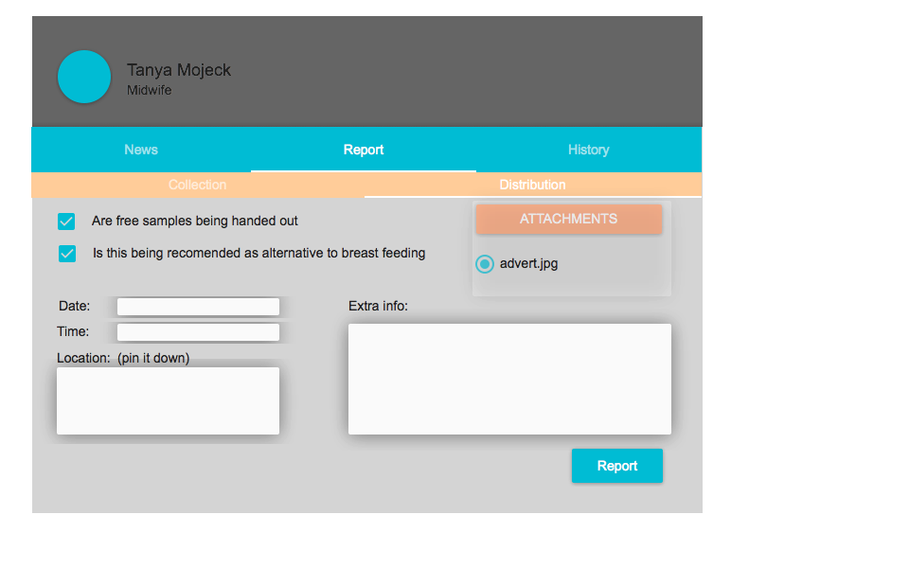
Report suspected violation

Slide 7
Alternative Portal
As some of the countries may not have reliable data signal an alternative way to report violations could be through SMS or a phone call to Save the Children who have access to the portal.

Slide 8
Save the Children Portal Page
Report managing
Administrators will be able to approve violations
Donation centres
Manage and track distribution
Joining kits

Slide 9
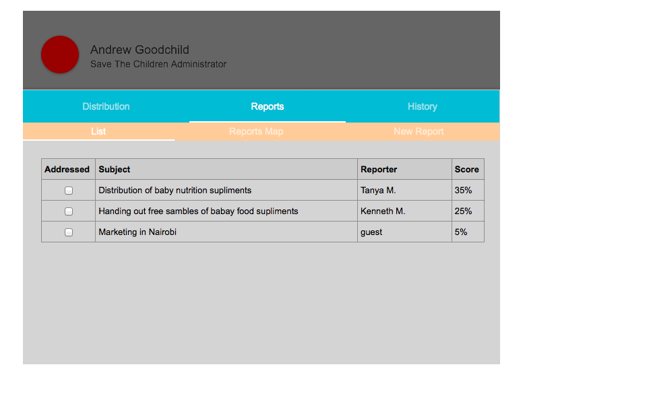
View suspected violations

Slide 10
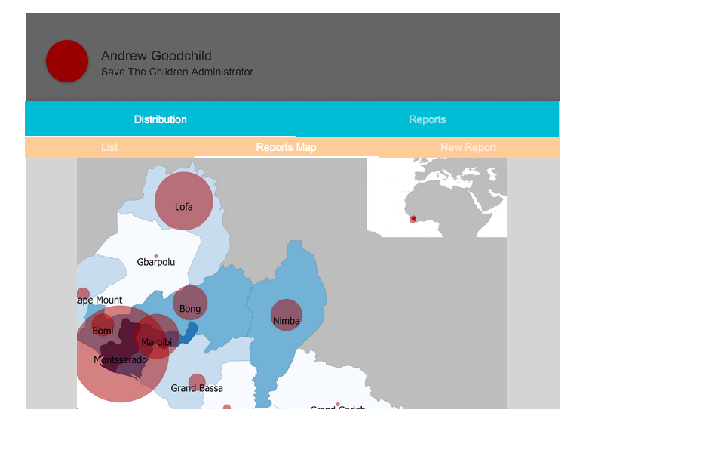
Report suspected violation

Slide 11
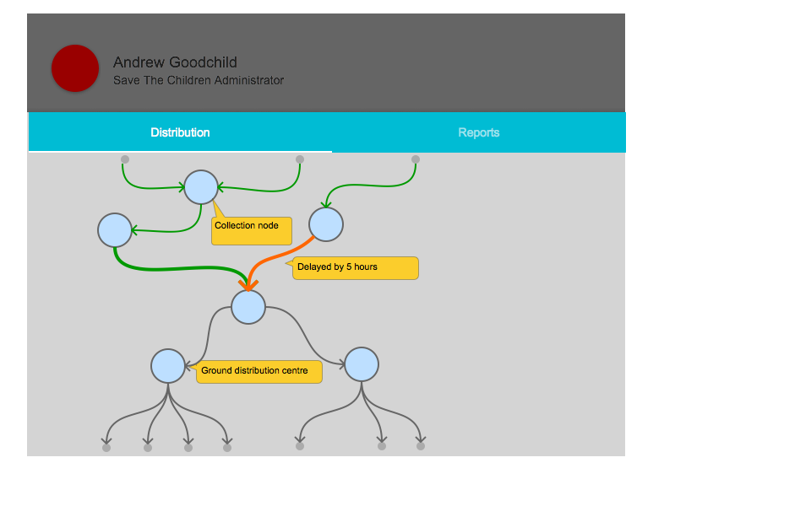
Distribution status

Slide 12
Save the Children Portal Page
This page maybe enhanced for the following
Inventory and distribution of donated stock
Mapping of available stock
Setting up a donation centre
View and download information
Administration

Slide 13
Save the Children Portal Page
Inventory and distribution of donated stock
At the point of stock is donated save the children will produce inventory quantity, sell by date and source.
Data will be stored and access trough the portal
Ease of stock control and distribution

Slide 14
Save the Children Portal Page
Mapping of available stock
Stock accessed by the portal can be easily displayed by a map format

Slide 15
Save the Children Portal Page
To manage the problem of ad-hoc distribution of donations, the portal will offer donors the capability to register a collection centre that can link into Save the Children’s distribution network.
The portal can provide advice and information about suitable items for donation and restricted items such as breast milk substitutes.
It allows the individual or organisation to register a collection centre and provide information about the “collection event” including when and where.
Identifies a suitable distribution centre(s) where the donated items should be delivered.
Provides feedback to the donor about where their donated items have been used.

Slide 16
Save the Children Portal Page
View/Download Information
Download information on the nearest distribution centre of aid
A map will be shown of where suppliers can donate emergency supplies
Information will be supplied on reports that have unsolicited milk distributions
Information of breast milk is the best way to feed children

Slide 17
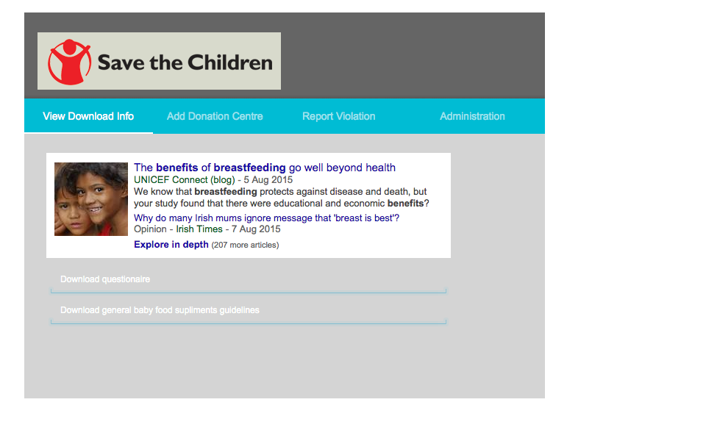
Save the children portal home page

