Slide 1
ITB VE Hackathon
Tech solution to real life problems.

Slide 2

Introduction
We have setup to deliver a solution for the Save The Children Organization.
We’re hoping to use our technical expertise to solve some of the problems the organization faces in its day to day activities.

Slide 3
The Challenge
As a team we decided to tackle challenge two, “How can we better control the distribution of breast milk substitutes in emergency areas? ”

Slide 4
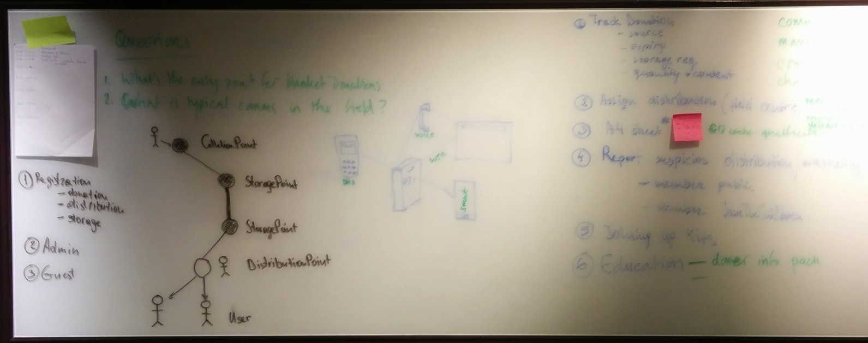
Thought process
Started putting down some of our first ideas…

Slide 5
Deciding on capabilities
Our solution will provide a centralized system that has the capability to:
Track donations
Inventory and distribution of the stock
Mapping of available stock
Setting up donation centers
Report suspicious activity
Educate on various issues

Slide 6
Solution vision
By using a set of APIs available to the public so that they can integrate with their own systems, websites or mobile apps. This creates an opportunity of modularized development. Adding one bit after another for the final solution.

Slide 7
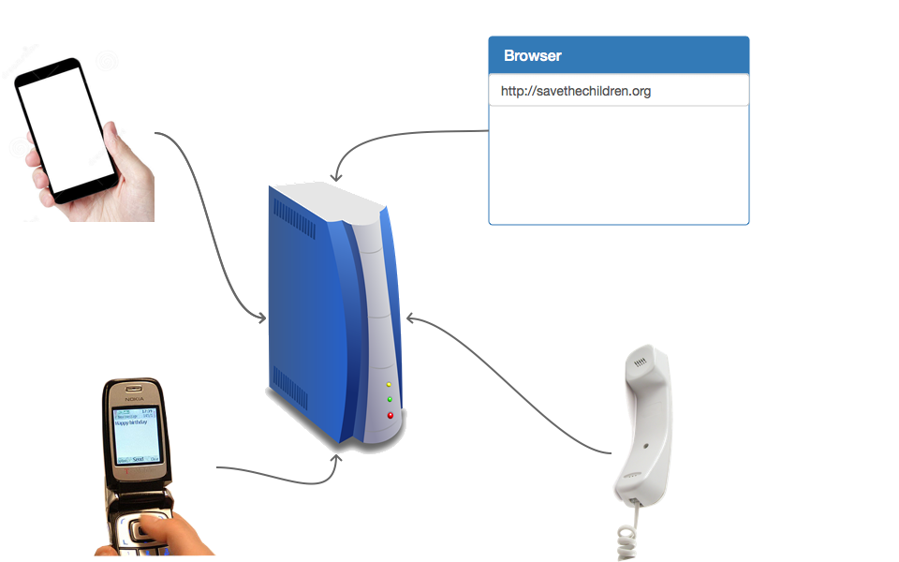
Solution vision
This APIs will provide a wide range of communication channels, to allow for any situation.
Notes:
We would expose:
Web service APIs to allow for web, mobile app and third party system/apps integrations
sms number – to allow for areas with no internet coverage or no other technology available
automatic voice calling service – when no other solutions are available

Slide 8
Zooming in…
As you can imagine the overall solution is quite big and we do not have the capability of detailing it here.
We have selected as the one of the things to address first: Reporting – we will detail the solution for it.
As mentioned at the beginning the overall solution can be extended and other modules added at a later time.
We will touch on some of them towards the end.

Slide 9
Reporting
Through its APIs our system will allow people to report suspicious activity, be it advertising, distribution or funds collection.
This can be done via any of the methods described in solution vision (i.e. web, app, sms, phone).

Slide 10
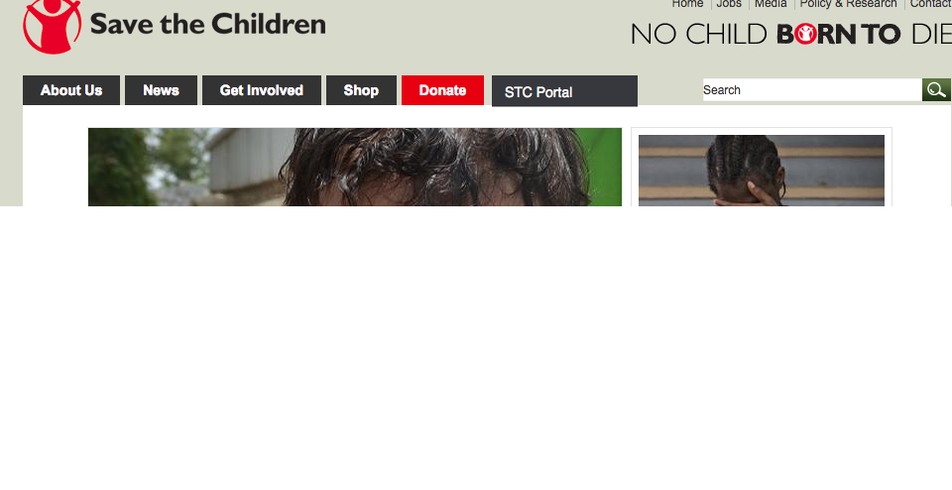
Reporting – web - access
Entry to the save The Children Web Portal

Slide 11
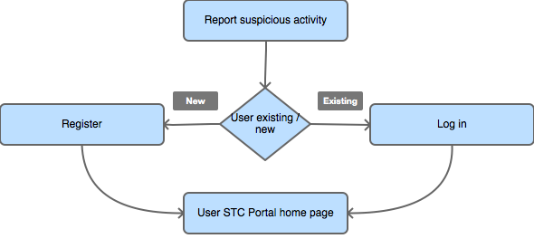
Reporting – base user flow
Notes:
We will provide the capability to register users “on the flight”, just by using their email address. So that not to discourage the usage due to complicated process flow.
It can be kept simple, enter email and desired password.
The system sends a confirmation email and creates a temporary user. Which is logged in within the same step.
The NEW logged in user is directed to the page to enter their details:
Name
Cotact details
Ocupation
Other relevant info
This user is kept on the system for a set amount of time (i.e. 3 days) untill is deleted unless the user confirms their registration form within the email.
There are many more low level scenarios that can be described here, for the purpose of this exercise, the user successfully loges in and is redirected to his/hers home page.

Slide 12
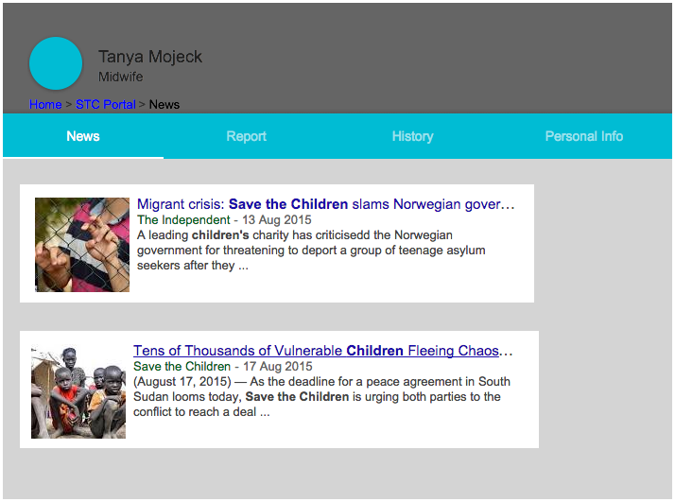
STC Portal User Home
Notes:
This is an example of homepage for existing user: Tanya Mojeck who is a midwife

Slide 13
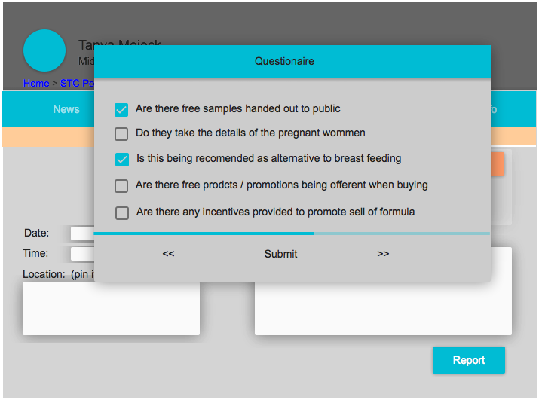
Reporting suspicious activity - questionnaire
Notes:
Report a violation questionnaire examples
Are free samples or feeding equipment being handed out?
Are company reps receiving bonuses related to sales?
Is the baby formula being advertised?
Is this being recommended as an alternative to breast feeding?
Is breast feeding being discouraged?
Are company reps contacting mothers and families directly?
Have the donations been requested by the government?

Slide 14
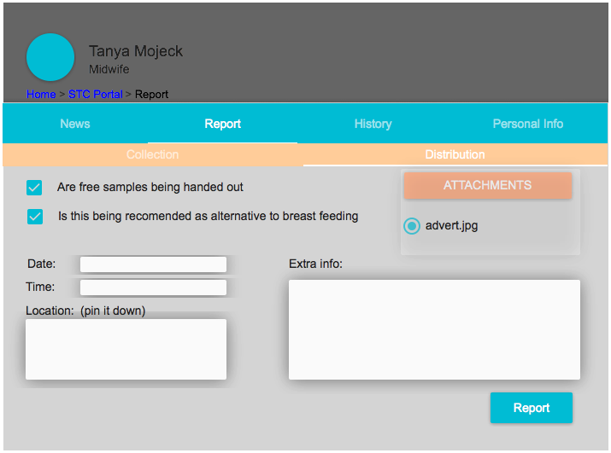
Reporting suspicious activity – details web
Notes:
Here the use has the fields for the extra details:
Date of the incident
Time
Location (free form) which can be an address or it has the capability to drop a pin on the map (pin it down option)
Pictures can be attached
Any other information free field

Slide 15
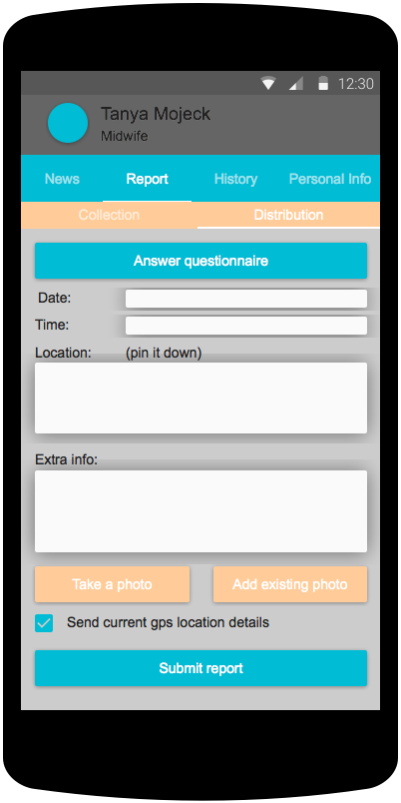
Reporting suspicious activity – details mobile
Notes:
Here the use has the fields for the extra details:
Date of the incident
Time
Location (free form) which can be an address or it has the capability to drop a pin on the map (pin it down option)
Pictures can be attached
GPS location
Any other information free field
This information can be submitted instantly or store and submitted when internet connection is available.

Slide 16
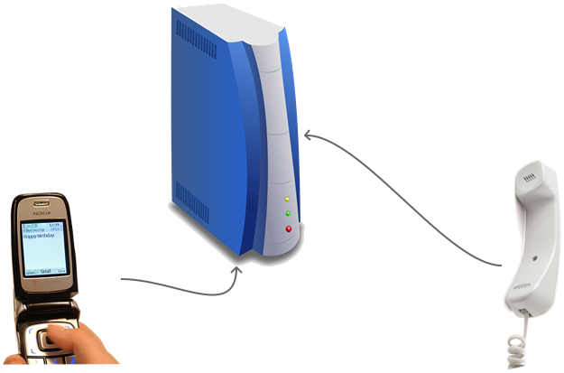
Reporting suspicious activity – alternative
As mentioned at the beginning there will be capability to submit information via alternative means

Slide 17
Reports administration
The reporting capability will generate a lot of data. This will have to be processed to filter and highlight the most important of the reports.
For this we propose two stages review:
System scoring
Manual review

Slide 18
Reports administration – system scoring
The system will be able to assign a credibility score to a report based on the number of factors:
Reporter’s previous activity
New or existing (with history) reporter
Reporter’s occupation
Hard details (pictures, gps coordinates)
…any other
The reports will be listed in an admin console with this score attached.

Slide 19
Reports administration – manual review
An administrator or someone entitled to review the reports will be able to login into the STC Portal and review and action the reports.

Slide 20
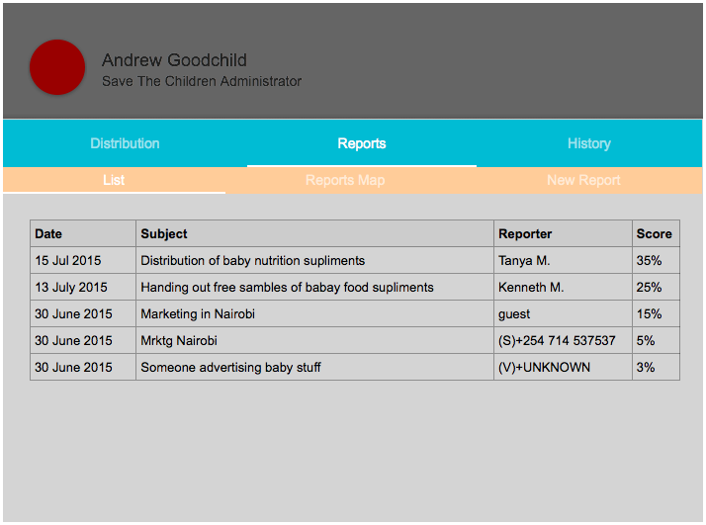
Reports administration – view suspected violations reports
Notes:
Here the admin person can sort the reports
View the details
Action the reports (i.e. dismiss, further action)

Slide 21
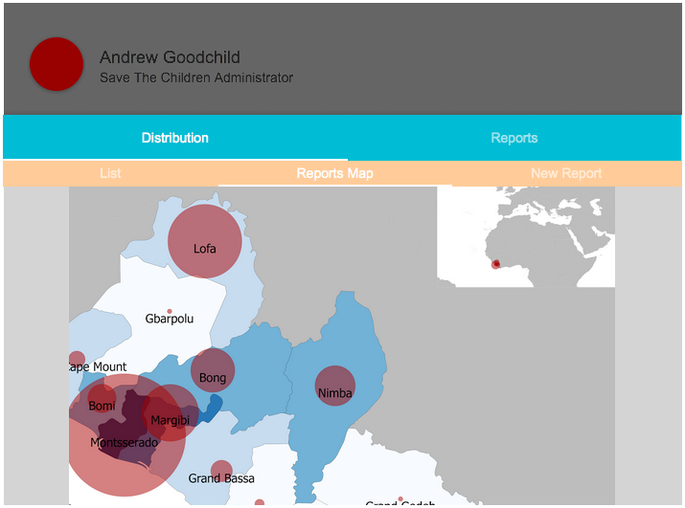
Reports administration – view reports heat map

Slide 22
Other functionality
Below we’ll describe the main idea points and the high level solution vision for the parts of the portal we were not able to detail on time.
As afore mentioned all the functionality can be developed in stages and added one by one.

Slide 23
Other functionality
Other functionality:
Donation/storage/distribution nodes management
Manage and track distribution
Join incomplete kits

Slide 24
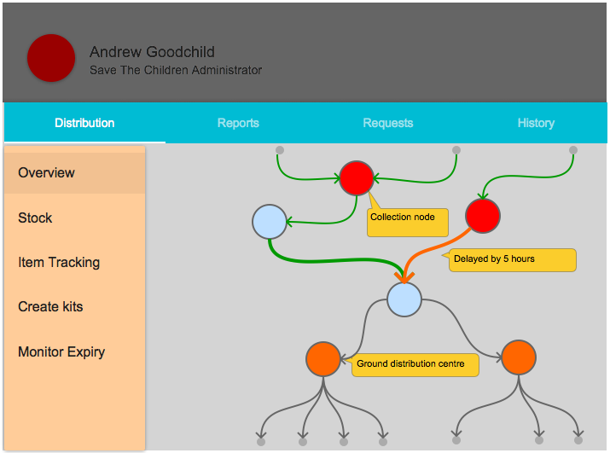
Distribution status
Notes:
An admin person will be able to login into the portal and monitor distribution of aid, track the packages, check package content and so on…
Here we have newuronetwork representation of aid tracking. It is split in 4 major points:
Small dots – donators / beneficiaries
Red circles – collection nodes/points
Blue circles – storage centers
Orange circles – distribution nodes
Green lines – distribution line, the package either has arrived or is on route and on schedule
Orange line – the package is on route but is already delayed in arriving at destination
Red lines – none here – the package is significantly delayed, no update known - check follow up
Grey lines – no package is being tracked trough that route.
Tracking can be done either by GPS or simple by entering in the system the destination. I.e. driver goes from point A to point B, submits in the system that aids is going to B, there is already an estimate for that route that it takes 20 h. After 20 h the lines turns orange, after 30 h turns red.
More functionality can be added, like route duration adjustments, if the route from A to B takes 25h every time, then the default duration is updated by the system/admin….

Slide 25
Node registrations
To manage the problem of ad-hoc distribution of donations, the portal will offer donors the capability to register a collection centre that can link into Save the Children’s distribution network.
The portal can provide advice and information about suitable items for donation and restricted items such as breast milk substitutes.
It allows the individual or organisation to register a collection centre and provide information about the “collection event” including when and where.
Identifies a suitable distribution centre(s) where the donated items should be delivered.
Provides feedback to the donor about where their donated items have been used.

Slide 26
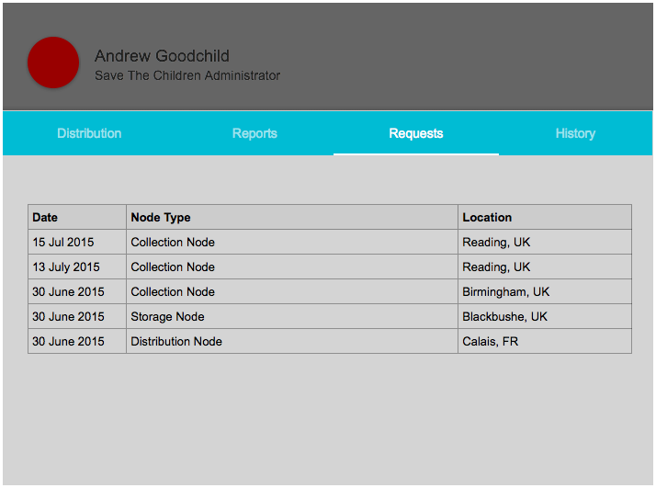
New node requests
Notes:
Member of public, companies or aid workers on the ground have the capability of submitting requests for creating (adding to the network) nodes.
For example:
A church / school setup an event where they are going to collect aid, they make a request to register a collection node. This can be approved by admin and as a result monitor progress provide help support.
A company has a storage facility next to the blackbushe airport, it is not continuously used, during a disaster, they decide to offer temporary their facilities to the SaveTheChildrenOrganisation so that it can be used as a storage faciity, or grouping further distribution. They register a storage node.
An aid worker in Calais sees the crisis escalating and request for aid to help the children in need, they register a distribution node. This is added to the network an helps to monitor track, aid to those nodes.

Slide 27
Inventory and distribution of donated stock
At the point of stock is donated save the children will produce inventory quantity, sell by date and source.
Stock will be QR labeled for easy tracking
Data will be stored and access trough the portal
Ease of stock control and distribution

Slide 28
Mapping of available stock
Stock accessed by the portal can be easily displayed by a map format.
GPS pallets can be used, or simple by tracking through the neural network described above that can be overlaid over Google maps.

Slide 29
View/Download Information
Download information on the nearest distribution centre of aid
A map will be shown of where suppliers can donate emergency supplies
Information will be supplied on reports that have unsolicited milk distributions
Information of breast milk is the best way to feed children

Slide 30
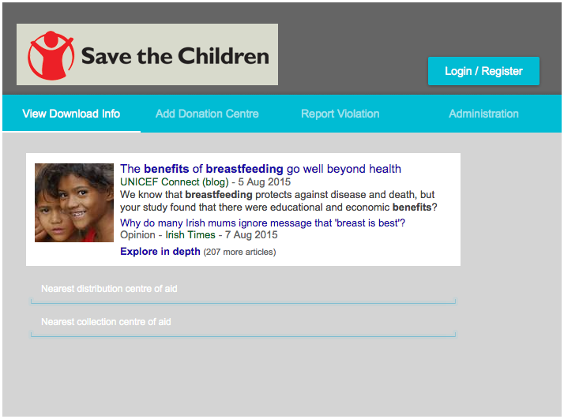
Portal Homepage - view/Download Information

Slide 31

Thank you

