Slide 1
THEME 12 / AI FOR 1092
Understand first.
Act only when sure.
3
0.80
languages now
confidence gate
Kannada, Hindi, English and mixed speech
below threshold, the AI clarifies instead of routing
CRITICAL
Vani-1092 is a voice-to-voice assistive layer for multilingual citizen calls. It translates distress into verified understanding before a human operator acts.
bypass mode
panic/urgent calls go straight to human control
citizen speaks naturally
AI verifies meaning
operator receives context
right action
repo evidence: VANI-1092-PLAN.md, conversation_engine.py, agent.py
01

Slide 2
PROBLEM DEPTH
The expensive failure is not no response.
It is the wrong response.
1092 calls are multilingual, dialect-rich, and emotionally charged. If the system hears words but misses meaning, government response can be delayed, misrouted, or escalated incorrectly.
Dialect / code-mix
Emotion
Misread intent
Wrong action
Kannada + Hindi + English can appear inside one sentence.
Fear, urgency, anger, and confusion change the required handling.
A complaint, help request, harassment, or emergency can be conflated.
The operator acts on a distorted summary, not the citizen's reality.
The intervention point is before routing
That is why Vani-1092 asks: “Did I understand correctly?”
source: user problem statement + VANI-1092-PLAN.md
02

Slide 3
PRODUCT THESIS
We built the helpline around
a yes/no moment.
Most voice agents optimize answer speed. Vani-1092 optimizes correctness before action, with a deliberate escape hatch for danger.
Analyze
Confirm
intent, urgency, location, confidence
same-language summary question
Listen
CRITICAL bypass: immediate human takeover
LiveKit audio stream
VERIFY
MEANING
Route
handoff payload to operator
Re-ask
if citizen says no or confidence is low
repo evidence: conversation_engine.py should_bypass_confirmation + check_confirmation_response
03

Slide 4
TECHNICAL IMPLEMENTATION
The prototype is a real voice path, not a staged chatbot.
The stack separates what should be commodity infrastructure from what is unique to 1092: verified understanding, urgency, and handoff.
Citizen browser
LiveKit WebRTC
Voice agent
Operator console
static/index.html
microphone + LiveKit JS
echo cancellation
noise suppression
jitter buffer
agent.py
STT -> analysis -> TTS
dashboard.html
summary + queue + feedback
1092-specific brain
conversation_engine.py extracts intent, urgency, location, language hint, emotion, confidence, and recommended action.
repo evidence: ARCHITECTURE.md, agent.py, sarvam_client.py, audio_utils.py, server.py
04

Slide 5
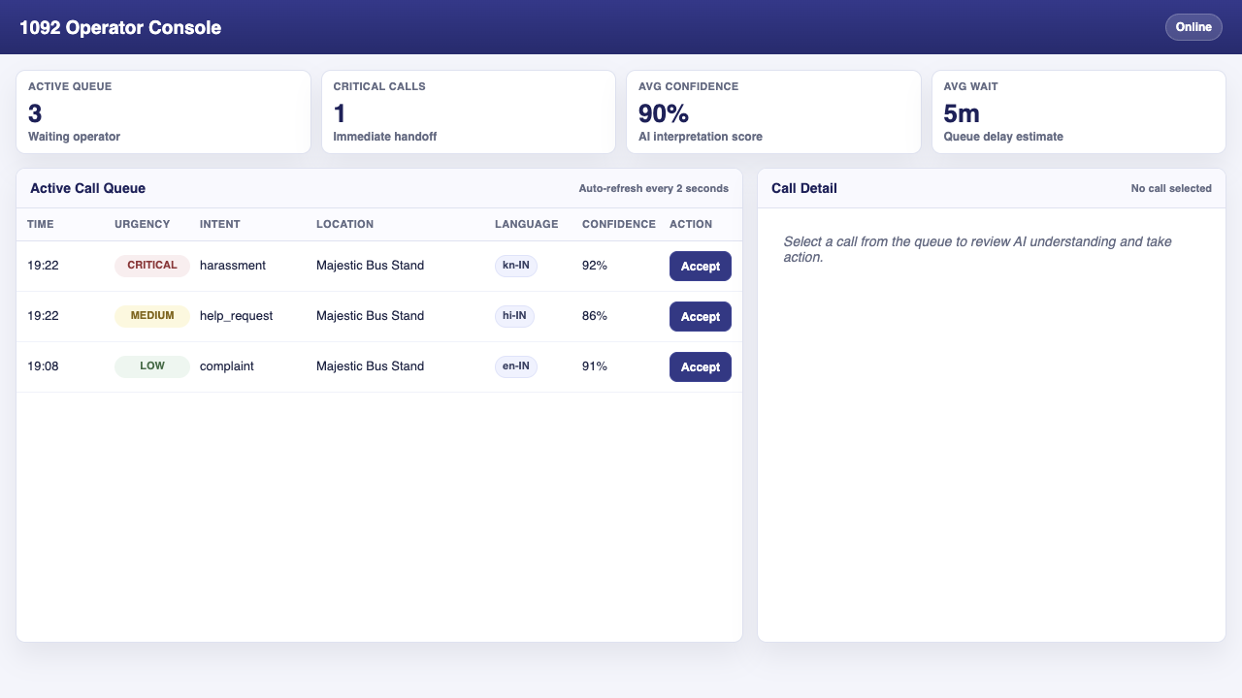
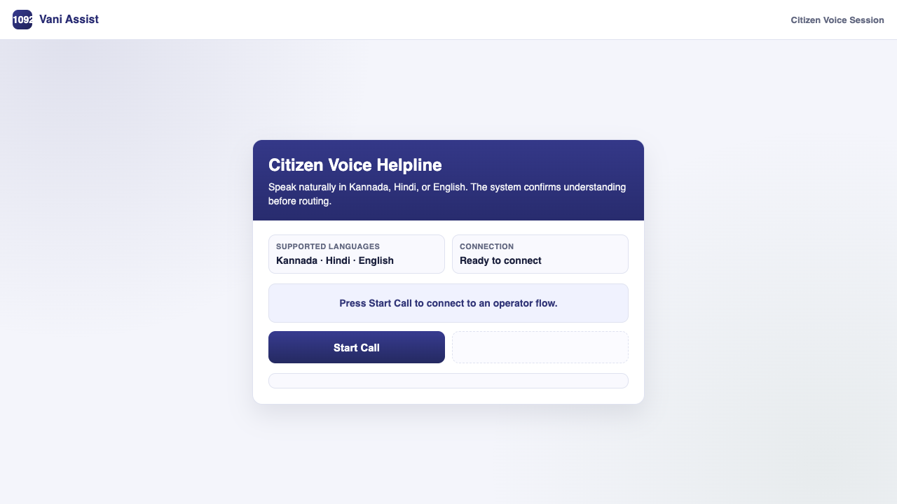
DEMO EVIDENCE
The demo shows a citizen surface and an operator control room.
The important demo is not a perfect AI monologue. It is the transfer of verified context from a natural voice call into a human-operated queue.
Citizen: speaks naturally in Kannada, Hindi, English, or mixed speech.
Operator: sees urgency, language, confidence, summary, transcript, and feedback controls.
repo assets: vani1092/.qa/client-redesign.png and dashboard-redesign.png
05

Slide 6
GUARDRAILS
The AI does not own the call. It earns the next step.
Vani-1092 uses confidence, confirmation, and urgency to decide whether it should ask, route, or get out of the way.
Signal
Condition
AI move
Why it matters
LOW / MEDIUM
confidence >= 0.80
Ask confirmation
Citizen explicitly validates understanding
LOW / MEDIUM
confidence < 0.80
Clarify
AI asks the citizen to repeat or simplify
NO / correction
any confidence
Re-ask
Previous understanding is discarded
CRITICAL
panic or danger
Bypass
Human takeover immediately
repo evidence: CONFIDENCE_THRESHOLD=0.80, PANIC_KEYWORDS, process_turn state machine
06

Slide 7
LEARNING LOOP
Every verified call can become a better future call.
The system captures confirmation and operator correction as structured feedback. That is the seed of a Kannada/Hindi/English 1092 dataset grounded in real service language.
1. Citizen phrase
2. AI interpretation
3. Human validation
4. Model
dialect, code-mix, emotion
intent, urgency, summary, confidence
AI correct / incorrect + notes
validated examples for tuning, prompts, rules
The data is valuable because it is confirmed meaning, not just raw speech.
repo evidence: database.py feedback table + server.py /api/calls/{id}/feedback
07

Slide 8
GOVERNMENT FEASIBILITY
Deployability comes from boring choices in the right places.
The ambition is high, but the deployment path is intentionally practical: browser client, Python service, human operator control, database audit trail.
Citizen layer
State deployment
Pilot room
Reusable multilingual voice assistance
across departments and helplines
Hackathon demo
State Data Centre / approved cloud
role-based access + audit retention
PostgreSQL + operator accounts
measured latency, accuracy, takeover rate
FastAPI + LiveKit Cloud + SQLite
runs on local laptop / external drive
01
02
03
04
Prototype cost in repo plan: within free credits / about ₹0-200 for demonstration scale.
repo evidence: stack choices and prototype cost from VANI-1092-PLAN.md
08

Slide 9
LONG-TERM IMPACT
The scale story is a reusable citizen-voice layer.
Once verified understanding works for 1092, the same pattern can support other services where wrong interpretation creates cost, delay, or harm.
More languages
1092 now
add other Indian languages without changing the loop
More departments
harassment, complaints, help requests, emergencies
health, transport, municipal, welfare, disaster response
Third-order effect: a state learns how citizens actually describe problems, not how forms assume they describe them.
That can improve scripts, staffing, routing policy, language resources, and early warning analytics.
source: inferred scale path from language-agnostic architecture and feedback loop in repo
09

Slide 10
WHY THIS SCORES
The pitch is not feature count.
It is trust at government scale.
Vani-1092 answers the judging rubric with one coherent product decision: verified understanding before action, with human control preserved.
20%
Problem relevance
Targets the real failure: misunderstood multilingual distress.
25%
Technical + innovation
Real voice pipeline, confirmation state machine, emotion/urgency payload.
25%
Deployability
FastAPI, LiveKit, Sarvam, SQLite audit trail, human operator console.
15%
Demo quality
Two-window voice demo: citizen call + operator handoff queue.
One sentence to remember
The AI is not the decision-maker. It is the understanding-checker.
15%
Scale + impact
Validated feedback can become a reusable citizen-language layer.
rubric mapped to repo evidence; no unsupported performance metrics claimed
10

