Slide 1
THEME 11
From Court Judgments to Verified Action Plans
Court judgments create value only when they become verified government action.
This is not a PDF
summary tool.
It is a decision-support layer
for the state.
Read
Lex-Gov AI turns long, inconsistent judgment PDFs into structured action plans, keeps a human reviewer in control, and publishes only trusted decisions to department dashboards.
Extracts case details, directions, deadlines, and departments from scanned or digital judgments.
Verify
Shows evidence, confidence, and source page context before anything is trusted.
₹15-30
2-pass
0
1
Prototype cost per judgment
AI pipeline design
Unverified items on dashboard
Human accountable gate
Repo-estimated Sarvam configuration
Vision first, legal reasoning second
Trusted view only
Approve, edit, or redo
Repo evidence: README, frontend routes, backend pipeline
01

Slide 2
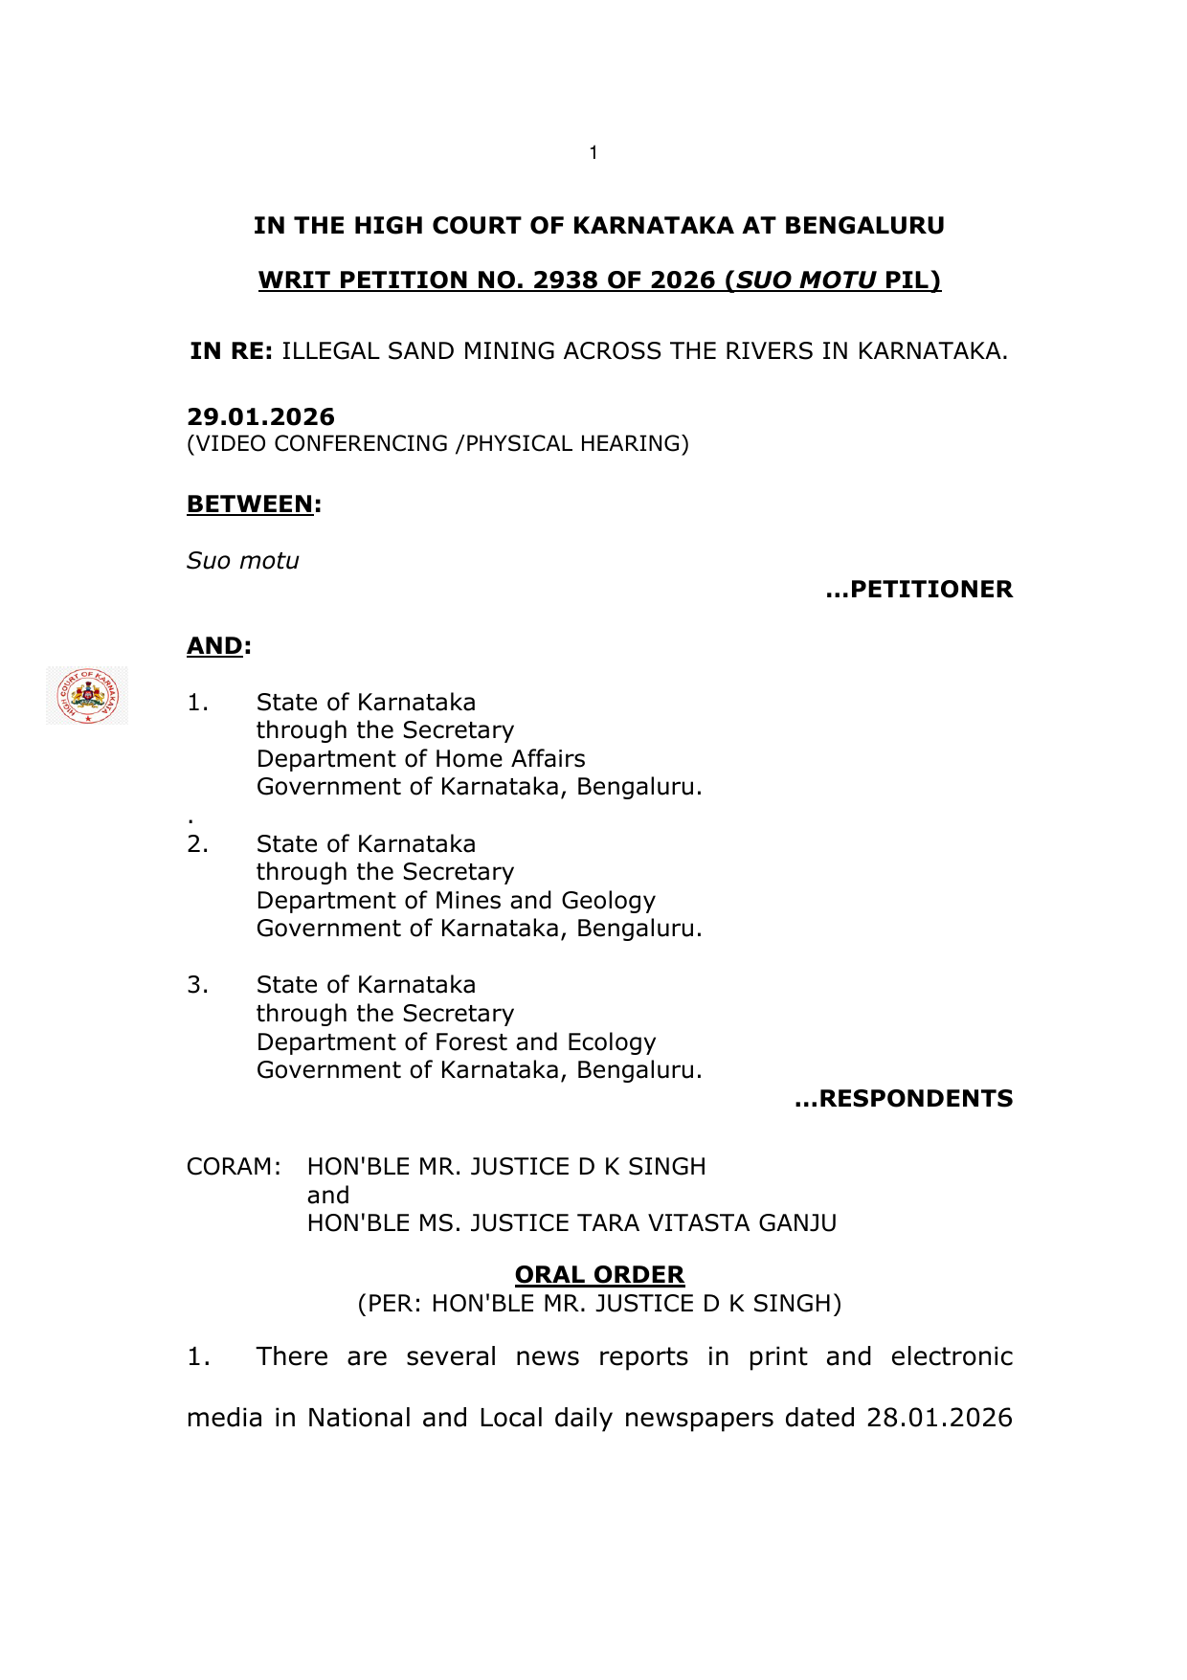
T H E R E A L P R O B L E M
The state does not suffer from lack of judgments. It suffers from unreadable decisions at the moment action is needed.
Today, officers have to read long PDFs, identify the operative order, infer who must act, and remember the deadline before the system can move.
Original Judgment PDF
Current operational reality
What government actually needs
Judgment arrives as a dense PDF, not a task list.
Responsible authority
Action type
Limitation clock
Critical directions are buried inside long legal prose.
Not a summarizer.
A verified action plan that makes the next administrative move obvious.
Departments and timelines often have to be inferred manually.
Appeal windows and compliance deadlines can be missed.
Who must act
By when
What happens next
Knowledge lives in individual officers, not in the system.
The win is operational clarity under legal ambiguity.
Repo evidence: README, frontend routes, backend pipeline
02

Slide 3
U N I Q U E W E D G E
Our differentiator is not extraction alone. It is a verified operating loop from judgment to action.
Most systems stop at OCR or summary. We push one step further: a structured action plan, a human decision gate, and a trusted dashboard that only shows approved outcomes.
1. Understand the judgment
2. Force human accountability
3. Publish only trusted actions
Pass 1 identifies the operative pages. Pass 2 extracts directives, departments, deadlines, and action types from the relevant block only.
Every extracted directive is shown with confidence and source-page context. The officer can approve, edit, or send it back with a correction note.
Departments do not see raw model output. They see verified directives, urgency bands, and pending items that are ready to be acted on.
Why this matters
Cuts the judgment down to the pages that matter before legal reasoning begins.
This is where the ambition starts: once verified action becomes structured data, the state can monitor compliance instead of merely storing judgments.
Builds an audit trail instead of hiding edits inside a black box.
Keeps final authority with the government officer, not the model.
Turns a one-time reading exercise into reusable institutional memory.
Repo evidence: README, frontend routes, backend pipeline
03

Slide 4
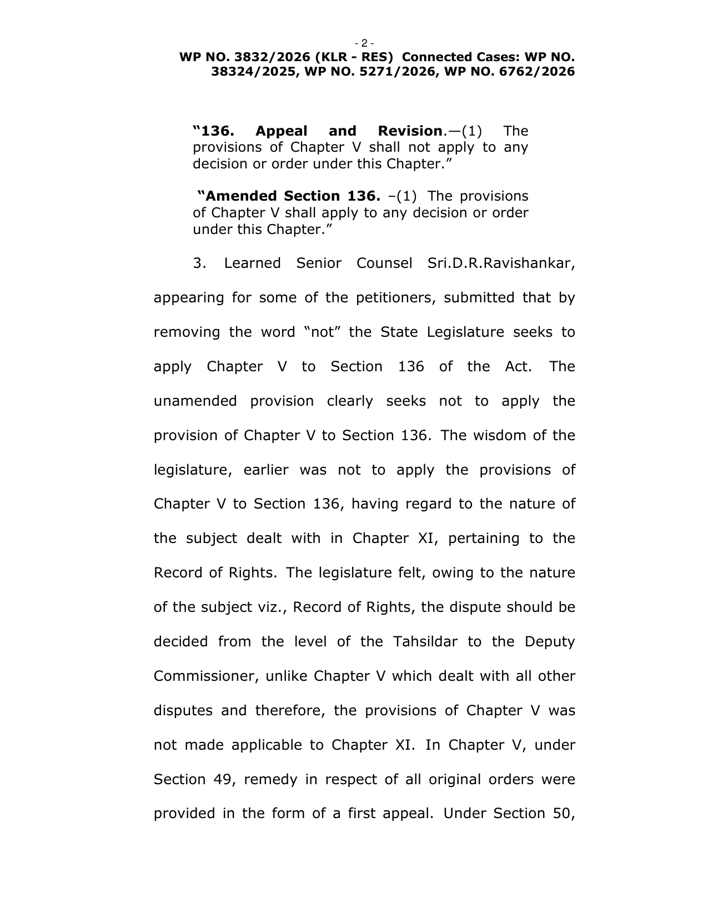
P R O D U C T P R O O F
One officer verifies with evidence. Every department downstream sees only trusted actions.
Verification Workspace
Department Dashboard
Repo flow: Approve, Edit, Redo, Publish, source page jump, confidence bar.
Urgent
Upcoming
Actioned
Verified only
Compliance
Revenue
Approved
Case ID
Directive
Deadline
Status
Days
Release compensation order and complete mutation process.
REV-1482
Release survey order
May 18
Urgent
4
Deadline: 14 days
Page 7
Confidence
92%
LAW-2207
Appeal review
May 31
Upcoming
17
Appeal
Law
FST-1021
Compliance report
Jun 14
On Track
31
Review whether grounds exist to challenge the order within limitation.
Deadline: 30 days
Page 8
Confidence
68%
The dashboard is intentionally boring in the best way: clean, actionable, department-wise, and safe for decision-makers.
Selected directive moves the reviewer to the supporting page context.
Repo evidence: README, frontend routes, backend pipeline
04

Slide 5
T E C H N I C A L I M P L E M E N T A T I O N
We made the hard part tractable by splitting it into two AI problems and one mandatory human gate.
This is not one giant prompt. It is a staged pipeline designed for long, inconsistent legal PDFs and operational reliability.
01
03
05
PDF upload
PDF slicer
Verification + self-correction
Digital or scanned judgment enters the system.
Only the relevant pages are passed forward, reducing noise and cost.
Officer approves, edits, or re-runs with a correction note.
02
04
06
Pass 1: Vision
Pass 2: Legal extraction
Trusted dashboard
Sarvam Vision OCRs, classifies structure, and identifies operative pages.
Sarvam 105B produces directives, departments, deadlines, and action types.
Only verified directives reach department users and alert views.
22
128K
10
1 command
Indian languages
Legal context window
Core tables
Demo startup
Sarvam Vision capability cited in repo
Sarvam-105B in repo rationale
Judgments, directives, alerts, audit and more
./start.sh launches the stack
Repo evidence: README, frontend routes, backend pipeline
05

Slide 6
G O V E R N M E N T F E A S I B I L I T Y
This can slot into government workflow because it respects how government already works.
Fits the current operating model
Deployable without a rewrite
Why officers can trust it
Judgments can be fetched from CCMS after High Court disposal, matching the problem statement.
Prototype runs with React + FastAPI + SQLite now; PostgreSQL and object storage are clear production upgrades.
Source page evidence beside every directive.
Role-based views already exist in the prototype: admin, nodal officer, department users.
Repo notes an on-premise path at the Karnataka State Data Centre with endpoint swap, not logic rewrite.
Confidence visibility instead of fake certainty.
Approve, edit, and redo actions are logged.
The officer remains the decision-maker; AI is decision support, not automation.
Docker and one-command startup reduce deployment friction for evaluation.
Dashboard excludes unverified model output by design.
That makes this feasible for government: the model helps officers move faster, but the system never asks the state to outsource judgment.
Repo evidence: README, frontend routes, backend pipeline
06

Slide 7
S C A L E A N D I M P A C T
The upside is not a few PDFs. It is a compliance operating layer sitting on top of the judiciary-government interface.
6.4M
48.8M
39
3710
High Court pending cases
District & taluka pending cases
High Court complexes
District & taluka complexes
eCourts public statistics
eCourts public statistics
National system breadth
National system breadth
The honest wedge
Scenario model: even modest adoption compounds fast
We are not claiming all pending cases are in scope. The entry point is narrower and more credible:
10,000 judgments/year
30 min saved each
5,000 officer-hours returned
Disposed High Court matters involving government departments that enter CCMS and require a real administrative response.
25,000 judgments/year
30 min saved each
12,500 officer-hours returned
100,000 judgments/year
30 min saved each
50,000 officer-hours returned
Illustrative assumption for judges: 30 minutes saved per judgment after verification support. The real strategic upside is reduced deadline slippage and better compliance visibility.
Third-order effects: fewer missed appeal windows, faster compliance, cleaner inter-department handoffs, and better taxpayer value from every resolved case.
eCourts public statistics, accessed May 7, 2026
07

Slide 8
W H Y T H I S E N T R Y C A N W I N
We are not selling features slide by slide. We are selling a believable future where court decisions convert into accountable state action.
01
Problem Relevance & Depth of Understanding
02
Technical Implementation & Innovation
We address the exact failure point in CCMS: judgments arrive, but action is still trapped inside PDFs and manual interpretation.
Two-pass extraction, operative-page slicing, human verification, self-correction loop, and a full stack prototype already exist.
03
Real-World Deployability & Government Feasibility
04
Demo Quality & Presentation
The system respects role-based workflow, supports on-prem direction, and does not require blind trust in AI.
The demo is readable end-to-end: upload, verify with evidence, publish, and monitor urgency in a trusted dashboard.
05
Scalability & Long-Term Impact
Structured verified directives create a reusable state memory layer for compliance, appeal tracking, and inter-department coordination.
Judge takeaway: this is ambitious enough to matter, but disciplined enough to deploy.
Repo evidence: README, frontend routes, backend pipeline
08

Slide 9
C L O S I N G V I S I O N
From judgment archives to a living action system for the state.
The ambition is not to read one more document. It is to make every disposed case easier to act on, easier to monitor, and harder to ignore.
Today
Next
Then
Later
Upload judgment
Verify and publish
Scale across departments
Statewide intelligence
Officer gets a structured first draft instead of starting from raw PDF.
Trusted directives move to dashboards with urgency and ownership.
CCMS becomes a decision layer, not just a case-tracking store.
Compliance memory, appeal discipline, and measurable administrative throughput.
Lex-Gov AI
Court orders should not die as PDFs. They should move the state.
A human-verified action pipeline for government after the judgment is delivered.
Repo evidence: README, frontend routes, backend pipeline
09

