Slide 1
Sentiment Analysis for Product Review
By:
Charu Saxena

Slide 2
Overview
Aim
Dataset
Approach
Detailed Approach
Primarily Experimental Setup
Results/discussion for L1
Results/discussion for L2
Results/discussion for Mult Naive Bayes
Conclusion/future work

Slide 3

Aim
The main aim of the project is to analyzes people's sentiments, attitudes, or emotions towards a particular product they bought from Amazon.com and posted their views in the form of comments/reviews on the website.

Slide 4
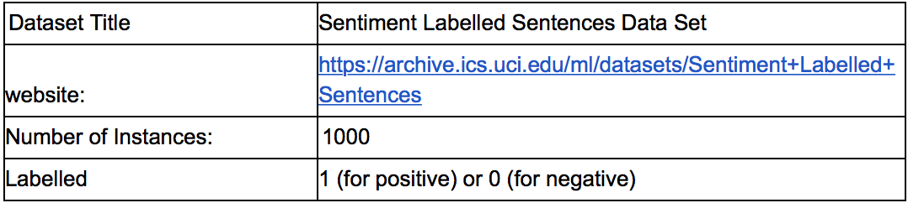
Dataset
Additional information :
Those were selected randomly for larger datasets of reviews. We attempted to select sentences that have a clearly positive or negative connotation, the goal was for no neutral sentences to be selected.
websai
Website: https://archive.ics.uci.edu/ml/datasets/Sentiment+Labelled+Sentences

Slide 5
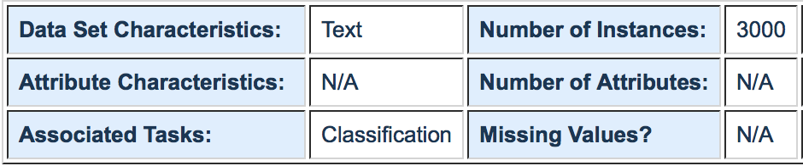
Dataset
Following is the table from the UCI website[1] showing different aspects of the dataset:

Slide 6
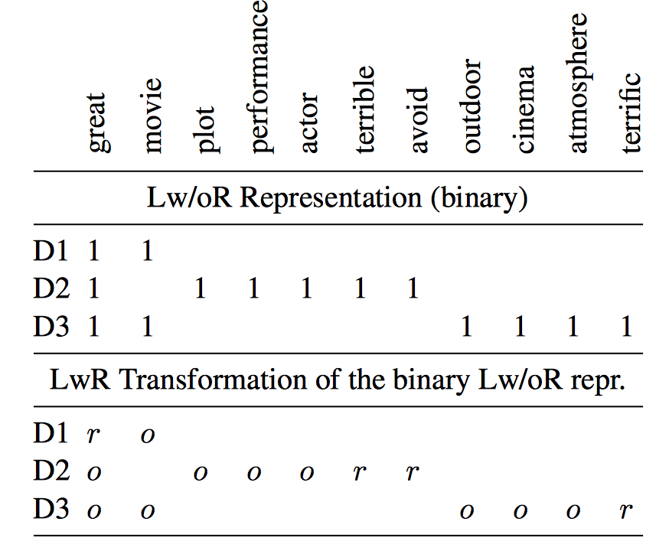
Approach
Primarily Idea
Used learning with rationale approach.
Automated user-based rationale by using chi-squared.
For generating rationales, we chose only the positive and negative features that had the highest χ2 (chi-squared) statistic in at least 5% of the positive and negative documents and ratio is greater.
In the training set updated the weights for words present by if a rationale then multiplied by ‘r’ else by ‘o’ for both positive and negative rationales and documents.
Fit this training set in iterative manner to models(LR and NB).

Slide 7
Detailed Approach
For here the program was set in two parts where in one we considered learning with rationals and other is learning without rationals(traditional approach). This was done in following steps:
I. With rationale
Preparing data
First of all we know that, the reviews do not have any features, so the using CountVectorizer() will provide bag of words as the features for to do modeling. During this, we remove all the stop-words, and we set min_df =5, which means that word should have minimum frequency in 5 documents. We then get a dataframe, which is having bag of words for whole training set as a features and rows as different reviews, also we will define a column which will be having ratings as the score for that review correspondingly, as a sparse matrix.NOw we will use train_test_split() with different random state value(to keep the documents selected same for every run while experimenting) and test data percentage.
Human-simulator
For learning with rationale approach I have taken simulated human-labeler to provide rationales based on the whole training set using chi-squared. This will give the chi-squared value for each feature and now we add them to a list of feature_score. Here also we are removing the nan values in the training set and setting it to 0. As, a result of which we see that we have 203 features in total. We rank the features and make a list of it. Now to consider a word as a rationale we see that of the word is present in the feature rank and if its occurrence is more in positive reviews we list them into positive rationale list or in negative rationale list.
Thus the the end we get two list: positive_rationale and negative_rationale

Slide 8
Detailed Approach
Updating weights in training examples
We will now update the values of the features for each review to show the effect of the rationals we have selected. As the matrix we are considering is a sparse matrix, we will work accordingly. In whole training set, for each review first we will see what label is present if the label is positive we will try to find the words present in the documents(value is 1 for it be a sparse matrix) and compare if it is also present in the positive rationales then we will multiply the value by ‘r’ else by ‘o’. And same for the negative labelled review we will compare with the negative rationale if that word is present update as ‘r’ if present and ‘o’ if not.One case here is that when there is a presence of multiple rationales then we will choose a rationale at random and update the weight for both labels. For here we will consider r=1 and o=0.01
Fit to model
We have considered two classifiers here: Logistic Regression(both L1 and L2 regularization ) and Multinomial Naive Bayes.
Here we fitted training dataset iteratively in pieces of 10,20,30.. And so on, and considered whole test set for to check accuracy and auc for it. When train_test_set split is 70%,66% and 80% we considered iterations of size 10 reviews as (10,20,30.. Till 100) and 10 times.
Whereas when we considered smaller training set with 5%, we considered iterations of 2 reviews stating taking 4 reviews as (4,6,8,10...till 22) total 10 times.
All the classifiers were set to default parameters, and fitting was done iteratively. To observe the results discussed in later part of the report.

Slide 9
Detailed Approach
II. Without rationale approach(Traditional)
For without rationale approach, the preparation of data was done in the similar was as done in rationale approach. After that no weights were updated we just fed the sparse matrix in iterative manner to all the three classifiers as discussed in the ( fit the model ) above, and the results were observed, which are discussed in later part of this report

Slide 10
Experimental Setup
Different train set set were taken
200 reviews as training out of 1000 total
There was no class imbalance
Features obtained: 203
Classifier used: Logistic Regression[L1,L2 ] and Multi Naive Bayes
Performance measure: AUC and Accuracy

Slide 11
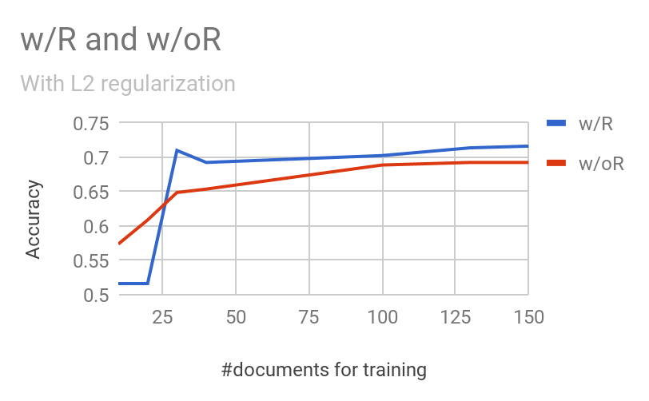
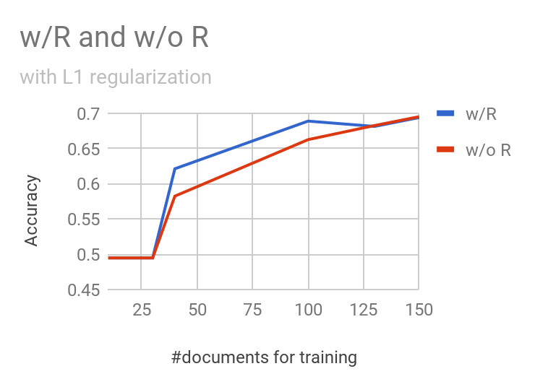
Primarly Experimental Results

Slide 12
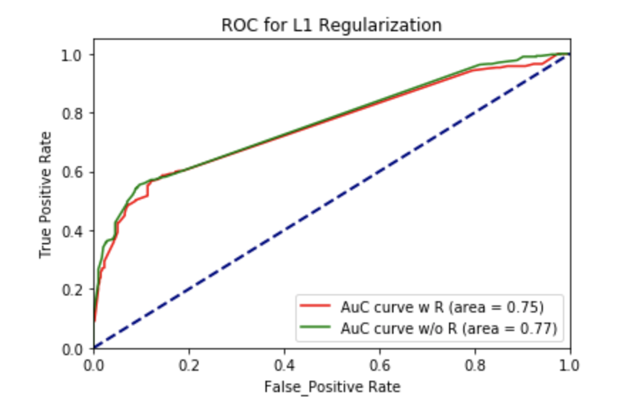
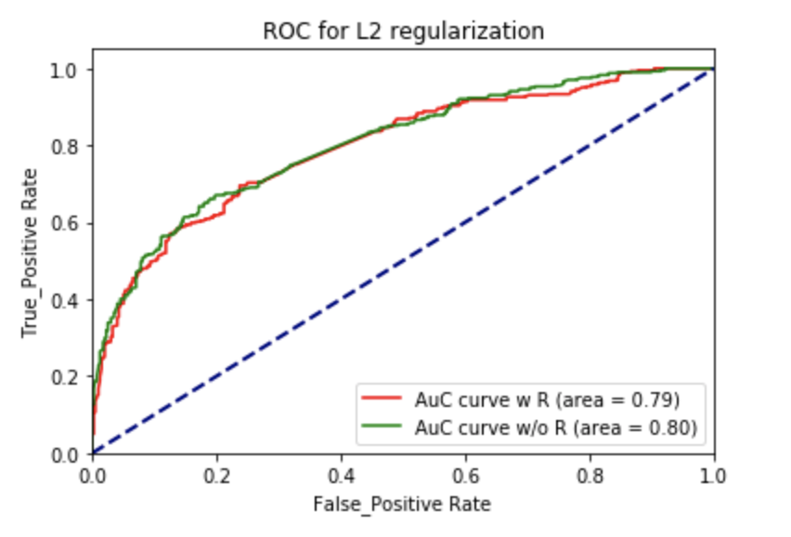
Primarily Experimental Results

Slide 13
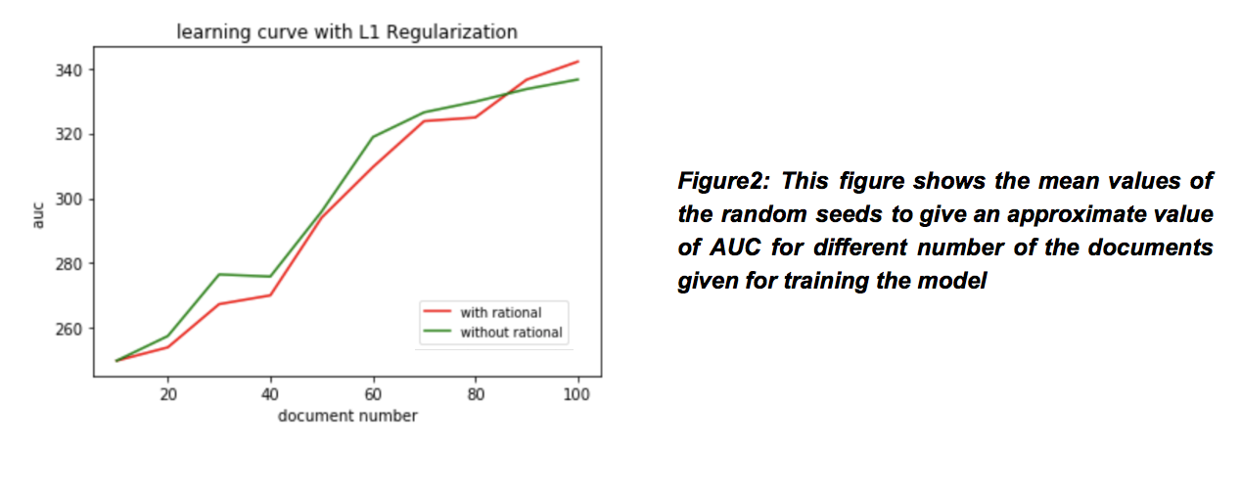
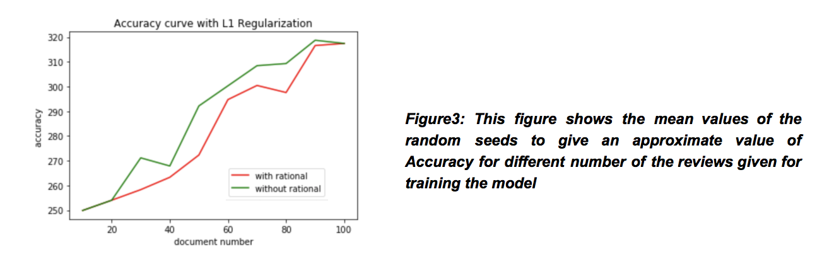
Results/discussions for L1
Here we have considered results for all three classifiers with different training data and random state:
I) For Logistic regression(L1 regularization)
Here first of all we see the results with different number of random seed used for selecting the documents and seeing the accuracy curve and AUC curve with number of documents given on as the training data in the different model:
So first here we are using
Model: logistic regression L1 regularization
Test data:700 , Train data:300
Top 5 Pos_rationale:
[great, works, price , love, good ,excellent ,best,comfortable ]
Top 5 negative_rationale:
[hear, poor, piece, buy ,terrible ,volume,broke, waste]

Slide 14
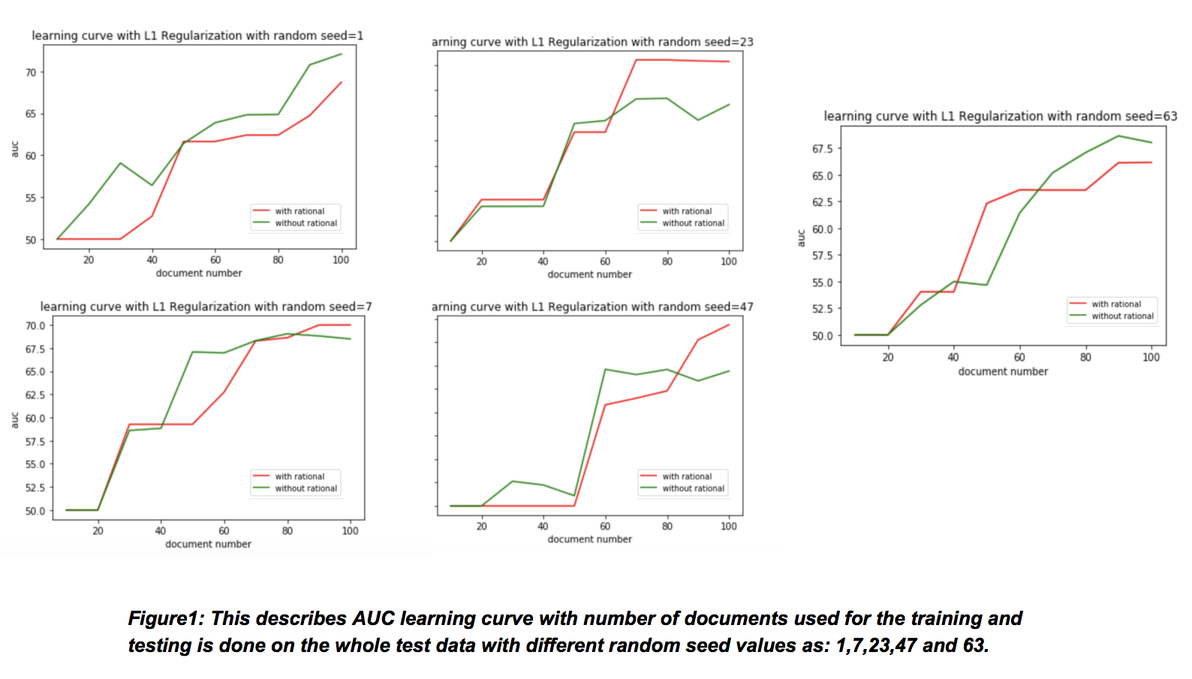
Results/discussions for L1
Discussion
Here we observe that when number of documents increasing model is learning better in the case of rationales rather than traditional learning(AUC curve). This is happening because the rationales are providing weights to only to important words(rationales) as suggested by our simulated labeler. As the words represent positive rationales make sense and some of the negative rationales too, and these were given weights for the reviews in training set

Slide 15
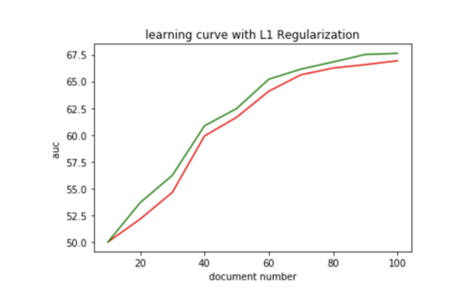
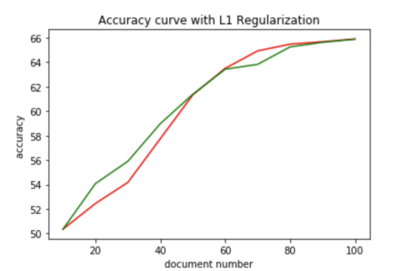
Results/discussion for L1
b) So now we try reducing the training dataset and observing the results.
Model: logistic regression L1 regularization
Test data:800 , Train data:200
Top 5 Pos_rationale:
[great, love,works, best,price, excellent]
Top 5 negative_rationale:
[poor, buy, piece, waste money]
Figure5: This figure shows the mean values of the random seeds to give an approximate value of AUC and Accuracy for different number of the reviews given for training the model.

Slide 16
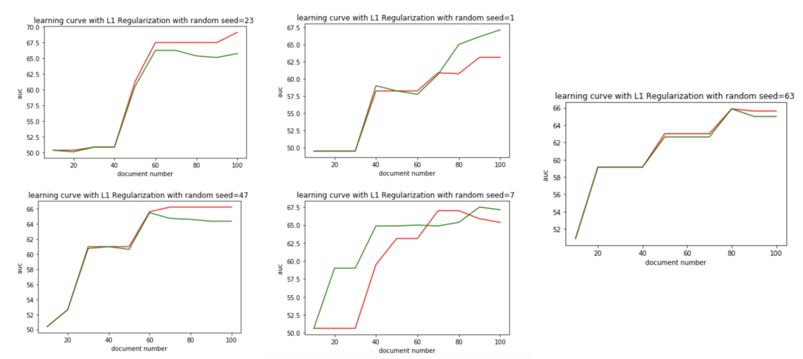
Results/discussion for L1
Discussion
Here we observe that when number of documents increasing model is learning better in the case of without rationales rather than rational learning this is opposite to what we observed in when the training set was larger by 100 reviews. This might be happening because the rationales provided might be not much as in the previous case and not good words observed as listed in the list of positive and negative rationals.
As the words represent positive rationales make sense to a level like(positive words included great love and best) and some of the negative rationales (like poor and waste )made sense but not buy or piece but these must be related with negative phrases like , and these were given weights for the reviews in training set
Figure4: This describes AUC learning curve with number of documents used for the training and testing is done on the whole test data with different random seed values as: 1,7,23,47 and 63.

Slide 17
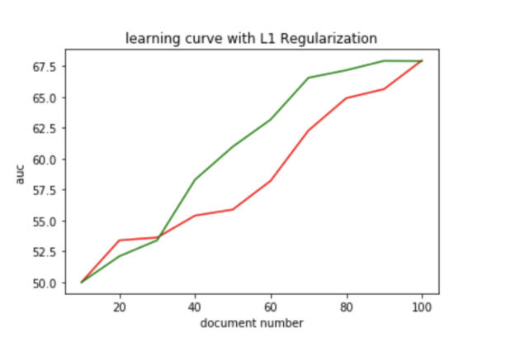
Results/discussion for L1
c) So now we try increase the training dataset and observing the results.
Model: logistic regression L1 regularization
Test data:660 , Train data:340
Top 5 Pos_rationale:
[great, good, love, works ,nice, price ,best ]
Top 5 negative_rationale:
[money, calls ,big ,bad ,disappointed ,stay,problem]
Discussion
Here we observe that when number of documents increasing model is learning better in the case of without rationales rather than rational learning this is opposite to what we observed in when the training set was smaller by 40 reviews. Here even though rationals make more sense than above cases like pos rationales(great, good, love) but negative rationales not much ([money, calls ,big where the first three don’t make sense). This might be happening because the rationales provided might be not be good enough to determine a good result much as in the previous case and not good words observed as listed in the list of positive and negative rationals.so the auc curve for rationals is higher than without rationales.
Figure6: This figure shows the mean values of the random seeds to give an approximate value of AUC for different number of the reviews given for training the model.

Slide 18
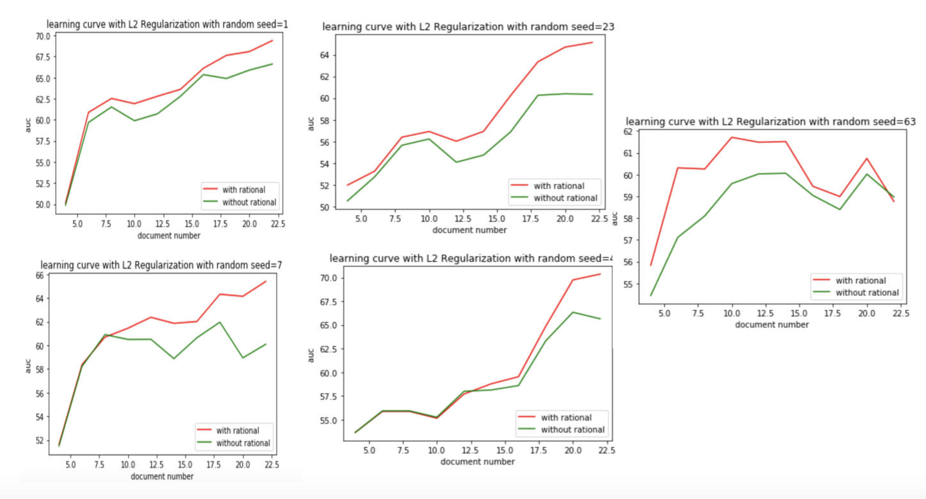
Results/discussion for L2
So first here we are using
Model: logistic regression L2 regularization
Test data:700 , Train data:300
Discussion
Here we observe that AUC curve is changing from the last L1 approach here the learning curve performs better in case of L2 than in case L1 when train-test split is 70%. Previously in case of learning with rationales curve was minutely increasing but in case of L2 regularization we see a good difference and in fact rationals make the model perform better than traditional learning
Figure 9: This describes AUC learning curve with number of documents used for the training and testing is done on the whole test data with different random seed values as: 1,7,23,47 and 63 for L2 regularization.

Slide 19
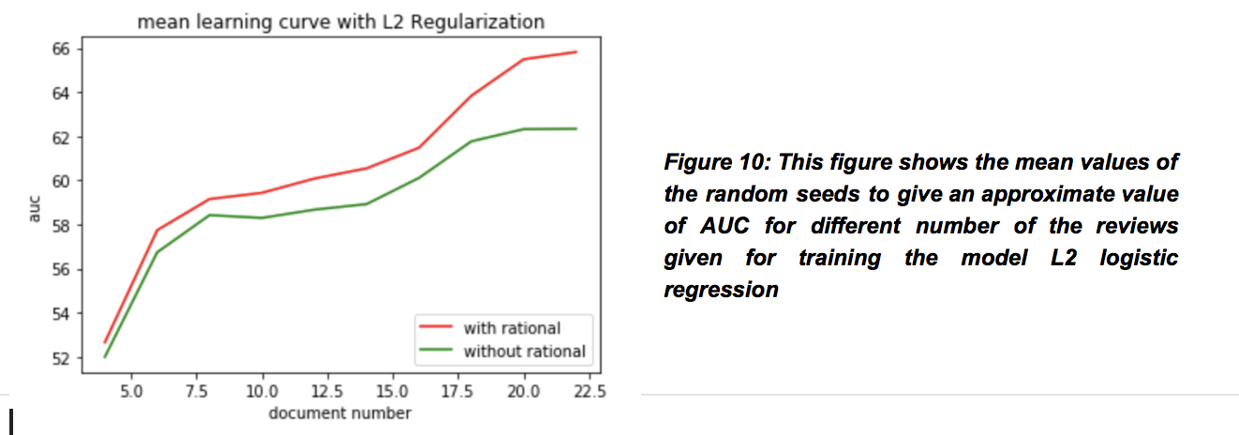
Results/discussion for L2
Model: logistic regression L2 regularization
Test data:700 , Train data:300

Slide 20
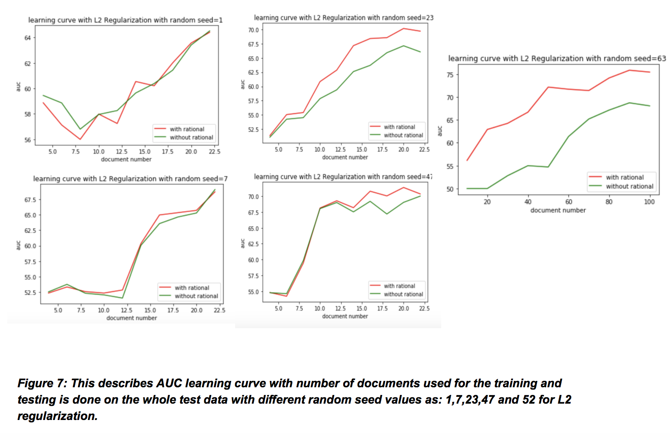
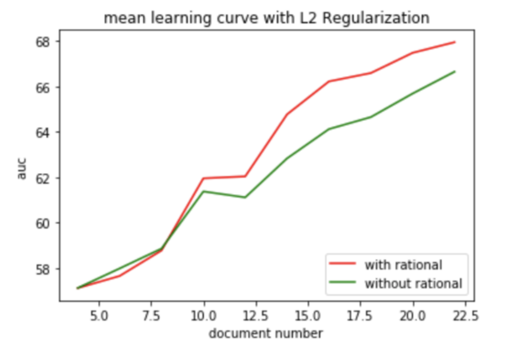
Results/discussion for L2
II) for logistic regression(L2 regularization)
b) So first here we are using
Model: logistic regression L2 regularization
Test data:800 , Train data:200
Discussion
Here we observe that accuracy and AUC curve is changing from the last L1 approach here the learning curve performs better in case of L2 than in case L1. here the curve(fig8) shows that the model is learning better and performing better for Learning with rationals than traditional and also the learning with rationals performs better with L2 better than with L1 for when test set split is 80%.
Figure8: This figure shows the mean values of the random seeds to give an approximate value of AUC and Accuracy for different number of the reviews given for training the model L2 logistic regression

Slide 21
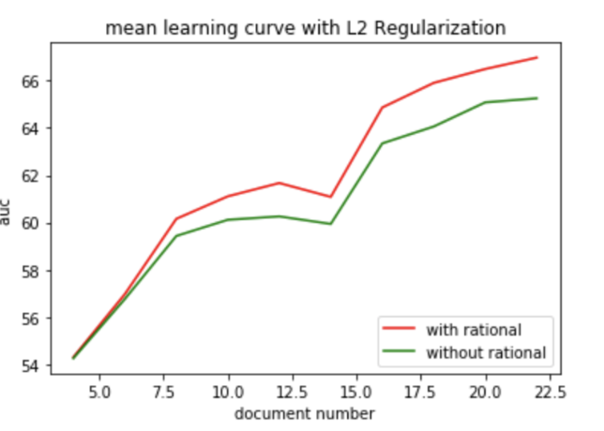
Results/discussion for L2
So first here we are using
Model: logistic regression L2 regularization
Test data:660 , Train data:340
Discussion:
Also for L2 we see with rationale approach works well than traditional approach for when we take just 50 documents and it make sense that it is increasing with number of documents as the rationales we are getting are better and better. Previously for L1 traditional method was performing well but here we see that with L2 regularization rationals is performing better
Figure 11:This figure shows the mean values of the random seeds to give an approximate value of AUC for different number of the reviews given for training the model L2 logistic regression .

Slide 22
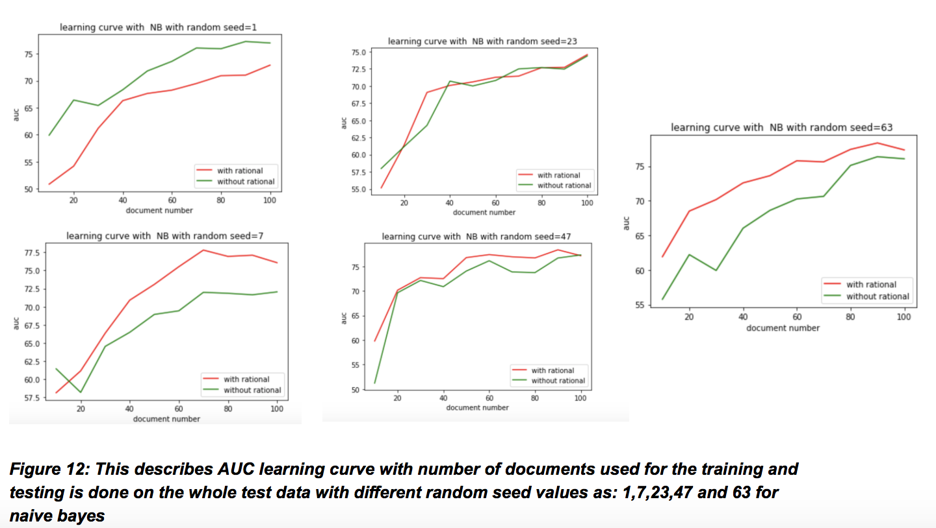
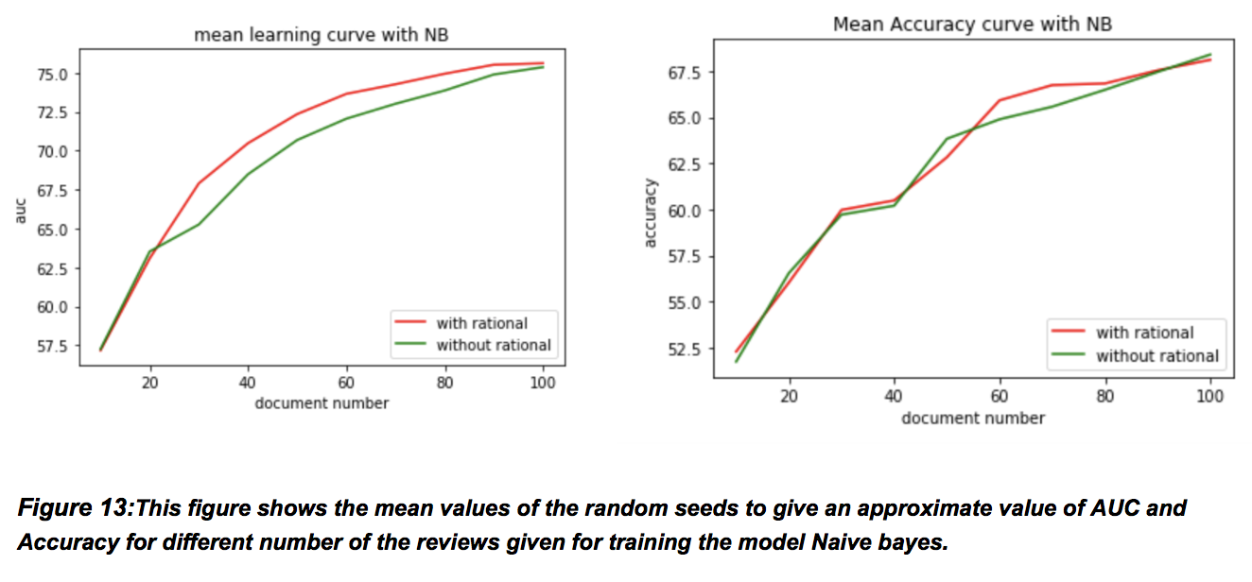
Results/discussion for Mult Naive Bayes
So first here we are using
Model: MultinomialNB
Test data:700 , Train data:300
Discussion:
Here we see that first of all, learning with rationals are performing better than traditional method which adds on to the result of L2 regularization. But there is less significant difference between the two.

Slide 23
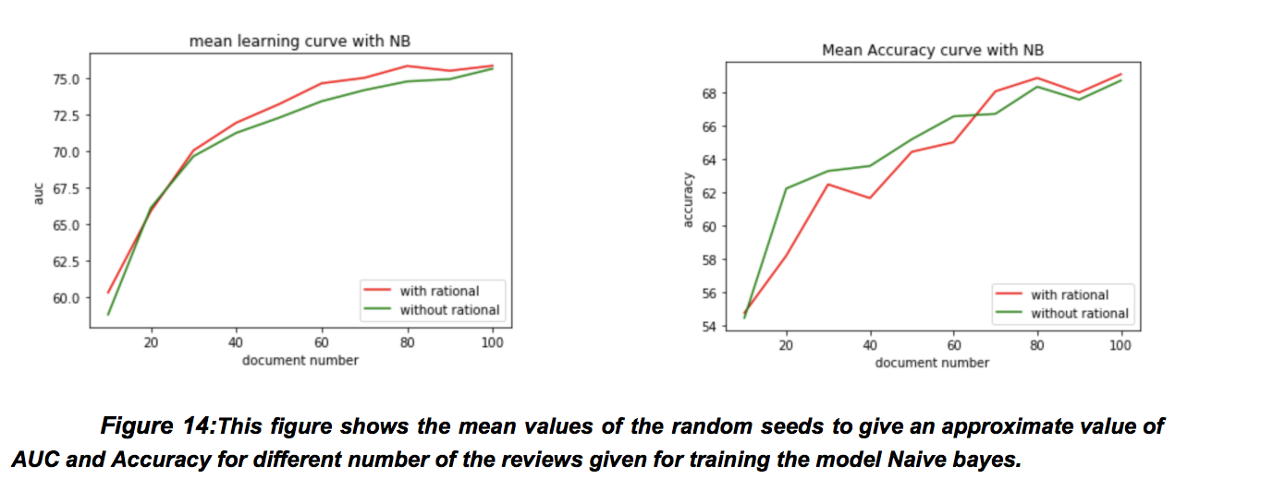
Results/discussion for Mult Naive Bayes
So first here we are using
Model: MultinomialNB
Test data:800 , Train data:200

Slide 24
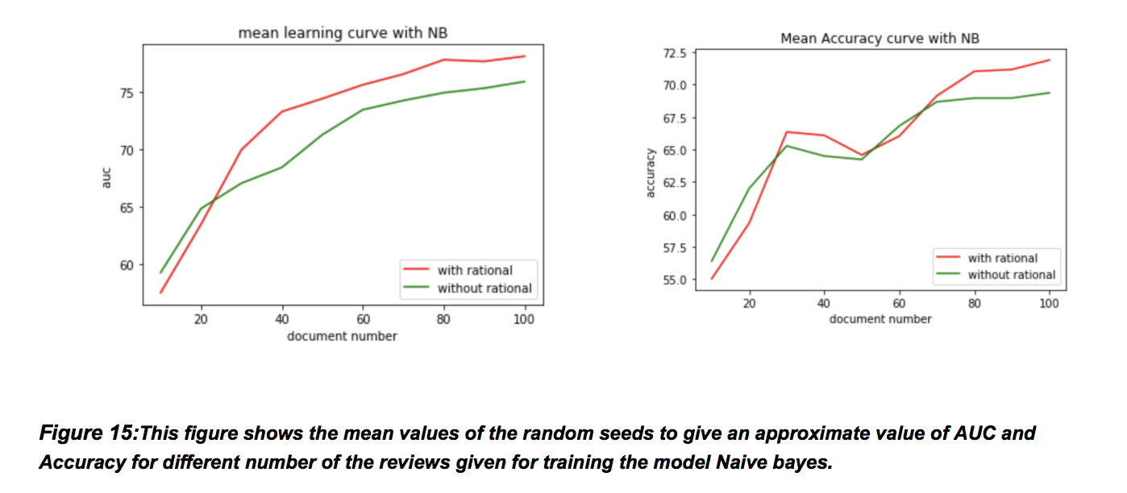
Results/discussion for Mult Naive Bayes
c) So first here we are using
Model: MultinomialNB
Test data:660 , Train data:340
Discussion: Here for both 68% and 80% we observe that the results are similar to 70% only, where learning with rationals are performing better than traditional method with lesser difference.

Slide 25
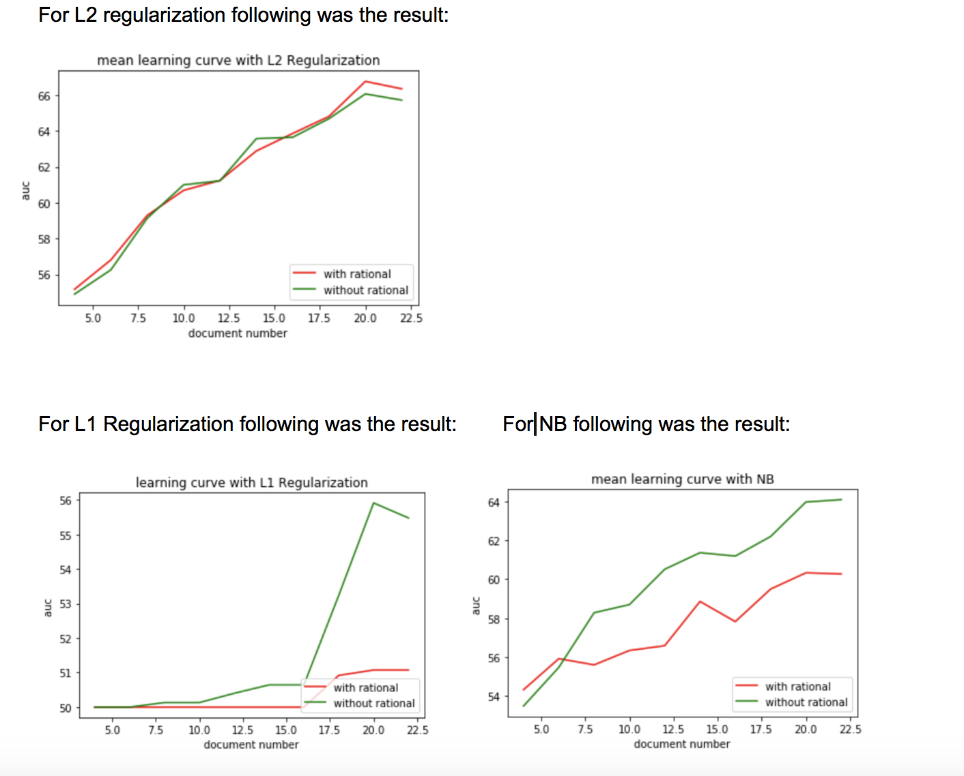
Results/discussion for very small dataset
III) This is the part which was done to see if we give very less documents:
Second part of testing was done taking very small set for training, here we considered:
Training dataset=50, and test dataset as 950.
Top 5 Pos_rationale:
[great ,works, cell,price,fits ,time,recommend ]
Top 5 negative_rationale:
[buttons,calls,life,year,terrible,small]
Discussion:
We see that when very less documents are given then learning with rationals work better only with L2 regularization and not in other classifiers. One of the plausible reason might be that, here there are very less reviews thus, simulator has very less documents to see and get rationales that might make sense also, as it will pick up rationales based on the ratio of positive and negative documents

Slide 26
Conclusion/Future work
Conclusively, we see that with l2 regularization of logistic regression and multinomial naive bayes learning with rationals works better than traditional learning, whereas logistic regression with L1 regularization was an exception for this.
For number of train set, we see that more the number of reviews we take as training ,better the simulator will choose the rationals and better will be the learning.

Slide 27
References:
[1]- https://archive.ics.uci.edu/ml/datasets/Sentiment+Labelled+Sentences
[2]- http://www.cs.iit.edu/~ml/pdfs/sharma-naaclhlt15.pdf

