Slide 1
Encrypted messaging app for secure communication
-Project Members
Manoj Reddy Dumpa
Rohan Girase
Omkar Salunke
Omkar Gadgil

Slide 2

Objective
Design and Implement an end to end encrypted & Secure application for communication.
Intuitive and fully functional and Responsive GUI
Application of the building blocks of crypto system like key generation and standard encryption algorithm like AES.

Slide 3
COMPONENTS:
Front End: Angular 2 with TypeScript using the Ionic Framework
Backend: Coded in Python.
Encryption: Implemented the AES algorithm, Diffie-Hellman, CBC
Internally it also uses the RESTful API to get Users Data i.e getPublicKey, getLoginDetails, getMessages etc etc

Slide 4
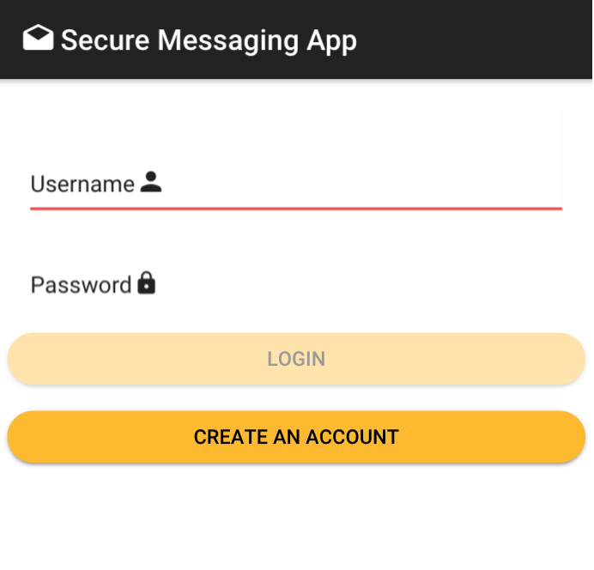
Front End Functionality
Simple to use with create account and login options on the main page.
Once logged in the user has option to add connections and establish a secure encrypted connection for communication among his/her connections.
Logout option for terminating the session and exiting the app.

Slide 5
Back-End
Consists a central program which has various sub routines for authentication and verifying the details.
Tokens are used for authentication purpose.
The program also checks for the existing user in the database and if present fetches the message in the message queue for the specific user.

Slide 6
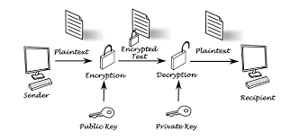
Encryption

Slide 7
DIFFIE-Hellman Key Exchange
Private key generated using the random number generator.
Math function used to generate public key.
Hashing is used for generation of a secret key with the help of public and private key.

Slide 8
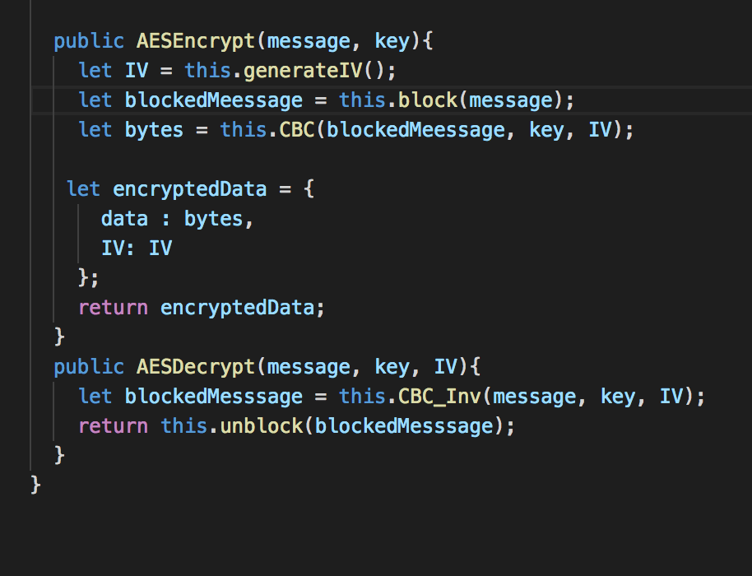
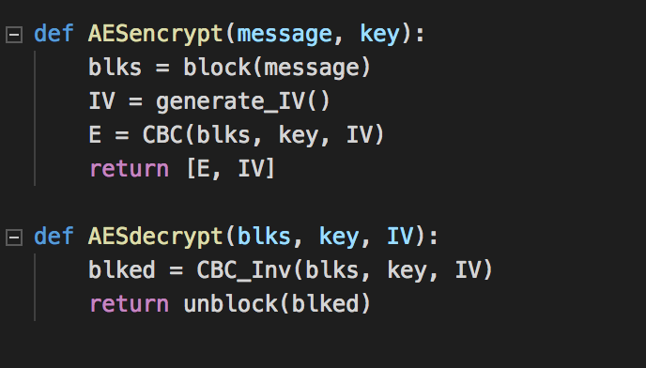
CIPHER BLOCK CHAIN IMPLEMENTATION (CBC):
Front-End
Back-End

Slide 9
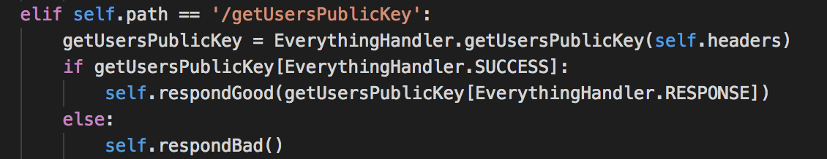
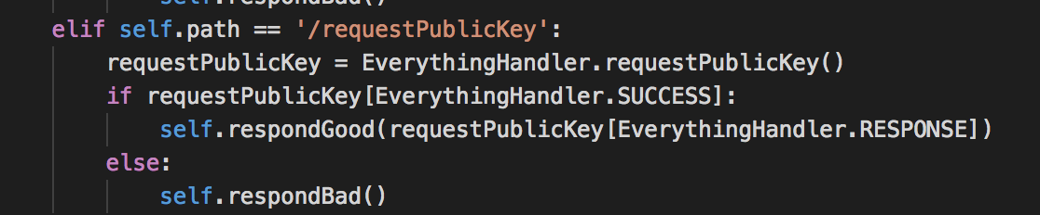
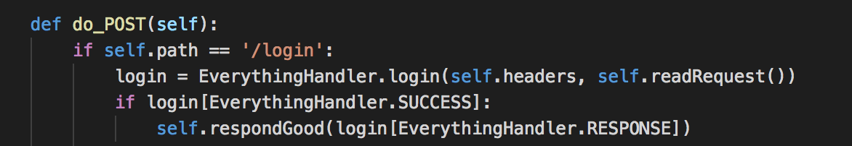
Diffie hellman key exchange implementation:

Slide 10
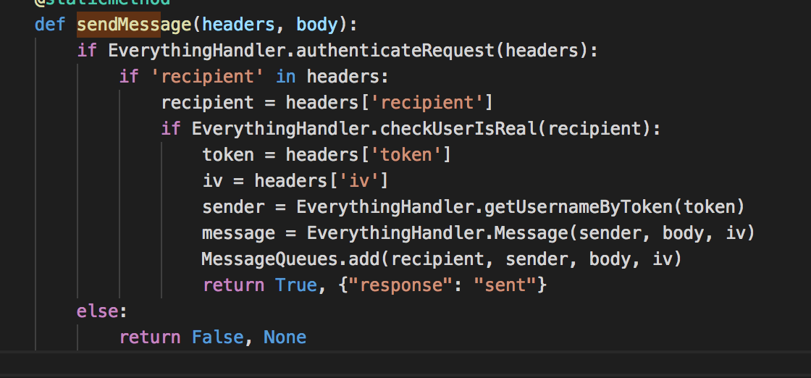
AES implementation:

Slide 11
Thank You

