Slide 1
ECE-5527 Speech Recognition
Introduction to Automatic Speech Recognition

Slide 2
Introduction to Speech Recognition
Introduction to ASR
  Problem definition
  State of the art examples
Course overview
  Lecture outline
  Assignments
  Term Project
  Grading
Veton Këpuska

Slide 3
INTRODUCTION TO AUTOMATIC SPEECH RECOGNTION
Veton Këpuska

Slide 4
Communication via Spoken Language
Input
Output
Speech
Speech
Human
Computer
Text
Text
Generation
Understanding
Meaning
Veton Këpuska

Slide 5
Automatic Speech Recognition
Spoken language understanding is a difficult task, and it is remarkable that humans do well at it.
The goal of automatic speech recognition ASR (ASR) research is to address this problem computationally by building systems that map from an acoustic signal to a string of words.
Automatic speech understanding (ASU) extends this goal to producing some sort of understanding of the sentence, rather than just the words.
Veton Këpuska

Slide 6
Virtues of Spoken Language
Natural: Requires no special training
Flexible: Leaves hands and eyes free
Efficient: Has high data rate
Economical: Can be transmitted/received inexpensively
Speech interfaces are ideal for information access and management when:
• The information space is broad and complex,
• The users are technically naive, or
• Only telephones are available
Veton Këpuska

Slide 7
Application Areas
The general problem of automatic transcription of speech by any speaker in any environment is still far from solved. But recent years have seen ASR technology mature to the point where it is viable in certain limited domains.
One major application area is in human-computer interaction.
  While many tasks are better solved with visual or pointing interfaces, speech has the potential to be a better interface than the keyboard for tasks where full natural language communication is useful, or for which keyboards are not appropriate.
  This includes hands-busy or eyes-busy applications, such as where the user has objects to manipulate or equipment to control.
Veton Këpuska

Slide 8
Application Areas
Another important application area is telephony, where speech recognition is already used for example
  in spoken dialogue systems for entering digits, recognizing “yes” to accept collect calls,
  finding out airplane or train information, and
  call-routing (“Accounting, please”, “Prof. Regier, please”).
In some applications, a multimodal interface combining speech and pointing can be more efficient than a graphical user interface without speech (Cohen et al., 1998).
Veton Këpuska

Slide 9
Application Areas
Finally, ASR is applied to dictation, that is, transcription of extended monologue by a single specific speaker. Dictation is common in fields such as law and is also important as part of augmentative communication (interaction between computers and humans with some disability resulting in the inability to type, or the inability to speak). The blind Milton famously dictated Paradise Lost to his daughters, and Henry James dictated his later novels after a repetitive stress injury.
Veton Këpuska

Slide 10
Diverse Sources of Constraint for
Spoken Language Communication
Phonological: gas shortage
fish sandwich
Phonetic: let us pray
lettuce spray
Acoustic: human vocal tract
Phonotactic: blit vnuk
Contextual: It is easy to recognize speech
It is easy to wreck a nice beach
Syntactic: I am flying to Chicago tomorrow
tomorrow I flying Chicago am to
Phonetic: let us pray
lettuce spray
Acoustic: human vocal tract
Semantic: Is the baby crying
Is the bay bee crying
Veton Këpuska

Slide 11
Useful Definitions
pho·nol·o·gy
Pronunciation: f&-'nä-l&-jE, fO-
Function: noun
Date: 1799
1 : the science of speech sounds including especially the history and theory of sound changes in a language or in two or more related languages
2 : the phonetics and phonemics of a language at a particular time
pho·net·ics
Pronunciation: f&-'ne-tiks
Function: noun plural but singular in construction
Date: 1836
1 : the system of speech sounds of a language or group of languages
2 a : the study and systematic classification of the sounds made in spoken utterance b : the practical application of this science to language study
pho·no·tac·tics
Pronunciation: "fo-n&-'tak-tiks
Function: noun plural but singular in construction
Date: 1956
: the area of phonology concerned with the analysis and description of the permitted sound sequences of a language
Veton Këpuska

Slide 12


Automatic Speech Recognition
ASR
System
Speech
Signal
Recognized
Words
An ASR system converts the speech signal into words
The recognized words can be:
  The final output, or
  The input to natural language processing
Veton Këpuska

Slide 13
Application Areas for Speech Based Interfaces
Mostly input (recognition only)
  Simple command and control
  Simple data entry (over the phone)
  Dictation
Interactive conversation (understanding needed)
  Information kiosks
  Transactional processing
  Intelligent agents
Veton Këpuska

Slide 14
Basic Speech Recognition Challenges
Co-articulation
Speaker independence
  Dialect variations
  Non-native speakers
Spontaneous speech
  Disfluencies
  Out-of-vocabulary words
Language modeling
Noise robustness
Veton Këpuska

Slide 15
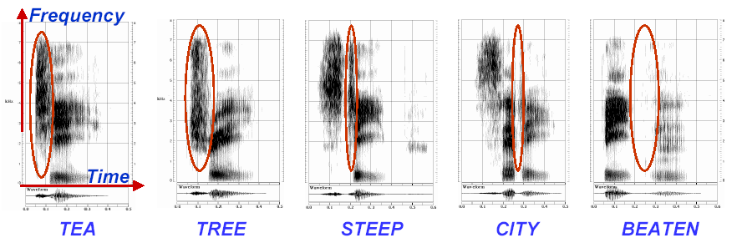
Phonological Variation Example
The acoustic realization of a phoneme depends strongly on the context in which it occurs
Veton Këpuska

Slide 16
Read vs. Spontaneous Speech
Filled and unfilled pauses:
Lengthened words:
False starts:
Veton Këpuska

Slide 17
Sometimes Real Data will Dictate Technology Requirements (City Name Domain)
Technology Required Example
Simple word spotting Um, Braintree
Complex word spotting Eh yes, Avis rent-a-car in
Boston
Hello, please Brighton,
uh, can I have the number
of Earthscape, in, uh, on
Nonantum Street
Speech understanding Woburn, uh, Somerville.
I'm sorry
Veton Këpuska

Slide 18
Parameters that Characterize the Capabilities of ASR Systems
Parameters | Range
Speaking Mode: | Isolated word to continuous speech
Speaking Style: | Read speech to spontaneous speech
Enrollment: | Speaker-dependent to speaker-independent
Vocabulary: | Small (<20 words) to large (>50,000 words)
Language Model: | Finite-state to context-sensitive
Perplexity: | Small (<10) to large (>200)
SNR: | High (>30dB) to low (<10dB)
Transducer: | Noise-canceling microphone to cell phone
Veton Këpuska

Slide 19
ASR Trends*: Then and Now
 | before mid 70’s | mid 70’s – mid 80;s | after mid 80’s
Recognition Units: | Whole-word & sub-word units | Sub-word units | Sub-word units
Modeling Approaches: | Heuristic and ad hoc | Template matching | Mathematical and formal
 | Rule-based and declarative | Deterministic and data-driven | Probabilistic and data-driven
Knowledge Representation: | Heterogeneous and complex | Homogeneous and simple | Homogeneous and simple
Knowledge Acquisition: | Intense knowledge engineering | Embedded in simple structure | Automatic learning
Veton Këpuska

Slide 20
Speech Recognition:
Where Are We Now?
High performance, speaker-independent speech recognition is now possible
  Large vocabulary (for cooperative speakers in benign environments)
  Moderate vocabulary (for spontaneous speech over the phone)
Commercial recognition systems are now available
  Dictation (e.g., Dragon, IBM, L&H, Philips) ScanSoft ➨Nuance
  Telephone transactions (e.g., AT&T, Nuance, Philips, SpeechWorks, etc.) ScanSoft
When well-matched to applications, technology is able to help perform real work
Veton Këpuska

Slide 21
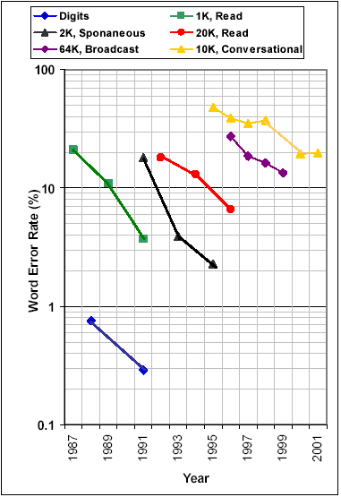
Examples of ASR Performance
Speaker-independent, continuous speech ASR now possible
Digit recognition over the telephone with word error rate of 0.3%
Error rate cut in half every two years for moderate vocabulary tasks
Error for spontaneous speech more than twice that of read speech
Conversational speech, involving multiple speakers and poor acoustic environment, remains a challenge
Tens of hours of training data to port to a different domain
Statistical modeling using automatic training achieves significant advances
Veton Këpuska

Slide 22
Important Lessons Learned
Statistical modeling and data-driven approaches have proved to be powerful
Research infrastructure is crucial:
  Large amounts of linguistic data
  Evaluation methodologies
Availability and affordability of computing power lead to shorter technology development cycles and real-time systems
Performance-driven paradigm accelerates technology development
Interdisciplinary collaboration produces enhanced capabilities (e.g., spoken language understanding)
Veton Këpuska

Slide 23
Major Components in a Speech Recognition System
Training Data
Applying Constrains
Acoustic
Models
Lexical
Models
Language
Models
Speech
Signal
Representation
Search
Recognized
Words
Speech recognition is the problem of deciding on
  How to represent the signal
  How to model the constraints
  How to search for the most optimal answer
Veton Këpuska

Slide 24
Conversational Interfaces: The Next Generation
Enables us to converse with machines (in much the same way we communicate with one another) in order to create, access, and manage information and to solve problems
Augments speech recognition technology with natural language technology in order to understand the verbal input
Can engage in a dialogue with a user during the interaction
Uses natural language to speak the desired response
Is what Hollywood and every “futurist” says we should have!
Veton Këpuska

Slide 25
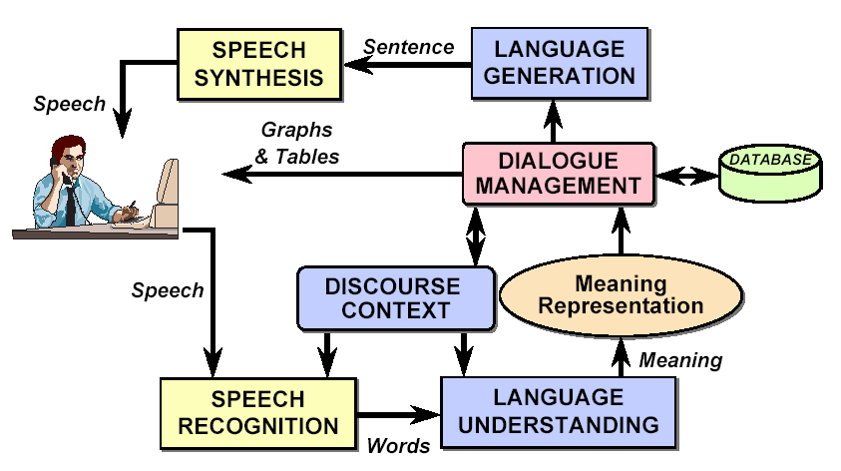
A Conversational System Architecture
Veton Këpuska

Slide 26
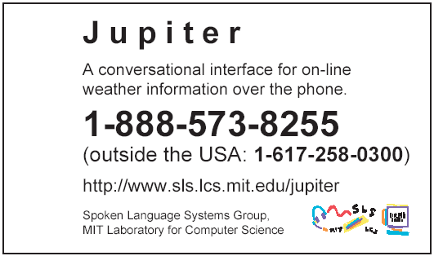
Demo: Conversational Interface
Jupiter weather information system
  Access through telephone
  500 cities worldwide
  Harvest weather information from the Web several times daily
Veton Këpuska

Slide 27
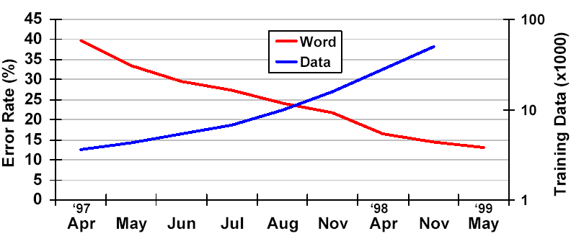
(Real) Data Improves Performance (Weather Domain)
Longitudinal evaluations show improvements
Collecting real data improves performance:
  Enables increased complexity and improved robustness for acoustic and language models
  Better match than laboratory recording conditions
Users come in all kinds
Veton Këpuska

Slide 28
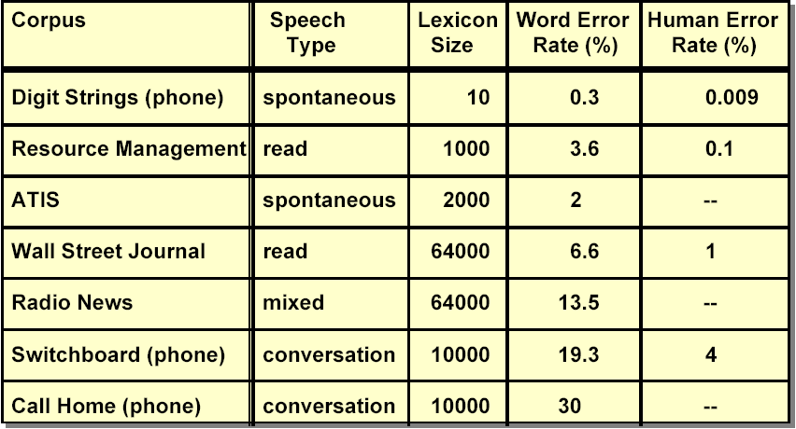
But We Are Far from Done!
Veton Këpuska

Slide 29
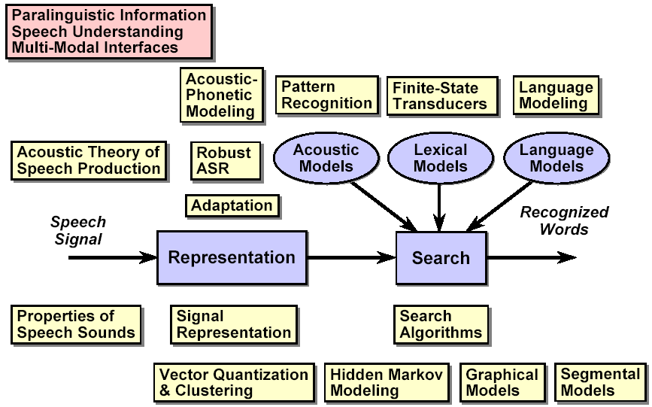
Course Outline
Veton Këpuska

Slide 30
Course Logistics
Lectures:
  Two sessions/week, 1.5 hours/session
Grading (Tentative)
  9 Assignments 45%
  2 Quizzes (?) 30%
  Term Project (about 4 weeks) 25%
Veton Këpuska

Slide 31
Assignments
There will be several assignments
  Problems that expand on the lecture material
  Assignments are due the following week on Monday
Veton Këpuska

Slide 32
Sphinx
http://cmusphinx.sourceforge.net/html/cmusphinx.php
Download Sphinx-3 from http://cmusphinx.sourceforge.net/html/compare.php#software that requires:
  CMUSphinx Components
  Common library: SphinxBase (download)
  Decoders:
    PocketSphinx (doc) (download)
    Sphinx-2 (doc) (download) – Fastest version
    Sphinx-3 (doc) (download) – Most accurate version
    Sphinx-4 (doc) (download) – Version written in java
  Acoustic Model Training: SphinxTrain (download)
  Language Model Training:
    cmuclmtk (doc) (download)
    SimpleLM (download)
  Utilities
    cepview (download)
    lm3g2dmp (download)
Veton Këpuska

Slide 33
Sphinx
Tutorial Documentation:
  http://www.speech.cs.cmu.edu/sphinx/tutorial.html
Wiki Pages and other useful links and information:
  http://www.speech.cs.cmu.edu/cmusphinx/moinmoin/
Information about resources needed for training models:
  http://cmusphinx.sourceforge.net/html/system.php
Veton Këpuska

Slide 34
Software and Data
Training Audio Data:
  http://fife.speech.cs.cmu.edu/databases/
Open Source Models and other sources:
  http://www.speech.cs.cmu.edu/sphinx/models/
Veton Këpuska

