Slide 1
ECE-5527 Speech Recognition
Introduction to Automatic Speech Recognition
Lecture notes adopted from MIT Lectures

Slide 2
Introduction to Speech Recognition
Introduction to ASR
Problem definition
State of the art examples
Course overview
Lecture outline
Assignments
Term Project
Grading

Slide 3
Introduction to Automatic Speech Recognition
1
Problem Definition
2
State of the art examples

Slide 4
Problem Definition:

Slide 5
Communication via Spoken Language
Input
Output
Speech
Speech
Human
Speech Recognition
Computer
Text
Text
Generation
Understanding
Meaning

Slide 6
Automatic Speech Recognition
Spoken language understanding is a difficult task, and it is remarkable that humans do well at it.
The goal of automatic speech recognition ASR (ASR) research is to address this problem computationally by building systems that maps from an acoustic signal to a string of words.
Automatic speech understanding (ASU) extends this goal to producing some sort of understanding of the sentence, rather than just the words.

Slide 7
ASR
Most if not all tasks in speech (and language) processing can be viewed as resolving ambiguity.
Example of Language Ambiguity:
I made her duck.

Slide 8
Possible Interpretations
I cooked waterfowl (e.g., duck) for her.
I cooked waterfowl (e.g., duck) belonging to her.
I created (plaster?) duck she owns.
I caused her to quickly lower her head or body.
I waived my magic wand and turned her into undifferentiated waterfowl (e.g., duck).

Slide 9
Virtues of Spoken Language
Natural: Requires no (additional) special training
Flexible: Leaves hands and eyes free
Efficient: Has high data rate
Economical: Can be transmitted/received inexpensively
Speech interfaces are ideal for information access and management when:
• The information space is broad and complex,
• The users are technically naive, or
• Only telephones/communication devices are available

Slide 10
Diverse Sources of Constraint for Spoken Language Communication
Acoustic: human vocal tract
Phonetic: let us pray
lettuce spray
Phonological: gas shortage
fish sandwich
Phonotactic: blit vnuk
Syntactic: I am flying to Chicago tomorrow
tomorrow I flying Chicago am to
Semantic: Is the baby crying
Is the bay bee crying
Contextual: It is easy to recognize speech
It is easy to wreck a nice beach

Slide 11
Useful Definitions
pho·nol·o·gy Pronunciation: f&-'nä-l&-jE, fO- Function: noun Date: 1799 1 : the science of speech sounds including especially the history and theory of sound changes in a language or in two or more related languages 2 : the phonetics and phonemics of a language at a particular time
pho·net·ics Pronunciation: f&-'ne-tiks Function: noun plural but singular in construction Date: 1836 1 : the system of speech sounds of a language or group of languages 2 a : the study and systematic classification of the sounds made in spoken utterance b : the practical application of this science to language study
pho·no·tac·tics Pronunciation: "fo-n&-'tak-tiks Function: noun plural but singular in construction Date: 1956 : the area of phonology concerned with the analysis and description of the permitted sound sequences of a language

Slide 12
Useful Definitions
se·man·tics /sɪˈmæntɪks/ Show Spelled[si-man-tiks] Show IPA –noun ( used with a singular verb ) 1. Linguistics . a. the study of meaning. b. the study of linguistic development by classifying and examining changes in meaning and form.
2. Also called significs. the branch of semiotics dealing with the relations between signs and what they denote.
3. the meaning, or an interpretation of the meaning, of a word, sign, sentence, etc.: Let's not argue about semantics.
4. general semantics.
se·man·tic adj \si-ˈman-tik\
Definition of SEMANTIC
1: of or relating to meaning in language
2 : of or relating to semantics
— se·man·ti·cal·ly \-ti-k(ə-)lē\ adverb

Slide 13
Useful Definitions
syn·tac·tic
/sɪnˈtæktɪk/ Show Spelled[sin-tak-tik] Show IPA
–adjective
1. of or pertaining to syntax.
2. consisting of or noting morphemes that are combined in the same order as they would be if they were separate words in a corresponding construction: The word blackberry, which consists of an adjective followed by a noun, is a syntactic compound.
syn·tac·tic adj \sin-ˈtak-tik\
Definition of SYNTACTIC
: of, relating to, or according to the rules of syntax or syntactics

Slide 14
Useful Defintions
syn·tax noun \ˈsin-ˌtaks\
Definition of SYNTAX
1 a : the way in which linguistic elements (as words) are put together to form constituents (as phrases or clauses)
b : the part of grammar dealing with this
2 : a connected or orderly system
: harmonious arrangement of parts or elements <the syntax of classical architecture>
3 : syntactics especially as dealing with the formal properties of languages or calculi

Slide 15


Automatic Speech Recognition
ASR System
Speech Signal
Recognized Words
An ASR system converts the speech signal into words
The recognized words can be:
The final output, or
The input to natural language processing, or …

Slide 16
Application Areas for Speech Based Interfaces
Mostly input (recognition only)
Simple command and control
Simple data entry (over the phone)
Dictation
Interactive conversation (understanding is needed)
Information kiosks
Transactional processing
Intelligent agents

Slide 17
Application Areas
The general problem of automatic transcription of speech by any speaker in any environment is still far from solved. But recent years have seen ASR technology mature to the point where it is viable in certain domains.
One major application area is in human-computer interaction.
While many tasks are better solved with visual or pointing interfaces, speech has the potential to be a better interface than the keyboard for tasks where full natural language communication is useful, or for which keyboards are not appropriate.
This includes hands-busy or eyes-busy applications, such as where the user has objects to manipulate or equipment to control.

Slide 18
Application Areas
Another important application area is telephony, where speech recognition is already used for example
in spoken dialogue systems for entering digits, recognizing “yes” to accept collect calls,
finding out airplane or train information, and
call-routing (“Accounting, please”, “Prof. Regier, please”).
In some applications, a multimodal interface combining speech and pointing can be more efficient than a graphical user interface without speech (Cohen et al., 1998).

Slide 19
Application Areas
Finally, ASR is applied to dictation, that is, transcription of extended monologue by a single specific speaker.
Dictation is common in fields such as law and is also important as part of augmentative communication (interaction between computers and humans with some disability resulting in the inability to type, or the inability to speak). The blind Milton famously dictated Paradise Lost to his daughters, and Henry James dictated his later novels after a repetitive stress injury.

Slide 20
Basic Speech Recognition Challenges
Co-articulation
Speaker independence
Dialect variations
Non-native speakers
Spontaneous speech (Zeri
Disfluencies
Out-of-vocabulary words
Language modeling
Noise robustness

Slide 21
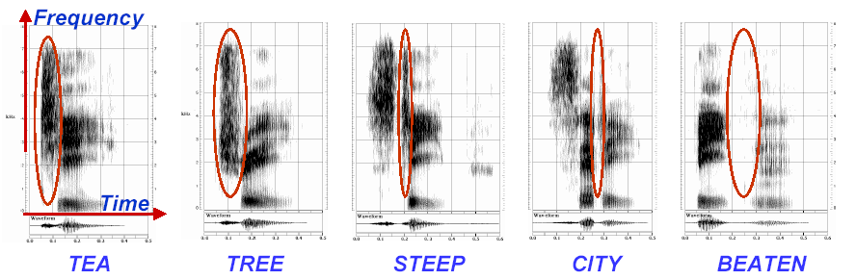
Phonological Variation Example
The acoustic realization of a phoneme depends strongly on the context in which it occurs:

Slide 22
Read vs. Spontaneous Speech
Filled and unfilled pauses:
Lengthened words:
False starts:

Slide 23
Sometimes Real Data will Dictate Technology Requirements (City Name Domain)
Technology Required Example
Simple word spotting Um, Braintree
Complex word spotting Eh yes, Avis rent-a-car in
Boston
Hello, please Brighton,
uh, can I have the number
of Earthscape, in, uh, on
Nonantum Street
Speech understanding Woburn, uh, Somerville.
I'm sorry

Slide 24
Parameters that Characterize the Capabilities of ASR Systems
Parameters | Range
Speaking Mode: | Isolated word to continuous speech
Speaking Style: | Read speech to spontaneous speech
Enrollment: | Speaker-dependent to speaker-independent
Vocabulary: | Small (<20 words) to large (>50,000 words)
Language Model: | Finite-state to context-sensitive
Perplexity: | Small (<10) to large (>200)
SNR: | High (>30dB) to low (<10dB)
Transducer: | Noise-canceling microphone to cell phone

Slide 25
ASR Trends
 | before mid 70’s | mid 70’s – mid 80’s | after mid 80’s
Recognition Units: | Whole-word & sub-word units | Sub-word units | Sub-word units
Modeling Approaches: | Heuristic and ad hoc | Template matching | Mathematical and formal
 | Rule-based and declarative | Deterministic and data-driven | Probabilistic and data-driven
Knowledge Representation: | Heterogeneous and complex | Homogeneous and simple | Homogeneous and simple
Knowledge Acquisition: | Intense knowledge engineering | Embedded in simple structure | Automatic learning

Slide 26
New Development
Incorporating “Deep Neural Network” into the “Back-End”
Amazon – Alexa http://alexa.amazon.com/
Microsoft – Cortana https://www.microsoft.com/en-us/research/blog/microsoft-researchers-achieve-new-conversational-speech-recognition-milestone/
Google – https://research.google.com/pubs/SpeechProcessing.html
Apple (Nuance) - https://support.apple.com/en-us/HT202584

Slide 27
State of the art examples

Slide 28
ASR Trends: Where Are We Now?
High performance, speaker-independent speech recognition is now possible
Large vocabulary (for cooperative speakers in benign environments)
Moderate vocabulary (for spontaneous speech over the phone)
Commercial recognition systems are now available
Dictation (e.g., Dragon, IBM, L&H, Philips) ScanSoft ➨Nuance
Telephone transactions (e.g., AT&T, Nuance, Philips, SpeechWorks, etc.) ScanSoft ➨Nuance
When well-matched to applications, technology is able to help perform real work

Slide 29
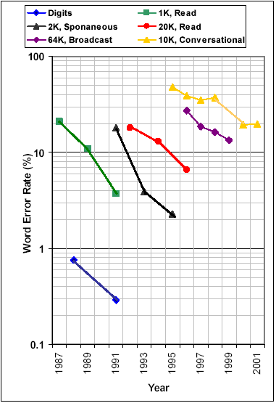
Examples of ASR Performance
Speaker-independent, continuous speech ASR now is possible
Digit recognition over the telephone with word error rate of >0.3%
Error rate cut in half every two years for moderate vocabulary tasks
Error for spontaneous speech more than twice that of read speech
Conversational speech, involving multiple speakers and poor acoustic environment, remains a challenge
Tens of hours of training data to port to a different domain
Statistical modeling using automatic training achieves significant advances

Slide 30
Knowledge in Speech & Language Processing
Techniques that process Spoken and Written human language.
Necessary use of knowledge of language.
Example: Unix wc command:
Counts bytes and number of lines that a text file contains.
Also counts number of words contained in a file.
Requires knowledge of what it means to be a word.

Slide 31
Example:
“Open Pad Bay Door – Hal” http://www.bing.com/videos/search?q=2001+a+space+odyssey+dave+bowman&form=VIRE1&first=1#view=detail&mid=99B0950DDBF6B1C3EE5599B0950DDBF6B1C3EE55

Slide 32
ASR Trends: Where Are We Now?
My Wake-Up-Word
Amazon: Alexa - Play “Fleetwood Mack” please!
Microsoft: “Historic Achievement: Microsoft researchers reach human parity in conversational speech recognition”

Slide 33
ASR Trends: Where Are We Now?
High performance, speaker-independent speech recognition is now possible
Large Vocabulary Tasks.
Language Processing Capabilities.
Computer ‘Hal’ Performance
Cloud Based Architecture is necessary

Slide 34
Knowledge in Speech & Language Processing
HAL ⇦ David:
Requires analysis of audio signal:
Generation of exact sequence of the words that David is saying.
Analysis of additional information that determines meaning of that sequence of the words.
HAL ⇨ David
Requires ability to generate an audio signal that can be recognized:
Phonetics,
Phonology,
Synthesis, and
Syntax (English)

Slide 35
Knowledge in Speech & Language Processing
Hal must have knowledge of morphology in order to capture the information about the shape and behavior of words in context:
Semantics

Slide 36
Knowledge in Speech & Language Processing
Beyond individual words:
HAL must know how to analyze the structure of Dave’s utterance.
REQUEST: HAL, open the pod bay door
STATEMENT: HAL, the pod bay door is open
QUESTION: HAL, is the pod bay door open?
HAL must use similar structural knowledge to properly string together the words that constitute its response (Syntax):
I’m I do, sorry that afraid Dave I’m can’t, vs.
I’m sorry Dave, I’m afraid I can’t do that

Slide 37
Knowledge in Speech & Language Processing
Knowing the words and Syntactic structure of what Dave said does not tell HAL much about the nature of his request (e.g., Language Processing).
Knowledge of the meanings of the component words is required (lexical semantics)
Knowledge of how these components combine to form larger meanings (compositional semantics).

Slide 38
Knowledge in Speech & Language Processing
Despite its bad behavior, HAL knows enough to be polite to Dave (pragmatics).
Direct Approach:
No
No, I won’t open the door.
Embellishment:
I’m sorry
I’m afraid
Indirect Refusal: I can’t
Direct Refusal: I won’t.

Slide 39
Knowledge in Speech & Language Processing
Instead simply ignoring Dave’s request, HAL chooses to engage in a structured conversation relevant to Dave’s initial request.
HAL’s correct use of the words “that” in its answer to Dave’s request is a simple illustration of the kind of between-utterance device common in such conversations.
Correctly structuring such conversations requires knowledge of discourse conventions (e.g., human behavior).

Slide 40
Knowledge in Speech & Language Processing
In the following question:
How many states were in the United States that year?
One needs to know what “that year” refers too.
Coreference Resolution

Slide 41
Summary
Phonetics and Phonology:
The study of linguistic sounds
Morphology:
The study of the meaningful components of words.
Syntax:
The study of the structural relationships between words.
Semantics:
The study of meaning
Pragmatics:
The study of how language is used to accomplish goals.
Discourse:
The study of linguistic units larger then a single utterance.

Slide 42
Lessons Learned

Slide 43
Important Lessons Learned
Statistical modeling and data-driven approaches have proved to be powerful
Research infrastructure is crucial:
Large amounts of linguistic/acoustic data
Evaluation methodologies
Availability and affordability of computing power lead to shorter technology development cycles and real-time systems
Performance-driven paradigm accelerates technology development
Interdisciplinary collaboration produces enhanced capabilities (e.g., spoken language understanding)

Slide 44
Major Components in a Speech Recognition System
Training Data
Applying Constrains
Acoustic Models
Lexical Models
Language Models
Representation
Search
Speech Signal
Recognized Words
Speech recognition is the problem of deciding on
How to represent the signal
How to model the constraints
How to search for the most optimal answer

Slide 45
Conversational Interfaces: The Next Generation
Enables us to converse with machines (in much the same way we communicate with one another) in order to create, access, and manage information and to solve problems
Augments speech recognition technology with natural language technology in order to understand the verbal input
Can engage in a dialogue with a user during the interaction
Uses natural language to speak the desired response
Is what Hollywood and every “futurist” says we should have!

Slide 46
Example of a Automatic Speech Recognition system

Slide 47
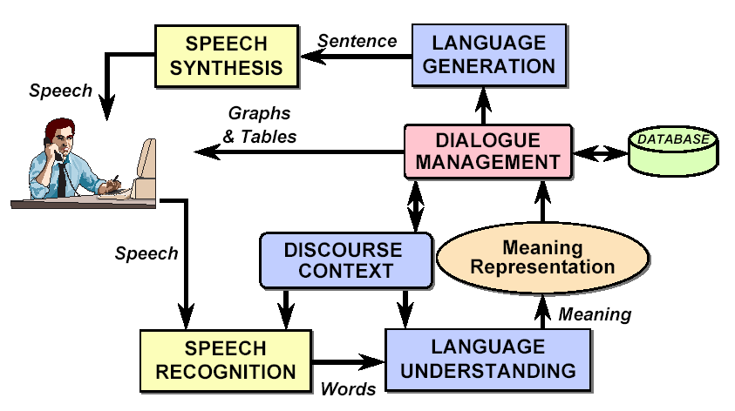
A Conversational System Architecture

Slide 48
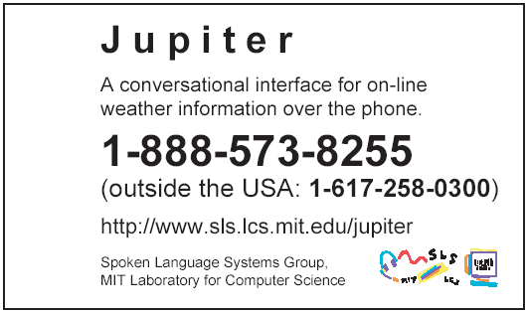
Demo: Conversational Interface
Jupiter weather information system
Access through telephone
500 cities worldwide
Harvest weather information from the Web several times daily

Slide 49
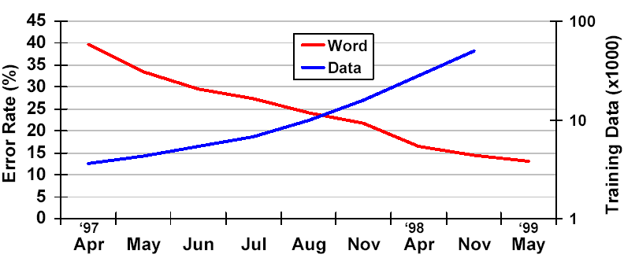
(Real) Data Improves Performance (Weather Domain)
Longitudinal evaluations show improvements
Collecting real data improves performance:
Enables increased complexity and improved robustness for acoustic and language models
Better match than laboratory recording conditions
Users come in all kinds

Slide 50
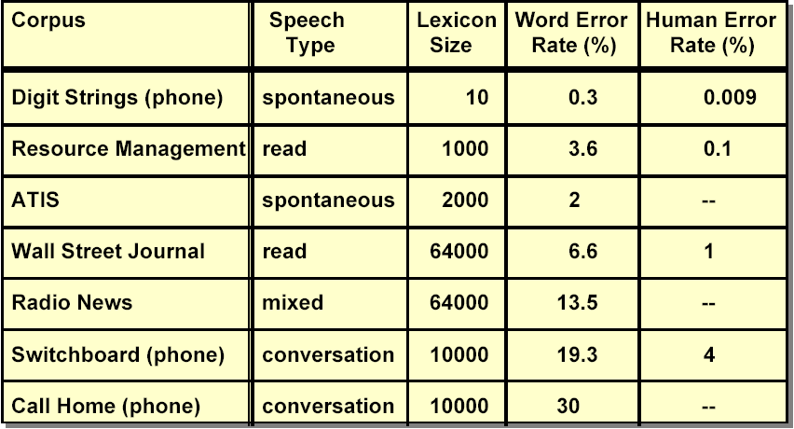
But We Are Far from Done (2010)!

Slide 51
Course outline

Slide 52
Course Outline
Paralinguistic Information Speech Understanding Multi-Modal Interfaces
Acoustic Phonetic Modeling
Pattern Recognition
Finite State Transducers
Language Modelling
Robust ASR
Acoustic Models
Lexical Models
Language Models
Acoustic Theory of Speech Production
Adaptation
Speech Signal
Representation
Search
Recognized Words
Properties of Speech Sounds
Signal Representation
Vector Quantization & Clustering
Hidden Markov Modeling
Graphical Models
Segmental Models
Neural Networks
Deep Learning

Slide 53
Course Logistics
Lectures:
Two sessions/week, 1.5 hours/session
Grading (Tentative)
Assignments 50%
Final Project (about 4 weeks) 50%

Slide 54
Assignments
There will be several assignments
Problems that expand on the lecture material
Assignments are due the following week on Monday

Slide 55
Software
Sphinx
Wake-up-word

Slide 56
Sphinx
http://cmusphinx.sourceforge.net/html/cmusphinx.php
Download Sphinx-3 from http://cmusphinx.sourceforge.net/html/compare.php#software that requires:
CMUSphinx Components
Common library: SphinxBase (download)
Decoders:
PocketSphinx (doc) (download)
Sphinx-2 (doc) (download) – Fastest version
Sphinx-3 (doc) (download) – Most accurate version
Sphinx-4 (doc) (download) – Version written in java
Acoustic Model Training: SphinxTrain (download)
Language Model Training:
cmuclmtk (doc) (download)
SimpleLM (download)
Utilities
cepview (download)
lm3g2dmp (download)

Slide 57
Sphinx
Tutorial Documentation:
http://www.speech.cs.cmu.edu/sphinx/tutorial.html
Wiki Pages and other useful links and information:
http://www.speech.cs.cmu.edu/cmusphinx/moinmoin/
Information about resources needed for training models:
http://cmusphinx.sourceforge.net/html/system.php

Slide 58
Software and Data
Training Audio Data:
http://www.repository.voxforge1.org/downloads/SpeechCorpus/
http://my.fit.edu/~vkepuska/share/Corpora/
Open Source Models and other sources:
http://www.speech.cs.cmu.edu/sphinx/models/

Slide 59
Wake-Up-Word
http://www.intechopen.com/books/speech-technologies/wake-up-word-speech-recognition

Slide 60
END

