Slide 1
Speech Recognition
Acoustic Theory of Speech Production

Slide 2
Acoustic Theory of Speech Production
Overview
Sound sources
Vocal tract transfer function
  Wave equations
  Sound propagation in a uniform acoustic tube
Representing the vocal tract with simple acoustic tubes
Estimating natural frequencies from area functions
Representing the vocal tract with multiple uniform tubes
Veton Këpuska

Slide 3
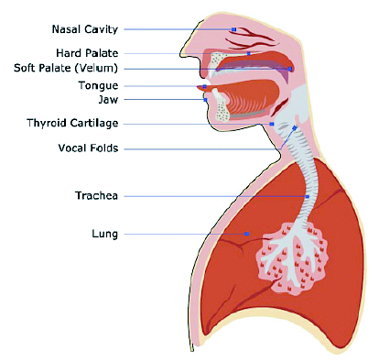
Anatomical Structures for Speech Production
Veton Këpuska

Slide 4
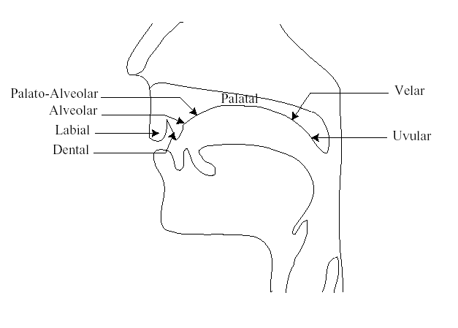
Places of Articulation for Speech Sounds
Veton Këpuska

Slide 5
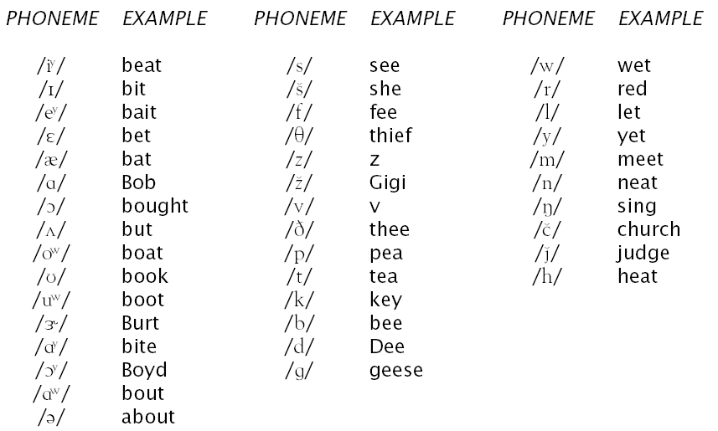
Phonemes in American English
Veton Këpuska

Slide 6
SPHINX Phone Set
 | Phoneme | Example | Translation
1 | AA | odd | AA D
2 | AE | at | AE T
3 | AH | hut | HH AH T
4 | AO | ought | AO T
5 | AW | cow | K AW
6 | AY | hide | HH AY D
7 | B | be | B IY
8 | CH | dee | D IY
9 | DH | thee | DH IY
10 | EH | Ed | EH D
11 | ER | hurt | HH ER T
12 | EY | ate | EY T
13 | F | fee | F IY
14 | G | green | G R IY N
15 | HH | he | HH IY
16 | IH | it | IH T
17 | IY | eat | IY T
18 | JH | gee | JH IY
 | Phoneme | Example | Translation
19 | K | key | K IY
20 | L | lee | L IY
21 | M | me | M IY
22 | N | knee | N IY
23 | NG | ping | P IH NG
24 | OW | oat | OW T
25 | OY | toy | T OY
26 | P | pee | P IY
27 | R | read | R IY D
28 | S | sea | S IY
29 | SH | she | SH IY
30 | T | tea | T IY
31 | TH | theta | TH EY T AH
32 | UH | two | T UW
33 | V | vee | V IY
34 | Y | yield | Y IY L D
35 | Z | zee | Z IY
36 | ZH | seizure | S IY ZH ER
Veton Këpuska

Slide 7
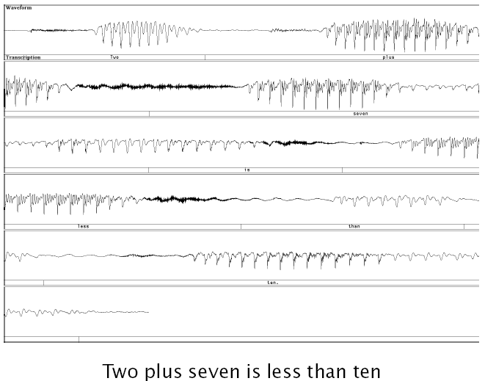
Speech Waveform: An Example
Veton Këpuska

Slide 8
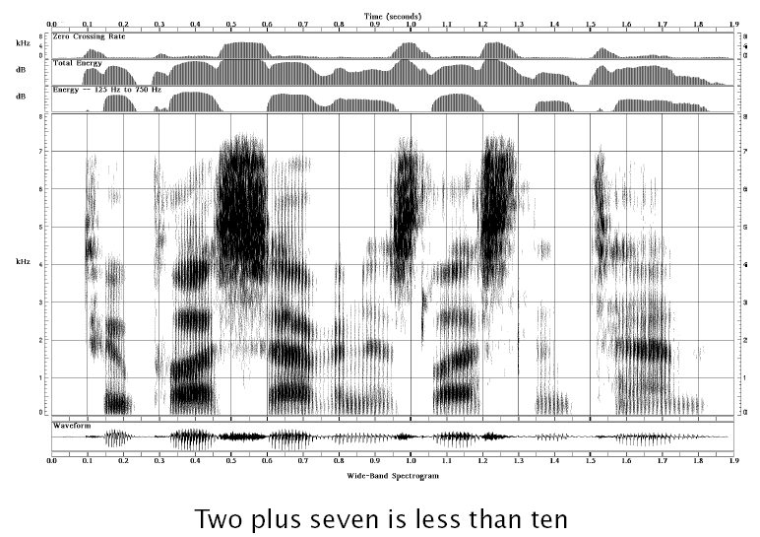
A Wideband Spectrogram
Veton Këpuska

Slide 9
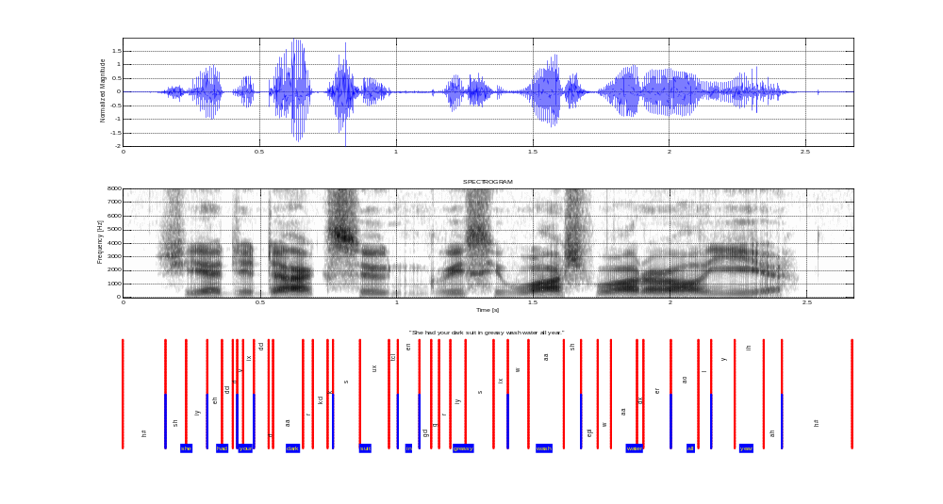
A Wideband Spectrogram
Veton Këpuska

Slide 10
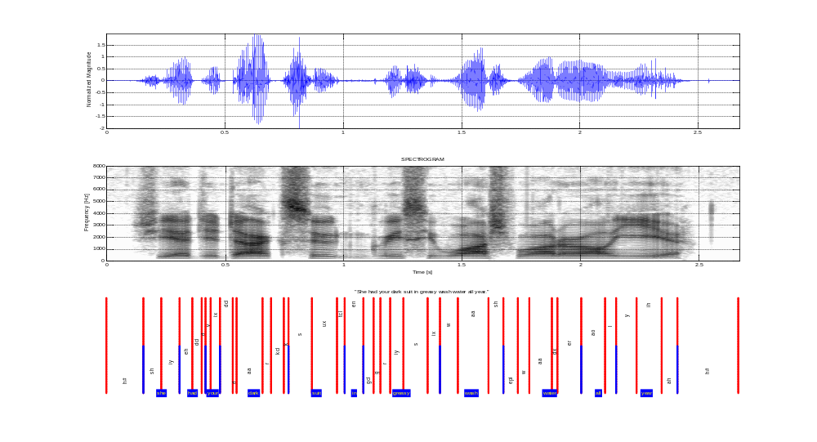
A Narrowband Spectrogram
Veton Këpuska

Slide 11
Physics of Sound
Sound Generation:
  Vibration of particles in a medium (e.g., air, water).
Speech Production:
  Perturbation of air particles near the lips.
Speech Communication:
  Propagation of particle vibrations/perturbations as chain reaction through free space (e.g., a medium like air) from the source (i.e., lips of a speaker) to the destination (i.e., ear of a listener).
  Listener’s ear ear-drum caused vibrations trigger series of transductions initiated by this mechanical motion leading to neural firing ultimately perceived by the brain.
Veton Këpuska

Slide 12
Physics of Sound
A sound wave is the propagation of a disturbance of particles through an air medium (or more generally any conducting medium) without the permanent displacement of the particles themselves.
Alternating compression and rarefaction phases create a traveling wave.
Associated with disturbance are local changes in particle:
  Pressure
  Displacement
  Velocity
Veton Këpuska

Slide 13
Physics of Sound
Sound wave:
  Wavelength, λ: distance between two consecutive peak compressions (or rarefactions) in space (not in time).
    Wavelength, λ,is also the distance the wave travels in one cycle of the vibration of air particles.
  Frequency, f: is the number of cycles of compression (or rarefaction) of air particle vibration per second.
    Wave travels a distance of f wavelengths in one second.
  Velocity of sound, c: is thus given by c = fλ.
    At sea level and temperature of 70ºF, c=344 m/s.
  Wavenumber, k:
    Radian frequency: Ω=2πf
    Ω/c=2π/λ=k
Veton Këpuska

Slide 14
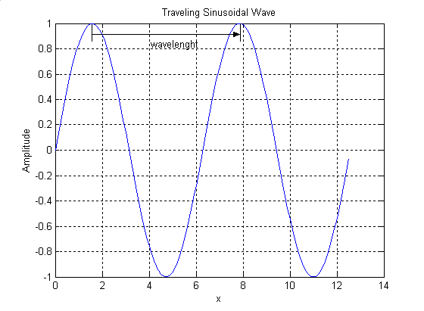
Traveling Wave
λ
Veton Këpuska

Slide 15
Physics of Sound
Suppose the frequency of a sound wave is f = 50 Hz, 1000 Hz, and 10000 Hz. Also assume that the velocity of sound at sea level is c = 344 m/s.
The wavelength of sound wave is respectively: λ= 6.88 m, 0.344 m and 0.0344 m.
Speech sounds have wide range of wavelengths values:
Audio range:
  f_{min} = 30 Hz ⇒ λ=11.5 m
  f_{max} = 20 kHz ⇒ λ=0.0172 m
In audible range a propagation of sound wave is considered to be an adiabatic process, that is,
  heat generated by particle collision during pressure fluctuations, has not time to dissipate away and therefore temperature changes occur locally in the medium.
Veton Këpuska

Slide 16
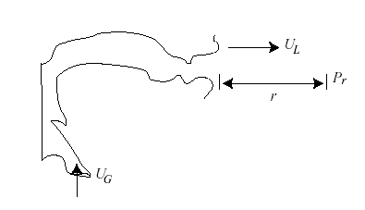
Acoustic Theory of Speech Production
The acoustic characteristics of speech are usually modeled as a sequence of source, vocal tract filter, and radiation characteristics
    P_{r} (jΩ) = S(jΩ) T (jΩ) R(jΩ)
For vowel production:
        S(jΩ) = U_{G}(jΩ)
        T (jΩ) = U_{L}(jΩ) /U_{G}(jΩ)
        R(jΩ) = P_{r} (jΩ) /U_{L}(jΩ)
Veton Këpuska

Slide 17
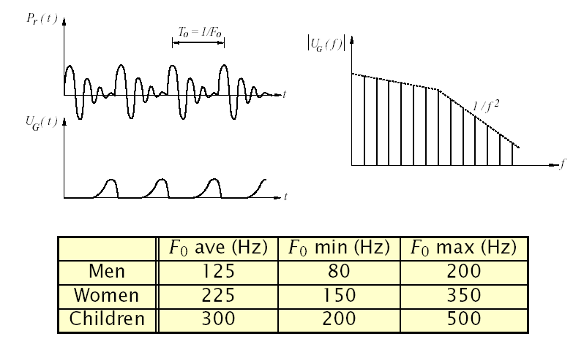
Sound Source:
Vocal Fold Vibration
Modeled as a volume velocity source at glottis, U_{G}(jΩ)
Veton Këpuska

Slide 18
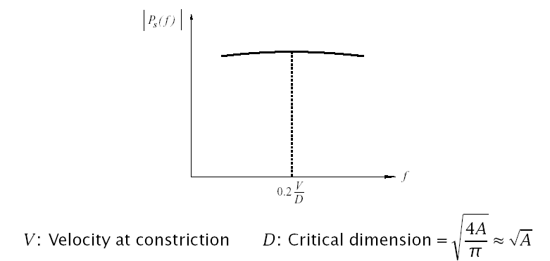
Sound Source:
Turbulence Noise
Turbulence noise is produced at a constriction in the vocal tract
  Aspiration noise is produced at glottis
  Frication noise is produced above the glottis
Modeled as series pressure source at constriction, P_{S}(jΩ)
Veton Këpuska

Slide 19
Vocal Tract Wave Equations
Define:
    u(x,t) ⇒ particle velocity
    U(x,t) ⇒ volume velocity (U = uA)
    p(x,t) ⇒ sound pressure variation (P = P_{O} + p)
    ρ ⇒ density of air
    c ⇒ velocity of sound
Assuming plane wave propagation (for across dimension ≪ λ), and a one-dimensional wave motion, it can be shown that:
Veton Këpuska

Slide 20
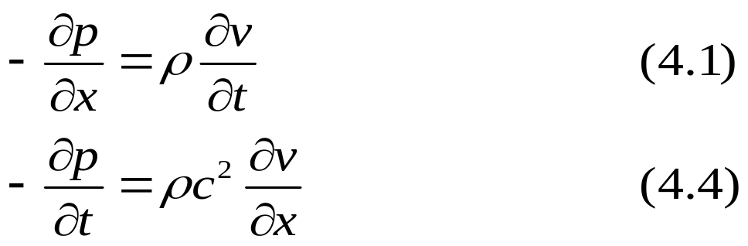
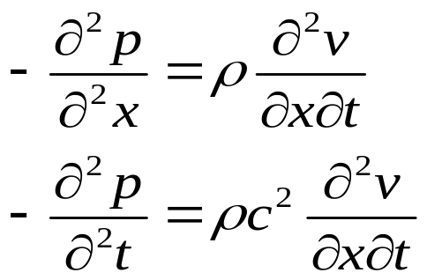
The Plane Wave Equation
First form of Wave Equation:
Second form is obtained by differentiating equations above with respect to x and t respectively:
Veton Këpuska

Slide 21
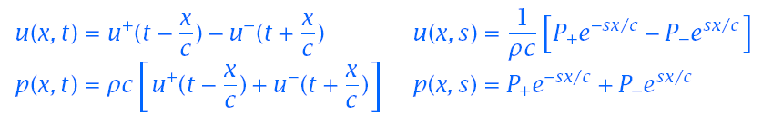
Solution of Wave Equations
Veton Këpuska

Slide 22
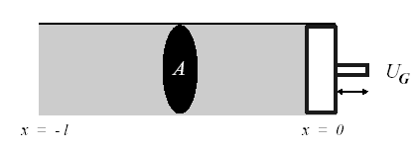
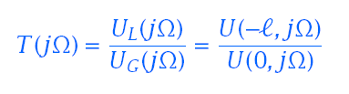
Propagation of Sound in a Uniform Tube
The vocal tract transfer function of volume velocities is
Veton Këpuska

Slide 23
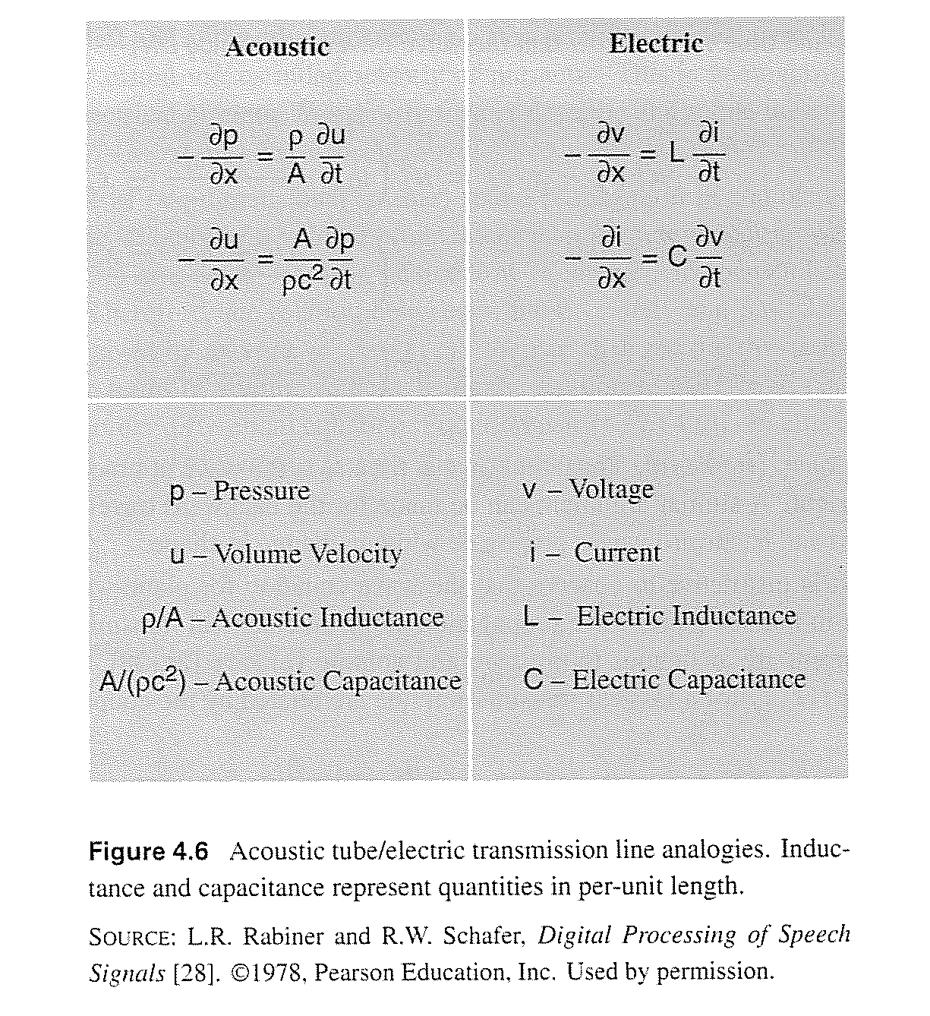
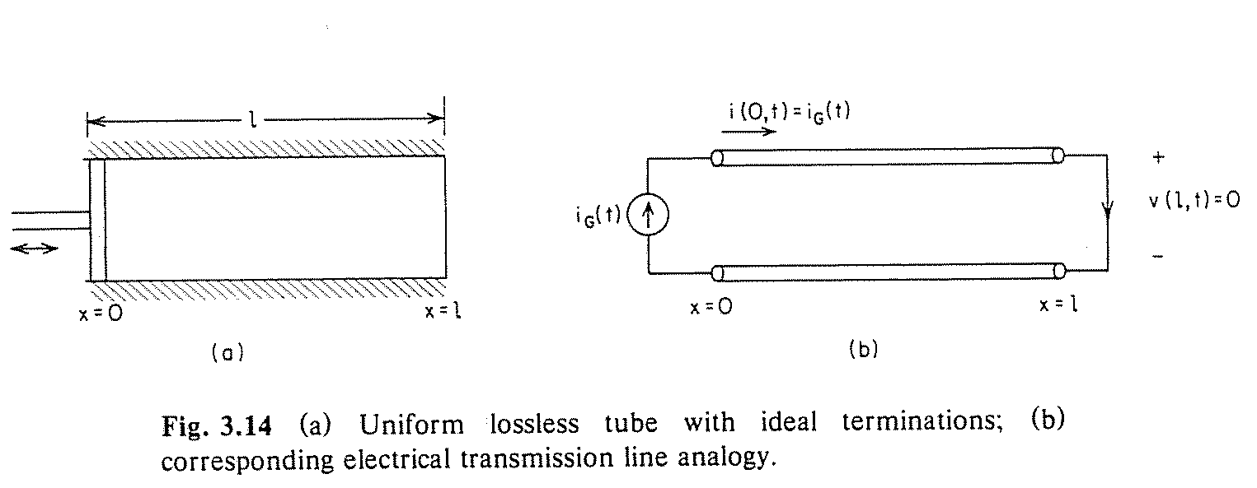
Analogy with Electrical Circuit Transmission Line
Veton Këpuska

Slide 24

Propagation of Sound in a Uniform Tube
Using the boundary conditions U (0,s)=U_{G}(s) and
P(-l,s)=0
The poles of the transfer function T (jΩ) are where cos(Ωl/c)=0
Veton Këpuska

Slide 25
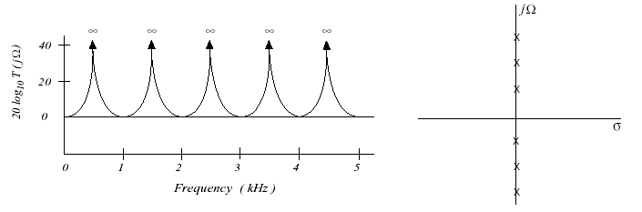
Propagation of Sound in a Uniform Tube (con’t)
For c =34,000 cm/sec, l =17 cm, the natural frequencies (also called the formants) are at 500 Hz, 1500 Hz, 2500 Hz, …
The transfer function of a tube with no side branches, excited at one end and response measured at another, only has poles
The formant frequencies will have finite bandwidth when vocal tract losses are considered (e.g., radiation, walls, viscosity, heat)
The length of the vocal tract, l, corresponds to 1/4λ₁, 3/4λ₂, 5/4λ₃, …, where λ_{i} is the wavelength of the ith natural frequency
Veton Këpuska

Slide 26

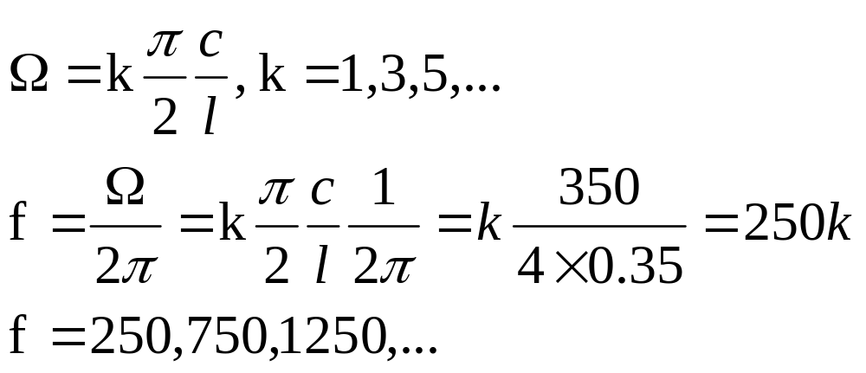
Uniform Tube Model
Example
  Consider a uniform tube of length l=35 cm. If speed of sound is 350 m/s calculate its resonances in Hz. Compare its resonances with a tube of length l = 17.5 cm.
  f=Ω/2π ⇒
Veton Këpuska

Slide 27
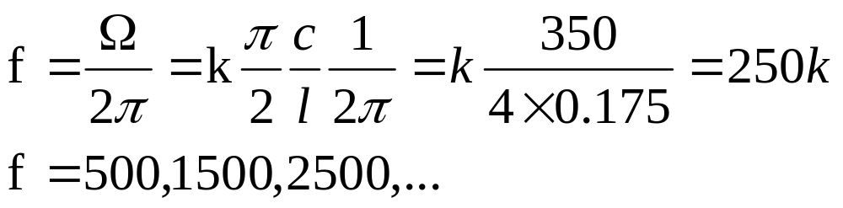
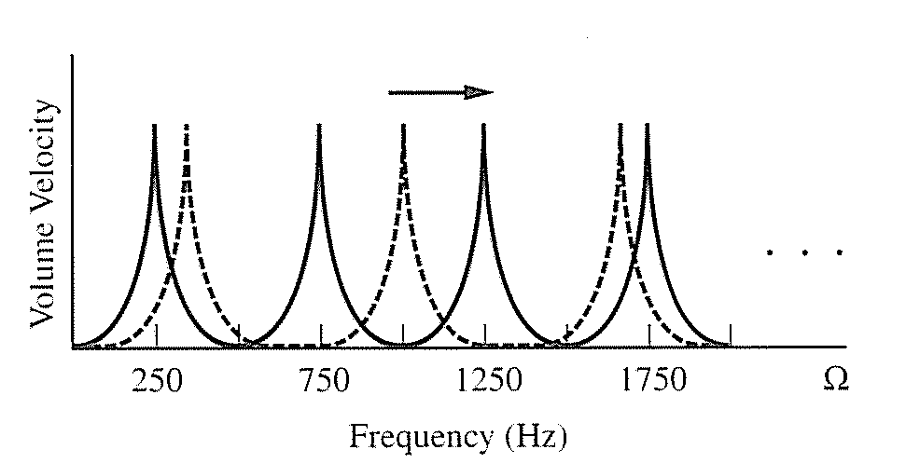
Uniform Tube Model
For 17.5 cm tube:
Veton Këpuska

Slide 28
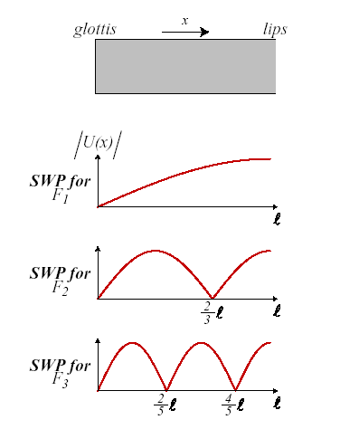
Standing Wave Patterns in a Uniform Tube
A uniform tube closed at one end and open at the other is often referred to as a quarter wavelength resonator
Veton Këpuska

Slide 29
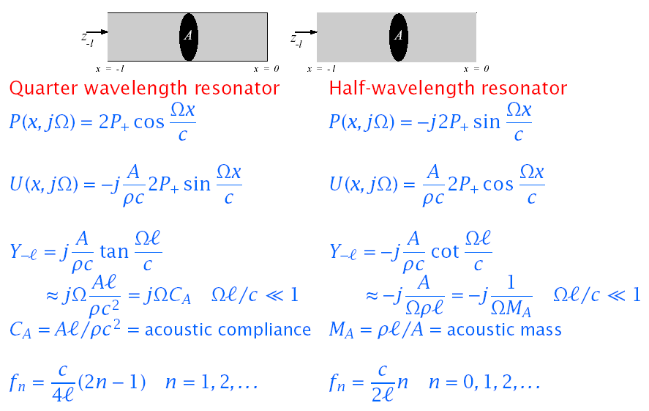
Natural Frequencies of Simple Acoustic Tubes
Veton Këpuska

Slide 30
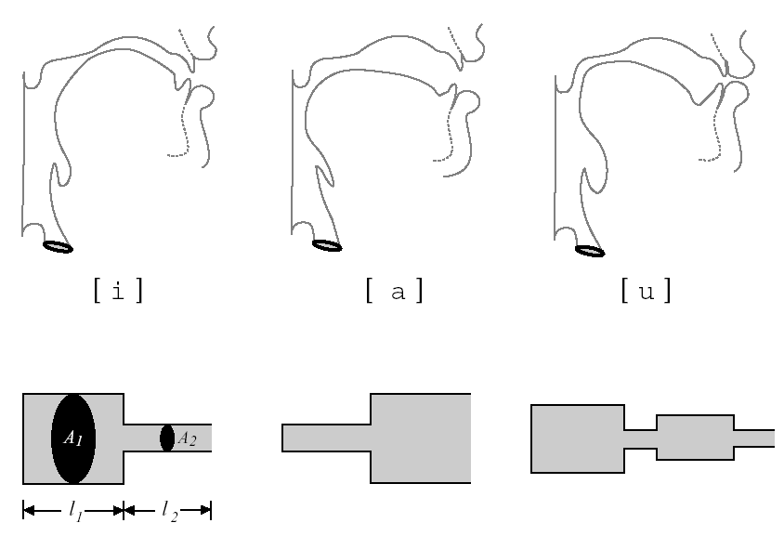
Approximating Vocal Tract Shapes
Veton Këpuska

Slide 31
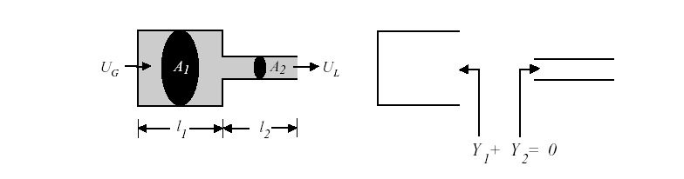
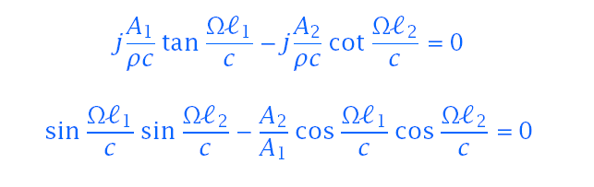
2 1 2l
Estimating Natural Resonance Frequencies
Resonance frequencies occur where impendence (or admittance) function equals natural (e.g., open circuit) boundary conditions
For a two tube approximation it is easiest to solve for Y₁ + Y₂ = 0.
Veton Këpuska

Slide 32
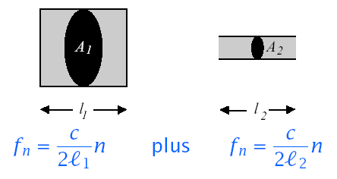

Decoupling Simple Tube Approximations
If A1≫A2,or A1≪A2, the tubes can be decoupled and natural frequencies of each tube can be computed independently
For the vowel /i^{y}/, the formant frequencies are obtained from:
At low frequencies:
This low resonance frequency is called the Helmholtz resonance.
Veton Këpuska

Slide 33
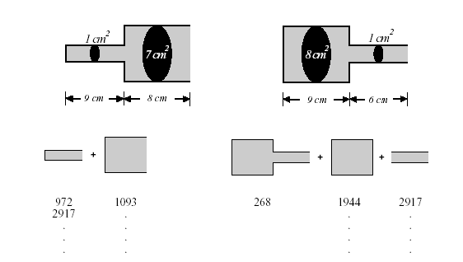
Vowel Production Example
Formant | Actual | Estimated | Formant | Actual | Estimated
F1 | 789 | 972 | F1 | 256 | 268
F2 | 1276 | 1093 | F2 | 1905 | 1944
F3 | 2808 | 2917 | F3 | 2917 | 2917
… | … | … | … | … | …
Veton Këpuska

Slide 34
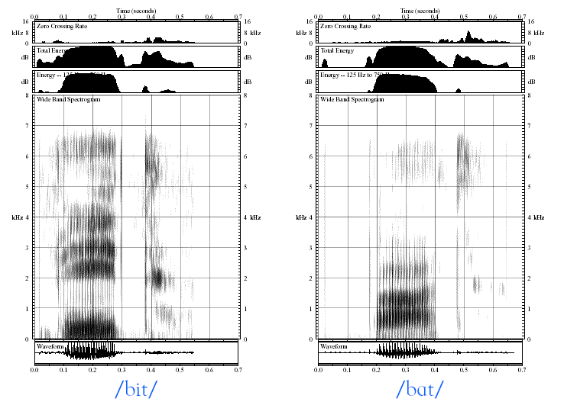
Example of Vowel Spectrograms
Veton Këpuska

Slide 35
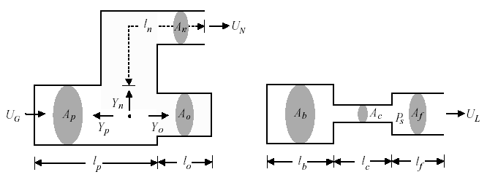
Estimating Anti-Resonance Frequencies (Zeros)
Zeros occur at frequencies where there is no measurable output
For nasal consonants, zeros in U_{N} occur where Y_{o} = ∞
For fricatives or stop consonants, zeros in U_{L} occur where the impedance behind source is infinite (i.e., a hard wall at source)
Veton Këpuska

Slide 36
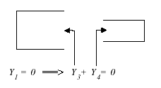
Estimating Anti-Resonance Frequencies (Zeros)
Zeros occur when measurements are made in vocal tract interior:
Veton Këpuska

Slide 37
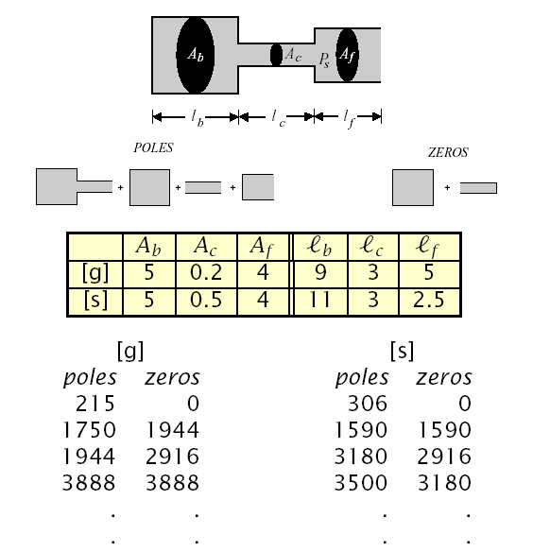
Consonant Production
Veton Këpuska

Slide 38
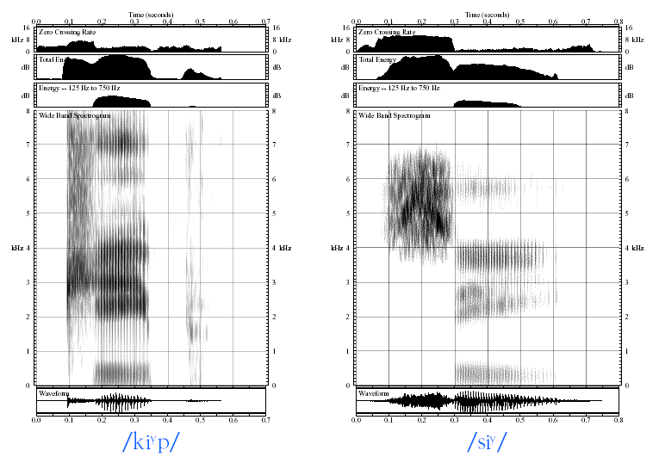
Example of Consonant Spectrograms
Veton Këpuska

Slide 39


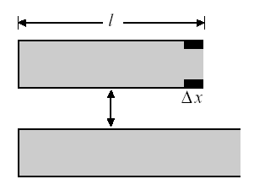
Perturbation Theory
Consider a uniform tube, closed at one end and open at the other.
Reducing the area of a small piece of the tube near the opening (where U is max) has the same effect as keeping the area fixed and lengthening the tube.
Since lengthening the tube lowers the resonant frequencies, narrowing the tube near points where U (x) is maximum in the standing wave pattern for a given formant decreases the value of that formant.
Veton Këpuska

Slide 40
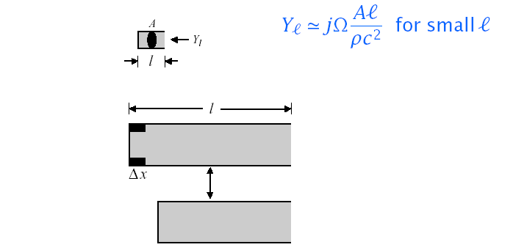
Perturbation Theory (Con’t)
Reducing the area of a small piece of the tube near the closure (where p is max) has the same effect as keeping the area fixed and shortening the tube
Since shortening the tube will increase the values of the formants, narrowing the tube near points where p(x) is maximum in the standing wave pattern for a given formant will increase the value of that formant
Veton Këpuska

Slide 41
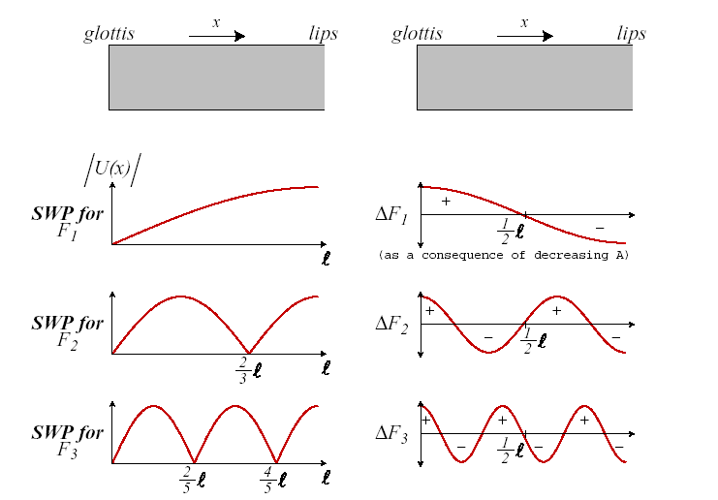
Summary of Perturbation Theory Results
Veton Këpuska

Slide 42
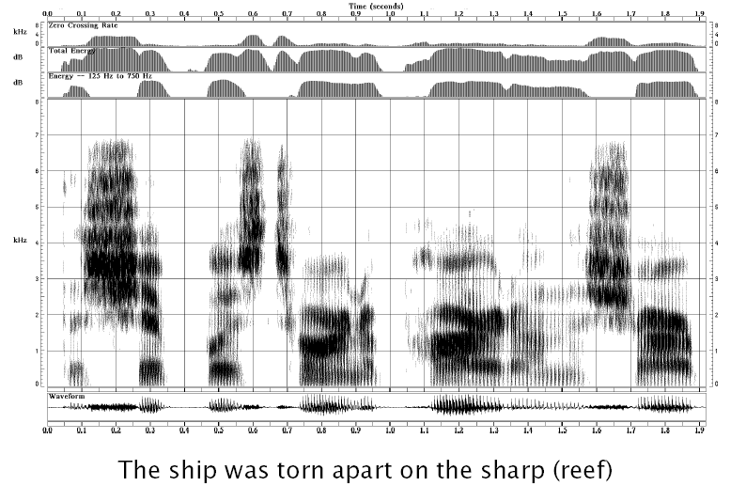
Illustration of Perturbation Theory
Veton Këpuska

Slide 43
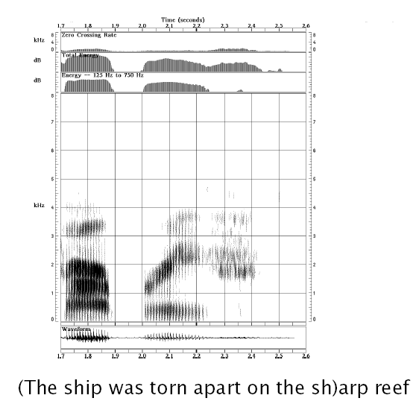
Illustration of Perturbation Theory
Veton Këpuska

Slide 44
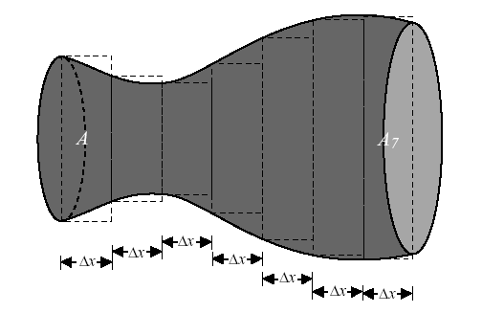
Multi-Tube Approximation of the Vocal Tract
We can represent the vocal tract as a concatenation of N lossless tubes with constant area {Ak}.and equal length Δx = l/N
The wave propagation time through each tube is τ =Δx/c = l/Nc
Veton Këpuska

Slide 45
A Discrete-Time Model Based on Tube Concatenation
Frequency response of vocal tract, V_{a}(Ω)=U(l,Ω)/U_{g}(Ω), is easy to obtain due to linearity of the model.
  Radiation impedance can be modified to match observed formant bandwidths.
  Concatenated tube model leads to resulting all-pole model which in turn leads to linear prediction speech analysis.
  Draw back of this technique is that although frequency response predicted from concatenated tube model can be made to approximately match spectral measurements, the concatenated tube model is less accurate in representing the physics of sound propagation than the coupled partial differential equation models.
    The contributions of energy loss from:
      Vibrating walls
      Viscosity,
      Thermal conduction, as well as
      Nonlinear coupling between the glottal and vocal tract airflow,
      Are not represented in the lossless concatenated tube model.
Veton Këpuska

Slide 46
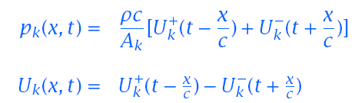
Sound Propagation in the Concatenated Tube Model
Consider an N-tube model of the previous figure. Each tube has length l_{k} and cross sectional area of A_{k}.
Assume:
  No losses
  Planar wave propagation
The wave equations for section k: 0≤x≤l_{k} are of the form:
  where x is measured from the left-hand side (0 ≤x ≤Δx)
Veton Këpuska

Slide 47
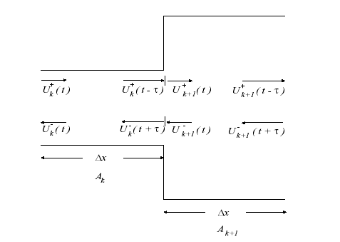
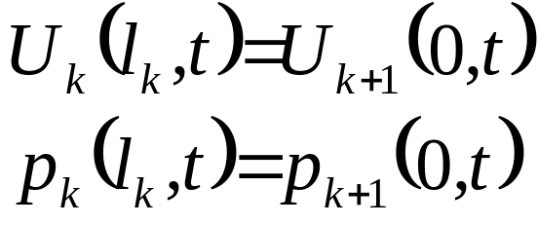
Sound Propagation in the Concatenated Tube Model
Boundary conditions:
Physical principle of continuity:
  Pressure and volume velocity must be continuous both in time and in space everywhere in the system:
At k’th/(k+1)’st junction we have:
Veton Këpuska

Slide 48
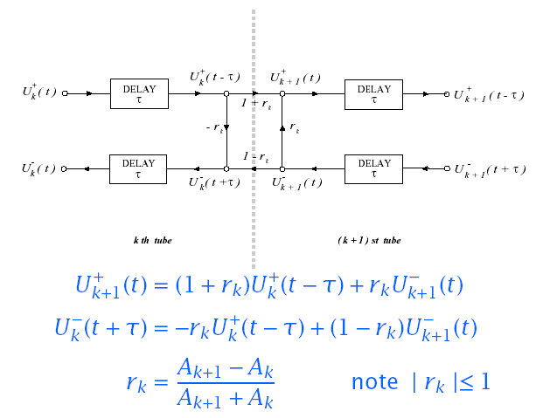
Update Expression at Tube Boundaries
We can solve update expressions using continuity constraints at tube boundaries e.g., p_{k}(Δx,t)= p_{k+1}(0,t),and U_{k}(Δx,t)= U_{k+1}(0,t)
Veton Këpuska

Slide 49
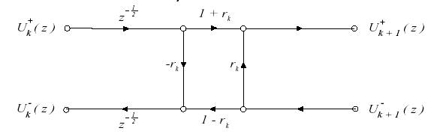

Digital Model of Multi-Tube Vocal Tract
Updates at tube boundaries occur synchronously every 2τ
If excitation is band-limited, inputs can be sampled every T =2τ
Each tube section has a delay of z^{-1/2}.
The choice of N depends on the sampling rate T
Veton Këpuska

Slide 50
Acoustic Theory of Speech Production
References
  Stevens, Acoustic Phonetics, MIT Press, 1998.
  Rabiner & Schafer, Digital Processing of Speech Signals, Prentice-Hall, 1978.
  Quatieri, Discrete-time Speech Signal Processing Principles and Practice, Prentice-Hall, 2002
Veton Këpuska

