Slide 1
Speech Recognition
Speech Sounds of American English
Notes:
Digital Systems: Hardware Organization and Design
Architecture of a Respresentative 32 Bit Processor

Slide 2
Speech Sounds of American English
There are over 40 speech sounds in American English which can be organized by their basic manner of production
Vowels, glides, and consonants differ in degree of constriction
Sonorant consonants have no pressure build up at constriction
Nasal consonants have no pressure build up at constriction
Continuant consonant do not block airflow in oral cavity
Manner Class | Number
Vowel | 18
Fricatives | 8
Stops | 6
Nasals | 3
Semivowels | 4
Affricates | 2
Aspirant | 1
Veton Këpuska
Notes:
Digital Systems: Hardware Organization and Design
Architecture of a Respresentative 32 Bit Processor

Slide 3
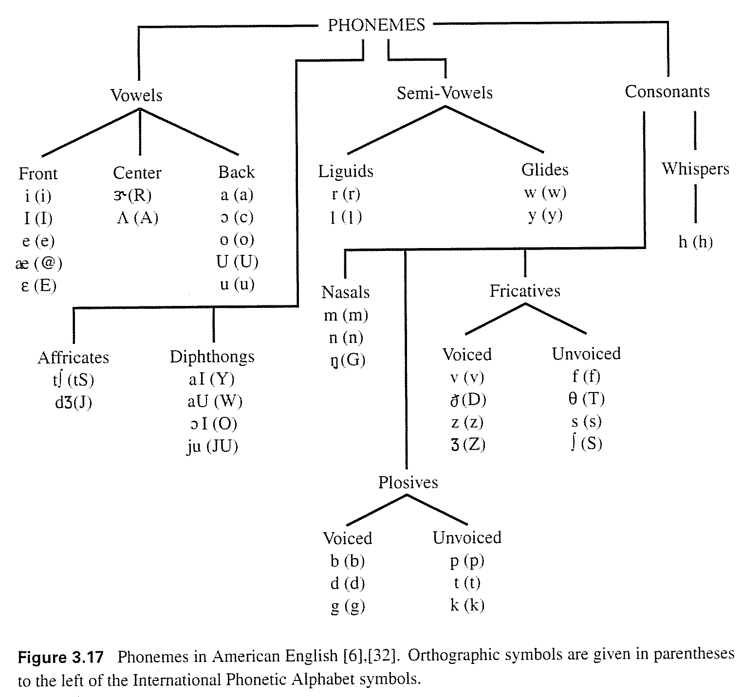
Phonemes of American English
Veton Këpuska
Notes:
Digital Systems: Hardware Organization and Design
Architecture of a Respresentative 32 Bit Processor

Slide 4
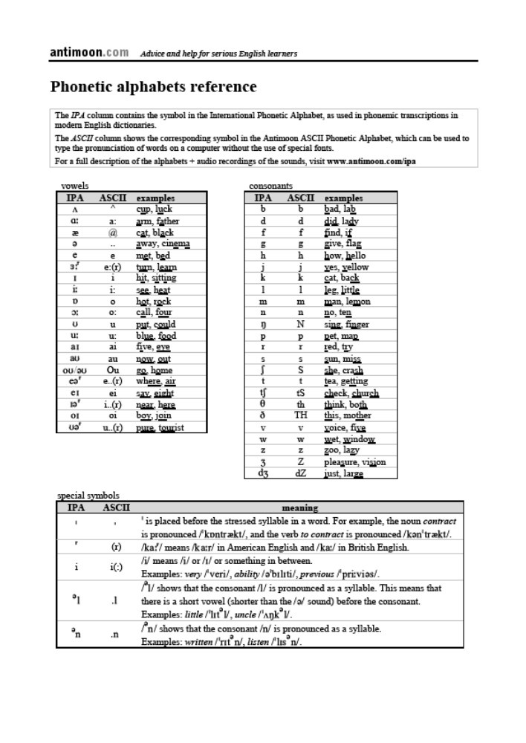
Phonetic Alphabets Reference
Veton Këpuska

Slide 5
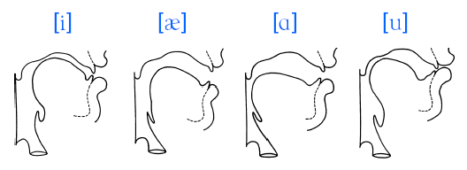
Vowel Production
No significant constriction in the vocal tract
Usually produced with periodic excitation
Acoustic characteristics depend on the position of the jaw, tongue, and lips
Veton Këpuska
Notes:
Digital Systems: Hardware Organization and Design
Architecture of a Respresentative 32 Bit Processor

Slide 6
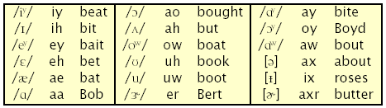
Vowels of American English
There are approximately 18 vowels in American English made up of monothongs, diphthongs, and reduced vowels (schwa’s)
They are often described by the articulatory features: High/Low, Front/Back, Retroflexed, Rounded, and Tense/Lax
Veton Këpuska
Notes:
Digital Systems: Hardware Organization and Design
Architecture of a Respresentative 32 Bit Processor

Slide 7
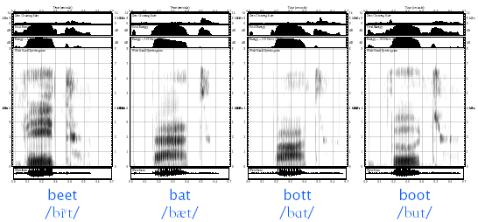
Spectrograms of the Cardinal Vowels
Veton Këpuska
Notes:
Digital Systems: Hardware Organization and Design
Architecture of a Respresentative 32 Bit Processor

Slide 8
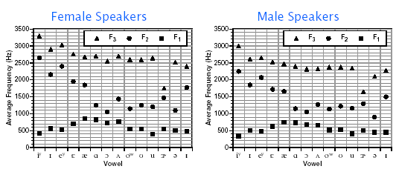
Vowel Formant Averages
Vowels are often characterized by the lower three formants:
  High/Low is correlated with the first formant, F1
  Front/Back is correlated with the second formant, F2
  Retroflexion is marked by a low third formant, F3
Veton Këpuska
Notes:
Digital Systems: Hardware Organization and Design
Architecture of a Respresentative 32 Bit Processor

Slide 9
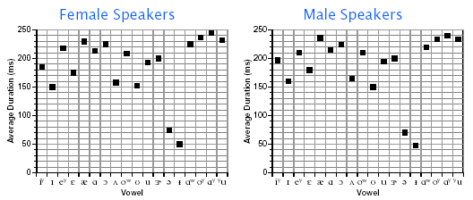
Vowel Durations
Each vowel has a different intrinsic duration
Schwa’s have distinctly shorter durations (50ms)
/I, ℇ, Λ, Ʊ/ are the shortest monothongs
Context can greatly influence vowel duration
Veton Këpuska
Notes:
Digital Systems: Hardware Organization and Design
Architecture of a Respresentative 32 Bit Processor

Slide 10
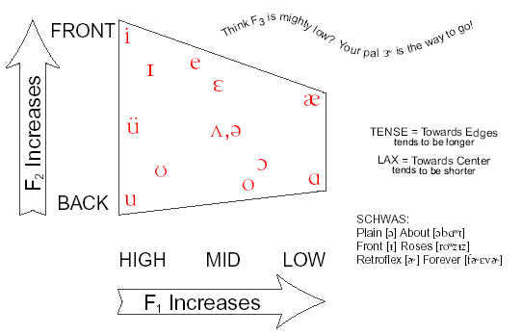

Happy Little Vowel Chart
Robb's
"So inaccurate, yet so useful."
Veton Këpuska
Notes:
Digital Systems: Hardware Organization and Design
Architecture of a Respresentative 32 Bit Processor

Slide 11
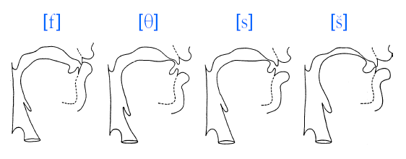
Fricative Production
Turbulence produced at narrow constriction
Constriction position determines acoustic characteristics
Can be produced with periodic excitation
Veton Këpuska
Notes:
Digital Systems: Hardware Organization and Design
Architecture of a Respresentative 32 Bit Processor

Slide 12
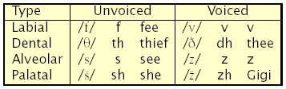
Fricatives of American English
There are 8 fricatives in American English
  Four places of articulation: Labio-Dental (Labial), Interdental (Dental), Alveolar, and Palato-Alveolar (Palatal)
  They are often described by the features Voiced/Unvoiced, or Strident/Non-Strident (constriction behind alveolar ridge)
Veton Këpuska
Notes:
Digital Systems: Hardware Organization and Design
Architecture of a Respresentative 32 Bit Processor

Slide 13
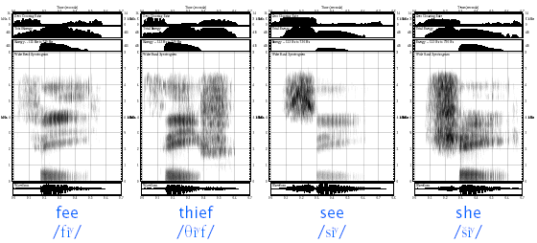
Spectrograms of Unvoiced Fricatives
Veton Këpuska
Notes:
Digital Systems: Hardware Organization and Design
Architecture of a Respresentative 32 Bit Processor

Slide 14
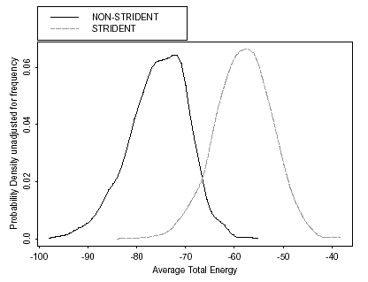
Fricative Energy
Strident fricatives tend to be stronger than non-strident fricatives.
Veton Këpuska
Notes:
Digital Systems: Hardware Organization and Design
Architecture of a Respresentative 32 Bit Processor

Slide 15
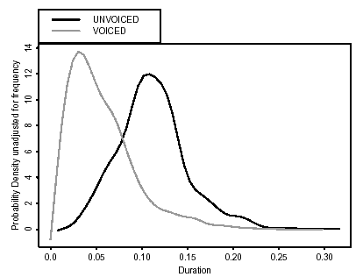
Fricative Durations
Voiced fricatives tend to be shorter than unvoiced fricatives.
Veton Këpuska
Notes:
Digital Systems: Hardware Organization and Design
Architecture of a Respresentative 32 Bit Processor

Slide 16
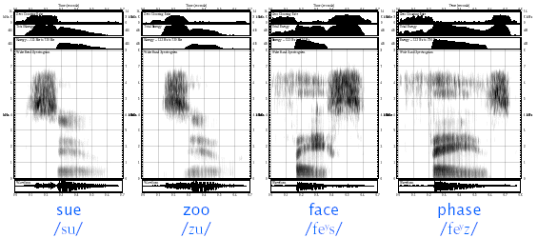
Examples of Fricative Voicing Contrast
Veton Këpuska
Notes:
Digital Systems: Hardware Organization and Design
Architecture of a Respresentative 32 Bit Processor

Slide 17
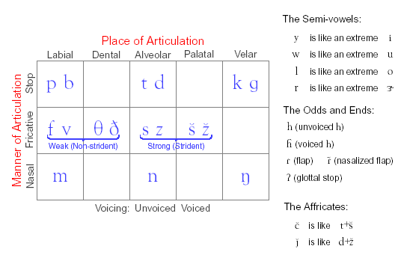
Friendly Little Consonant Chart
Robb's
"Somewhat more accurate, yet somewhat less useful."
Veton Këpuska
Notes:
Digital Systems: Hardware Organization and Design
Architecture of a Respresentative 32 Bit Processor

Slide 18
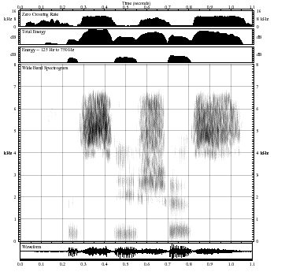
What is this word?
Veton Këpuska
Notes:
Digital Systems: Hardware Organization and Design
Architecture of a Respresentative 32 Bit Processor

Slide 19
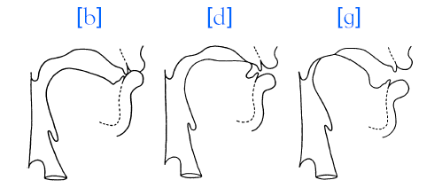
Stop Production
Complete closure in the vocal tract, pressure build up
Sudden release of the constriction, turbulence noise
Can have periodic excitation during closure
Veton Këpuska
Notes:
Digital Systems: Hardware Organization and Design
Architecture of a Respresentative 32 Bit Processor

Slide 20

Stops of American English
There are 6 stop consonants in American English
Three places of articulation: Labial, Alveolar, and Velar
Each place of articulation has a voiced and unvoiced stop
Unvoiced stops are typically aspirated
Voiced stops usually exhibit a “voice-bar’’ during closure
Information about formant transitions and release useful for classification
Veton Këpuska
Notes:
Digital Systems: Hardware Organization and Design
Architecture of a Respresentative 32 Bit Processor

Slide 21
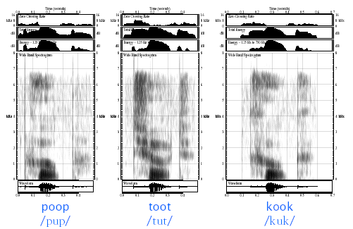
Spectrograms of Unvoiced Stops
Veton Këpuska
Notes:
Digital Systems: Hardware Organization and Design
Architecture of a Respresentative 32 Bit Processor

Slide 22
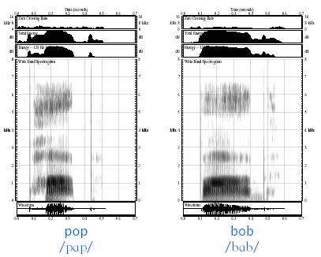
Examples of Stop Voicing Contrast
Veton Këpuska
Notes:
Digital Systems: Hardware Organization and Design
Architecture of a Respresentative 32 Bit Processor

Slide 23
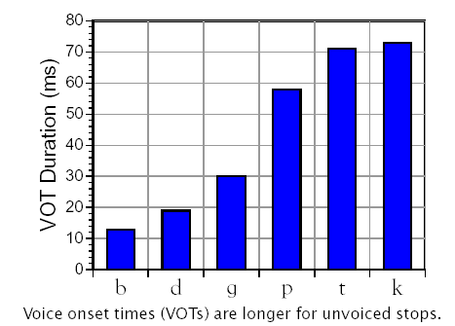
Singleton Stop Durations
Veton Këpuska
Notes:
Digital Systems: Hardware Organization and Design
Architecture of a Respresentative 32 Bit Processor

Slide 24
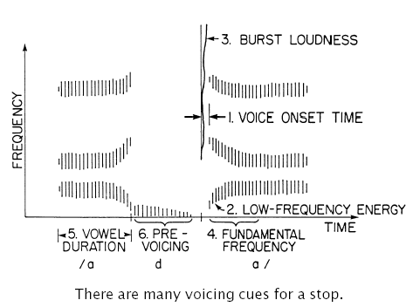
Voicing Cues for Stops
Veton Këpuska
Notes:
Digital Systems: Hardware Organization and Design
Architecture of a Respresentative 32 Bit Processor

Slide 25
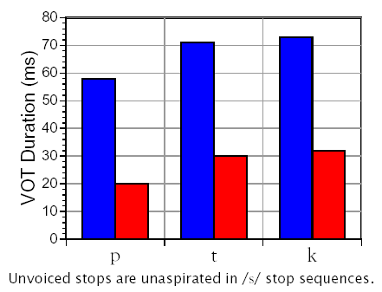
/s/-Stop Durations
Veton Këpuska
Notes:
Digital Systems: Hardware Organization and Design
Architecture of a Respresentative 32 Bit Processor

Slide 26
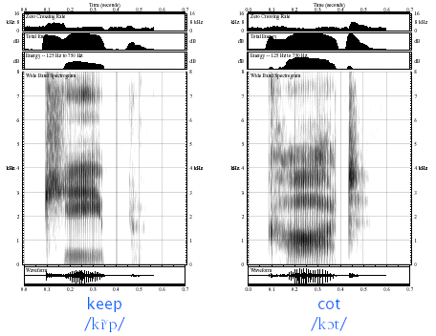
Examples of Front and Back Velars
Veton Këpuska
Notes:
Digital Systems: Hardware Organization and Design
Architecture of a Respresentative 32 Bit Processor

Slide 27
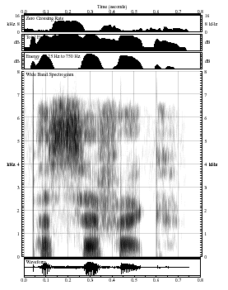
What is this word?
Veton Këpuska
Notes:
Digital Systems: Hardware Organization and Design
Architecture of a Respresentative 32 Bit Processor

Slide 28
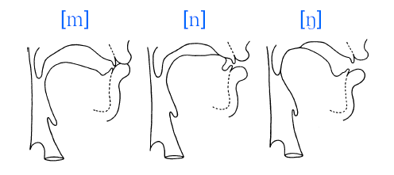
Nasal Production
Velum lowering results in airflow through nasal cavity
Consonants produced with closure in oral cavity
Nasal murmurs have similar spectral characteristics
Veton Këpuska
Notes:
Digital Systems: Hardware Organization and Design
Architecture of a Respresentative 32 Bit Processor

Slide 29

Nasal of American English
Three places of articulation: Labial, Alveolar, and Velar
Nasal consonants are always attached to a vowel, though can form an entire syllable in unstressed environments ([n], [m], [ŋ])
/ŋ/ is always post-vocalic in English
Place identified by neighboring formant transitions
Veton Këpuska
Notes:
Digital Systems: Hardware Organization and Design
Architecture of a Respresentative 32 Bit Processor

Slide 30
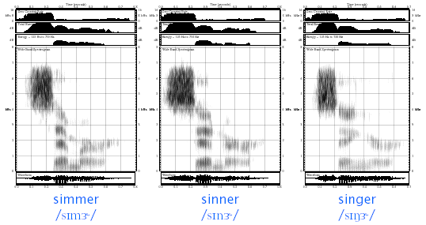
Spectrograms of Nasals
Veton Këpuska
Notes:
Digital Systems: Hardware Organization and Design
Architecture of a Respresentative 32 Bit Processor

Slide 31
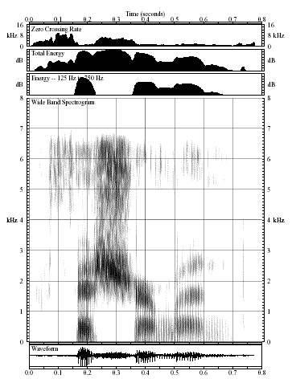
What is this word?
Veton Këpuska
Notes:
Digital Systems: Hardware Organization and Design
Architecture of a Respresentative 32 Bit Processor

Slide 32
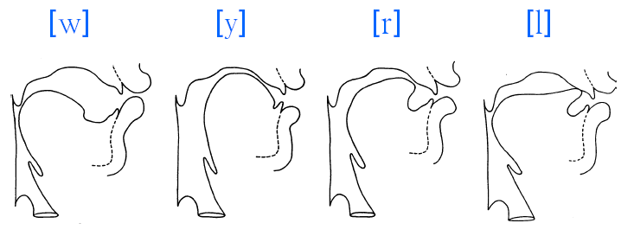
Semivowel Production
Constriction in vocal tract, no turbulence
Slower articulatory motion than other consonants
Laterals form complete closure with tongue tip, airflow via sides of constriction
Veton Këpuska
Notes:
Digital Systems: Hardware Organization and Design
Architecture of a Respresentative 32 Bit Processor

Slide 33
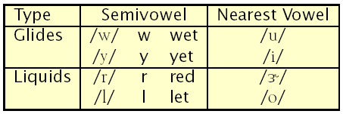
Semivowels of American English
There are 4 semivowels in American English
Sometimes referred to as Liquids or Glides
Glides are a more extreme articulation of a corresponding vowel
  Similar, though more extreme, formant positions
  Generally weaker due to narrower constriction
Semivowels are always attached to a vowel, though /l/ can form an entire syllable in unstressed environments ([l])
Veton Këpuska
Notes:
Digital Systems: Hardware Organization and Design
Architecture of a Respresentative 32 Bit Processor

Slide 34
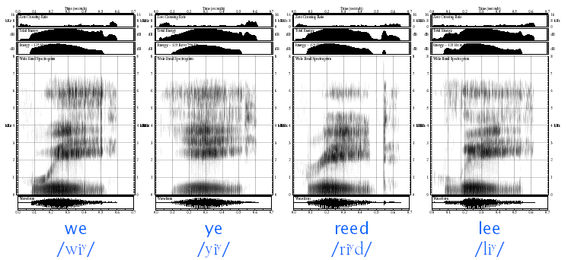
Spectrograms of Semivowels
Veton Këpuska
Notes:
Digital Systems: Hardware Organization and Design
Architecture of a Respresentative 32 Bit Processor

Slide 35
Acoustic Properties of Semivowels
/w/ and /l/ are the most confusable semivowels
/w/ is characterized by a very low F1, F2
  Typically a rapid spectral fallo above F2
/l/ is characterized by a low F1 and F2
  Often presence of high frequency energy
  Postvocalic /l/ characterized by minimal spectral discontinuity, gradual motion of formants
/y/ is characterized by very low F1, very high F2
  /y/ only occurs in a syllable onset position (i.e., pre-vocalic)
/r/ is characterized by a very low F3
  Prevocalic F3 < medial F3 < postvocalic F3
Veton Këpuska
Notes:
Digital Systems: Hardware Organization and Design
Architecture of a Respresentative 32 Bit Processor

Slide 36
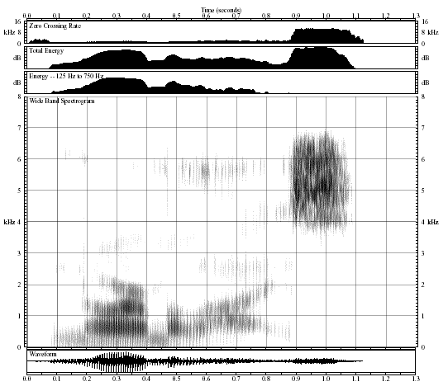
What is this word?
Veton Këpuska
Notes:
Digital Systems: Hardware Organization and Design
Architecture of a Respresentative 32 Bit Processor

Slide 37

Affricate Production
There are two affricates in American English:
Alveolar-stop palatal-fricative pairs
Sudden release of the constriction, turbulence noise
Can have periodic excitation during closure
Veton Këpuska
Notes:
Digital Systems: Hardware Organization and Design
Architecture of a Respresentative 32 Bit Processor

Slide 38
Aspirant Production
There is one aspirant in American English: /h/ (e.g., “hat’’)
Produced by generating turbulence excitation at glottis
No constriction in the vocal tract, normal formant excitation
Sub-glottal coupling results in little energy in F1 region
Periodic excitation can be present in medial position
Veton Këpuska
Notes:
Digital Systems: Hardware Organization and Design
Architecture of a Respresentative 32 Bit Processor

Slide 39
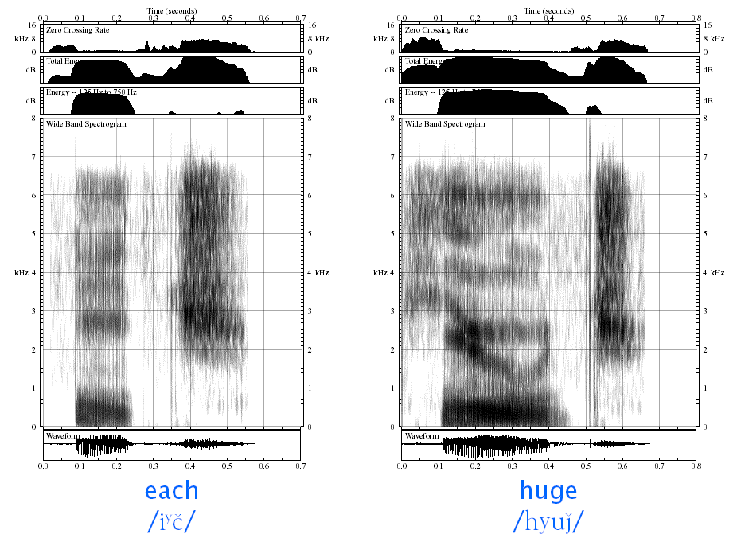
Spectrograms of Affricates and Aspirant
Veton Këpuska
Notes:
Digital Systems: Hardware Organization and Design
Architecture of a Respresentative 32 Bit Processor

Slide 40
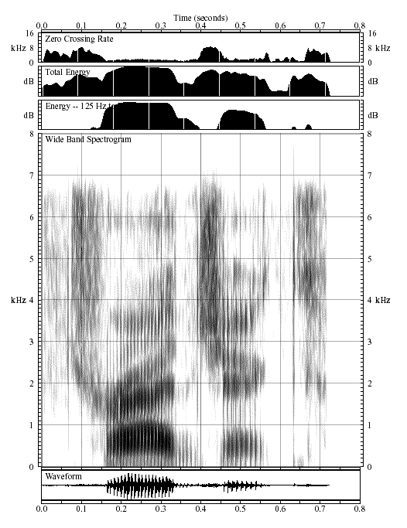
What is this word?
Veton Këpuska
Notes:
Digital Systems: Hardware Organization and Design
Architecture of a Respresentative 32 Bit Processor

Slide 41
Phonotactic Constraints
Phonotactics is the study of allowable sound sequences
Analyses of word-initial and -final clusters reveal:
  73 distinct initial clusters (about 10 “foreign’’ clusters)
  208 distinct final clusters
Can be used to eliminate impossible phoneme sequences:
  /tk/ can’t end a word, and
  /kt/ can’t begin a word,
  Therefore, */… t k t …/ is an impossible sequence
Veton Këpuska
Notes:
Digital Systems: Hardware Organization and Design
Architecture of a Respresentative 32 Bit Processor

Slide 42
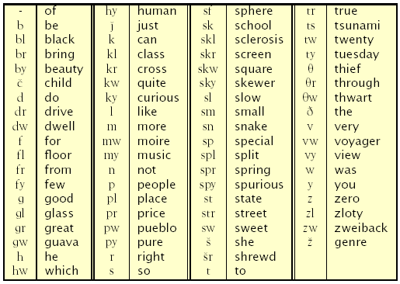
Word-Initial Consonants from MWP Dictionary
Veton Këpuska
Notes:
Digital Systems: Hardware Organization and Design
Architecture of a Respresentative 32 Bit Processor

Slide 43
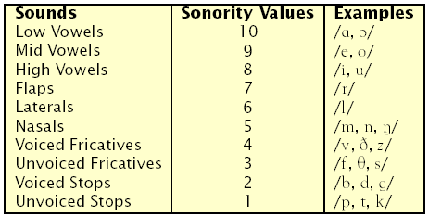
The Syllable
Syllable structure captures many useful generalizations
  Phoneme realization often depends on syllabification
  Many phonological rules depend on syllable structure
Syllable structure is predicated on the notion of ranking the speech sounds in terms of their sonority values
Veton Këpuska
Notes:
Digital Systems: Hardware Organization and Design
Architecture of a Respresentative 32 Bit Processor

Slide 44
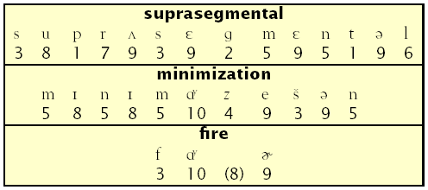
Syllables and Sonority
Utterances can be divided into syllables
The number of syllables equals the number of sonority peaks
Within any syllable, there is a segment constituting a sonority peak that is preceded and/or followed by a sequence of segments with progressively decreasing sonority values
Veton Këpuska
Notes:
Digital Systems: Hardware Organization and Design
Architecture of a Respresentative 32 Bit Processor

Slide 45
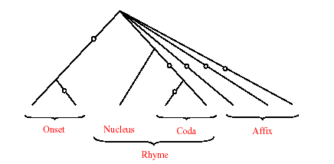
The Syllable Template
Branches marked by “o” are optional
Nucleus must contain a non-obstruent
Sonority decreases away from nucleus
Affix contains only coronals:
Only the last syllable in a word can have an affix
/sp/, /st/, and /sk/ are treated as single obstruents
Veton Këpuska
Notes:
Digital Systems: Hardware Organization and Design
Architecture of a Respresentative 32 Bit Processor

Slide 46
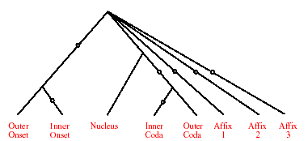
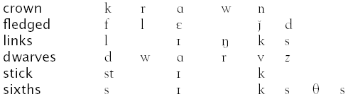
Some Examples
Veton Këpuska
Notes:
Digital Systems: Hardware Organization and Design
Architecture of a Respresentative 32 Bit Processor

Slide 47
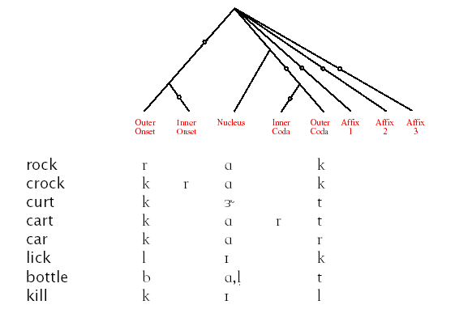
Words Containing /r/ and /l/
Veton Këpuska
Notes:
Digital Systems: Hardware Organization and Design
Architecture of a Respresentative 32 Bit Processor

Slide 48
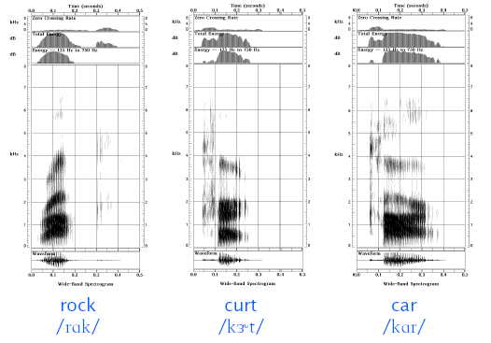
Acoustic Realizations of /r/
Veton Këpuska
Notes:
Digital Systems: Hardware Organization and Design
Architecture of a Respresentative 32 Bit Processor

Slide 49
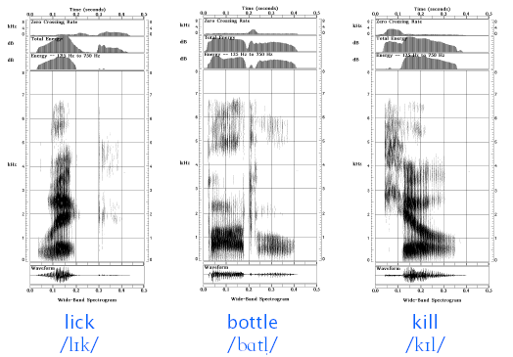
Acoustic Realizations of /l/
Veton Këpuska
Notes:
Digital Systems: Hardware Organization and Design
Architecture of a Respresentative 32 Bit Processor

Slide 50
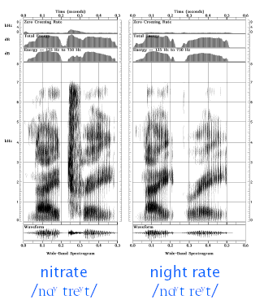
Allophonic Variations at Syllable Boundaries
Veton Këpuska
Notes:
Digital Systems: Hardware Organization and Design
Architecture of a Respresentative 32 Bit Processor

Slide 51
References
“Acoustics of American English Speech – A Dynamic Approach”, J. Olive, A. Greenwood, and J. Coleman, Springer-Verlag 1993.
“Articulatory-Acoustic-Auditory Relationships”, Kenneth Stevens, in The Handbook of Phonetic Sciences, Ed. William Hardcastle and John Laver, Blackwell Publishers, 1997.
Veton Këpuska
Notes:
Digital Systems: Hardware Organization and Design
Architecture of a Respresentative 32 Bit Processor

