Slide 1
Speech Recognition
Pattern Classification
Notes:
Digital Systems: Hardware Organization and Design
Architecture of a Respresentative 32 Bit Processor

Slide 2
Pattern Classification
Introduction
Parametric classifiers
Semi-parametric classifiers
Dimensionality reduction
Significance testing
Veton Këpuska
Notes:
Digital Systems: Hardware Organization and Design
Architecture of a Respresentative 32 Bit Processor

Slide 3
Pattern Classification
Goal: To classify objects (or patterns) into categories (or classes)
Types of Problems:
  Supervised: Classes are known beforehand, and data samples of each class are available
  Unsupervised: Classes (and/or number of classes) are not known beforehand, and must be inferred from data
Feature Extraction
Classifier
Observation
s
Feature Vectors
x
Class
ω_{i}
Veton Këpuska
Notes:
Digital Systems: Hardware Organization and Design
Architecture of a Respresentative 32 Bit Processor

Slide 4
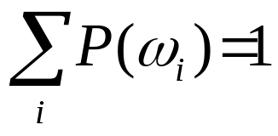
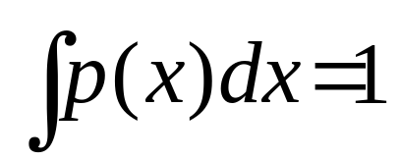
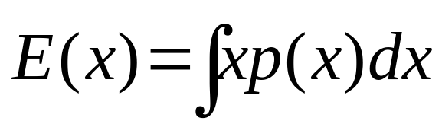
Probability Basics
Discrete probability mass function (PMF): P(ω_{i})
Continuous probability density function (PDF): p(x)
Expected value: E(x)
Veton Këpuska
Notes:
Digital Systems: Hardware Organization and Design
Architecture of a Respresentative 32 Bit Processor

Slide 5
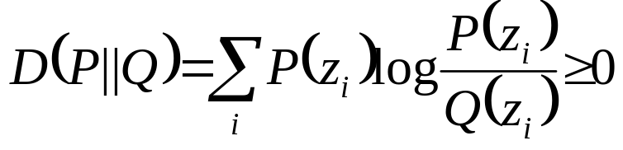
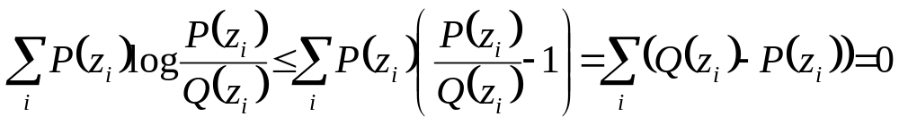

Kullback-Liebler Distance
Can be used to compute a distance between two probability mass distributions, P(z_{i}), and Q(z_{i})
Makes use of inequality log x ≤ x - 1
Known as relative entropy in information theory
The divergence of P(z_{i}) and Q(z_{i}) is the symmetric sum
Veton Këpuska
Notes:
Digital Systems: Hardware Organization and Design
Architecture of a Respresentative 32 Bit Processor

Slide 6
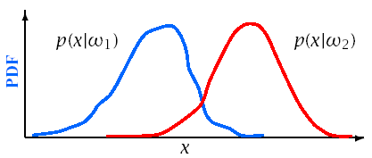
Bayes Theorem
Define:
{ω_{i}} | a set of M mutually exclusive classes
P(ω_{i}) | a priori probability for class ω_{i}
p(x|ω_{i}) | PDF for feature vector x in class ω_{i}
P(ω_{i}|x) | A posteriori probability of ω_{i} given x
Veton Këpuska
Notes:
Digital Systems: Hardware Organization and Design
Architecture of a Respresentative 32 Bit Processor

Slide 7
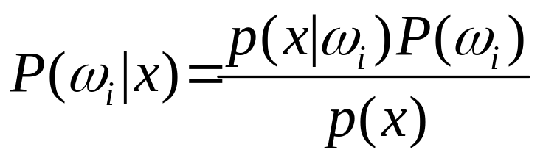
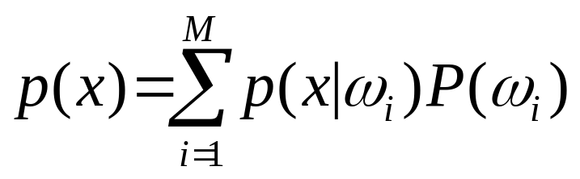
Bayes Theorem
From Bayes Rule:
Where:
Veton Këpuska
Notes:
Digital Systems: Hardware Organization and Design
Architecture of a Respresentative 32 Bit Processor

Slide 8
Bayes Decision Theory
The probability of making an error given x is:
  P(error|x)=1-P(ω_{i}|x) if decide class ω_{i}
To minimize P(error|x) (and P(error)):
  Choose ω_{i} if P(ω_{i}|x)>P(ω_{j}|x) ∀j≠i
Veton Këpuska
Notes:
Digital Systems: Hardware Organization and Design
Architecture of a Respresentative 32 Bit Processor

Slide 9
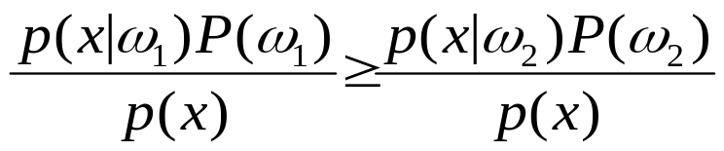
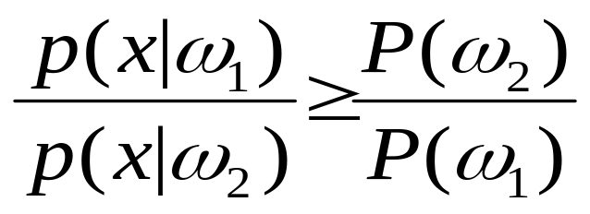
Bayes Decision Theory
For a two class problem this decision rule means:
  Choose ω₁
  if
  else
  ω₂
This rule can be expressed as a likelihood ratio:
Veton Këpuska
Notes:
Digital Systems: Hardware Organization and Design
Architecture of a Respresentative 32 Bit Processor

Slide 10
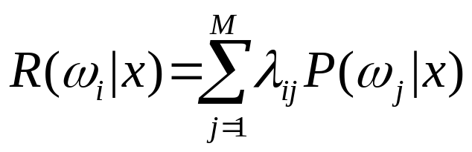
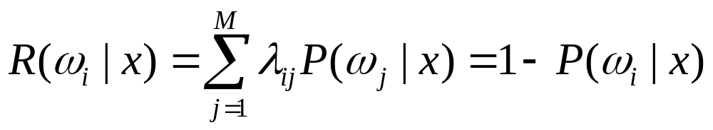
Bayes Risk
Define cost function λ_{ij} and conditional risk R(ω_{i}|x):
  λ_{ij} is cost of classifying x as ω_{i} when it is really ω_{j}
  R(ω_{i}|x) is the risk for classifying x as class ω_{i}
Bayes risk is the minimum risk which can be achieved:
  Choose ω_{i} if R(ω_{i}|x) < R(ω_{j}|x) ∀i≠j
Bayes risk corresponds to minimum P(error|x) when
  All errors have equal cost (λ_{ij} = 1, i≠j)
  There is no cost for being correct (λ_{ii} = 0)
Veton Këpuska
Notes:
Digital Systems: Hardware Organization and Design
Architecture of a Respresentative 32 Bit Processor

Slide 11
Discriminant Functions
Alternative formulation of Bayes decision rule
Define a discriminant function, g_{i}(x), for each class ω_{i}
    Choose ω_{i} if g_{i}(x)>g_{j}(x) ∀j ≠ i
Functions yielding identical classiffication results:
    g_{i} (x) = P(ω_{i}|x)
    = p(x|ω_{i})P(ω_{i})
    = log p(x|ω_{i})+log P(ω_{i})
Choice of function impacts computation costs
Discriminant functions partition feature space into decision regions, separated by decision boundaries.
Veton Këpuska
Notes:
Digital Systems: Hardware Organization and Design
Architecture of a Respresentative 32 Bit Processor

Slide 12
Density Estimation
Used to estimate the underlying PDF p(x|ω_{i})
Parametric methods:
  Assume a specific functional form for the PDF
  Optimize PDF parameters to fit data
Non-parametric methods:
  Determine the form of the PDF from the data
  Grow parameter set size with the amount of data
Semi-parametric methods:
  Use a general class of functional forms for the PDF
  Can vary parameter set independently from data
  Use unsupervised methods to estimate parameters
Veton Këpuska
Notes:
Digital Systems: Hardware Organization and Design
Architecture of a Respresentative 32 Bit Processor

Slide 13
Parametric Classifiers
Gaussian distributions
Maximum likelihood (ML) parameter estimation
Multivariate Gaussians
Gaussian classifiers
Veton Këpuska
Notes:
Digital Systems: Hardware Organization and Design
Architecture of a Respresentative 32 Bit Processor

Slide 14
Maximum Likelihood Parameter Estimation

Slide 15
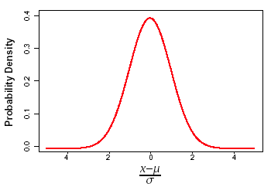
Gaussian Distributions
Gaussian PDF’s are reasonable when a feature vector can be viewed as perturbation around a reference
Simple estimation procedures for model parameters
Classification often reduced to simple distance metrics
Gaussian distributions also called Normal
Veton Këpuska
Notes:
Digital Systems: Hardware Organization and Design
Architecture of a Respresentative 32 Bit Processor

Slide 16
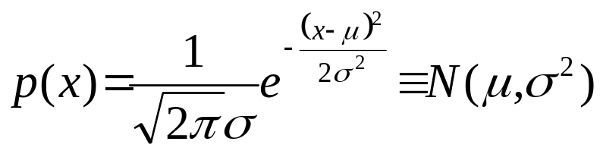
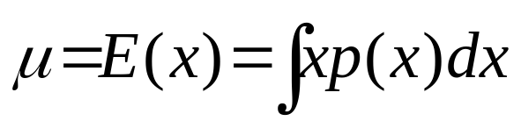
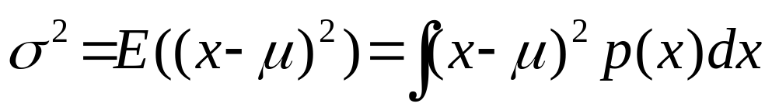
Gaussian Distributions: One Dimension
One-dimensional Gaussian PDF’s can be expressed as:
The PDF is centered around the mean
The spread of the PDF is determined by the variance
Veton Këpuska
Notes:
Digital Systems: Hardware Organization and Design
Architecture of a Respresentative 32 Bit Processor

Slide 17
Maximum-Likelihood Parameter Estimation
Veton Këpuska

Slide 18
Assumtions
The following assumptions hold:
  The samples come from a known number of c classes.
  The prior probabilities P(w_{j}) for each class are known, j=1,…,c
Veton Këpuska

Slide 19
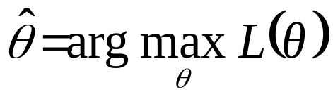
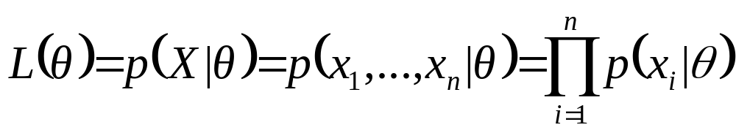
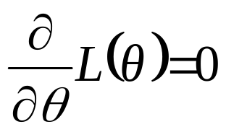
Maximum Likelihood Parameter Estimation
Maximum likelihood parameter estimation determines an estimate θ for parameter θ by maximizing the likelihood L(θ) of observing data X = {x₁,...,x_{n}}
Assuming independent, identically distributed data
ML solutions can often be obtained via the derivative:
^
Veton Këpuska
Notes:
Digital Systems: Hardware Organization and Design
Architecture of a Respresentative 32 Bit Processor

Slide 20
Maximum Likelihood Parameter Estimation
For Gaussian distributions log L(θ) is easier to solve
Veton Këpuska
Notes:
Digital Systems: Hardware Organization and Design
Architecture of a Respresentative 32 Bit Processor

Slide 21
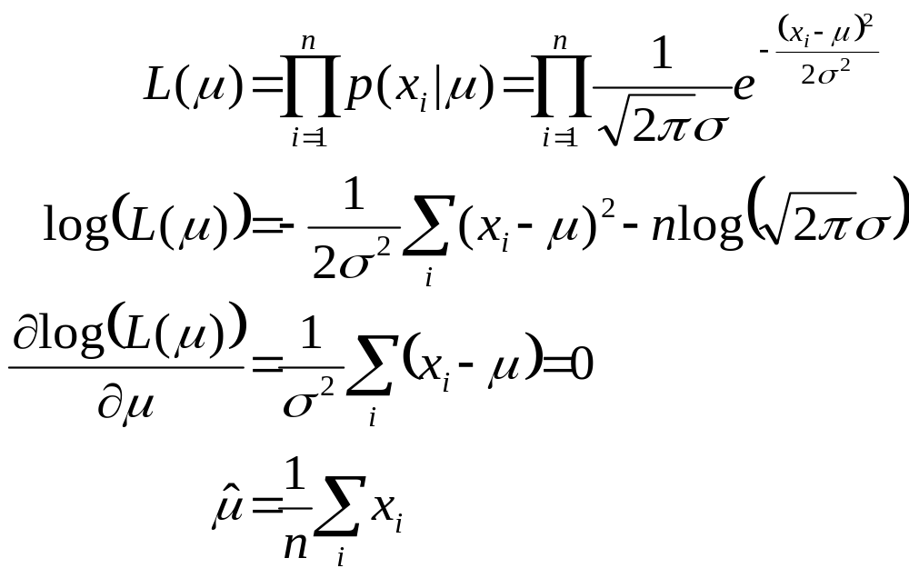
Gaussian ML Estimation: One Dimension
The maximum likelihood estimate for μ is given by:
Veton Këpuska
Notes:
Digital Systems: Hardware Organization and Design
Architecture of a Respresentative 32 Bit Processor

Slide 22
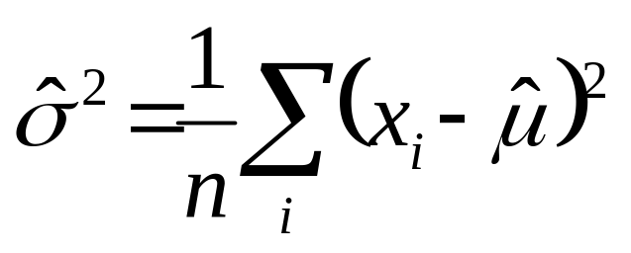
Gaussian ML Estimation: One Dimension
The maximum likelihood estimate for σ is given by:
Veton Këpuska
Notes:
Digital Systems: Hardware Organization and Design
Architecture of a Respresentative 32 Bit Processor

Slide 23
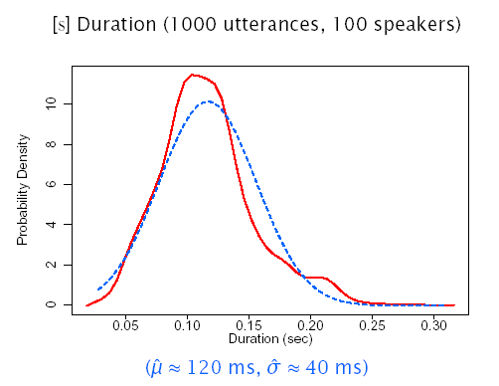
Gaussian ML Estimation: One Dimension
Veton Këpuska
Notes:
Digital Systems: Hardware Organization and Design
Architecture of a Respresentative 32 Bit Processor

Slide 24
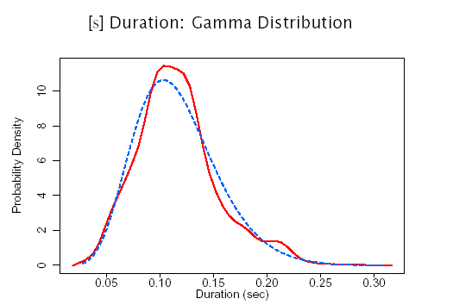
ML Estimation: Alternative Distributions
Veton Këpuska
Notes:
Digital Systems: Hardware Organization and Design
Architecture of a Respresentative 32 Bit Processor

Slide 25
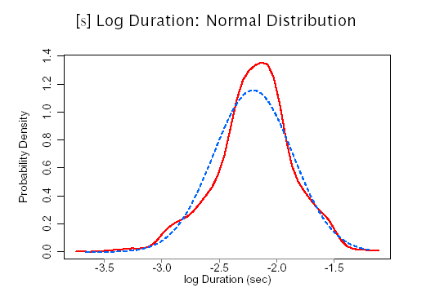
ML Estimation: Alternative Distributions
Veton Këpuska
Notes:
Digital Systems: Hardware Organization and Design
Architecture of a Respresentative 32 Bit Processor

Slide 26
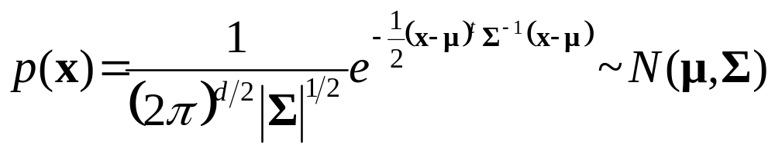
Gaussian Distributions: Multiple Dimensions (Multivariate)
A multi-dimensional Gaussian PDF can be expressed as:
d is the number of dimensions
x={x₁,…,x_{d}} is the input vector
μ= E(x)= {μ₁,...,μ_{d} } is the mean vector
Σ= E((x-μ )(x-μ)^{t}) is the covariance matrix with elements σ_{ij} , inverse Σ⁻¹ , and determinant |Σ|
σ_{ij} = σ_{ji} = E((x_{i} - μ_{i} )(x_{j} - μ_{j} )) = E(x_{i}x_{j} ) - μ_{i}μ_{j}
Veton Këpuska
Notes:
Digital Systems: Hardware Organization and Design
Architecture of a Respresentative 32 Bit Processor

Slide 27
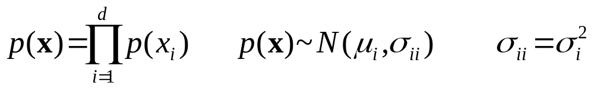
Gaussian Distributions: Multi-Dimensional Properties
If the i^{th} and j^{th} dimensions are statistically or linearly independent then E(x_{i}x_{j})= E(x_{i})E(x_{j}) and σ_{ij} =0
If all dimensions are statistically or linearly independent, then σ_{ij}=0 ∀i≠j and Σ has non-zero elements only on the diagonal
If the underlying density is Gaussian and Σ is a diagonal matrix, then the dimensions are statistically independent and
Veton Këpuska
Notes:
Digital Systems: Hardware Organization and Design
Architecture of a Respresentative 32 Bit Processor

Slide 28
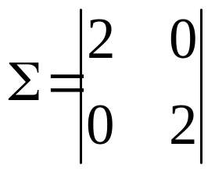
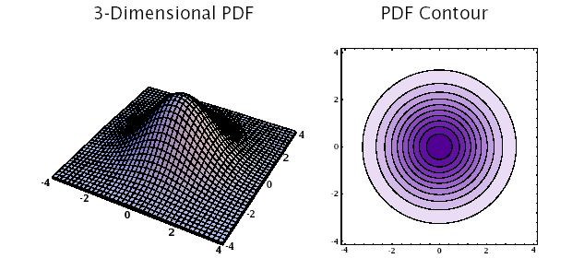
Diagonal Covariance Matrix:
Σ=σ²I
Veton Këpuska
Notes:
Digital Systems: Hardware Organization and Design
Architecture of a Respresentative 32 Bit Processor

Slide 29
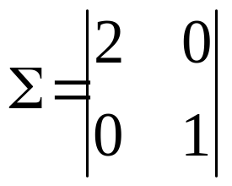
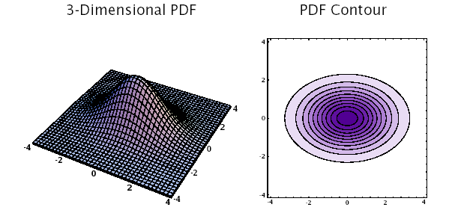
Diagonal Covariance Matrix: σ_{ij}=0 ∀i≠j
Veton Këpuska
Notes:
Digital Systems: Hardware Organization and Design
Architecture of a Respresentative 32 Bit Processor

Slide 30
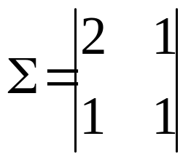
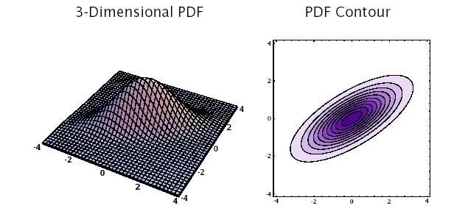
General Covariance Matrix: σ_{ij}≠0
Veton Këpuska
Notes:
Digital Systems: Hardware Organization and Design
Architecture of a Respresentative 32 Bit Processor

Slide 31
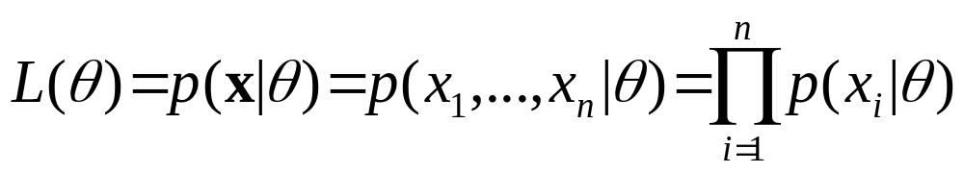
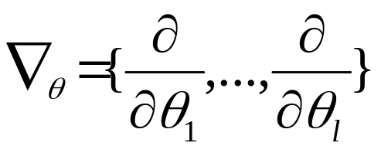
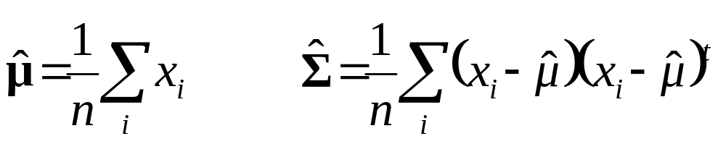
Multivariate ML Estimation
The ML estimates for parameters θ = {θ₁,...,θ_{l} } are determined by maximizing the joint likelihood L(θ) of a set of i.i.d. data x = {x₁,..., x_{n}}
To find θ we solve ∇_{θ}L(θ)= 0, or ∇_{θ} log L(θ)= 0
The ML estimates of μ and Σ are
^
Veton Këpuska
Notes:
Digital Systems: Hardware Organization and Design
Architecture of a Respresentative 32 Bit Processor

Slide 32
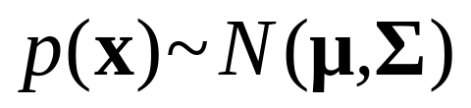
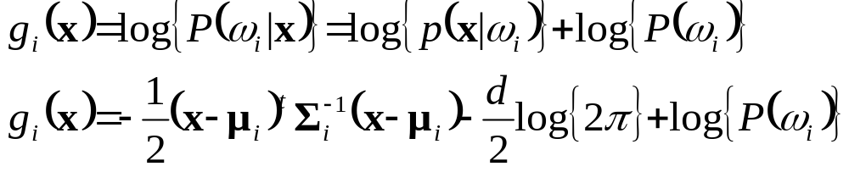
Multivariate Gaussian Classifier
Requires a mean vector μ_{i}, and a covariance matrix Σ_{i} for each of M classes {ω₁, ··· ,ω_{M} }
The minimum error discriminant functions are of the form:
Classification can be reduced to simple distance metrics for many situations.
Veton Këpuska
Notes:
Digital Systems: Hardware Organization and Design
Architecture of a Respresentative 32 Bit Processor

Slide 33
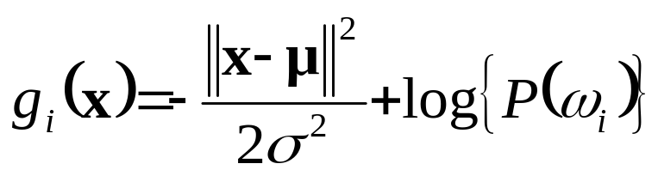
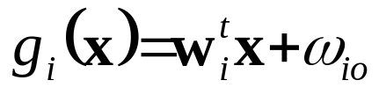
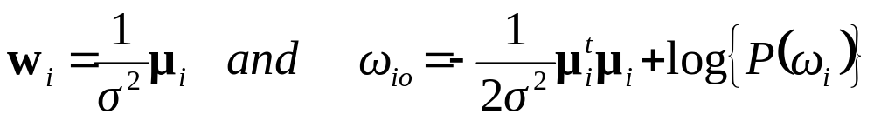
Gaussian Classifier: Σ_{i} = σ²I
Each class has the same covariance structure: statistically independent dimensions with variance σ²
The equivalent discriminant functions are:
If each class is equally likely, this is a minimum distance classifier, a form of template matching
The discriminant functions can be replaced by the following linear expression:
where
Veton Këpuska
Notes:
Digital Systems: Hardware Organization and Design
Architecture of a Respresentative 32 Bit Processor

Slide 34
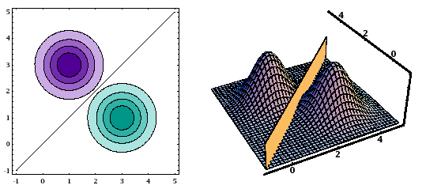
Gaussian Classifier: Σ_{i} = σ²I
For distributions with a common covariance structure the decision regions a hyper-planes.
Veton Këpuska
Notes:
Digital Systems: Hardware Organization and Design
Architecture of a Respresentative 32 Bit Processor

Slide 35
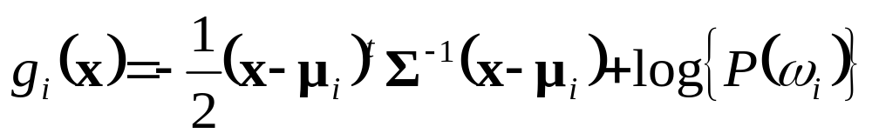
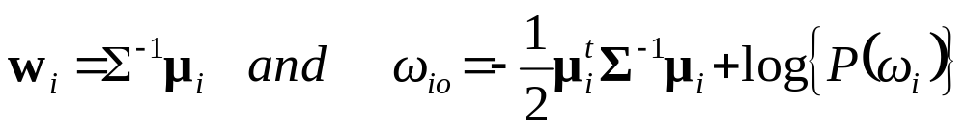
Gaussian Classifier: Σ_{i}=Σ
Each class has the same covariance structure Σ
The equivalent discriminant functions are:
If each class is equally likely, the minimum error decision rule is the squared Mahalanobis distance
The discriminant functions remain linear expressions:
where
Veton Këpuska
Notes:
Digital Systems: Hardware Organization and Design
Architecture of a Respresentative 32 Bit Processor

Slide 36
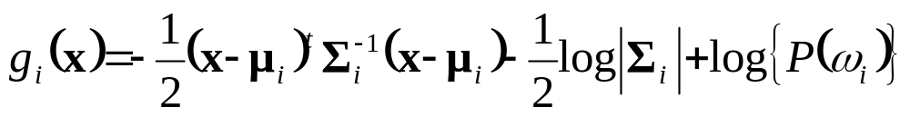
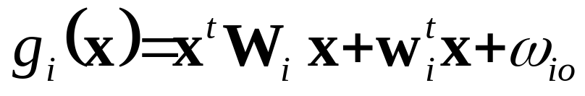
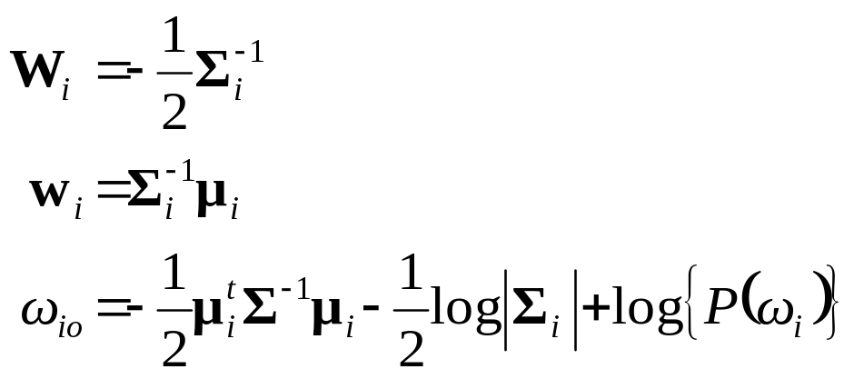
Gaussian Classifier: Σ_{i} Arbitrary
Each class has a different covariance structure Σ_{i}
The equivalent discriminant functions are:
The discriminant functions are inherently quadratic:
where
Veton Këpuska
Notes:
Digital Systems: Hardware Organization and Design
Architecture of a Respresentative 32 Bit Processor

Slide 37
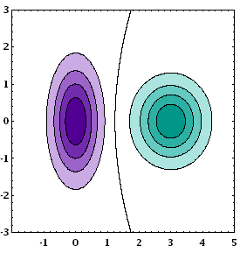
Gaussian Classifier: Σ_{i} Arbitrary
For distributions with arbitrary covariance structures the decision regions are defined by hyper-spheres.
Veton Këpuska
Notes:
Digital Systems: Hardware Organization and Design
Architecture of a Respresentative 32 Bit Processor

Slide 38
3 Class Classification
(Atal & Rabiner, 1976)
Distinguish between silence, unvoiced, and voiced sounds
Use 5 features:
  Zero crossing count
  Log energy
  Normalized first autocorrelation coefficient
  First predictor coefficient, and
  Normalized prediction error
Multivariate Gaussian classifier, ML estimation
Decision by squared Mahalanobis distance
Trained on four speakers (2 sentences/speaker), tested on 2 speakers (1 sentence/speaker)
Veton Këpuska
Notes:
Digital Systems: Hardware Organization and Design
Architecture of a Respresentative 32 Bit Processor

Slide 39
Maximum A Posteriori Parameter Estimation

Slide 40
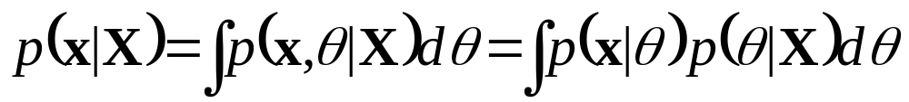
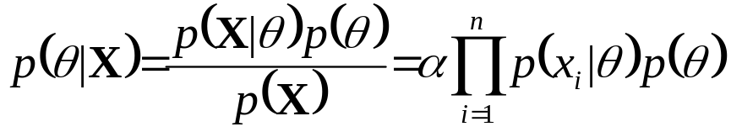
Maximum A Posteriori Parameter Estimation
Bayesian estimation approaches assume the form of the PDF p(x|θ) is known, but the value of θ is not
Knowledge of θ is contained in:
  An initial a priori PDF p(θ)
  A set of i.i.d. data X = {x₁,...,x_{n}}
The desired PDF for x is of the form
The value posteriori θ that maximizes p(θ|X) is called the maximum a posteriori (MAP) estimate of θ
^
Veton Këpuska
Notes:
Digital Systems: Hardware Organization and Design
Architecture of a Respresentative 32 Bit Processor

Slide 41
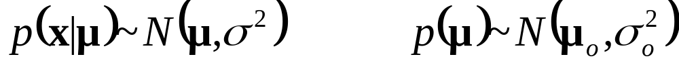

Gaussian MAP Estimation: One Dimension
For a Gaussian distribution with unknown mean μ:
MAP estimates of μ and x are given by
As n increases, p(μ|X) converges to μ, and p(x,X) converges to the ML estimate ~ N(μ,σ²)
^
^
Veton Këpuska
Notes:
Digital Systems: Hardware Organization and Design
Architecture of a Respresentative 32 Bit Processor

Slide 42
References
Huang, Acero, and Hon, Spoken Language Processing, Prentice-Hall, 2001.
Duda, Hart and Stork, Pattern Classification, John Wiley & Sons, 2001.
Atal and Rabiner, A Pattern Recognition Approach to Voiced-Unvoiced-Silence Classification with Applications to Speech Recognition, IEEE Trans ASSP, 24(3), 1976.
Veton Këpuska
Notes:
Digital Systems: Hardware Organization and Design
Architecture of a Respresentative 32 Bit Processor

