Slide 1
Speech Recognition
Pattern Classification

Slide 2
Pattern Classification
Introduction
Parametric classifiers
Semi-parametric classifiers
Dimensionality reduction
Significance testing

Slide 3
Pattern Classification
Goal: To classify objects (or patterns) into categories (or classes)
Types of Problems:
  Supervised: Classes are known beforehand, and data samples of each class are available
  Unsupervised: Classes (and/or number of classes) are not known beforehand, and must be inferred from data
Feature Extraction
Classifier
Observation
s
Feature Vectors
x
Class
ω_{i}

Slide 4
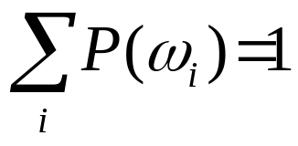
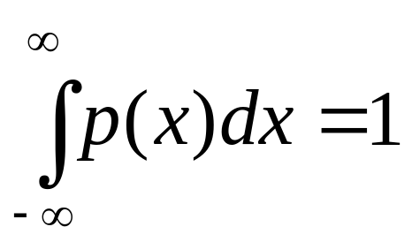
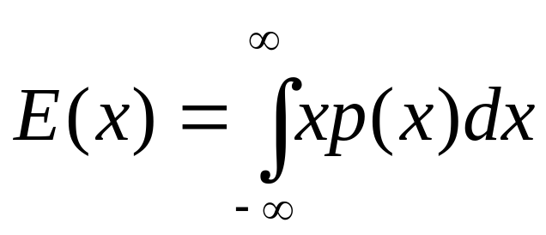
Probability Basics
Discrete probability mass function (PMF): P(ω_{i})
Continuous probability density function (PDF): p(x)
Expected value: E(x)

Slide 5
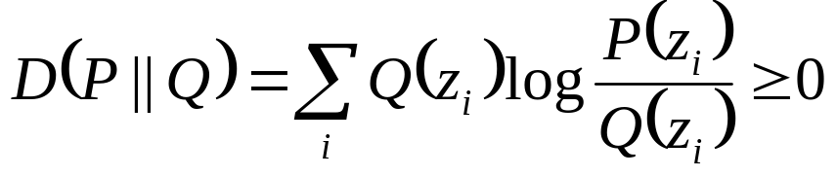
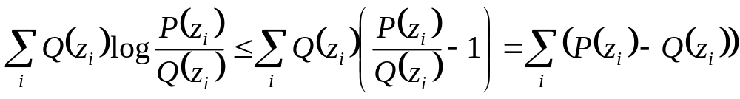

Kullback-Liebler Distance
Can be used to compute a distance between two probability mass distributions, P(z_{i}), and Q(z_{i})
Makes use of inequality log x ≤ x - 1
Known as relative entropy in information theory
The divergence of P(z_{i}) and Q(z_{i}) is the symmetric sum

Slide 6
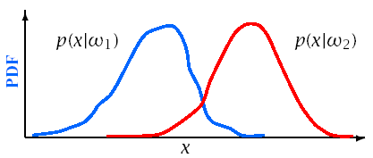
Bayes Theorem
Define:
{ω_{i}} | a set of M mutually exclusive classes
P(ω_{i}) | a priori probability for class ω_{i}
p(x|ω_{i}) | PDF for feature vector x in class ω_{i}
P(ω_{i}|x) | A posteriori probability of ω_{i} given x

Slide 7
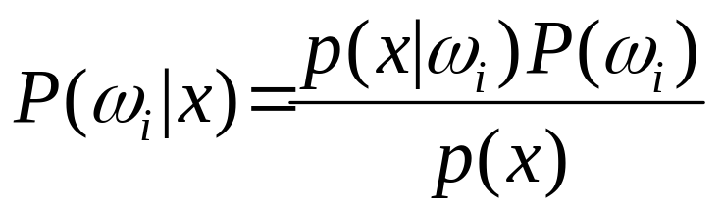
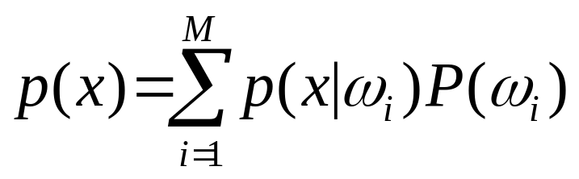
Bayes Theorem
From Bayes Rule:
Where:

Slide 8
Bayesian Decision Theory
Reference:
Pattern Classification – R. Duda, P. Hard & D. Stork, Wiley & Sons, 2001

Slide 9
Bayes Decision Theory
The probability of making an error given x is:
  P(error|x)=1-P(ω_{i}|x) if decide class ω_{i}
To minimize P(error|x) (and P(error)):
  Choose ω_{i} if P(ω_{i}|x)>P(ω_{j}|x) ∀j≠i

Slide 10
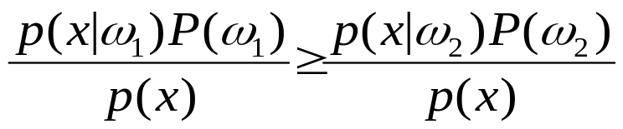
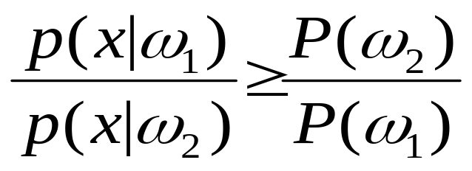
Bayes Decision Theory
For a two class problem this decision rule means:
  Choose ω₁
  if
  else ω₂
This rule can be expressed as a likelihood ratio:

Slide 11
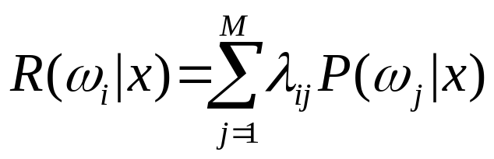
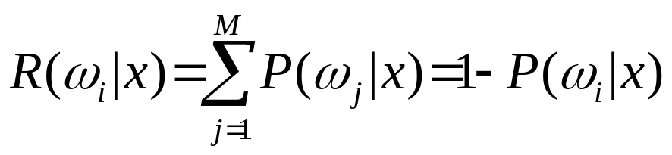
Bayes Risk
Define cost function λ_{ij} and conditional risk R(ω_{i}|x):
  λ_{ij} is cost of classifying x as ω_{i} when it is really ω_{j}
  R(ω_{i}|x) is the risk for classifying x as class ω_{i}
Bayes risk is the minimum risk which can be achieved:
  Choose ω_{i} if R(ω_{i}|x) < R(ω_{j}|x) ∀i≠j
Bayes risk corresponds to minimum P(error|x) when
  All errors have equal cost (λ_{ij} = 1, i≠j)
  There is no cost for being correct (λ_{ii} = 0)

Slide 12
Discriminant Functions
Alternative formulation of Bayes decision rule
Define a discriminant function, g_{i}(x), for each class ω_{i}
    Choose ω_{i} if g_{i}(x)>g_{j}(x) ∀j ≠ i
Functions yielding identical classiffication results:
    g_{i} (x) = P(ω_{i} |x)
    = p(x|ω_{i} )P(ω_{i} )
    = log p(x|ω_{i} )+log P(ω_{i} )
Choice of function impacts computational costs
Discriminant functions partition feature space into decision regions, separated by decision boundaries.

Slide 13
Density Estimation
Used to estimate the underlying PDF p(x|ω_{i})
Parametric methods:
  Assume a specific functional form for the PDF
  Optimize PDF parameters to fit data
Non-parametric methods:
  Determine the form of the PDF from the data
  Grow parameter set size with the amount of data
Semi-parametric methods:
  Use a general class of functional forms for the PDF
  Can vary parameter set independently from data
  Use unsupervised methods to estimate parameters

Slide 14
Parametric Classifiers
Gaussian distributions
Maximum likelihood (ML) parameter estimation
Multivariate Gaussians
Gaussian classifiers

Slide 15
Maximum Likelihood Parameter Estimation

Slide 16
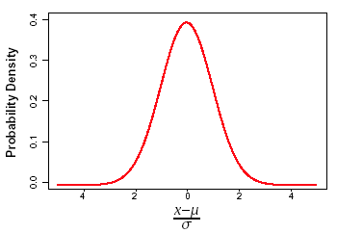
Gaussian Distributions
Gaussian PDF’s are reasonable when a feature vector can be viewed as perturbation around a reference
Simple estimation procedures for model parameters
Classification often reduced to simple distance metrics
Gaussian distributions also called Normal

Slide 17
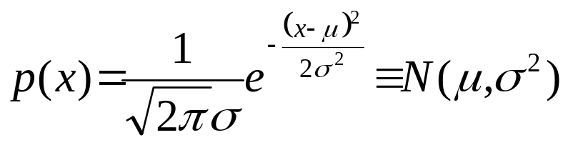
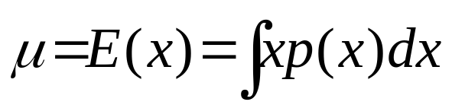
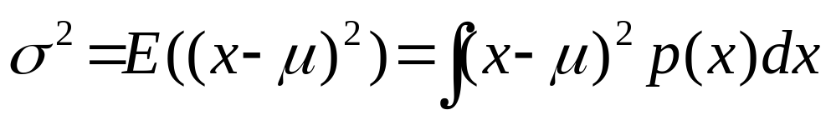
Gaussian Distributions: One Dimension
One-dimensional Gaussian PDF’s can be expressed as:
The PDF is centered around the mean
The spread of the PDF is determined by the variance

Slide 18
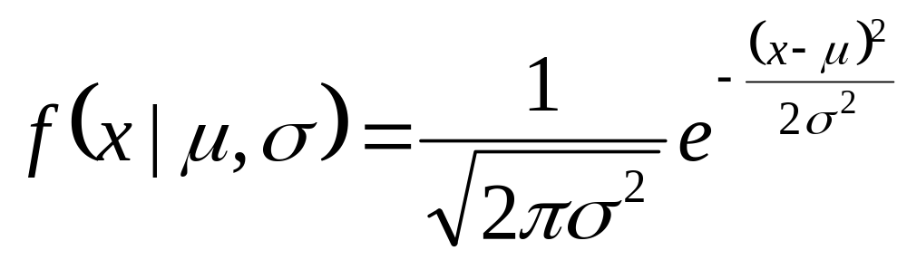
Univariate Gaussians
The Gaussian distribution, also known as the normal distribution, is the bell-curve function familiar from basic statistics.
A Gaussian distribution is a function parameterized by a mean, or average value, and a variance, which characterizes the average spread or dispersal from the mean.
We will use μ to indicate the mean, and σ² to indicate the variance, giving the following formula for a Gaussian function:

Slide 19
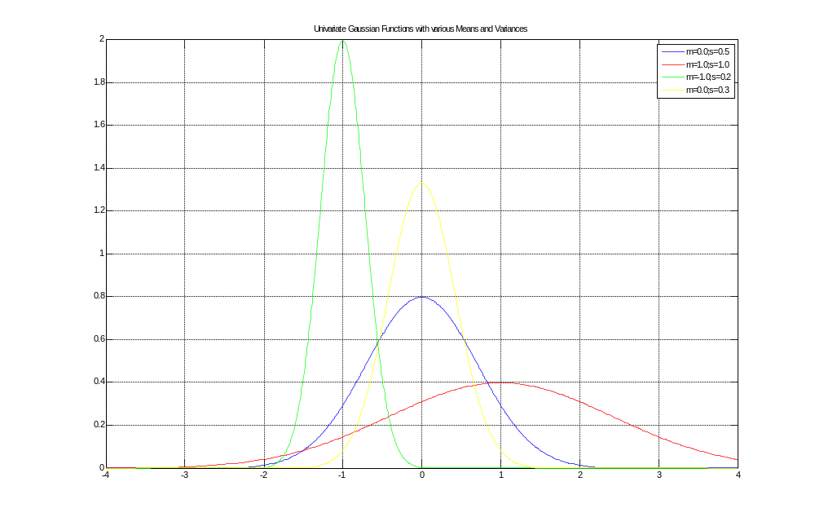
Univariate Gaussian PDFs

Slide 20
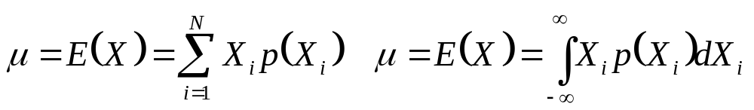
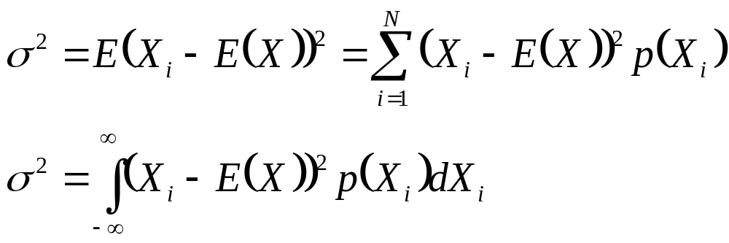
Gaussian PDFs
Mean of a Random variable X is the expected value of X.
  For a discrete variable X. this is the weighted sum over the values of X:
  The variance of a random variable X is the weighted squared average deviation from the mean:

Slide 21
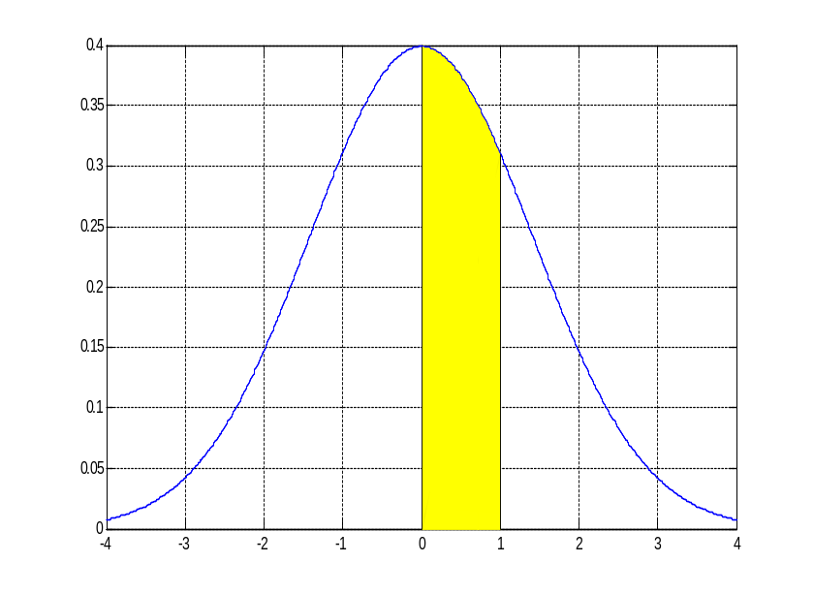
Gaussian PDFs
When a Gaussian function is used as a probability density function, the area under the curve is constrained to be equal to one. Then the probability that a random variable takes on any particular range of values can be computed by summing the area under the curve for that range of values. Fig. 9.19 shows the probability expressed by the area under an interval of a Gaussian pdf.

Slide 22
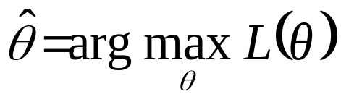
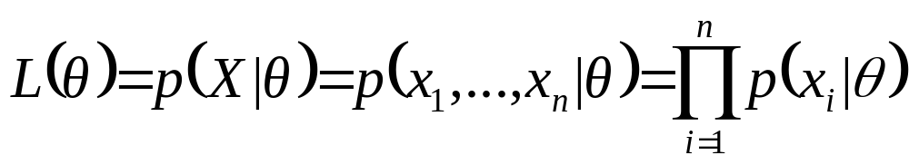
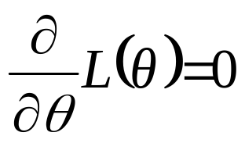
Maximum Likelihood Parameter Estimation
Maximum likelihood parameter estimation determines an estimate θ for parameter θ by maximizing the likelihood L(θ) of observing data X = {x₁,...,x_{n}}
Assuming independent, identically distributed data
ML solutions can often be obtained via the derivative:
^

Slide 23
Maximum Likelihood Parameter Estimation
For Gaussian distributions log L(θ) is easier to solve

Slide 24
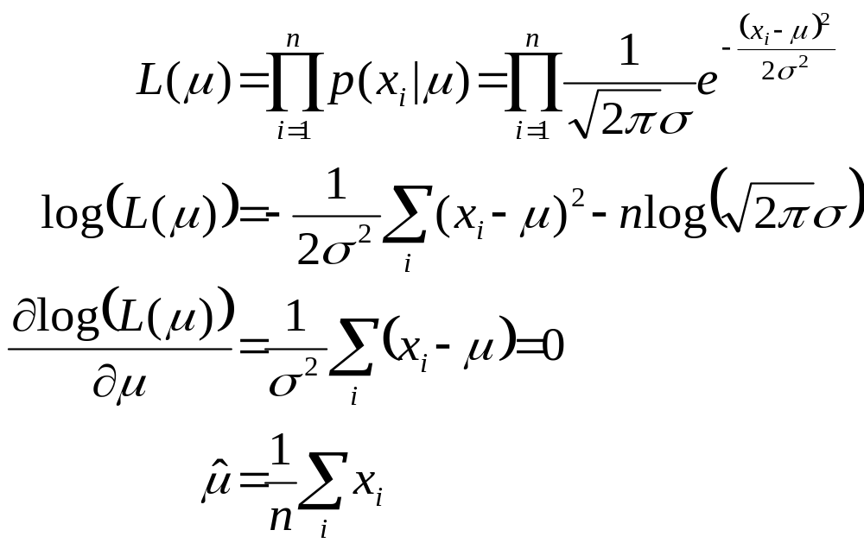
Gaussian ML Estimation: One Dimension
The maximum likelihood estimate for μ is given by:

Slide 25
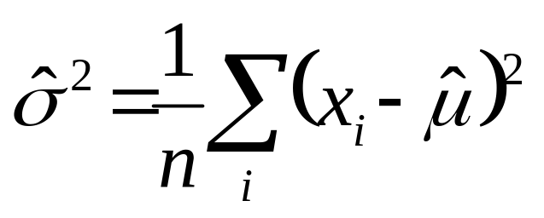
Gaussian ML Estimation: One Dimension
The maximum likelihood estimate for σ is given by:

Slide 26
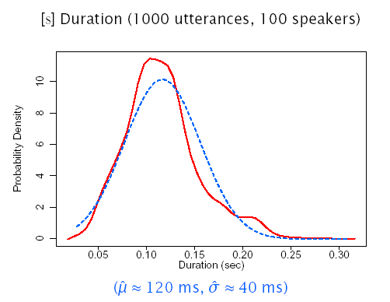
Gaussian ML Estimation: One Dimension

Slide 27
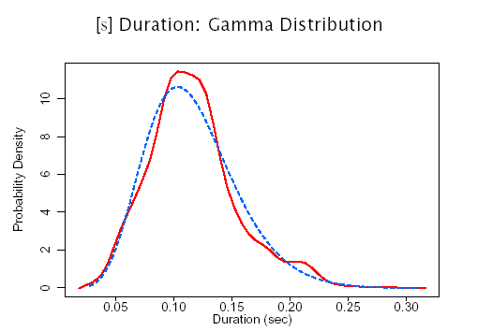
ML Estimation: Alternative Distributions

Slide 28
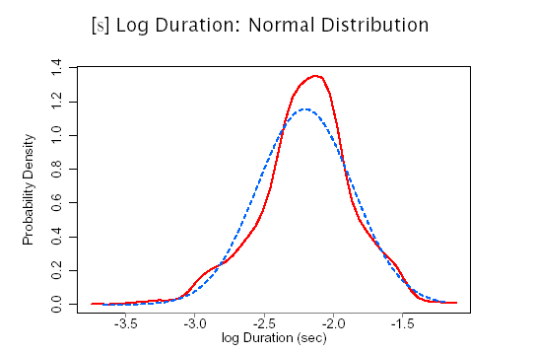
ML Estimation: Alternative Distributions

Slide 29
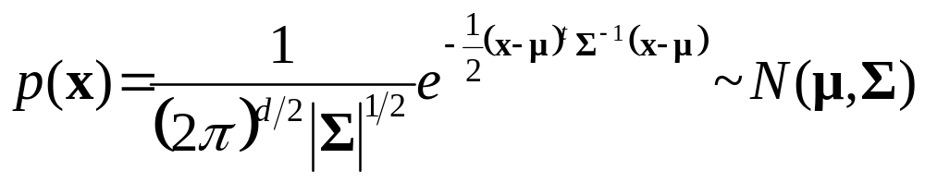
Gaussian Distributions: Multiple Dimensions (Multivariate)
A multi-dimensional Gaussian PDF can be expressed as:
d is the number of dimensions
x={x₁,…,x_{d}} is the input vector
μ= E(x)= {μ₁,...,μ_{d} } is the mean vector
Σ= E((x-μ )(x-μ)^{t}) is the covariance matrix with elements σ_{ij} , inverse Σ⁻¹ , and determinant |Σ|
σ_{ij} = σ_{ji} = E((x_{i} - μ_{i} )(x_{j} - μ_{j} )) = E(x_{i}x_{j} ) - μ_{i}μ_{j}

Slide 30
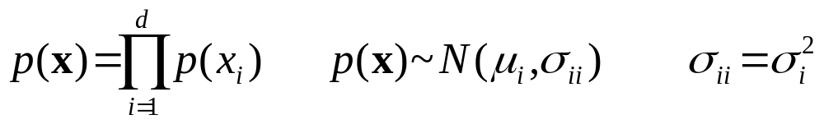
Gaussian Distributions: Multi-Dimensional Properties
If the i^{th} and j^{th} dimensions are statistically or linearly independent then E(x_{i}x_{j})= E(x_{i})E(x_{j}) and σ_{ij} =0
If all dimensions are statistically or linearly independent, then σ_{ij}=0 ∀i≠j and Σ has non-zero elements only on the diagonal
If the underlying density is Gaussian and Σ is a diagonal matrix, then the dimensions are statistically independent and

Slide 31
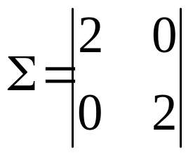
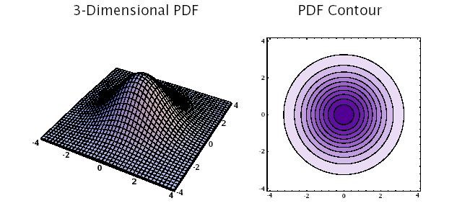
Diagonal Covariance Matrix:
Σ=σ²I

Slide 32
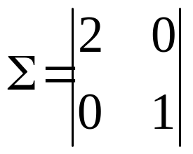
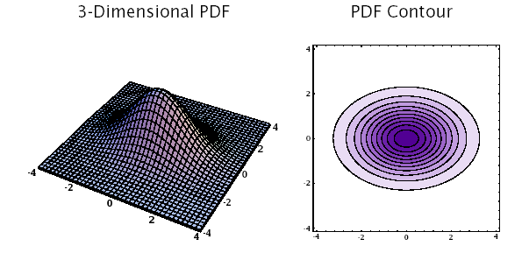
Diagonal Covariance Matrix: σ_{ij}=0 ∀i≠j

Slide 33
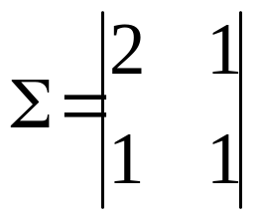
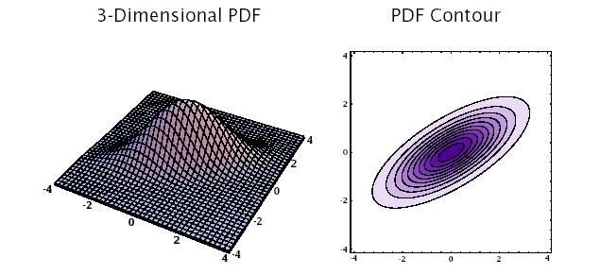
General Covariance Matrix: σ_{ij}≠0

Slide 34
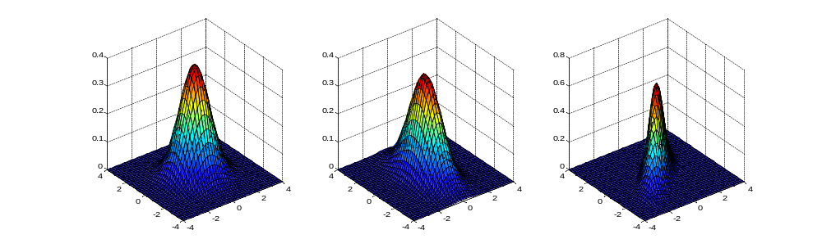
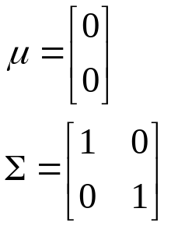
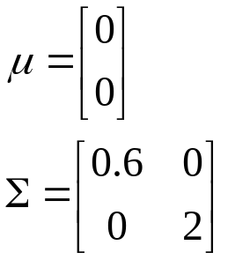
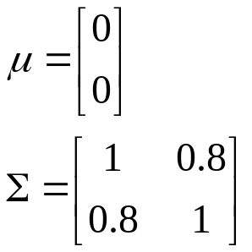
2D Gaussian PDF’s

Slide 35
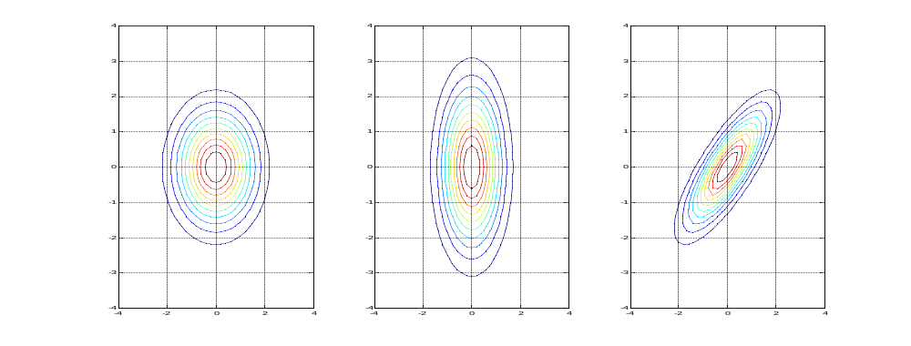

Slide 36
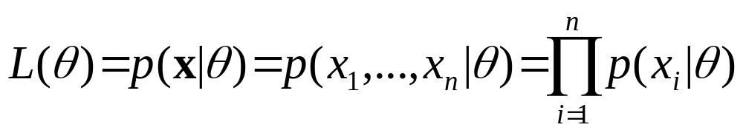
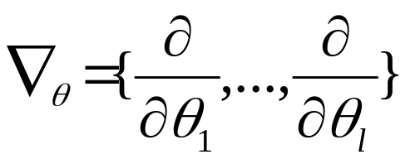
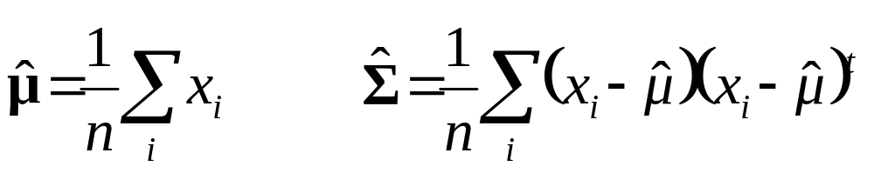
Multivariate ML Estimation
The ML estimates for parameters θ = {θ₁,...,θ_{l} } are determined by maximizing the joint likelihood L(θ) of a set of i.i.d. data x = {x₁,..., x_{n}}
To find θ we solve ∇_{θ}L(θ)= 0, or ∇_{θ} log L(θ)= 0
The ML estimates of μ and Σ are
^

Slide 37
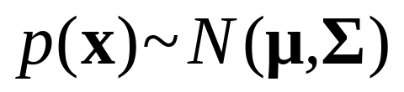
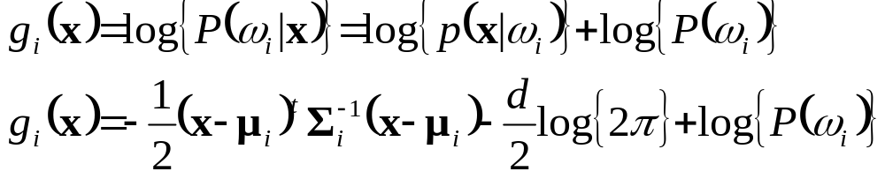
Multivariate Gaussian Classifier
Requires a mean vector μ_{i}, and a covariance matrix Σ_{i} for each of M classes {ω₁, ··· ,ω_{M} }
The minimum error discriminant functions are of the form:
Classification can be reduced to simple distance metrics for many situations.

Slide 38
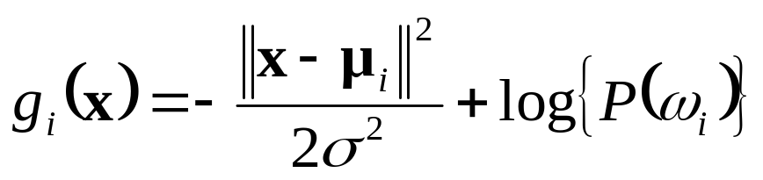
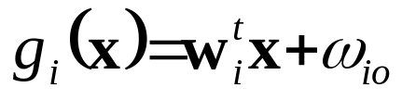
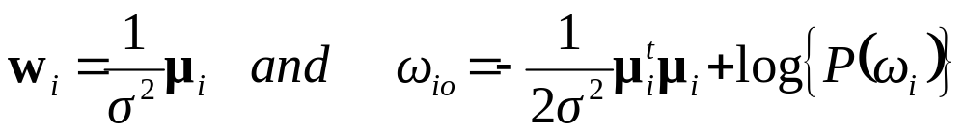
Gaussian Classifier: Σ_{i} = σ²I
Each class has the same covariance structure: statistically independent dimensions with variance σ²
The equivalent discriminant functions are:
If each class is equally likely, this is a minimum distance classifier, a form of template matching
The discriminant functions can be replaced by the following linear expression:
where

Slide 39

Gaussian Classifier: Σ_{i} = σ²I
For distributions with a common covariance structure the decision regions a hyper-planes.

Slide 40


Gaussian Classifier: Σ_{i}=Σ
Each class has the same covariance structure Σ
The equivalent discriminant functions are:
If each class is equally likely, the minimum error decision rule is the squared Mahalanobis distance
The discriminant functions remain linear expressions:
where

Slide 41



Gaussian Classifier: Σ_{i} Arbitrary
Each class has a different covariance structure Σ_{i}
The equivalent discriminant functions are:
The discriminant functions are inherently quadratic:
where

Slide 42

Gaussian Classifier: Σ_{i} Arbitrary
For distributions with arbitrary covariance structures the decision regions are defined by hyper-spheres.

Slide 43
3 Class Classification
(Atal & Rabiner, 1976)
Distinguish between silence, unvoiced, and voiced sounds
Use 5 features:
  Zero crossing count
  Log energy
  Normalized first autocorrelation coefficient
  First predictor coefficient, and
  Normalized prediction error
Multivariate Gaussian classifier, ML estimation
Decision by squared Mahalanobis distance
Trained on four speakers (2 sentences/speaker), tested on 2 speakers (1 sentence/speaker)

Slide 44
Maximum A Posteriori Parameter Estimation

Slide 45
Maximum A Posteriori Parameter Estimation
Maximum likelihood estimation approaches assume the form of the PDF p(x|θ) is known, but the value of θ is not
Maximum A Posteriori (MAP) Parameter Estimation techniques assume that parameter vector θ is a random variable with a prior distribution p(θ)

Slide 46



Maximum A Posteriori Parameter Estimation
Knowledge of θ is contained in:
  An initial a priori PDF p(θ)
  A set of independent and identically distributed (i.i.d.) data X = {x₁,...,x_{n}} with PDF p(X|θ)
According to Bayes rule, posterior distribution of θ is defined as:
One intuitive interpretation is that a prior pdf p(θ) represent the relative likelihood before the values of x₁,...,x_{n} have been observed.
Posterior PDF p(θ|X) represents the relative likelihood after the values of x₁,...,x_{n} have been observed. Choosing that maximizes is intuitively consistent.

Slide 47
Maximum A Posteriori Parameter Estimation
The previous estimator defines MAP

Slide 48


Gaussian MAP Estimation: One Dimension
For a Gaussian distribution with unknown mean μ:
MAP estimates of μ and x are given by
As n increases, p(μ|X) converges to μ, and p(x,X) converges to the ML estimate ~ N(μ,σ²)
^
^

Slide 49
Significance Testing
Significance testing in parameter estimation and in model comparisons is an important topic of SR and is part of Statistical Inference.
For more information check reference [1] chapter 3.3.

Slide 50
References
Huang, Acero, and Hon, Spoken Language Processing, Prentice-Hall, 2001.
Duda, Hart and Stork, Pattern Classification, John Wiley & Sons, 2001.
Atal and Rabiner, A Pattern Recognition Approach to Voiced-Unvoiced-Silence Classification with Applications to Speech Recognition, IEEE Trans ASSP, 24(3), 1976.

