Slide 1
Speech Recognition
Pattern Classification 2

Slide 2
Pattern Classification
Introduction
Parametric classifiers
Semi-parametric classifiers
Dimensionality reduction
Significance testing

Slide 3
Semi-Parametric Classifiers
Mixture densities
ML parameter estimation
Mixture implementations
Expectation maximization (EM)

Slide 4
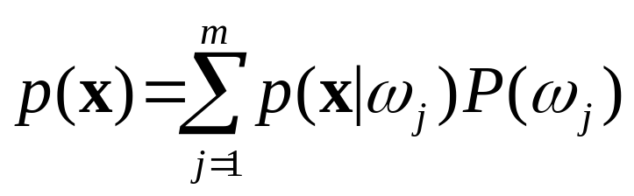
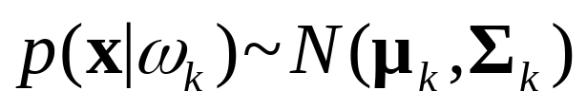
Mixture Densities
PDF is composed of a mixture of m components densities {ω₁,…,ω₂}:
Component PDF parameters and mixture weights P(ω_{j}) are typically unknown, making parameter estimation a form of unsupervised learning.
Gaussian mixtures assume Normal components:

Slide 5
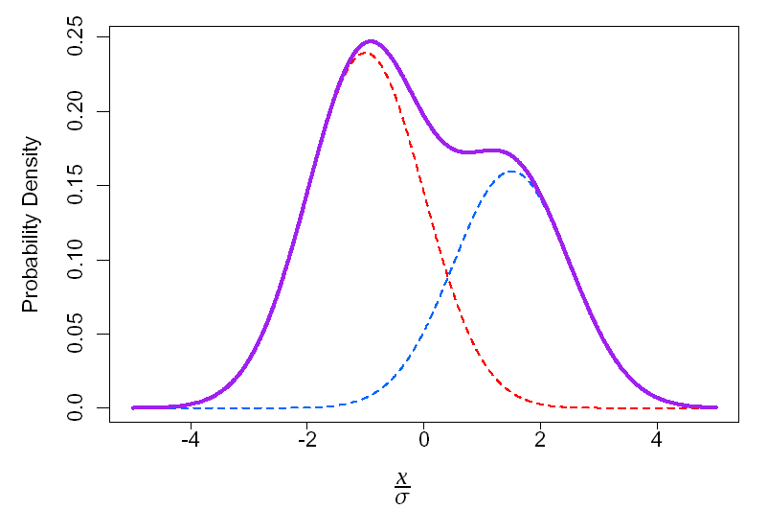
Gaussian Mixture Example: One Dimension
p(x)=0.6p₁(x)+0.4p₂(x)
p1(x)~N(-σ,σ²) p₂(x) ~N(1.5σ,σ²)

Slide 6
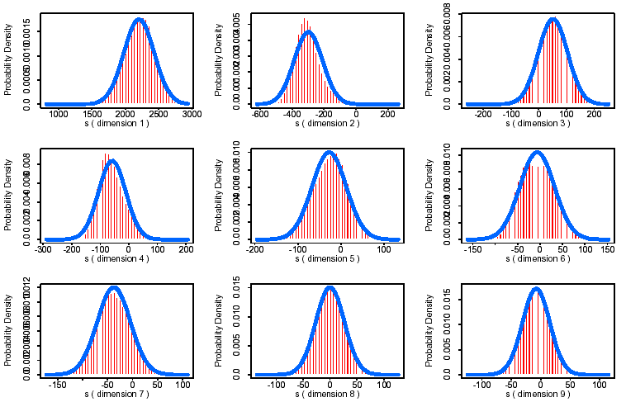
Gaussian Example
First 9 MFCC’s from [s]: Gaussian PDF

Slide 7
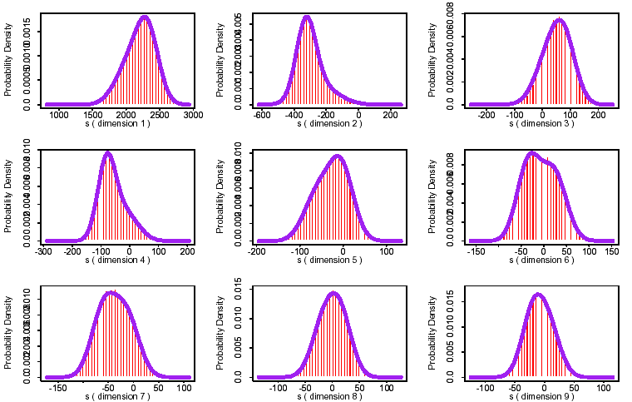
Independent Mixtures
[s]: 2 Gaussian Mixture Components/Dimension

Slide 8
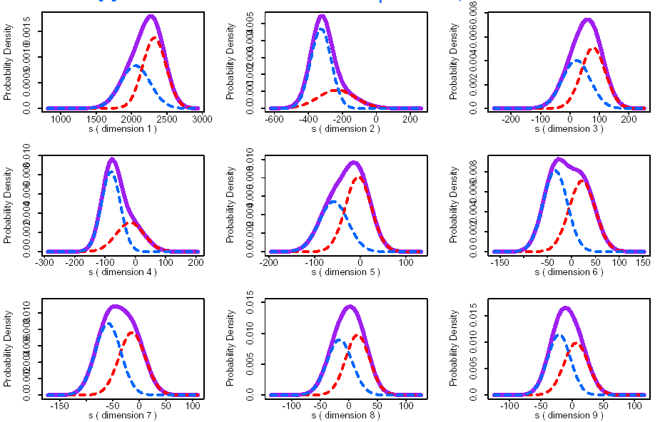
Mixture Components
[s]: 2 Gaussian Mixture Components/Dimension

Slide 9
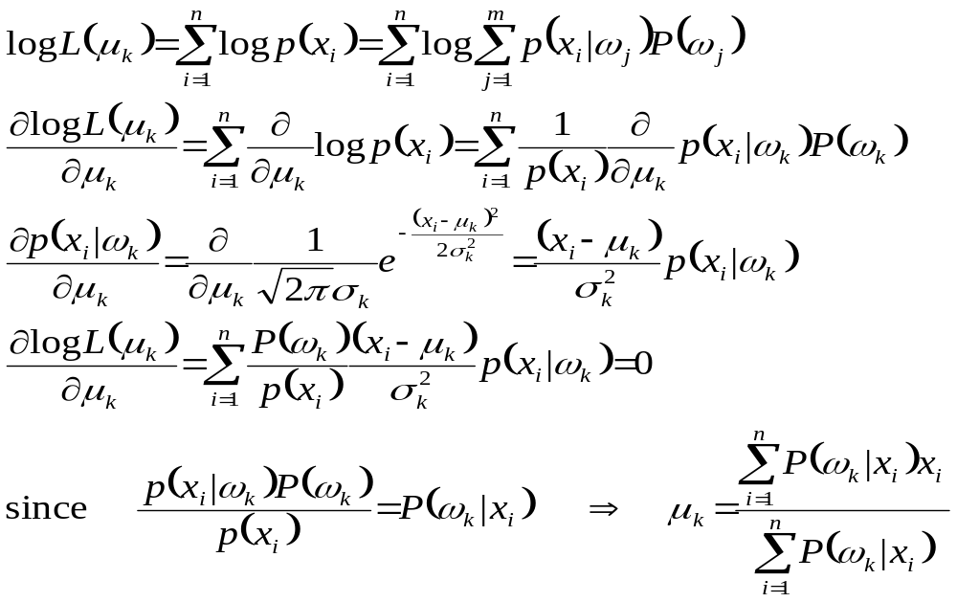
ML Parameter Estimation:
1D Gaussian Mixture Means

Slide 10
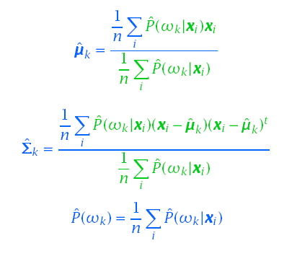
Gaussian Mixtures: ML Parameter Estimation
The maximum likelihood solutions are of the form:

Slide 11
Gaussian Mixtures: ML Parameter Estimation
The ML solutions are typically solved iteratively:
  Select a set of initial estimates for P(ω_{k}), µ_{k}, Σ_{k}
  Use a set of n samples to re-estimate the mixture parameters until some kind of convergence is found
Clustering procedures are often used to provide the initial parameter estimates
Similar to K-means clustering procedure
ˆ
ˆ
ˆ

Slide 12
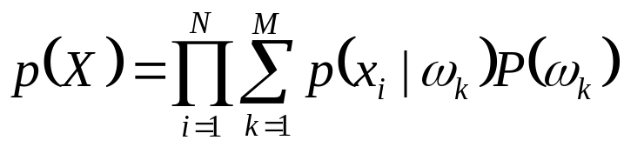
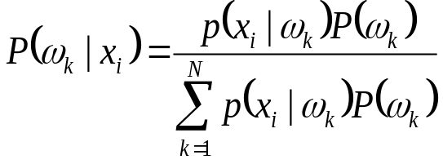
Example: 4 Samples, 2 Densities
Data: X = {x₁,x₂,x₃,x₄} = {2,1,-1,-2}
Init: p(x|ω₁)~N(1,1), p(x|ω₂)~N(-1,1), P(ω_{i})=0.5
Estimate:
Recompute mixture parameters (only shown for ω₁):
 | x₁ | x₂ | x₃ | x₄
P(ω₁|x) | 0.98 | 0.88 | 0.12 | 0.02
P(ω₂|x) | 0.02 | 0.12 | 0.88 | 0.98
p(X) ∝ (e^{-0.5} + e^{-4.5})(e⁰ + e⁻²)(e⁰ + e⁻²)(e^{-0.5} + e^{-4.5})0.5⁴

Slide 13
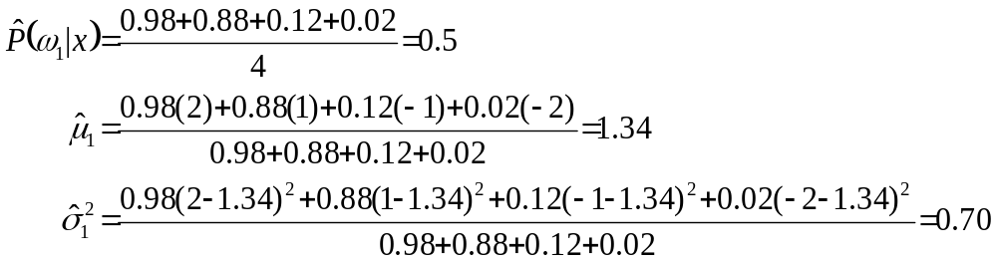
Example: 4 Samples, 2 Densities
Repeat steps 3,4 until convergence.

Slide 14
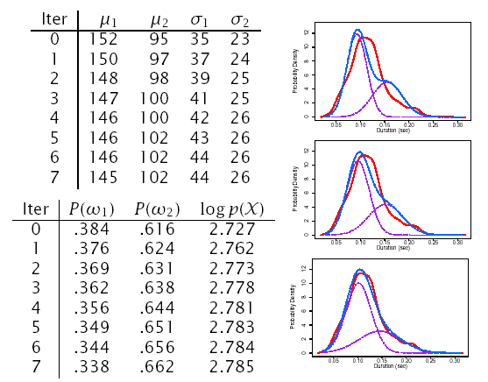
[s] Duration: 2 Densities

Slide 15
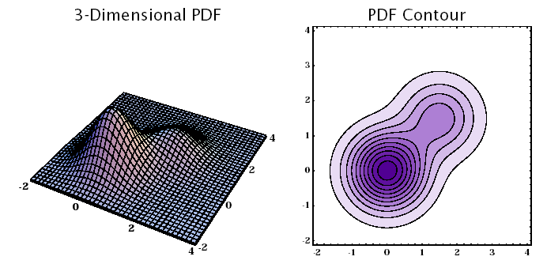
Gaussian Mixture Example: Two Dimensions

Slide 16
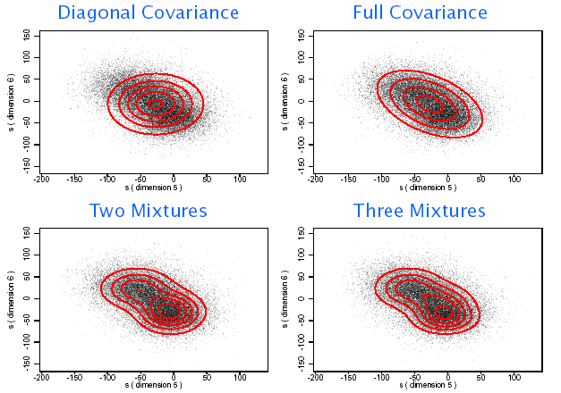
Two Dimensional Mixtures...

Slide 17
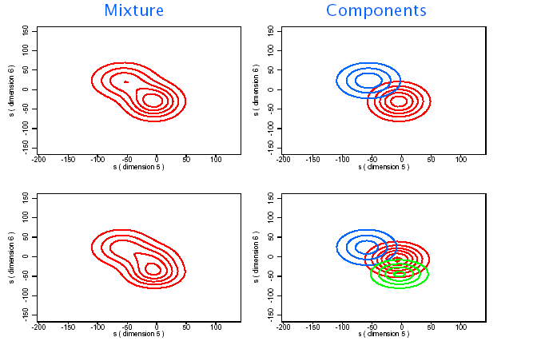
Two Dimensional Components

Slide 18
Mixture of Gaussians:
Implementation Variations
Diagonal Gaussians are often used instead of full-covariance Gaussians
  Can reduce the number of parameters
  Can potentially model the underlying PDF just as well if enough components are used
Mixture parameters are often constrained to be the same in order to reduce the number of parameters which need to be estimated
  Richter Gaussians share the same mean in order to better model the PDF tails
  Tied-Mixtures share the same Gaussian parameters across all classes. Only the mixture weights P(ω_{i}) are class specific. (Also known as semi-continuous)
ˆ

Slide 19
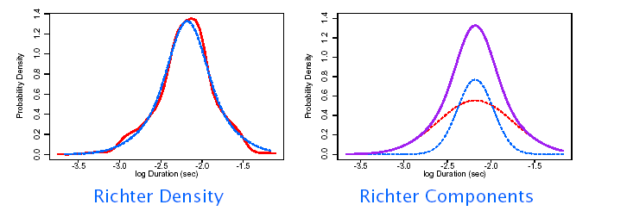
Richter Gaussian Mixtures
[s] Log Duration: 2 Richter Gaussians

Slide 20
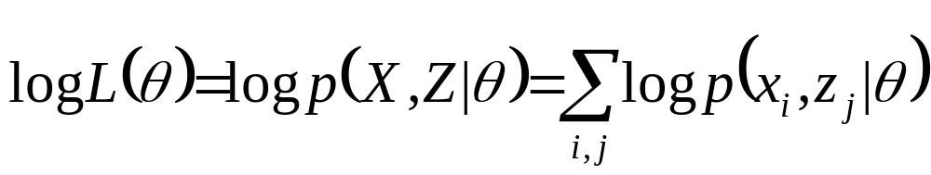
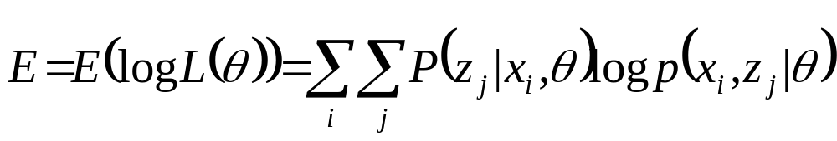
Expectation-Maximization (EM)
Used for determining parameters, θ, for incomplete data, X = {x_{i}} (i.e., unsupervised learning problems)
Introduces variable, Z = {z_{j}}, to make data complete so can be solved using conventional ML techniques
In reality, z_{j} can only be estimated by P(z_{j}|x_{i},θ), so we can only compute the expectation of log L(θ)
EM solutions are computed iteratively until convergence
  Compute the expectation of log L(θ)
  Compute the values θ^{j}, which maximize E

Slide 21
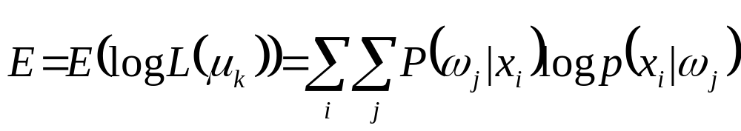
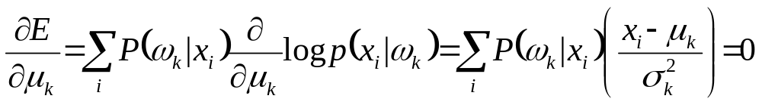
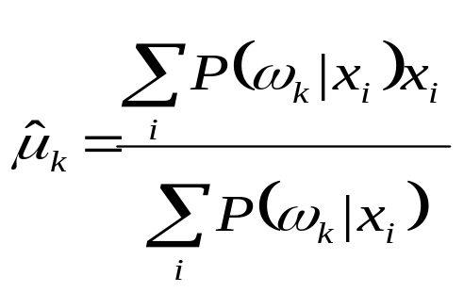
EM Parameter Estimation:
1D Gaussian Mixture Means
Let z_{i} be the component id, {ω_{j}}, which x_{i} belongs to
Convert to mixture component notation:
Differentiate with respect to μ_{k}:

Slide 22
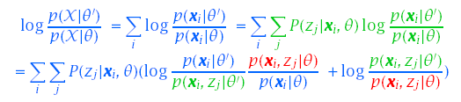

EM Properties
Each iteration of EM will increase the likelihood of X
Using Bayes rule and the Kullback-Liebler distance metric:

Slide 23

EM Properties
Since θ’ was determined to maximize E(log L(θ)):
Combining these two properties: p(X|θ’)≥ p(X|θ)

Slide 24
Dimensionality Reduction
Given a training set, PDF parameter estimation becomes less robust as dimensionality increases
Increasing dimensions can make it more difficult to obtain insights into any underlying structure
Analytical techniques exist which can transform a sample space to a different set of dimensions
  If original dimensions are correlated, the same information may require fewer dimensions
  The transformed space will often have more Normal distribution than the original space
  If the new dimensions are orthogonal, it could be easier to model the transformed space

Slide 25
Principal Components Analysis
Linearly transforms d-dimensional vector, x, to d’ dimensional vector, y, via orthonormal vectors, W
y=W^{t}x W={w₁,…,w_{d’}} W^{t}W=I
If d’<d, x can be only partially reconstructed from y
x=Wy
^
^

Slide 26
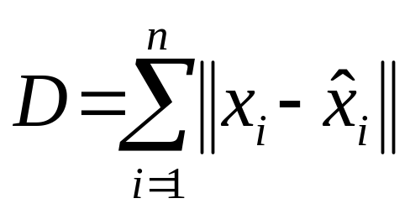
Principal Components Analysis
Principal components, W, minimize the distortion, D, between x, and x, on training data X = {x₁,…,x_{n}}
Also known as Karhunen-Loéve (K-L) expansion (w_{i}’s are sinusoids for some stochastic processes)

Slide 27
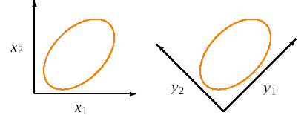
PCA Computation
W corresponds to the first d’ eigenvectors, P, of Σ
P= {e₁,…,e_{d}} Σ=PΛP^{t} w_{i} = e_{i}
Full covariance structure of original space, Σ, is transformed to a diagonal covariance structure Λ’
Eigenvalues, { λ₁,…, λ_{d’}}, represents the variances in Λ’

Slide 28
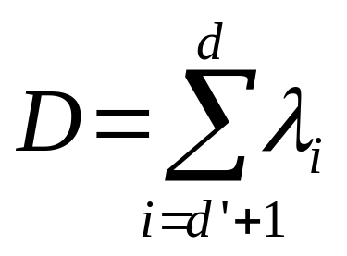
PCA Computation
Axes in d’-space contain maximum amount of variance

Slide 29
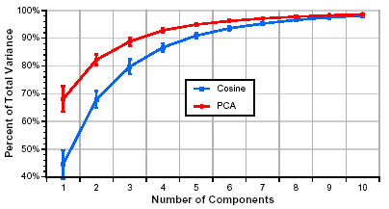
PCA Example
Original feature vector mean rate response (d = 40)
Data obtained from 100 speakers from TIMIT corpus
First 10 components explains 98% of total variance

Slide 30
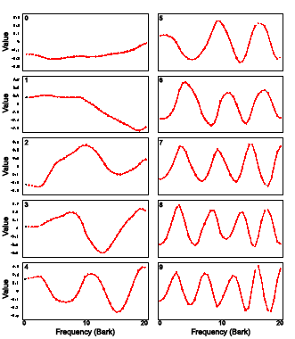
PCA Example

Slide 31
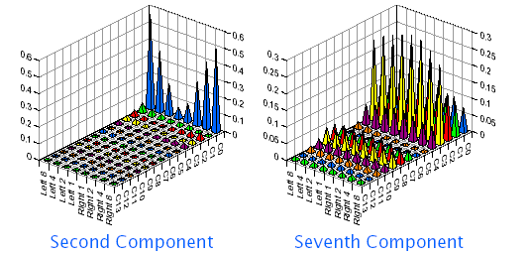
PCA for Boundary Classification
Eight non-uniform averages from 14 MFCCs
First 50 dimensions used for classification

Slide 32
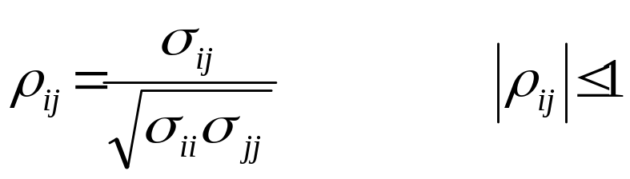
PCA Issues
PCA can be performed using
  Covariance matrixes Σ
  Correlation coefficients matrix P
P is usually preferred when the input dimensions have significantly different ranges
PCA can be used to normalize or whiten original d-dimensional space to simplify subsequent processing:
Σ⇒P⇒Λ⇒I
Whitening operation can be done in one step: z=V^{t}x

Slide 33
Significance Testing
To properly compare results from different classifier algorithms, A1, and A2, it is necessary to perform significance tests
  Large differences can be insignificant for small test sets
  Small differences can be significant for large test sets
General significance tests evaluate the hypothesis that the probability of being correct, p_{i}, of both algorithms is the same
The most powerful comparisons can be made using common train and test corpora, and common evaluation criterion
  Results reflect differences in algorithms rather than accidental differences in test sets
  Significance tests can be more precise when identical data are used since they can focus on tokens misclassified by only one algorithm, rather than on all tokens

Slide 34
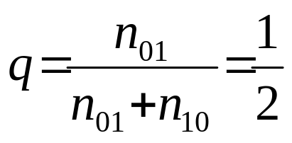
McNemar’s Significance Test
When algorithms A1 and A2 are tested on identical data we can collapse the results into a 2x2 matrix of counts
To compare algorithms, we test the null hypothesis H₀ that
  p₁ = p₂, or
  n₀₁ = n₁₀, or
A1/A2 | Correct | Incorrect
Correct | n₀₀ | n₀₁
Incorrect | n₁₀ | n₁₁

Slide 35
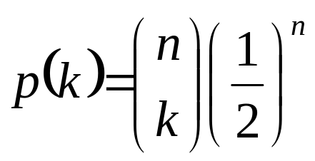
McNemar’s Significance Test
Given H₀, the probability of observing k tokens asymmetrically classified out of n = n₀₁ + n₁₀ has a Binomial PMF
McNemar’s Test measures the probability, P, of all cases that meet or exceed the observed asymmetric distribution, and tests P < α

Slide 36
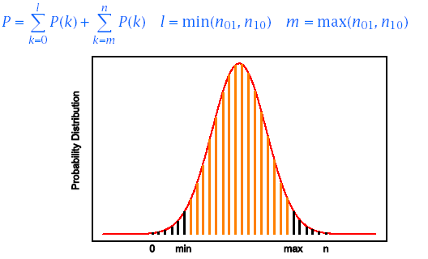
McNemar’s Significance Test
The probability, P, is computed by summing up the PMF tails
For large n, a Normal distribution is often assumed.

Slide 37
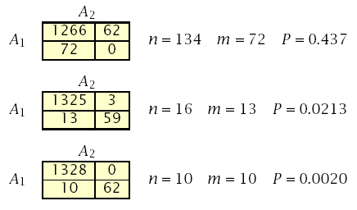
Significance Test Example (Gillick and Cox, 1989)
Common test set of 1400 tokens
Algorithms A1 and A2 make 72 and 62 errors
Are the differences significant?

Slide 38
References
Huang, Acero, and Hon, Spoken Language Processing, Prentice-Hall, 2001.
Duda, Hart and Stork, Pattern Classification, John Wiley & Sons, 2001.
Jelinek, Statistical Methods for Speech Recognition. MIT Press, 1997.
Bishop, Neural Networks for Pattern Recognition, Clarendon Press, 1995.
Gillick and Cox, Some Statistical Issues in the Comparison of Speech Recognition Algorithms, Proc. ICASSP, 1989.

