Slide 1
Speech Recognition
Pattern Classification 2

Slide 2
Pattern Classification
Introduction
Parametric classifiers
Semi-parametric classifiers
Dimensionality reduction
Significance testing

Slide 3
Semi-Parametric Classifiers
Mixture densities
Maximum Likelihood (ML) parameter estimation
Mixture implementations
Expectation maximization (EM)

Slide 4
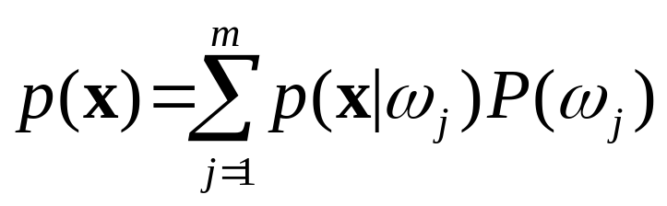
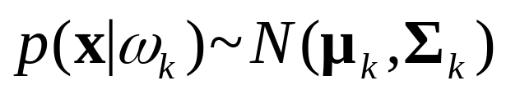
Mixture Densities
PDF is composed of a mixture of m components densities {ω₁,…,ω₂}:
Component PDF parameters and mixture weights P(ω_{j}) are typically unknown, making parameter estimation a form of unsupervised learning.
Gaussian mixtures assume Normal components:

Slide 5
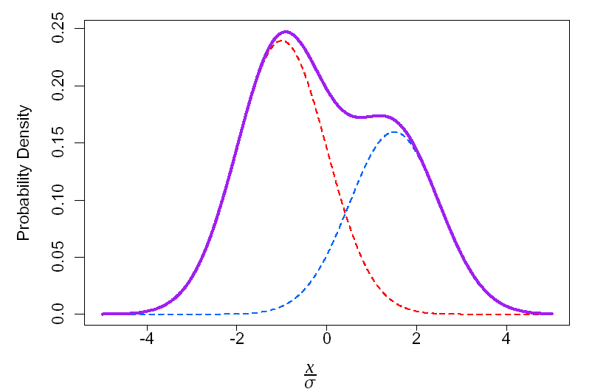
Gaussian Mixture Example: One Dimension
p(x)=0.6p₁(x)+0.4p₂(x)
p1(x)~N(-σ,σ²) p₂(x) ~N(1.5σ,σ²)

Slide 6
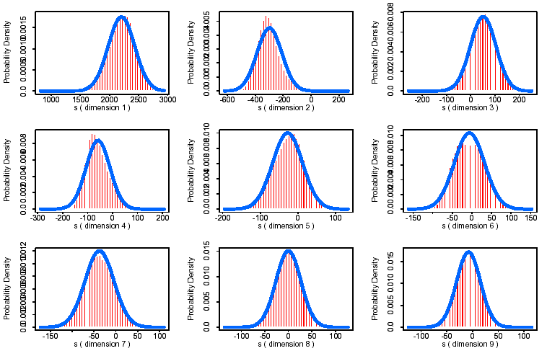
Gaussian Example
First 9 MFCC’s from [s]: Gaussian PDF

Slide 7
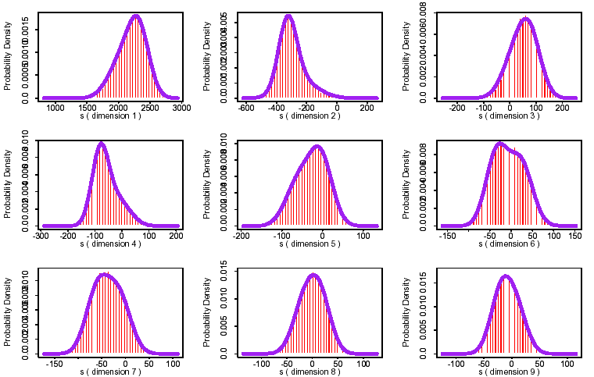
Independent Mixtures
[s]: 2 Gaussian Mixture Components/Dimension

Slide 8
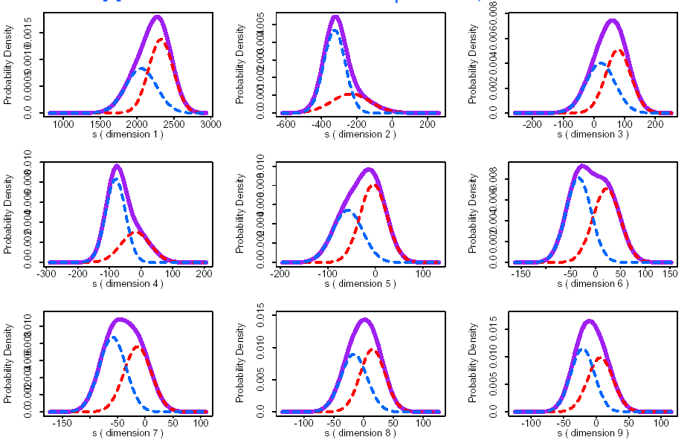
Mixture Components
[s]: 2 Gaussian Mixture Components/Dimension

Slide 9
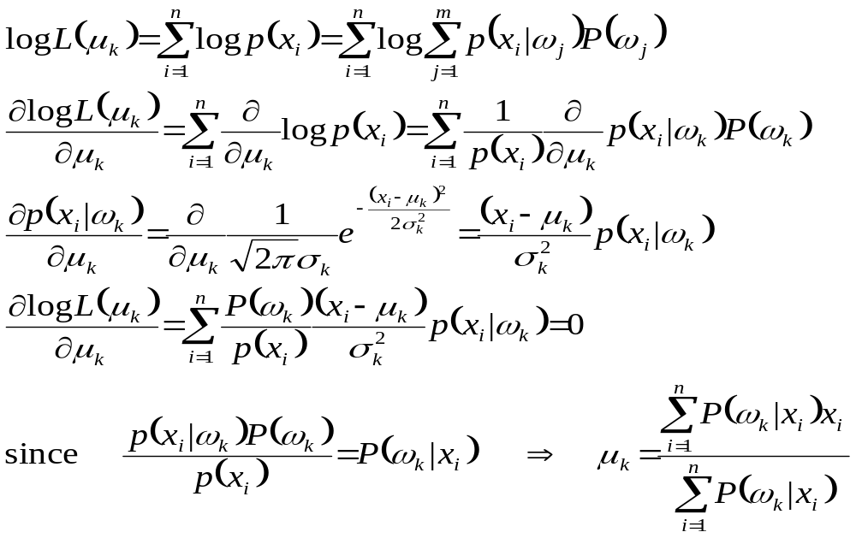
ML Parameter Estimation:
1D Gaussian Mixture Means

Slide 10
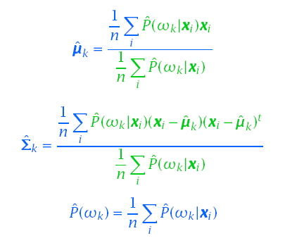
Gaussian Mixtures: ML Parameter Estimation
The maximum likelihood solutions are of the form:

Slide 11
Gaussian Mixtures: ML Parameter Estimation
The ML solutions are typically solved iteratively:
  Select a set of initial estimates for P(ω_{k}), µ_{k}, Σ_{k}
  Use a set of n samples to re-estimate the mixture parameters until some kind of convergence is found
Clustering procedures are often used to provide the initial parameter estimates
Similar to K-means clustering procedure
ˆ
ˆ
ˆ

Slide 12
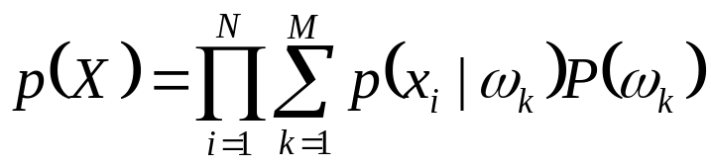
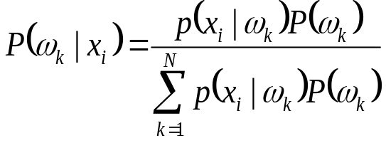
Example: 4 Samples, 2 Densities
Data: X = {x₁,x₂,x₃,x₄} = {2,1,-1,-2}
Init: p(x|ω₁)~N(1,1), p(x|ω₂)~N(-1,1), P(ω_{i})=0.5
Estimate:
Recompute mixture parameters (only shown for ω₁):
 | x₁ | x₂ | x₃ | x₄
P(ω₁|x) | 0.98 | 0.88 | 0.12 | 0.02
P(ω₂|x) | 0.02 | 0.12 | 0.88 | 0.98
p(X) ∝ (e^{-0.5} + e^{-4.5})(e⁰ + e⁻²)(e⁰ + e⁻²)(e^{-0.5} + e^{-4.5})0.5⁴

Slide 13
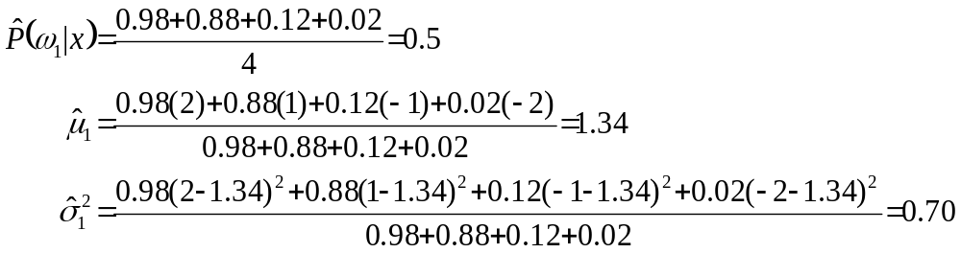
Example: 4 Samples, 2 Densities
Repeat steps 3,4 until convergence.

Slide 14
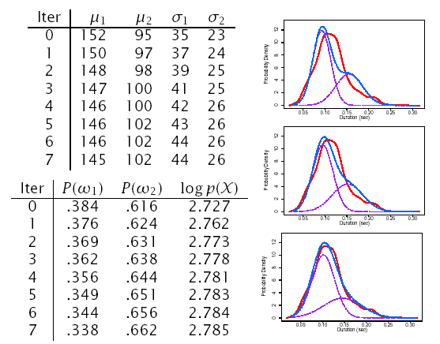
[s] Duration: 2 Densities

Slide 15
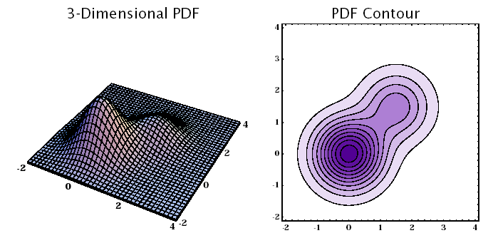
Gaussian Mixture Example: Two Dimensions

Slide 16
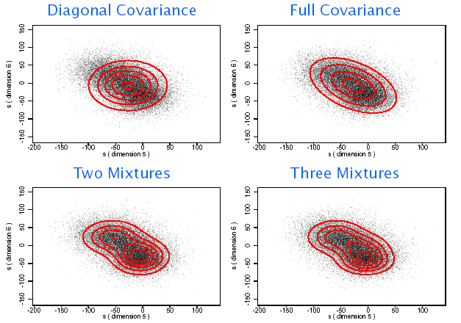
Two Dimensional Mixtures...

Slide 17
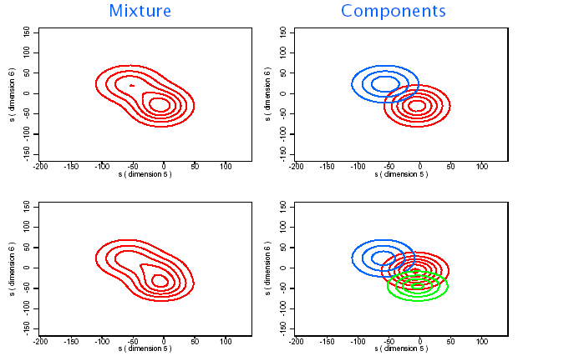
Two Dimensional Components

Slide 18
Mixture of Gaussians:
Implementation Variations
Diagonal Gaussians are often used instead of full-covariance Gaussians
  Can reduce the number of parameters
  Can potentially model the underlying PDF just as well if enough components are used
Mixture parameters are often constrained to be the same in order to reduce the number of parameters which need to be estimated
  Richter Gaussians share the same mean in order to better model the PDF tails
  Tied-Mixtures share the same Gaussian parameters across all classes. Only the mixture weights P(ω_{i}) are class specific. (Also known as semi-continuous)
ˆ

Slide 19
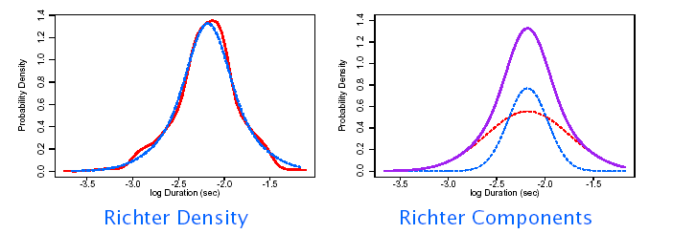
Richter Gaussian Mixtures
[s] Log Duration: 2 Richter Gaussians

Slide 20
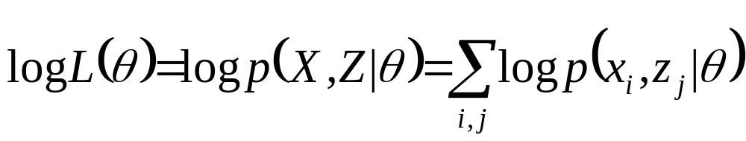
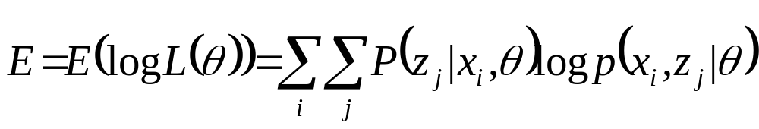
Expectation-Maximization (EM)
Used for determining parameters, θ, for incomplete data, X = {x_{i}} (i.e., unsupervised learning problems)
Introduces variable, Z = {z_{j}}, to make data complete so can be solved using conventional ML techniques
In reality, z_{j} can only be estimated by P(z_{j}|x_{i},θ), so we can only compute the expectation of log L(θ)
EM solutions are computed iteratively until convergence
  Compute the expectation of log L(θ)
  Compute the values θ^{j}, which maximize E

Slide 21
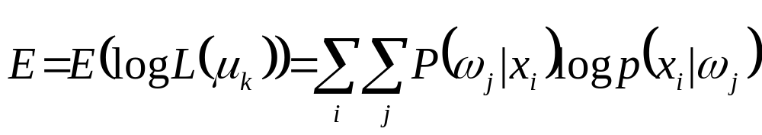
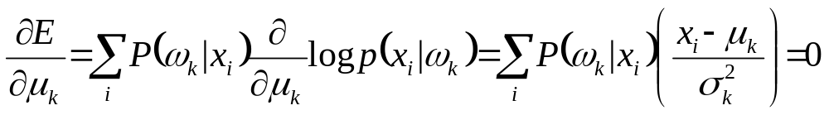
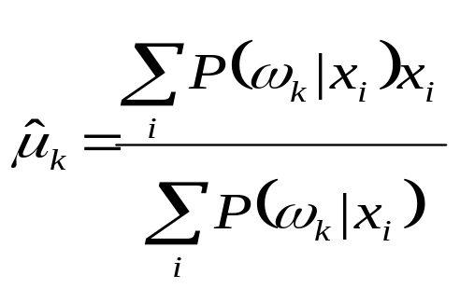
EM Parameter Estimation:
1D Gaussian Mixture Means
Let z_{i} be the component id, {ω_{j}}, which x_{i} belongs to
Convert to mixture component notation:
Differentiate with respect to μ_{k}:

Slide 22
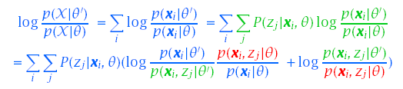

EM Properties
Each iteration of EM will increase the likelihood of X
Using Bayes rule and the Kullback-Liebler distance metric:

Slide 23

EM Properties
Since θ’ was determined to maximize E(log L(θ)):
Combining these two properties: p(X|θ’)≥ p(X|θ)

Slide 24
Dimensionality Reduction

Slide 25
Dimensionality Reduction
Given a training set, PDF parameter estimation becomes less robust as dimensionality increases
Increasing dimensions can make it more difficult to obtain insights into any underlying structure
Analytical techniques exist which can transform a sample space to a different set of dimensions
  If original dimensions are correlated, the same information may require fewer dimensions
  The transformed space will often have more Normal distribution than the original space
  If the new dimensions are orthogonal, it could be easier to model the transformed space

Slide 26
Principal Component Analysis
The Principal Component (or Karhunen-Loéve transform) is computed on a full training data set that has:
  μ - d dimensional vector, and
  Σ - d x d dimensinal covariance matrix
Eigenvalues and Eigenvectors are computed as discussed in following:

Slide 27


Eigenvectors and Eigenvalues
A very important class of matrixes have the following property:
M – matrix (dxd)
x – vector (d)
λ - scalar
The solution vector x = e_{i} and its corresponding scalar value λ = λ_{i} are called the eigenvector and associated eigenvalue.

Slide 28

Eigenvectors and Eigenvalues
If M is real and symmetric, there are d (possibly nondistinct) solution vectors: {e₁, e₂, …, e_{d}} each with associated eigenvalue: {λ₁, λ₂, …, λ_{d}}
Under multiplication with M eigenvectors are only changed in magnitude not direction
If M is diagonal, then the eigenvectors are parallel to the coordinate axes.

Slide 29
Eigenvectors and Eigenvalues
One method of finding the eigenvectors and eigenvalues is to solve the characteristic equation:
d (possibly nondistinct) roots are used by forming a set of linear equations to find associated eigevectors.

Slide 30
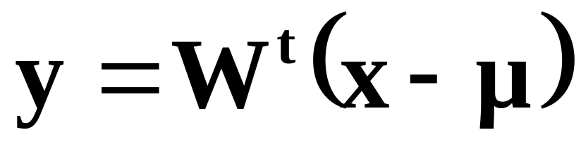
Principal Components Analysis
Given a covariance matrix of a full training data set Σ we compute eigenvalues and its corresponding eigenvectors.
  Eigenvalues are ordered in descending order based on their absolute value.
  First k out of d (d>k) largest eigenvalues: {λ₁, λ₂, …, λ_{κ}} and their corresponding eigenvectors {e₁, e₂, …, e_{k}} are selected.
  Matrix W (d x k) is formed whose columns consist of eigenvectors.
  The representation of data with reduced dimensionality is obtained by projecting original data onto the k-dimensional subspace according to:

Slide 31
Principal Components Analysis
Linearly transforms d-dimensional vector, x, to k dimensional vector, y, via orthonormal vectors, W
y=W^{t}(x-μ) W={w₁,…,w_{d’}} W^{t}W=I
If k<d, x can be only partially reconstructed from y
x=Wy+μ
^

Slide 32
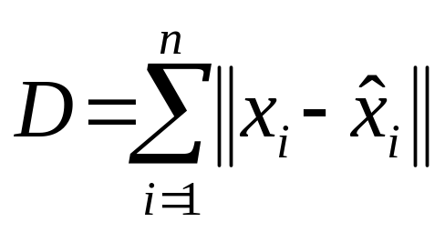
Principal Components Analysis
Principal components, W, minimize the distortion, D, between x, and x, on training data X = {x₁,…,x_{n}}
Also known as Karhunen-Loéve (K-L) expansion (w_{i}’s are sinusoids for some stochastic processes)
^

Slide 33
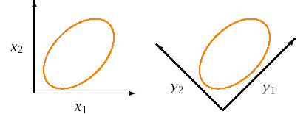
PCA Computation
W corresponds to the first k eigenvectors, P, of Σ
P= {e₁,…,e_{d}} Σ=PΛP^{t} w_{i} = e_{i}
Full covariance structure of original space, Σ, is transformed to a diagonal covariance structure Λ’
Eigenvalues, { λ₁,…, λ_{k}}, represents the variances in Λ’

Slide 34
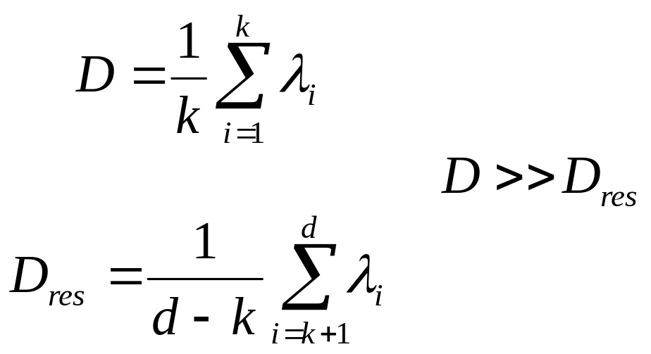
PCA Computation
Axes in k-space contain maximum amount of variance

Slide 35
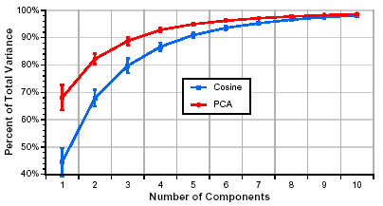
PCA Example
Original feature vector mean rate response (d = 40)
Data obtained from 100 speakers from TIMIT corpus
First 10 components explains 98% of total variance

Slide 36
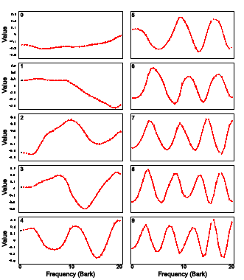
PCA Example

Slide 37
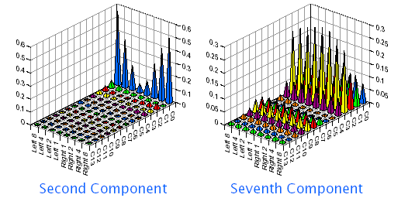
PCA for Boundary Classification
Eight non-uniform averages from 14 MFCCs
First 50 dimensions used for classification

Slide 38
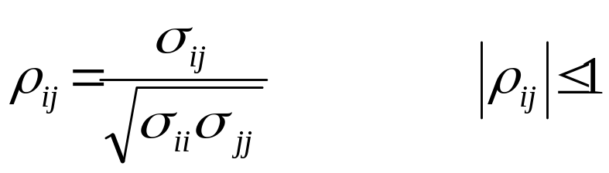
PCA Issues
PCA can be performed using
  Covariance matrixes Σ
  Correlation coefficients matrix P
P is usually preferred when the input dimensions have significantly different ranges
PCA can be used to normalize or whiten original d-dimensional space to simplify subsequent processing:
Σ⇒P⇒Λ⇒I
Whitening operation can be done in one step: z=V^{t}x

Slide 39
Significance Testing

Slide 40
Significance Testing
To properly compare results from different classifier algorithms, A1, and A2, it is necessary to perform significance tests
  Large differences can be insignificant for small test sets
  Small differences can be significant for large test sets
General significance tests evaluate the hypothesis that the probability of being correct, p_{i}, of both algorithms is the same
The most powerful comparisons can be made using common train and test corpora, and common evaluation criterion
  Results reflect differences in algorithms rather than accidental differences in test sets
  Significance tests can be more precise when identical data are used since they can focus on tokens misclassified by only one algorithm, rather than on all tokens

Slide 41
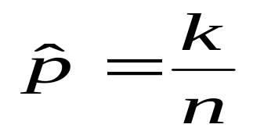
McNemar’s Significance Test
When algorithms A1 and A2 are tested on identical data we can collapse the results into a 2x2 matrix of counts
Suppose that the true unknown classification error rate of the classifier (algorithm) is p.
Suppose that in an experiment one observes that k out of n independent randomly drawn samples are misclassified.
If the random variable k has a binomial distribution B(n,p) then the maximum likelihood estimation for p should be:
A1/A2 | Correct | Incorrect
Correct | n₀₀ | n₀₁
Incorrect | n₁₀ | n₁₁

Slide 42
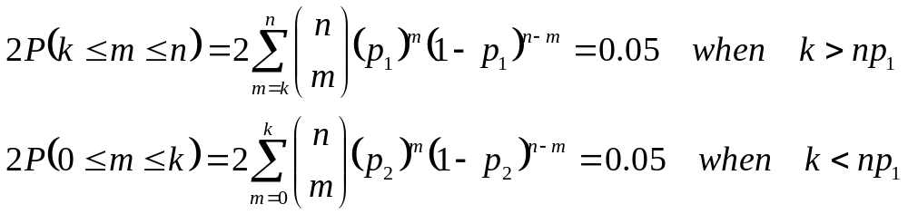
McNemar’s Significance Test
The statistical test for binomial distribution for a 0.05 significance level can be computed with the following equations to get the range (p₁,p₂)
Above equations are cumbersome to solve. The normal test is used instead.

Slide 43
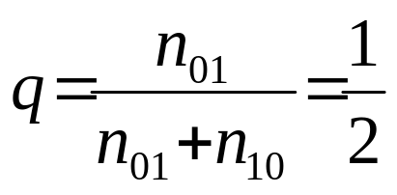
McNemar’s Significance Test
To compare algorithms, we test the null hypothesis H₀ that
  p₁ = p₂, or
  n₀₁ = n₁₀, or
  q_{ij} is defined as follows:
    q₀₀ = P(A1 and A2 classify the data correctly)
    q₀₁ = P(A1 classifies data correctly and A2 classifies the data incorrectly)
    q₁₀ = P(A1 classifies the data incorrectly and A2 classifies the data correctly)
    q₀₀ = P(A1 and A2 classify the data incorrectly)

Slide 44
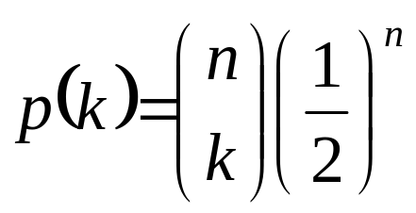
McNemar’s Significance Test
Given H₀, the probability of observing k tokens asymmetrically classified out of n = n₀₁ + n₁₀ has a Binomial PMF
McNemar’s Test measures the probability, P, of all cases that meet or exceed the observed asymmetric distribution, and tests P < α

Slide 45
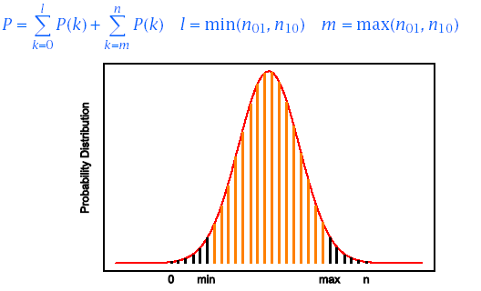
McNemar’s Significance Test
The probability, P, is computed by summing up the PMF tails
For large n, a Normal distribution is often assumed.

Slide 46
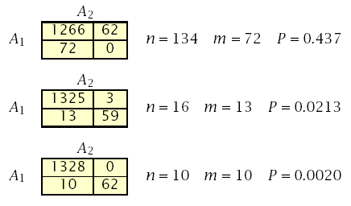
Significance Test Example (Gillick and Cox, 1989)
Common test set of 1400 tokens
Algorithms A1 and A2 make 72 and 62 errors
Are the differences significant?

Slide 47
References
Huang, Acero, and Hon, Spoken Language Processing, Prentice-Hall, 2001.
Duda, Hart and Stork, Pattern Classification, John Wiley & Sons, 2001.
Jelinek, Statistical Methods for Speech Recognition. MIT Press, 1997.
Bishop, Neural Networks for Pattern Recognition, Clarendon Press, 1995.
Gillick and Cox, Some Statistical Issues in the Comparison of Speech Recognition Algorithms, Proc. ICASSP, 1989.

Slide 48
Speech Recognition
Hidden Markov Models for Speech Recognition

Slide 49
Outline
Introduction
  Information Theoretic Approach to Automatic Speech Recognition
Problem formulation
  Discrete Markov Processes
Forward-Backward algorithm
Viterbi search
Baum-Welch parameter estimation
Other considerations
  Multiple observation sequences
  Phone-based models for continuous speech recognition
  Continuous density HMMs
  Implementation issues

Slide 50
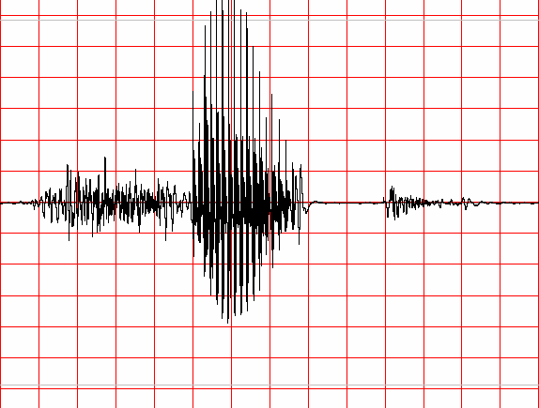
Information Theoretic Approach to ASR
Speaker's
Mind
Speech
Producer
Acoustic
Processor
Linguistic
Decoder
W
Speech
A
Ŵ
Speaker
Acoustic Channel
Speech Recognizer
Statistical Formulation of Speech Recognition
A – denotes the acoustic evidence (collection of feature vectors, or data in general) based on which recognizer will make its decision about which words were spoken.
W – denotes a string of words each belonging to a fixed and known vocabulary.

Slide 51
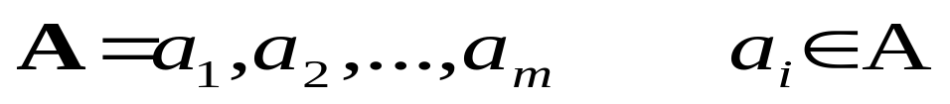

Information Theoretic Approach to ASR
  Assume that A is a sequence of symbols taken from some alphabet A.
  W – denotes a string of n words each belonging to a fixed and known vocabulary V.

Slide 52
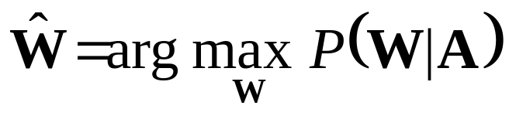
Information Theoretic Approach to ASR
  If P(W|A) denotes the probability that the words W were spoken, given that the evidence A was observed, then the recognizer should decide in favor of a word string Ŵ satisfying:
  The recognizer will pick the most likely word string given the observed acoustic evidence.

Slide 53
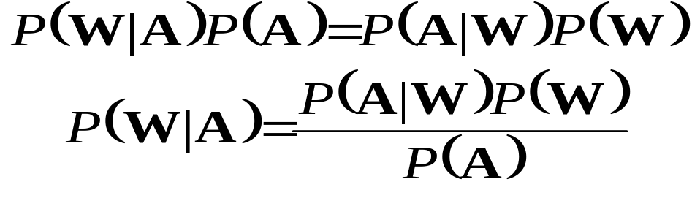
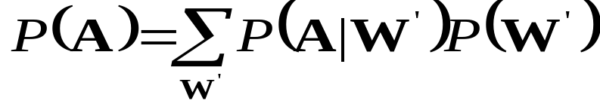
Information Theoretic Approach to ASR
From the well known Bayes’ rule of probability theory:
P(W) – Probability that the word string W will be uttered
P(A|W) – Probability that when W was uttered the acoustic evidence A will be observed
P(A) – is the average probability that A will be observed:

Slide 54
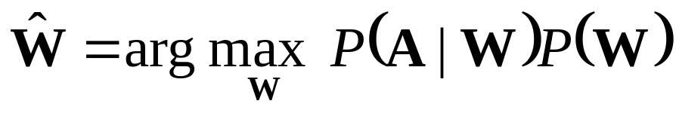
Information Theoretic Approach to ASR
Since Maximization in:
Is carried out with the variable A fixed (e.g., there is not other acoustic data save the one we are give), it follows from Baye’s rule that the recognizer’s aim is to find the word string Ŵ that maximizes the product P(A|W)P(W), that is

Slide 55
Markov Processes
About Markov Chains
  Sequence of a Discrete Value Random Variable:
    X₁, X₂, …, X_{n}
  Set of N Distinct States
    Q = {1,2,…,N}
  Time Instants
    t={t₁,t₂,…}
  Corresponding State at Time Instant
    q_{t} at time t

Slide 56
Discrete-Time Markov Processes Examples
Consider a simple three-state Markov Model of the weather as shown:
State 1: Precipitation (rain or snow)
State 2: Cloudy
State 3: Sunny
0.4
0.3
0.6
1
2
0.2
0.1
0.1
0.3
0.2
3
0.8

Slide 57
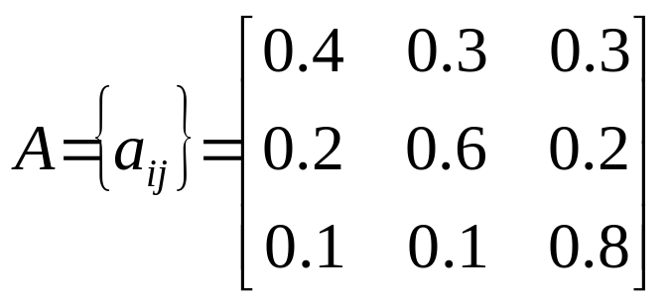
Discrete-Time Markov Processes Examples
Matrix of state transition probabilities:
Given the model in the previous slide we can now ask (and answer) several interesting questions about weather patterns over time.

Slide 58
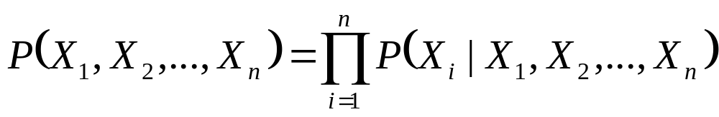
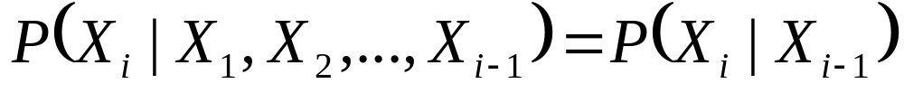
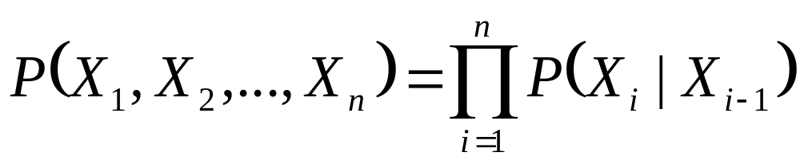
Bayesian Formulation under Independence Assumption
Bayes Formula:
  Probability of an Observation Sequence
  First Order Markov Chain is defined when Bayes formula holds under following simplification:
  Thus:

Slide 59
Markov Chain
Random Process has the simplest memory in First Order Markov Chain:
  The value at time t_{i} depends only on the value at the preceding time t_{i-1} and on
  Nothing that went on before

Slide 60
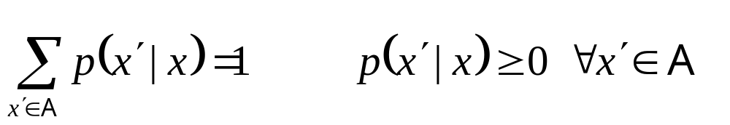
Definitions
Time Invariant (Homogeneous):
i.e. is not dependent on i.
Transition Probability Function p(x’,x) – N x N Matrix
For all x ∈ A

Slide 61
Definitions
Definition of State Transition Probability:
  a_{ij} = P(q_{t+1}=s_{j}|q_{t}=s_{i}), 1 ≤ i,j ≤ N

Slide 62
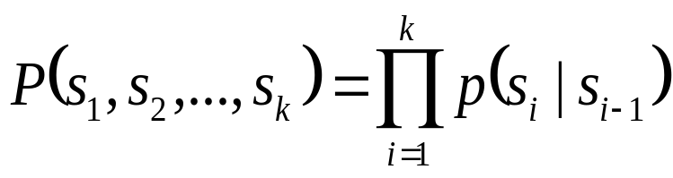
Discrete-Time Markov Processes Examples
Problem 1:
  What is the probability (according to the model) that the weather for eight consecutive days is “sun-sun-sun-rain-sun-cloudy-sun”?
Solution:
  Define the observation sequence, O, as:
  Day 1 2 3 4 5 6 7 8
    O = ( sunny, sunny, sunny, rain, rain, sunny, cloudy, sunny )
    O = ( 3, 3, 3, 1, 1, 3, 2, 3 )
  Want to calculate P(O|Model), the probability of observation sequence O, given the model of previous slide. Given that:

Slide 63
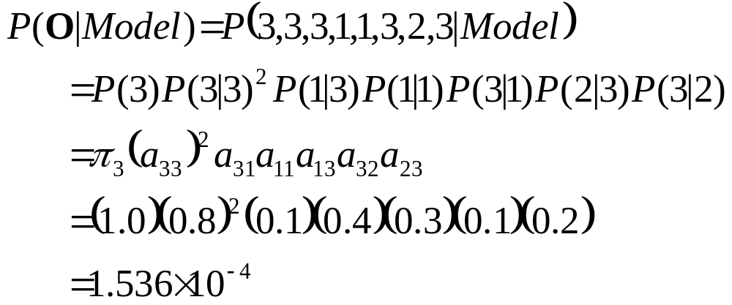
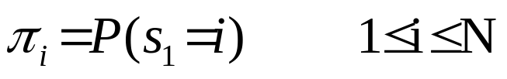
Discrete-Time Markov Processes Examples
Above the following notation was used

Slide 64

Discrete-Time Markov Processes Examples
Problem 2:
  Given that the system is in a known state, what is the probability (according to the model) that it stays in that state for d consecutive days?
Solution
  Day 1 2 3 d d+1
    O = ( i, i, i, …, i, j≠i )
The quantity p_{i}(d) is the probability
distribution function of duration d in
state i. This exponential distribution is
characteristic of the sate duration in
Markov Chains.

Slide 65


Discrete-Time Markov Processes Examples
  Expected number of observations (duration) in a state conditioned on starting in that state can be computed as ⇨
  Thus, according to the model, the expected number of consecutive days of
    Sunny weather: 1/0.2=5
    Cloudy weather: 2.5
    Rainy weather: 1.67
Exercise Problem: Derive the above formula or directly mean of p_{i}(d)
Hint:

Slide 66
Extensions to Hidden Markov Model
In the examples considered only Markov models in which each state corresponded to a deterministically observable event.
This model is too restrictive to be applicable to many problems of interest.
Obvious extension is to have observation probabilities to be a function of the state, that is, the resulting model is doubly embedded stochastic process with an underlying stochastic process that is not directly observable (it is hidden) but can be observed only through another set of stochastic processes that produce the sequence of observations.

Slide 67
Elements of a Discrete HMM
N: number of states in the model
  states s = {s₁,s₂,...,s_{N}}
  state at time t, q_{t} ∈ s
M: number of (distinct) observation symbols (i.e., discrete observations) per state
  observation symbols, V = {v₁,v₂,...,v_{M} }
  observation at time t, o_{t} ∈ V
A = {a_{ij}}: state transition probability distribution
  a_{ij} = P(q_{t+1}=s_{j}|q_{t}=s_{i}), 1 ≤ i,j ≤ N
B = {b_{j}}: observation symbol probability distribution in state j
  b_{j}(k) = P(v_{k} at t|q_{t}=s_{j} ), 1 ≤ j ≤ N, 1 ≤ k ≤ M
π = {π_{i}}: initial state distribution
  π_{i} = P(q₁=s_{i} ) 1 ≤ i ≤ N
HMM is typically written as: λ = {A, B, π}
  This notation also defines/includes the probability measure for O, i.e., P(O|λ)

Slide 68
State View of Markov Chain
Finite State Process
Transitions between states specified by p(x’,x)
For a small alphabet A Markov Chain can be specified by a diagram as in next figure:
p(1|3)
p(1|1)
1
p(3|1)
3
p(3|2)
p(2|3)
2
p(2|1)
Example of Three State Markov Chain

Slide 69


One-Step Memory of Markov Chain
Does not restrict in modeling processes of arbitrary complexity:
Define Random Variable X_{i}:
Then the Z-sequence specifies the X-sequence, and vice versa
The X process is a Markov Chain for which formula holds.
Resulting space is very large and the Z process can be characterized directly in a much simpler way.

Slide 70
The Hidden Markov Model Concept
Two goals:
  More Freedom to model the random process
  Avoid Substantial Complication to the basic structure of Markov Chains.
Allow states of the chain to generate observable data while hiding the state sequence itself.

Slide 71
Definitions
An Output Alphabet:
v = {v₁,v₂,...,v_{M} }
A state space with a unique starting state s₀:
S = {s₁,s₂,...,s_{N}}
A probability distribution of transitions between states:
p(s’|s)
An output probability distribution associated with transitions from state s to state s’:
b(o|s,s’)

Slide 72

Hidden Markov Model
Probability of observing an HMM output string o₁,o₂,..o_{k} is:
Example of an HMM with b=2 and c=3
b(o|3,1)
p(1|3)
1
b(o|1,2)
1
b(o|1,3)
3
1
0
3
p(1|1)
p(3|1)
b(o|2,3)
0
b(o|3,2)
0
1
p(3|2)
1
1
p(2|3)
b(o|2,1)
2
2
p(2|1)
0

Slide 73

Hidden Markov Model
Underlying State Process still has only one-step memory:
The memory of observables is unlimited. For k≥2:
Advantage:
  Each HMM transition can be identified with a different identifier t and
  Define an output function Y(t) that assigns to t a unique output symbol taken from the output alphabet Y.

Slide 74

Hidden Markov Model
For a transition t denote:
  L(t) – source state
  R(t) – target state
  p(t) – probability that the state is exited via the transition t
  Thus for all s ∈ S

Slide 75

Hidden Markov Model
Correspondence between two ways of viewing an HMM:
When transitions determine outputs, the probability:

Slide 76

Hidden Markov Model
More Formal Formulation:
Both HMM views important depending on the problem at hand:
  Multiple transitions between states s and s’,
  Multiple possible outputs generated by the single transition s→s’

Slide 77

Trellis
Example of HMM with output symbols associated with transitions
Offers easy way to calculate probability:
Trellis of two different stages for outputs 0 and 1
o=0
1
1
1
1
0
3
2
2
0
0
1
1
1
3
3
2
o=1
0
1
1
2
2
3
3

Slide 78
Trellis of the sequence 0110
1
1
1
1
1
2
2
2
2
2
3
3
3
3
3
o=0
o=1
o=1
o=0
s₀
1
1
1
1
1
2
2
2
2
2
3
3
3
3
3
t=1
t=2
t=2
t=3
t=4

Slide 79


Probability of an Observation Sequence
Recursive computation of the Probability of the observation sequence:
Define:
  A system with N distinct states S = {s₁,s₂,…,s_{N}}
  Time instances associated with state changes as t=1,2,…
  Actual state at time t as s_{t}
  State-transition probabilities as:
a_{ij} = p(s_{t}=j|s_{t-i}=i), 1≤i,j≤N
  State-transition probability properties
a_{ij}
j
i

Slide 80


Computation of P(O|λ)
Wish to calculate the probability of the observation sequence, O={o₁,o₂,...,o_{T}} given the model λ.
The most straight forward way is through enumeration of every possible state sequence of length T (the number of observations). Thus there are N^{T} such state sequences:
Where:

Slide 81



Computation of P(O|λ)
Consider the fixed state sequence: Q= q₁q₂ ...q_{T}
The probability of the observation sequence O given the state sequence, assuming statistical independence of observations, is:
Thus:
The probability of such a state sequence Q can be written as:

Slide 82

Computation of P(O|λ)
The joint probability of O and Q, i.e., the probability that O and Q occur simultaneously, is simply the product of the previous terms:
The probability of O given the model λ is obtained by summing this joint probability over all possible state sequences Q :

Slide 83
Computation of P(O|λ)
Interpretation of the previous expression:
  Initially at time t=1 we are in state q₁ with probability π_{q1}, and generate the symbol o₁ (in this state) with probability b_{q1}(o₁).
  In the next time instance t=t+1 (t=2) transition is made to state q₂ from state q₁ with probability a_{q1q2} and generate the symbol o₂ with probability b_{q2}(o₂).
  Process is repeated until the last transition is made at time T from state q_{T} from state q_{T-1} with probability a_{qT-1qT} and generate the symbol o_{T} with probability b_{qT}(o_{T}).

Slide 84
Computation of P(O|λ)
Practical Problem:
  Calculation required ≈ 2T · N^{T} (there are N^{T} such sequences)
  For example: N =5 (states),T = 100 (observations) ⇒ 2 · 100 · 5¹⁰⁰ = 10⁷² computations!
  More efficient procedure is required ⇒ Forward Algorithm

Slide 85


The Forward Algorithm
Let us define the forward variable, α_{t}(i), as the probability of the partial observation sequence up to time t and state s_{i} at time t, given the model λ, i.e.
It can be easily shown that:
Thus the algorithm:

Slide 86



The Forward Algorithm
Initialization
Induction
Termination
t
t+1
s₁
s₂
a_{1j}
a_{2j}
s₃
a_{3j}
s_{j}
a_{Nj}
s_{N}
α_{t}(i)
α_{t+1}(j)

Slide 87

The Forward Algorithm

Slide 88
References
Huang, Acero, and Hon, Spoken Language Processing, Prentice-Hall, 2001.
Rabiner, Juang, Fundamentals of Speech Recognition, Prentice-Hall, 1993.
Jelinek, Statistical Methods for Speech Recognition. MIT Press, 1997.
Duda, Hart and Stork, Pattern Classification, John Wiley & Sons, 2001.
Bishop, Neural Networks for Pattern Recognition, Clarendon Press, 1995.
Gillick and Cox, Some Statistical Issues in the Comparison of Speech Recognition Algorithms, Proc. ICASSP, 1989.

