Slide 1
Speech Recognition
Hidden Markov Models

Slide 2
Outline
Introduction
Problem formulation
Forward-Backward algorithm
Viterbi search
Baum-Welch parameter estimation
Other considerations
  Multiple observation sequences
  Phone-based models for continuous speech recognition
  Continuous density HMMs
  Implementation issues

Slide 3
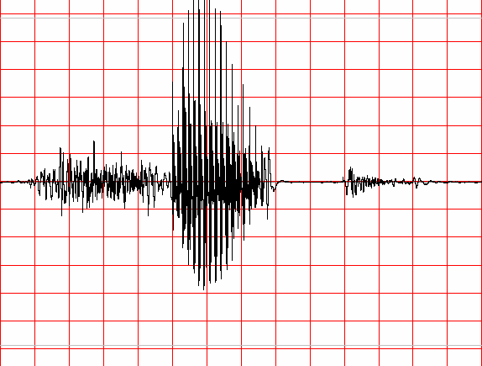
Information Theoretic Approach to ASR
Speaker's
Mind
Speech
Producer
Acoustic
Processor
Linguistic
Decoder
W
Speech
A
Ŵ
Speaker
Acoustic Channel
Speech Recognizer
Statistical Formulation of Speech Recognition
A – denotes the acoustic evidence (collection of feature vectors, or data in general) based on which recognizer will make its decision about which words were spoken.
W – denotes a string of words each belonging to a fixed and known vocabulary.

Slide 4
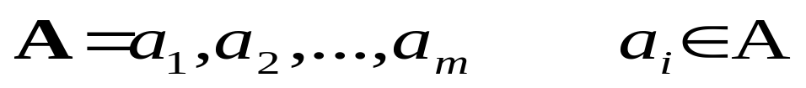
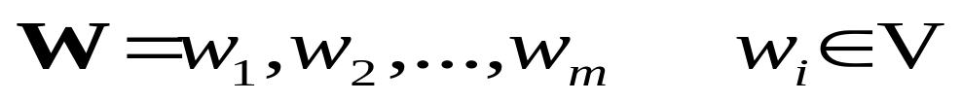
Information Theoretic Approach to ASR
  Assume that A is a sequence of symbols taken from some alphabet A.
  W – denotes a string of n words each belonging to a fixed and known vocabulary V.

Slide 5
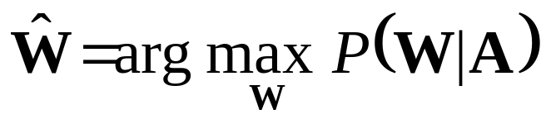
Information Theoretic Approach to ASR
  If P(W|A) denotes the probability that the words W were spoken, given that the evidence A was observed, then the recognizer should decide in favor of a word string Ŵ satisfying:
  The recognizer will pick the most likely word string given the observed acoustic evidence.

Slide 6
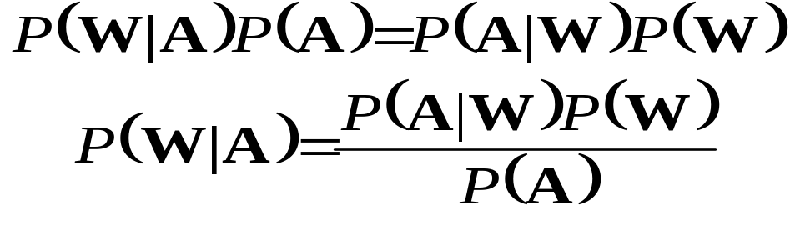
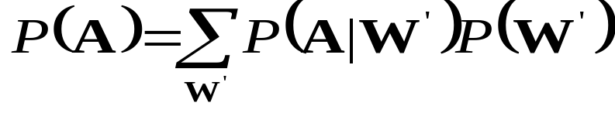
Information Theoretic Approach to ASR
From the well known Bayes’ rule of probability theory:
P(W) – Probability that the word string W will be uttered
P(A|W) – Probability that when W was uttered the acoustic evidence A will be observed
P(A) – is the average probability that A will be observed:

Slide 7
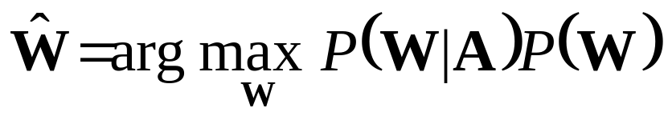
Information Theoretic Approach to ASR
Since Maximization in:
Is carried out with the variable A fixed (e.g., there is not other acoustic data save the one we are give), it follows from Baye’s rule that the recognizer’s aim is to find the word string Ŵ that maximizes the product P(A|W)P(W), that is

Slide 8
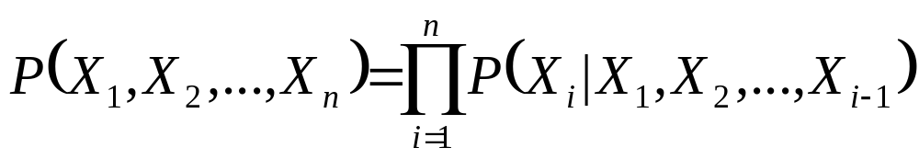

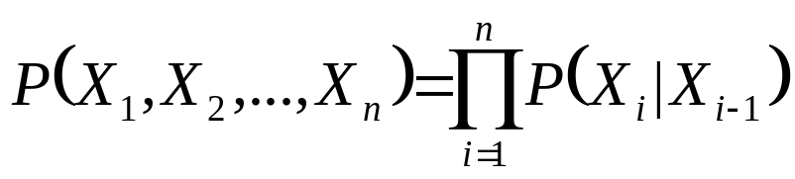
Hidden Markov Models
About Markov Chains:
  Let X₁, X₂, …, X_{n}, … be a sequence of random variables taking their values in the same finite alphabet χ = {1,2,3,…,c}. If nothing more is said then Bayes’ formula applies:
  The random variables are said to form a Markov chain, however, if
  Thus for Markov chains the following holds:

Slide 9

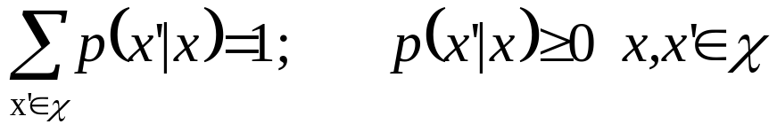
Markov Chains
The Markov chain is time invariant or homogeneous if regardless of the value of the time index i,
p(x’|x) – referred to as transition function and can be represented as a c x c matrix and it satisfies the usual conditions:
One can think of the values of X_{i} as sates and thus of the Markov chain as a finite state process with transitions between states specified by the function p(x’|x).

Slide 10
Markov Chains
If the alphabet χ is not too large then the chain can be completely specified by an intuitively appealing diagram presented below:
Arrows with attached transition probability values mark the transitions between states
Missing transitions imply zero transition probability: p(1|2)=p(2|2)=p(3|3)=0.
p(1|3)
1
p(3|1)
3
p(3|2)
p(1|1)
p(2|1)
2
p(2|3)

Slide 11
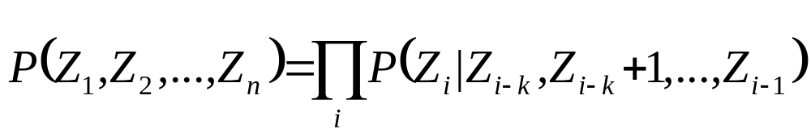

Markov Chains
Markov chains are capable of modeling processes of arbitrary complexity even though they are restricted to one-step memory:
  Consider a process Z₁, Z₂, …, Z_{n},… of memory length k:
  If we define new random variables:
  Then Z sequence specifies X-sequence (and vice versa), and
  X process is a Markov chain as defined earlier.

Slide 12
Hidden Markov Model Concept
Hidden Markov Models allow more freedom to the random process while avoiding a substantial complications to the basic structure of Markov chains.
This freedom can be gained by letting the states of the chain generate observable data while hiding the sate sequence itself from the observer.

Slide 13
Hidden Markov Model Concept
Focus on three fundamental problems of HMM design:
  The evaluation of the probability (likelihood) of a sequence of observations given a specific HMM;
  The determination of a best sequence of model states;
  The adjustment of model parameters so as to best account for the observed signal.

Slide 14
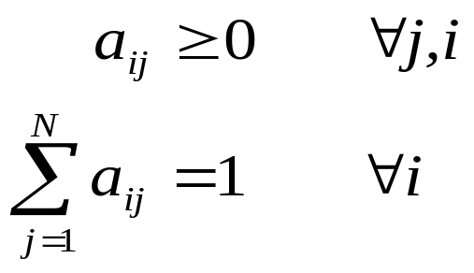
Discrete-Time Markov Processes Examples
Define:
  A system with N distinct states S = {1,2,…,N}
  Time instances associated with state changes as t=1,2,…
  Actual state at time t as s_{t}
  State-transition probabilities as:
a_{ij} = p(s_{t}=j|s_{t-i}=i), 1≤i,j≤N
  State-transition probability properties
a_{ij}
j
i

Slide 15
Discrete-Time Markov Processes Examples
Consider a simple three-state Markov Model of the weather as shown:
State 1: Precipitation (rain or snow)
State 2: Cloudy
State 3: Sunny
0.4
0.3
0.6
1
2
0.2
0.1
0.1
0.3
0.2
3
0.8

Slide 16
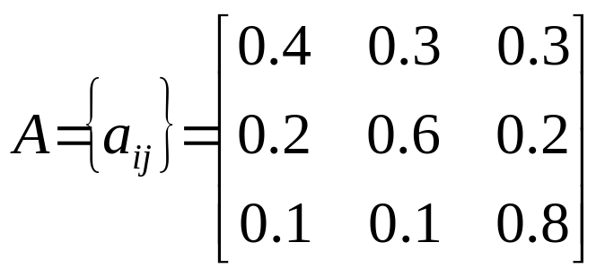
Discrete-Time Markov Processes Examples
Matrix of state transition probabilities:
Given the model in the previous slide we can now ask (and answer) several interesting questions about weather patterns over time.

Slide 17
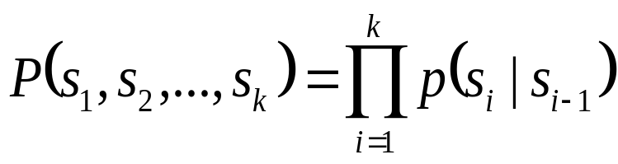
Discrete-Time Markov Processes Examples
Problem 1:
  What is the probability (according to the model) that the weather for eight consecutive days is “sun-sun-sun-rain-sun-cloudy-sun”?
Solution:
  Define the observation sequence, O, as:
  Day 1 2 3 4 5 6 7 8
    O = ( sunny, sunny, sunny, rain, rain, sunny, cloudy, sunny )
    O = ( 3, 3, 3, 1, 1, 3, 2, 3 )
  Want to calculate P(O|Model), the probability of observation sequence O, given the model of previous slide. Given that:

Slide 18
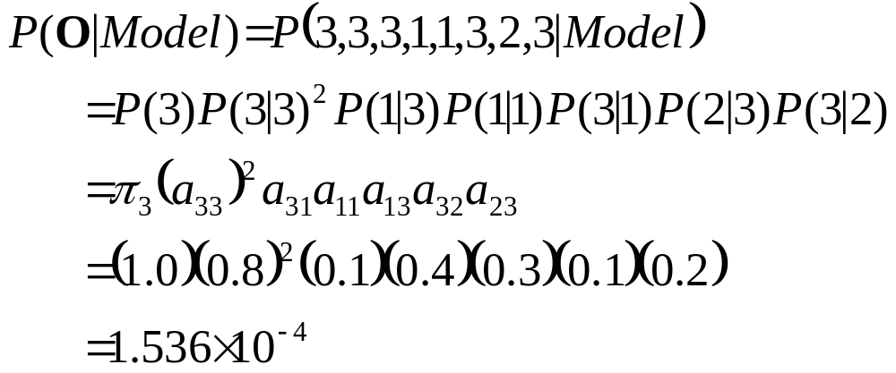
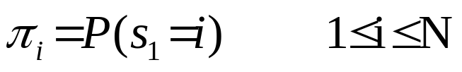
Discrete-Time Markov Processes Examples
Above the following notation was used

Slide 19
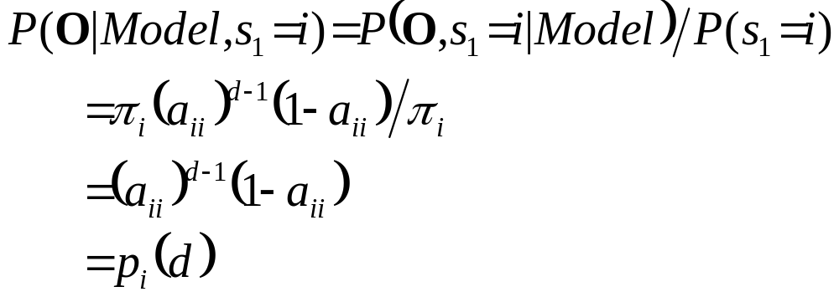
Discrete-Time Markov Processes Examples
Problem 2:
  Given that the system is in a known state, what is the probability (according to the model) that it stays in that state for d consecutive days?
Solution
  Day 1 2 3 d d+1
    O = ( i, i, i, …, i, j≠i )
The quantity p_{i}(d) is the probability
distribution function of duration d in
state i. This exponential distribution is
characteristic of the sate duration in
Markov Chains.

Slide 20
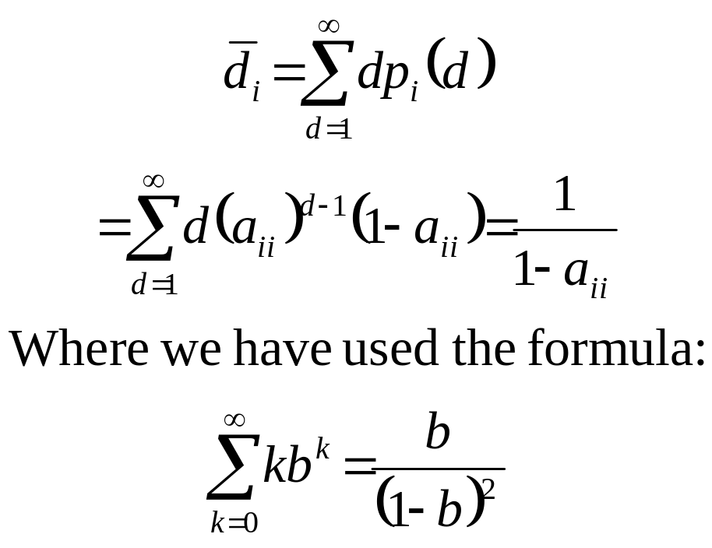
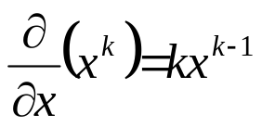
Discrete-Time Markov Processes Examples
  Expected number of observations (duration) in a state conditioned on starting in that state can be computed as ⇨
  Thus, according to the model, the expected number of consecutive days of
    Sunny weather: 1/0.2=5
    Cloudy weather: 2.5
    Rainy weather: 1.67
Exercise Problem: Derive the above formula or directly mean of p_{i}(d)
Hint:

Slide 21
Extensions to Hidden Markov Model
In the examples considered only Markov models in which each state corresponded to a deterministically observable event.
This model is too restrictive to be applicable to many problems of interest.
Obvious extension is to have observation probabilities to be a function of the state, that is, the resulting model is doubly embedded stochastic process with an underlying stochastic process that is not directly observable (it is hidden) but can be observed only through another set of stochastic processes that produce the sequence of observations.

Slide 22
Illustration of Basic Concept of HMM.
Exercise 1.
  Given a single fair coin, i.e., P(Heads)=P(Tails)=0.5. which you toss once and observe Tails.
  What is the probability that the next 10 tosses will provide the sequence (HHTHTTHTTH)?
  What is the probability that the next 10 tosses will produce the sequence (HHHHHHHHHH)?
  What is the probability that 5 out of the next 10 tosses will be tails? What is the expected number of tails overt he next 10 tosses?

Slide 23
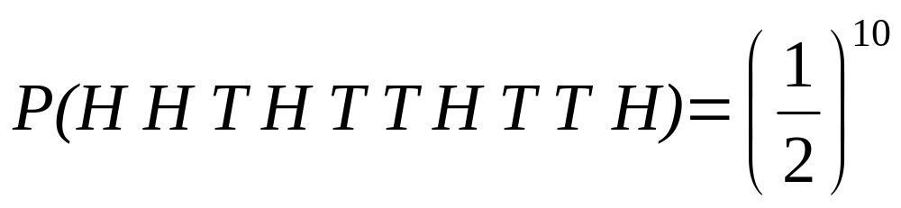
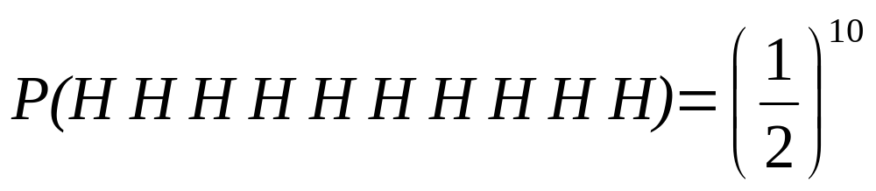
Illustration of Basic Concept of HMM.
Solution 1.
  For a fair coin, with independent coin tosses, the probability of any specific observation sequence of length 10 (10 tosses) is (1/2)¹⁰ since there are 2¹⁰ such sequences and all are equally probable. Thus:
  Using the same argument:

Slide 24
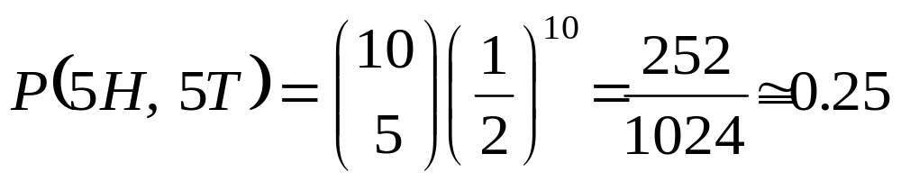
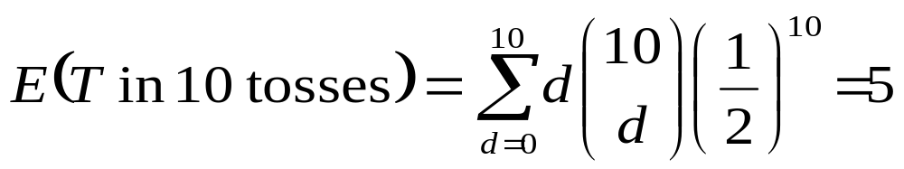
Illustration of Basic Concept of HMM.
Solution 1. (Continued)
  Probability of 5 tails in the next 10 tosses is just the number of observation sequences with 5 tails and 5 heads (in any order) and this is:
    Expected Number of tails in 10 tosses is:
  Thus, on average, there will be 5H and 5T in 10 tosses, but the probability of exactly 5H and 5T is only 0.25.

Slide 25
Illustration of Basic Concept of HMM.
Coin-Toss Models
  Assume the following scenario: You are in a room with a barrier (e.g., a curtain) through which you cannot see what is happening.
  On the other side of the barrier is another person who is performing a coin-tossing experiment (using one or more coins).
  The person (behind the curtain) will not tell you which coin he selects at any time; he will only tell you the result of each coin flip.
  Thus a sequence of hidden coin-tossing experiments is performed, with the observation sequence consisting of a series of heads and tails.

Slide 26
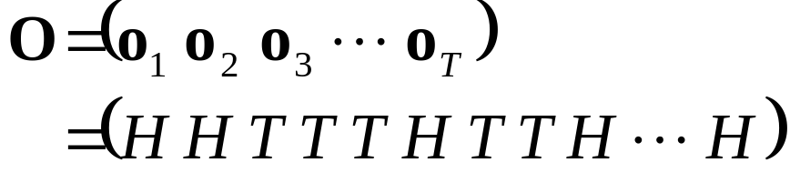
Coin-Toss Models
A typical observation sequence could be:
Given the above scenario, the question is:
  How do we build an HMM to explain (model) the observation sequence of heads and tails?
  First problem we face is deciding what the states in the model correspond to.
  Second, how many states should be in the model.

Slide 27
Coin-Toss Models
One possible choice would be to assume that only a single biased coin was being tossed.
In this case, we could model the situation with a two-state model in which each state corresponds to the outcome of the previous toss (i.e., heads or tails).
P(T)=1-P(H)
P(T)=1-P(H)
1- Coin Model
(Observable Markov Model)
O = H H T T H T H H T T H …
S = 1 1 2 2 1 2 1 1 2 2 1 …
P(H)
1
2
P(H)
HEADS
TAILS

Slide 28
Coin-Toss Models
Second HMM for explaining the observed sequence of con toss outcomes is given in the next slide.
In this case:
  There are two states in the model, and
  Each state corresponds to a different, biased coin being tossed. Each state is characterized by a probability distribution of heads and tails, and
  Transitions between state are characterized by a state-transition matrix.
  The physical mechanism that accounts for how state transitions are selected could be itself be a set of independent coin tosses or some other probabilistic event.

Slide 29
Coin-Toss Models
1-a₁₁
a₂₂
2- Coins Model
(Hidden Markov Model)
O = H H T T H T H H T T H …
S = 2 1 1 2 2 2 1 2 2 1 2 …
a₁₁
1
2
1-a₂₂
P(H) = P₁
P(T) = 1-P₁
P(H) = P₂
P(T) = 1-P₂

Slide 30
Coin-Toss Models
A third form of HMM for explaining the observed sequence of coin toss outcomes is given in the next slide.
In this case:
  There are three states in the model.
  Each state corresponds to using one of the three biased coins, and
  Selection is based on some probabilistic event.

Slide 31
Coin-Toss Models
3- Coins Model
(Hidden Markov Model)
O = H H T T H T H H T T H …
S = 3 1 2 3 3 1 1 2 3 1 3 …
a₁₂
a₂₂
a₁₁
1
2
a₂₁
a₃₁
a₃₂
a₁₃
a₂₃
3
a₃₃
 | State
Probability | 1 | 2 | 3
P(H) | P₁ | P₂ | P₃
P(T) | 1-P₁ | 1-P₂ | 1-P₃

Slide 32
Coin-Toss Models
Given the choice among the three models shown for explaining the observed sequence of heads and tails, a natural question would be which model best matches the actual observations.
  It should be clear that the simple one-coin model has only one unknown parameter,
  The two-coin model has four unknown parameters, and
  The three-coin model has nine unknown parameters.
HMM with larger number of parameters inherently has greater number of degrees of freedom and thus potentially more capable of modeling a series of coin-tossing experiments than HMM’s with smaller number of parameters.
Although this is theoretically true, practical considerations impose some strong limitations on the size of models that we can consider.

Slide 33
Coin-Toss Models
Another fundamental question here is whether the observed head-tail sequence is long and rich enough to be able to specify a complex model.
Also, it might just be the case that only a single coin is being tossed. In such a case it would be inappropriate to use three-coin model because it would be using an underspecified system.

Slide 34
The Urn-and-Ball Model
To extend the ideas of the HMM to a somewhat more complicated situation, consider the urn-and-ball system depicted in the figure.
Assume that there are N (large) brass urns in a room.
Assume that there are M distinct colors.
Within each urn there is a large quantity of colored marbles.
A physical process for obtaining observations is as follows:
  A genie is in the room, and according to some random procedure, it chooses an initial urn.
  From this urn, a ball is chosen at random, and its color is recorded as the observation.
  The ball is then replaced in the urn form which it was selected.
  A new urn is then selected according to the random selection procedure associated with the current urn.
  Ball selection process is repeated.
This entire process generates a finite observation sequence of colors, which we would like to model as the observable output of an HMM.

Slide 35
The Urn-and-Ball Model
Simples HMM model that corresponds to the urn-and-ball process is one in which:
  Each state corresponds to a specific urn, and
  For which a (marble) color probability is defined for each state.
  The choice of state is dictated by the state-transition matrix of the HMM.
It should be noted that the color of the marble in each urn may be the same, and the distinction among various urns is in the way the collection of colored marbles is composed.
Therefore, an isolated observation of a particular color ball does not immediately tell which urn it is drawn from.

Slide 36

The Urn-and-Ball Model
…
An N-State urn-and-ball model illustrating the general case of a discrete symbol HMM
O = {GREEN, GREEN, BLUE, RED, YELLOW, …, BLUE}
URN 1 | URN 2 | URN N
P(RED)=b₁(1) | P(RED)=b₂(1) | P(RED)=b_{N}(1)
P(BLUE)=b₁(2) | P(BLUE)=b₂(2) | P(BLUE)=b_{N}(2)
P(GREEN)=b₁(3) | P(GREEN)=b₂(3) | P(GREEN)=b_{N}(3)
P(YELLOW)=b₁(4) | P(YELLOW)=b₂(4) | P(YELLOW)=b_{N}(4)
… | … | …
P(ORANGE)=b₁(M) | P(ORANGE)=b₂(M) | P(ORANGE)=b_{N}(M)

Slide 37
Elements of a Discrete
HMM
N : number of states in the model
  states s = {s₁,s₂,...,s_{N}}
  state at time t, q_{t} ∈ s
M: number of (distinct) observation symbols (i.e., discrete observations) per state
  observation symbols, v = {v₁,v₂,...,v_{M} }
  observation at time t, o_{t} ∈ v
A = {a_{ij}} : state transition probability distribution
  a_{ij} = P(q_{t+1}=s_{j}|q_{t}=s_{i}), 1 ≤ i,j ≤ N
B = {bj} : observation symbol probability distribution in state j
  b_{j}(k) = P(v_{k} at t|q_{t}=sj ), 1 ≤ j ≤ N, 1 ≤ k ≤ M
π = {π_{i}}: initial state distribution
  π_{i} = P(q₁=s_{i} )1 ≤ i ≤ N
HMM is typically written as: λ = {A, B, π}
  This notation also defines/includes the probability measure for O, i.e., P(O|λ)

Slide 38
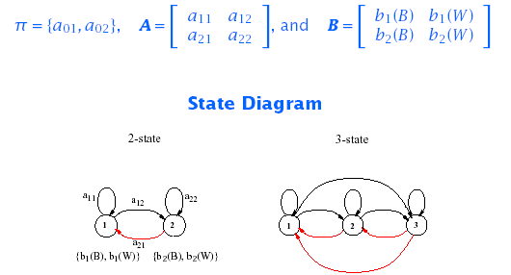
HMM: An Example
For our simple example:

Slide 39
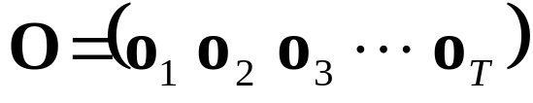
HMM Generator of Observations
Given appropriate values of N, M, A, B, and π, the HMM can be used as a generator to give an observation sequence:
Each observation o_{t} is one of the symbols from V, and T is the number of observation in the sequence.

Slide 40
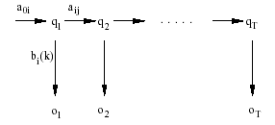
HMM Generator of Observations
The algorithm:
  Choose an initial state q₁=s_{i} according to the initial state distribution π.
  For t=1 to T:
    Choose o_{t}=v_{k} according to the symbol probability distribution in state s_{i}, i.e., b_{i}(k).
    Transit to a new state q_{t+1} = s_{j} according the state-transition probability distribution for state s_{i}, i.e., a_{ij}.
  Increment t, t=t+1; return to step 2 if t<T; otherwise, terminate the procedure.

Slide 41
Three Basic HMM Problems
Scoring: Given an observation sequence O={o₁,o₂,...,o_{T}} and a model λ = {A, B,π}, how do we compute P(O| λ), the probability of the observation sequence?
    ⇒ The Probability Evaluation (Forward & Backward Procedure)
Matching: Given an observation sequence O={o₁,o₂,...,o_{T}} how do we choose a state sequence Q={q₁,q₂,...,q_{T}} which is optimum in some sense?
    ⇒ The Viterbi Algorithm
Training: How do we adjust the model parameters λ = {A,B, π} to maximize P(O| λ)?
    ⇒ The Baum-Welch Re-estimation

Slide 42
Three Basic HMM Problems
Problem 1 - Scoring:
  Is the evaluation problem; namely, given a model and a sequence of observations, how do we compute the probability that the observed sequence was produced by the model?
  It can also be views as the problem of scoring how well a given model matches a given observation sequence.
  The later viewpoint is extremely useful in cases in which we are trying to choose among several competing models. The solution to Problem 1 allows us to choose the model that best matches the observations.

Slide 43
Three Basic HMM Problems
Problem 2- Matching:
  Is the one in which we attempt to uncover the hidden part of the model – that is to find the “correct” state sequence.
  It must be noted that for all but the case of degenerate models, there is no “correct” state sequence to be found. Hence, in practice one can only find an optimal state sequence based on chosen optimality criterion.
    Several reasonable optimality criteria can be imposed and thus the choice of criterion is a strong function of the intended use.
    Typical uses are:
      Learn about the structure of the model
      Find optimal state sequences for continues speech recognition.
      Get average statistics of individual states, etc.

Slide 44
Three Basic HMM Problems
Problem 3 – Training:
  Attempts to optimize the model parameters to best describe how a given observation sequence comes about.
  The observation sequence used to adjust the model parameters is called a training sequence because it is used to “train” the HMM.
  Training algorithm is the crucial one since it allows to optimally adapt model parameters to observed training data to create best HMM models for real phenomena.

Slide 45
Simple Isolated-Word Speech Recognition
For each word of a W word vocabulary design separate N-state HMM.
Speech signal of a given word is represented as a time sequence of coded spectral vectors (How?).
There are M unique spectral vectors; hence each observation is the index of the spectral vector closest (in some spectral distortion sense) to the original speech signal.
For each vocabulary word, we have a training sequence consisting of a number of repetitions of sequences of codebook indices of the word (by one ore more speakers).

Slide 46
Simple Isolated-Word Speech Recognition
First task is to build individual word models.
  Use solution to Problem 3 to optimally estimate model parameters for each word model.
  To develop an understanding of the physical meaning of the model states:
    Use the solution to Problem 2 to segment each word training sequences into states
    Study the properties of the spectral vectors that led to the observations occurring in each state.
    Goal is to make refinements of the model:
      More states,
      Different Codebook size, etc.
    Improve and optimize the model
Once the set of W HMM’s has been designed and optimized, recognition of an unknown word is performed using the solution to Problem 1 to score each word model based upon the given test observation sequence, and select the word whose model score is highest (i.e., the highest likelihood).

Slide 47
Computation of P(O|λ)

Slide 48
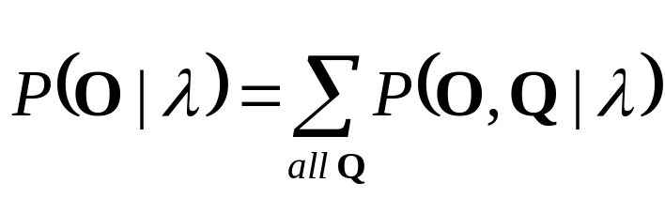
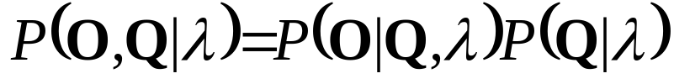
Computation of P(O|λ)
Solution to Problem 1:
  Wish to calculate the probability of the observation sequence, O={o₁,o₂,...,o_{T}} given the model λ.
  The most straight forward way is through enumeration of every possible state sequence of length T (the number of observations). Thus there are N^{T} such state sequences:
  Where:

Slide 49
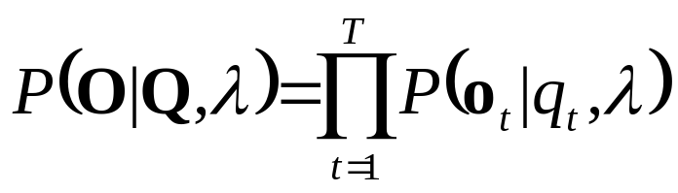
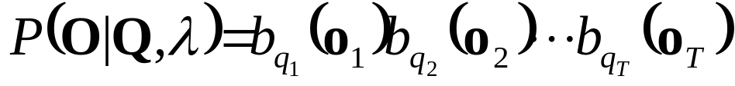
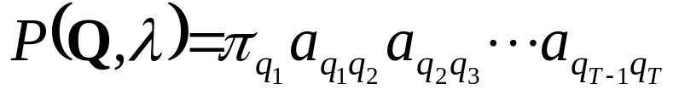
Computation of P(O|λ)
Consider the fixed state sequence: Q= q₁q₂ ...q_{T}
The probability of the observation sequence O given the state sequence, assuming statistical independence of observations, is:
Thus:
The probability of such a state sequence q can be written as:

Slide 50
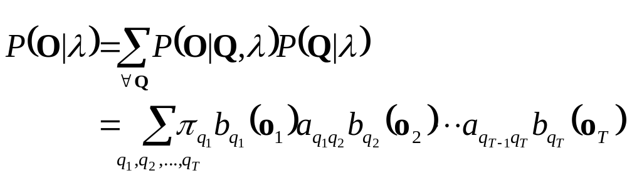
Computation of P(O|λ)
The joint probability of O and Q, i.e., the probability that O and Q occur simultaneously, is simply the product of the previous terms:
The probability of O given the model λ is obtained by summing this joint probability over all possible state sequences Q:

Slide 51
Computation of P(O|λ)
Interpretation of the previous expression:
  Initially at time t=1 we are in state q₁ with probability π_{q1}, and generate the symbol o₁ (in this state) with probability b_{q1}(o₁).
  In the next time instance t=t+1 (t=2) transition is made to state q₂ from state q₁ with probability a_{q1q2} and generate the symbol o₂ with probability b_{q2}(o₂).
  Process is repeated until the last transition is made at time T from state q_{T} from state q_{T-1} with probability a_{qT-1qT} and generate the symbol o_{T} with probability b_{qT}(o_{T}).
Practical Problem:
  Calculation required ≈ 2T · N^{T} (there are N^{T} such sequences)
  For example: N =5 (states),T = 100 (observations) ⇒ 2 · 100 · 5¹⁰⁰ . 10⁷² computations!
  More efficient procedure is required ⇒ Forward Algorithm

Slide 52
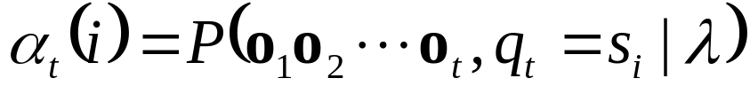
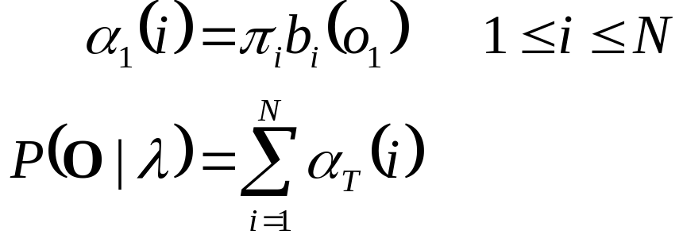
The Forward Algorithm
Let us define the forward variable, α_{t}(i), as the probability of the partial observation sequence up to time t and state s_{i} at time t, given the model, i.e.
It can easily be shown that:
Thus the algorithm:

Slide 53
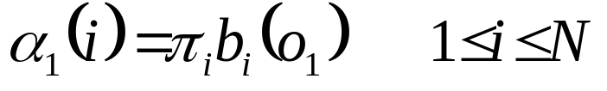
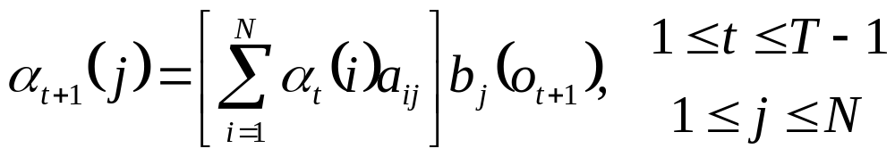
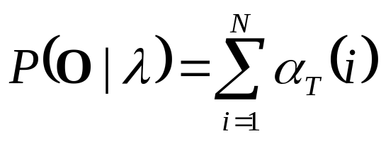
The Forward Algorithm
Initialization
Induction
Termination
t
t+1
s₁
s₂
a_{1j}
a_{2j}
s₃
a_{3j}
s_{j}
a_{Nj}
s_{N}
α_{t}(i)
α_{t+1}(j)

Slide 54
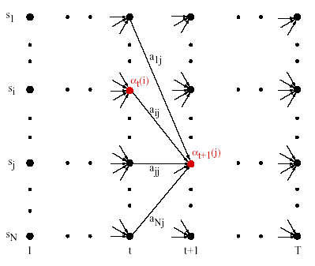
The Forward Algorithm

Slide 55
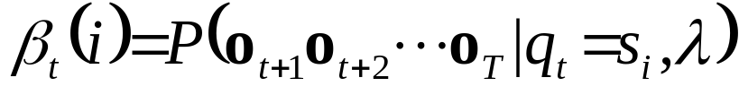
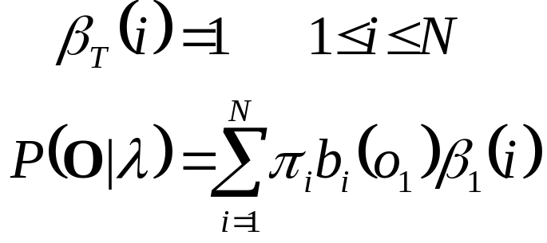
The Backward Algorithm
Similarly, let us define the backward variable, β_{t}(i), as the probability of the partial observation sequence from time t+1 to the end, given state s_{i} at time t and the model, i.e.
It can easily be shown that:
By induction the following algorithm is obtained:

Slide 56
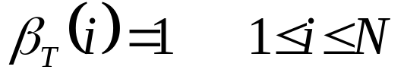
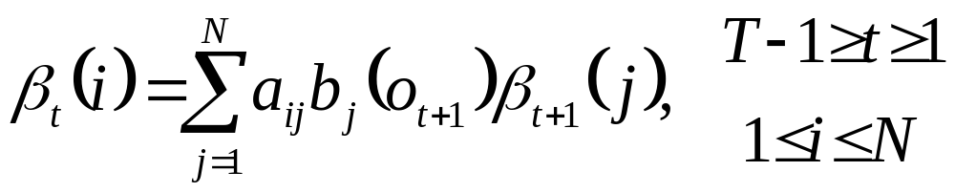
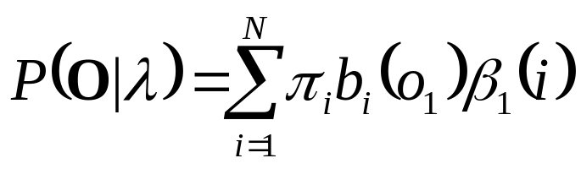
The Backward Algorithm
Initialization
Induction
Termination
t
t+1
s₁
a_{i1}
a_{i2}
s₂
s_{i}
a_{i3}
s₃
a_{iN}
s_{N}
β_{t}(i)
β_{t+1}(j)

Slide 57
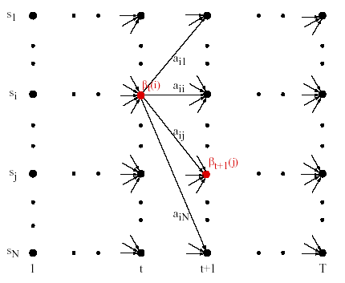
The Backward Algorithm

Slide 58
Finding Optimal State Sequences

Slide 59
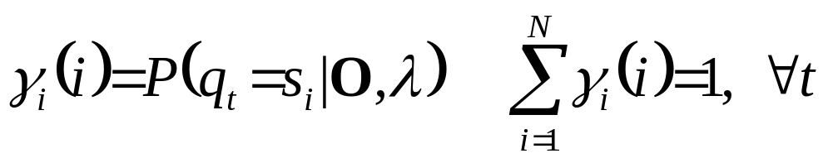
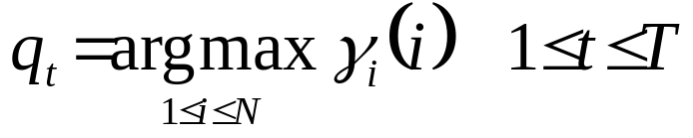
Finding Optimal State Sequences
One criterion chooses states, q_{t}, which are individually most likely
  This maximizes the expected number of correct states
Let us define γ_{t}(i) as the probability of being in state s_{i} at time t, given the observation sequence and the model, i.e.
Then the individually most likely state, q_{t}, at time t is:

Slide 60
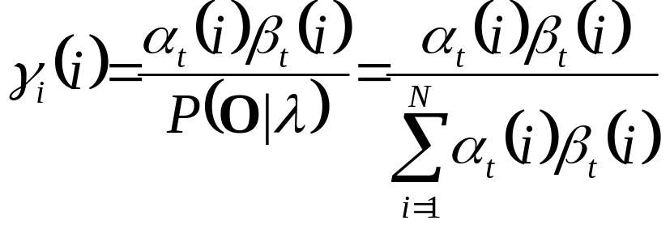
Finding Optimal State Sequences
Note that it can be shown that:
The individual optimality criterion has the problem that the optimum state sequence may not obey state transition constraints
Another optimality criterion is to choose the state sequence which maximizes P(Q ,O|λ);
  This can be found by the Viterbi algorithm

Slide 61
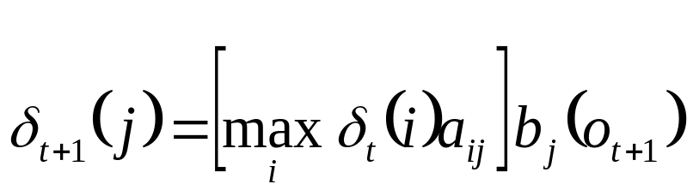
The Viterbi Algorithm
Let us define δ_{t}(i) as the highest probability along a single path, at time t, which accounts for the first t observations, i.e.
By induction:
To retrieve the state sequence, we must keep track of the state sequence which gave the best path, at time t, to state s_{i}
  We do this in a separate array ψ_{t}(i).

Slide 62
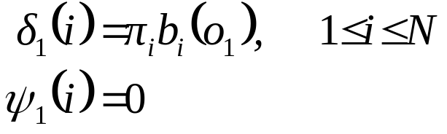


The Viterbi Algorithm
Initialization:
Recursion
Termination

Slide 63

The Viterbi Algorithm
Path (state-sequence) backtracking:
Computation Order: ≈N²T

Slide 64

The Viterbi Algorithm Example
0.5*0.8
0.3*0.7
0.2*1
0.4*0.5

Slide 65

The Viterbi Algorithm: An Example (cont’d)

Slide 66

Matching Using Forward-Backward Algorithm

Slide 67
Baum-Welch
Re-estimation

Slide 68


Solution to Problem 3:
Baum-Welch Re-estimation
Baum-Welch re-estimation uses EM to determine ML parameters
Define ξ_{t}(i,j) as the probability of being in state s_{i} at time t and state s_{j} at time t+1, given the model and observation sequence
Then, from the definitions of the forward and backward variables, can write ξ_{t}(i,j) in the form:

Slide 69


Solution to Problem 3:
Baum-Welch Re-estimation
Hence considering that we have defined γ_{t}(i) as the probability of being in state s_{i} at time t, we can relate γ_{t}(i) to ξ_{t}(i,j) by summing over j:

Slide 70

Solution to Problem 3:
Baum-Welch Re-estimation
Summing over γ_{t}(i) and ξ_{t}(i,j), we get

Slide 71

Baum-Welch Re-estimation Procedures

Slide 72

Baum-Welch Re-estimation Formulas

Slide 73

Baum-Welch Re-estimation Formulas
If λ =(A , B, π).is the initial model, and re-estimated model. Then it can be proved that either:
  The initial model, λ, defines a critical point of the likelihood function, in which case λ = λ, or
  Model λ is more likely than λ in the sense that P(O|λ)>P(O|λ), i.e., we have found a new model λ from which the observation sequence is more likely to have been produced.
Thus we can improve the probability of O being observed from the model if we iteratively use λ in place of λ and repeat the re-estimation until some limiting point is reached. The resulting model is called the maximum likelihood HMM.
-
-
-
-
-

Slide 74
Multiple Observation Sequences

Slide 75
Multiple Observation Sequences
Speech recognition typically uses left-to-right HMMs. These HMMs can not be trained using a single observation sequence, because only a small number of observations are available to train each state. To obtain reliable estimates of model parameters, one must use multiple observation sequences. In this case, the re-estimation procedure needs to be modified.
Let us denote the set of K observation sequences as
O = {O⁽¹⁾, O⁽²⁾, …, O^{(K)}}
Where O^{(k)} = {O₁^{(k)}, O₂^{(k)}, …, O_{Tk}^{(k)}} is the k-th observation sequence.

Slide 76

Multiple Observation Sequences
Assume that the observations sequences are mutually independent, we want to estimate the parameters so as to maximize
Since the re-estimation formulas are based on frequency of occurrence of various events, we can modify them by adding up the individual frequencies of occurrence for each sequence. The modified re-estimation formulas for ā_{ij} and b_{j}(l) are:
_

Slide 77

Multiple Observation Sequences

Slide 78
Multiple Observation Sequences
Note: π_{i} is not re-estimated since:
  π₁ = 1 and
  π_{i} = 0, i≠1.

Slide 79
HMMs in Speech Recognition

Slide 80

Example of HMM for Speech Recognition
What are states used for and what do they model?
  For speech the (hidden) states can be
    Phones,
    Parts of speech, or
    Words

Slide 81
Example of HMM for Speech Recognition
Observation is information about the spectrum and energy of waveform at a point in time.
Decoding process maps this sequence of acoustic information to phones, words and ultimately to sentences.
The observation sequence for speech recognition is a sequence of acoustic feature vectors. Each acoustic feature vector represents information such as the amount of energy in different frequency bands at a particular point in time.
Each observation consists of a vector of e.g. 39 real-valued features indicating spectral information.
Observations are generally drawn every 10 milliseconds, so 1 second of speech requires 100 spectral feature vectors, each vector of length e.g. 39.

Slide 82
Hidden States of HMM
The hidden states of Hidden Markov Models can be used to model speech in a number of different ways.
  For small tasks, like
    digit recognition, (the recognition of the 10 digit words zero through nine), or for
    yes-no recognition (recognition of the two words yes and no),
  we could build an HMM whose states correspond to entire words.
For most larger tasks, however, the hidden states of the HMM correspond to phone-like units, and words are sequences of these phone-like units

Slide 83

Word-based HMMs
Word-based HMMs are appropriate for small vocabulary speech recognition. For large vocabulary ASR, sub-word-based (e.g., phone-based) models are more appropriate.

Slide 84

Example of HMM
An HMM for the word six, consisting of four emitting states and two non-emitting states, the transition probabilities A, the observation probabilities B, and a sample observation sequence.
This kind of left-to-right HMM structure is called a Bakis network.

Slide 85

Phone-based HMMs (cont’d)
The phone models can have many states, and words are made up from a concatenation of phone models.

Slide 86
Duration Modeling
The use of self-loops allows a single phone to repeat so as to cover a variable amount of the acoustic input.
Phone durations vary hugely, dependent on
  the phone identity,
  the speaker’s rate of speech,
  the phonetic context, and
  the level of prosodic prominence of the word.
Looking at the Switchboard corpus,
  the phone [aa] varies in length from 7 to 387 milliseconds (1 to 40 frames), while
  the phone [z] varies in duration from 7 milliseconds to more than 1.3 seconds (130 frames) in some utterances!
Self-loops thus allow a single state to be repeated many times.

Slide 87
What HMM’s States Model?
For very simple speech tasks (recognizing small numbers of words such as the 10 digits), using an HMM state to represent a phone is sufficient.
In general LVCSR tasks, however, a more fine-grained representation is necessary. This is because phones can last over 1 second, i.e., over 100 frames, but the 100 frames are not acoustically identical. The spectral characteristics of a phone, and the amount of energy, vary dramatically across a phone.
  For example, recall that stop consonants have a closure portion, which has very little acoustic energy, followed by a release burst.
  Similarly, diphthongs are vowels whose F1 and F2 change significantly.
  Fig. 9.6 (next slide) shows these large changes in spectral characteristics over time for each of the two phones in the word “Ike”, ARPAbet [ay k].

Slide 88

Ike [ay k]

Slide 89

Spectrogram of Mike – [m ay k]

Slide 90
Phone Modeling with HMMs
To capture this fact about the non-homogeneous nature of phones over time, in LVCSR we generally model a phone with more than one HMM state. The most common configuration is to use three HMM states,
  a beginning,
  middle, and
  end state.
Each phone thus consists of 3 emitting HMM states instead of one (plus two non-emitting states at either end), as shown in next slide.
It is common to reserve the word model or phone model to refer to the entire 5-state phone HMM, and use the word HMM state (or just state for short) to refer to each of the 3 individual sub-phone HMM states.

Slide 91

Phone Modeling with HMMs
A standard 5-state HMM model for a phone, consisting of three emitting states (corresponding to the transition-in, steady state, and transition-out regions of the phone) and two non-emitting states.

Slide 92
Phone Modeling with HMMs
To build a HMM for an entire word using these more complex phone models, we can simply replace each phone/state of the word model in Example of HMM for Speech Recognition with a 3-state phone HMM.
We replace the non-emitting start and end states for each phone model with transitions directly to the emitting state of the preceding and following phone, leaving only two non-emitting states for the entire word.
Figure in the next slide shows the expanded word.

Slide 93

Phone Modeling with HMMs
A composite word model for “six”, [s ih k s], formed by concatenating four phone models, each with three emitting states.

Slide 94
Phone Modeling with HMMs
Another way of looking at the A – transitional probabilities and the states Q is that together they represent a lexicon: a set of pronunciations for words, each pronunciation consisting of a set of sub-phones, with the order of the sub-phones specified by the transition probabilities A.
We have now covered the basic structure of HMM states for representing phones and words in speech recognition. Later in this chapter we will see further augmentations of the HMM word model shown in the Figure in previous slide, such as
  the use of triphone models which make use of phone context, and
  the use of special phones to model silence.

Slide 95
HMM for Acoustic Observations Modeling
We have now almost completed discussion of Acoustic Modeling with HMM’s.
The only one remaining factor is computation of output observation probability b_{j}(o_{t}) for a given observation o_{t} at time t.
This topic is discussed next.

Slide 96
Continuous Density Hidden Markov Models

Slide 97


Continuous Density Hidden Markov Models
A continuous density HMM replaces the discrete observation probabilities, b_{j}(k), by a continuous PDF b_{j}(x)
A common practice is to represent b_{j}(x) as a mixture of Gaussians:
Where:

Slide 98
Continuous Density Hidden Markov Models
Continuous Density Hidden Markov Models are Described in Detail in previous lecture series (Ch3-Pattern Classification2.ppt)

Slide 99
Acoustic Modeling Variations
Semi-continuous HMMs first compute a VQ codebook of size M
  The VQ codebook is then modeled as a family of Gaussian PDFs
Each codeword is represented by a Gaussian PDF, and may be used together with others to model the acoustic vectors
  From the CD-HMM viewpoint, this is equivalent to using the same set of M mixtures to model all the states
  It is therefore often referred to as a Tied Mixture HMM
All three methods have been used in many speech recognition tasks, with varying outcomes
For large-vocabulary, continuous speech recognition with sufficient amount (i.e., tens of hours) of training data, CD-HMM systems currently yield the best performance, but with considerable increase in computation

Slide 100
Implementation Issues
Scaling:
  To prevent underflow
Segmental K-means Training:
  To train observation probabilities by first performing Viterbi alignment
Initial estimates of λ:
  To provide robust models
Pruning:
  To reduce search computation

Slide 101
References
X. Huang, A. Acero, and H. Hon, Spoken Language Processing, Prentice-Hall, 2001.
F. Jelinek, Statistical Methods for Speech Recognition. MIT Press, 1997.
L. Rabiner and B. Juang, Fundamentals of Speech Recognition, Prentice-Hall, 1993.

Slide 102
Hidden Markov Model Concept
Definitions:
  An output alphabet Y={0,1,…,b-1}
  A state space S={1,2,…,c} with a unique starting state s₀.
  A probability distribution of transitions between states p(s’|s), and
  An output probability distribution q(y|s,s’) associated with transitions from state s to state s’.

Slide 103

Hidden Markov Model Concept
The probability of observing an HMM output string y₁, y₂, …,y_{k} is given by:
Next Figure is an example of an HMM with b=2 and c=3.
q(y|3,1)
1
q(y|1,3)
3
q(y|1,1)
q(y|2,3)
q(y|1,2)
2
q(y|3,2)
Three State Hidden Markov Model with outputs y ∈ {0,1}

Slide 104
Hidden Markov Model Concept
The underlying state process still has only one-step memory:
However, the memory of observables is unlimited (except in degenerate cases.
That is is, in general for all k≥2

Slide 105
Hidden Markov Model Concept
It will frequently be convenient to regard the HMM as having multiple transitions between pairs of states, each associated with a different output symbol generated, with probability of 1, when transition is taken. The HMM example given below can generate the same random sequence as the pervious example assuming that q(1|1,1)=q(1|1,3)=q(0|3,1)=q(0|3,2) = 0
1
1
0
3
0
0
1
1
0
2
1
Hidden Markov Model representation attaching outputs to transitions

Slide 106


Hidden Markov Model Concept
This view has the advantage of allowing us to provide each transition of the entire HMM with a different identifier t and to define an output function Y(t) that assigns to t a unique output symbol taken from the alphabet Y.
We then denote by L(t) and R(t) the source and target states of the transition t, respectively. We let p(t) denote the probability that the state L(t) is exited via the transition t, so that for all s ∈S
The correspondence between the two ways of viewing an HMM is given by the relationship

Slide 107


Hidden Markov Model Concept
When transitions determine outputs, the probability P(y₁,y₂,…, y_{k}) becomes equal to the sum of the products:
over all transition sequences t₁,…,t_{k} such that
L(t₁)=s₀, Y(t_{i})=y_{i,} and R(t_{i})=L(t_{i+1}) for i=1,…,k or formally:
Where
S (y₁,y₂,…, y_{k}) = {t₁,t₂,…, t_{k}: L(t₁)=s₀,Y(t_{i})=y_{i}, R(t_{i})=L(t_{i+1}) for i=1,…,k}
In the following sections we will take whichever point of view:
  Multiple transitions between states s and s’, or
  Multiple possible outputs generated by the single transition s→s’
  Will be more convenient for the problem at hand.

Slide 108
The evaluation of the probability: The Trellis
There is an easy way to calculate the probability P(y₁,y₂,…, y_{k}) with the help of trellis. Trellis:
  Consists of the concatenation of elementary stages determined by the particular outputs y_{i}.
  The number of elementary states is equal to the number of different output symbols.
1
1
1
1
2
2
2
2
3
3
3
3
y=0
y=1
Two different trellis stages corresponding to the binary HMM presented in the slide 16.

Slide 109
The Trellis
Trellis corresponding to the output sequence 0110.
The required probability P(0110) is equal to the sum of the probabilities of all complete paths through the trellis (those ending in the last column) that start in the obligatory starting state.
1
1
1
1
1
2
2
2
2
2
3
3
3
3
3
y=0
y=1
y=1
y=0
Trellis for output sequence 0110 generated by the binary HMM presented in the slide 16.

Slide 110
The Trellis
Example of paths for s₀=1 that could generate 0110 sequence.
s₀
1
1
1
1
1
2
2
2
2
2
3
3
3
3
3
y=0
y=1
y=1
y=0
Trellis of previous slide purged of all paths that could not have generated the output sequence 0110.

Slide 111



The Trellis
The probability P(y₁,y₂,…, y_{n}) can be obtained recursively:
  Define the probabilities:
  Using boundary conditions:
  And applying the simplified notation:

Slide 112


The Trellis
We get the recursion expression:
From the definition of α_{i}(s) the desired probability is then:

Slide 113






The Trellis
Unit probability assigned to starting state s₀=1, i.e., α₀(s₀)=1.
Computing the flows p(0,s|1)α₀(1) for s∈{1,2,3}
s₀
1
1
1
1
1
2
2
2
2
2
3
3
3
3
3
y=0
y=1
y=1
y=0
Trellis of previous slide purged of all paths that could not have generated the output sequence 0110.

