Slide 1
Speech Recognition
Pattern Classification

Slide 2
Pattern Classification
Introduction
Parametric classifiers
Semi-parametric classifiers
Dimensionality reduction
Significance testing

Slide 3
Pattern Classification
Goal: To classify objects (or patterns) into categories (or classes)
Types of Problems:
Supervised: Classes are known beforehand, and data samples of each class are known/available
Unsupervised: Classes (and/or number of classes) are not known beforehand, and must be inferred from data
Feature Extraction
Classifier
Observation s
Feature Vectors x
Class ω_{i}

Slide 4
Supervised Learning
Pattern recognition is generally categorized according to the type of learning procedure used to generate the output value.
Supervised Learning
Training set consisting of instances that have been properly labeled by hand (or other means) with the “correct” label.
The goal of a training procedure is to generate a model that attempts to meet two sometimes conflicting objectives:
Perform as well as possible on the training data, and
Generalize as well as possible to new data
Occam's Razor. It is a problem-solving principle that, when presented with competing hypothetical answers to a problem, one should select the one that makes the fewest assumptions: simplest solution.

Slide 5
Einstein's Constraint: "It can scarcely be denied that the supreme goal of all theory is to make the irreducible basic elements as simple and as few as possible without having to surrender the adequate representation of a single datum of experience".

Slide 6
Unsupervised Learning
Unsupervised Learning,
Training set consisting of instances that have NOT been labeled by hand (or other means) and the algorithm will attempt to find the “best” labels.
The same goal, as in supervised training procedure, is the same for the unsupervised training procedure, which is: to generate a model that attempts to meet two sometimes conflicting objectives:
Perform as well as possible on the training data, and
Generalize as well as possible to new data
By definition the training data is not been hand-labeled, and the goal is to find inherent patterns in the data that can then be used to determine the correct classification for the new data instances.

Slide 7
Clustering
Note that sometimes different terms are used to describe the corresponding supervised and unsupervised learning procedures for the same type of output.
For example, the unsupervised equivalent of classification is normally known as clustering,
based on the common perception of the task as involving no training data to speak of, and
of grouping the input data into clusters based on some inherent similarity measure (e.g. the distance between instances, considered as vectors in a multi-dimensional vector space), rather than assigning each input instance into one of a set of pre-defined classes.

Slide 8
Probability
In order to understand how we do Classification (e.g., Clustering) we need to be well versed in probability theory.

Slide 9
Probability Theory
Notes on Basic Concepts of Probability Theory

Slide 10
Probability Basics
Discrete probability mass function (PMF): P(x_{i})
Expected Value for a discrete Random Variable x_{i}
Continuous probability density function (PDF): p(x)
Expected value: E(x)

Slide 11
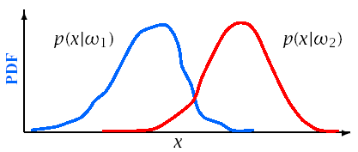
Bayes Theorem
Define:
{ω_{i}} | a set of M mutually exclusive classes
P(ω_{i}) | a priori probability for class ω_{i}
p(x|ω_{i}) | PDF for feature vector x in the class ω_{i}
P(ω_{i}|x) | A posteriori probability of ω_{i} given x

Slide 12
Bayes Theorem
Bayes Rule:
From Bayes Rule:
Where:

Slide 13
Kullback-Liebler Distance
Can be used to compute a distance between two probability mass distributions, P(z_{i}), and Q(z_{i})
Makes use of inequality: log(x) ≤ x - 1
Known as relative entropy in information theory
The divergence of P(z_{i}) and Q(z_{i}) is the symmetric sum

Slide 14
Bayesian Decision Theory
Reference:
Pattern Classification – R. Duda, P. Hard & D. Stork, Wiley & Sons, 2001
PPTx Link

Slide 15
Bayes Decision Theory
The probability of making an error given x is:
P(error|x)=1-P(ω_{i}|x) if decide class ω_{i}
To minimize P(error|x) (and P(error)):
Choose ω_{i} if P(ω_{i}|x)>P(ω_{j}|x) ∀j≠i

Slide 16
Bayes Decision Theory
For a two class problem this decision rule means:
Choose ω₁
if
else ω₂
This rule can be expressed as a likelihood ratio:

Slide 17
Bayes Risk
Define cost function λ_{ij} and conditional risk R(ω_{i}|x):
λ_{ij} is cost of classifying x as ω_{i} when it is really ω_{j}
R(ω_{i}|x) is the risk for classifying x as class ω_{i}
Bayes risk is the minimum risk which can be achieved:
Choose ω_{i} if R(ω_{i}|x) < R(ω_{j}|x) ∀i≠j
Bayes risk corresponds to minimum P(error|x) when
All errors have equal cost (λ_{ij} = 1, i≠j)
There is no cost for being correct (λ_{ii} = 0)

Slide 18
Discriminant Functions
Alternative formulation of Bayes decision rule
Define a discriminant function, g_{i}(x), for each class ω_{i}
Choose ω_{i} if g_{i}(x)>g_{j}(x) ∀j ≠ i
Functions yielding identical classiffication results:
g_{i} (x) = P(ω_{i} |x) = p(x|ω_{i} )P(ω_{i} ) = log p(x|ω_{i} )+log P(ω_{i} )
Choice of function impacts computational costs
Discriminant functions partition feature space into decision regions, separated by decision boundaries.

Slide 19
Density Estimation
Used to estimate the underlying PDF p(x|ω_{i})
Parametric methods:
Assume a specific functional form for the PDF, this in turn requires:
Optimize PDF parameters to fit data
Non-parametric methods:
Determine the form of the PDF from the data
Grow parameter set size with the amount of data
Semi-parametric methods:
Use a general class of functional forms for the PDF
Can vary parameter set independently from data
Use unsupervised methods to estimate parameters

Slide 20
Parametric Classifiers
Gaussian distributions
Maximum likelihood (ML) parameter estimation
Gaussian classifiers
Multivariate Gaussians

Slide 21
Maximum Likelihood Parameter Estimation
Gaussian Distribution:
Notes from “Pattern Classification” Duda, Hart & Stork

Slide 22
Gaussian Distributions
Gaussian PDF’s are reasonable when a feature vector can be viewed as perturbation around a reference
Simple estimation procedures for model parameters
Classification often reduced to simple distance metrics
Gaussian distributions also called Normal

Slide 23
Gaussian Distributions: One Dimension (Univariate)
One-dimensional Gaussian PDF’s can be expressed as:
The PDF is centered around the mean
The spread of the PDF is determined by the variance

Slide 24
Univariate Gaussians
The Gaussian distribution, also known as the normal distribution, is the bell-curve function familiar from basic statistics.
A Gaussian distribution is a function parameterized by a mean, or average value, and a variance, which characterizes the average spread or dispersal from the mean.
We will use μ to indicate the mean, and σ² to indicate the variance, giving the following formula for a Gaussian function:

Slide 25
Univariate Gaussian PDFs

Slide 26
Gaussian PDFs
Mean of a Random variable X is the expected value of X.
For a discrete variable X. this is the weighted sum over the values of X:
The variance of a random variable X is the weighted squared average deviation from the mean:

Slide 27
Gaussian PDFs
When a Gaussian function is used as a probability density function, the area under the curve is constrained to be equal to one. Then the probability that a random variable takes on any particular range of values can be computed by summing the area under the curve for that range of values.
Fig. below shows the probability expressed by the area under an interval of a Gaussian pdf.

Slide 28
Maximum Likelihood Parameter Estimation

Slide 29
Maximum Likelihood Parameter Estimation
Maximum likelihood parameter estimation determines an estimate θ for parameter θ by maximizing the likelihood L(θ)=p(X|θ) of observing data X = {x₁,...,x_{n}}
Assuming independent, identically distributed data
ML solutions can often be obtained via the derivative:
^

Slide 30
Maximum Likelihood Parameter Estimation
For Gaussian distributions log(L(θ)) is easier to solve?

Slide 31
Gaussian ML Estimation: One Dimension
The maximum likelihood estimate for μ is given by:

Slide 32
Gaussian ML Estimation: One Dimension
The maximum likelihood estimate for σ is given by (Homework- Derive this formula?):

Slide 33
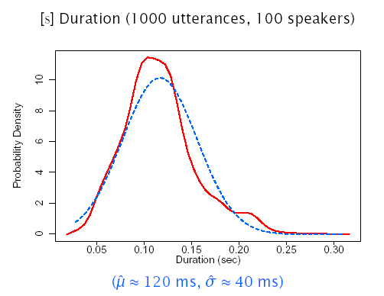
Gaussian ML Estimation: One Dimension

Slide 34
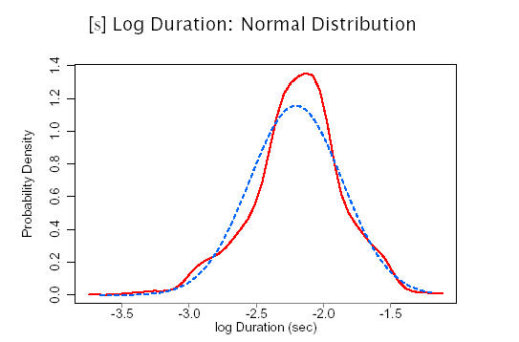
ML Estimation: Alternative Distributions

Slide 35
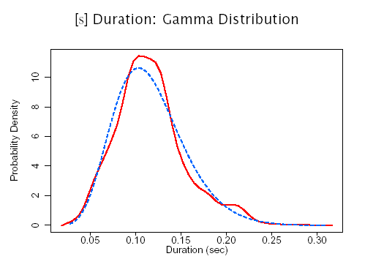
ML Estimation: Alternative Distributions

Slide 36
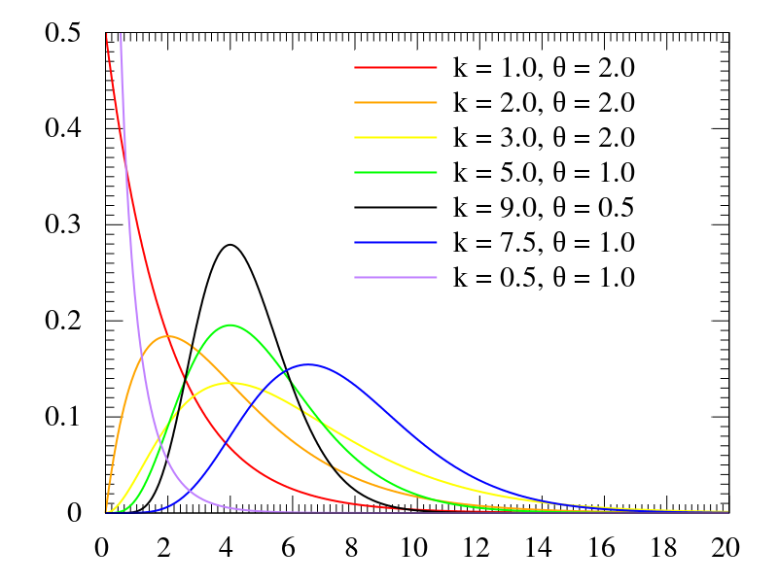
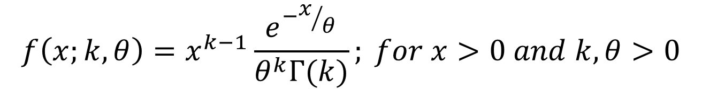

Gamma Distribution
$$X\sim Γ\left(k,θ\right)≝Gamma(k,θ)$$
$$f\left(x;k,θ\right)=x^{k−1}\frac{e^{−x/θ}}{θ^{k}Γ(k)}; for x>0 and k,θ>0$$
$$y=f\left(x | a,b\right)=\frac{1}{b^{a}Γ(a)}x^{a−1}e^{−\frac{x}{b}}$$

Slide 37
Gaussian Distributions: Multiple Dimensions (Multivariate)
A multi-dimensional Gaussian PDF can be expressed as:
d is the number of dimensions
x={x₁,…,x_{d}} is the input vector
μ= E(x)= {μ₁,...,μ_{d} } is the mean vector
Σ= E((x-μ )(x-μ)^{t}) is the covariance matrix with elements σ_{ij} , inverse Σ⁻¹ , and determinant |Σ|
σ_{ij} = σ_{ji} = E((x_{i} - μ_{i} )(x_{j} - μ_{j} )) = E(x_{i}x_{j} ) - μ_{i}μ_{j}

Slide 38
Gaussian Distributions: Multi-Dimensional Properties
If the i^{th} and j^{th} dimensions are statistically or linearly independent then E(x_{i}x_{j})= E(x_{i})E(x_{j}) and σ_{ij} =0
If all dimensions are statistically or linearly independent, then σ_{ij}=0 ∀i≠j and Σ has non-zero elements only in the diagonal
If the underlying density is Gaussian and Σ is a diagonal matrix (e.g., the dimensions are statistically independent) and

Slide 39
Diagonal Covariance Matrix: Σ=σ²I

Slide 40
Diagonal Covariance Matrix: σ_{ij}=0 ∀i≠j

Slide 41
General Covariance Matrix: σ_{ij}≠0

Slide 42
2D Gaussian PDF’s

Slide 44
Multivariate ML Estimation
The ML estimates for parameters θ = {θ₁,...,θ_{l} } are determined by maximizing the joint likelihood L(θ) of a set of i.i.d. data x = {x₁,..., x_{n}}
To find θ we solve ∇_{θ}L(θ)= 0, or ∇_{θ} log L(θ)= 0
The ML estimates of μ and Σ are
^

Slide 45
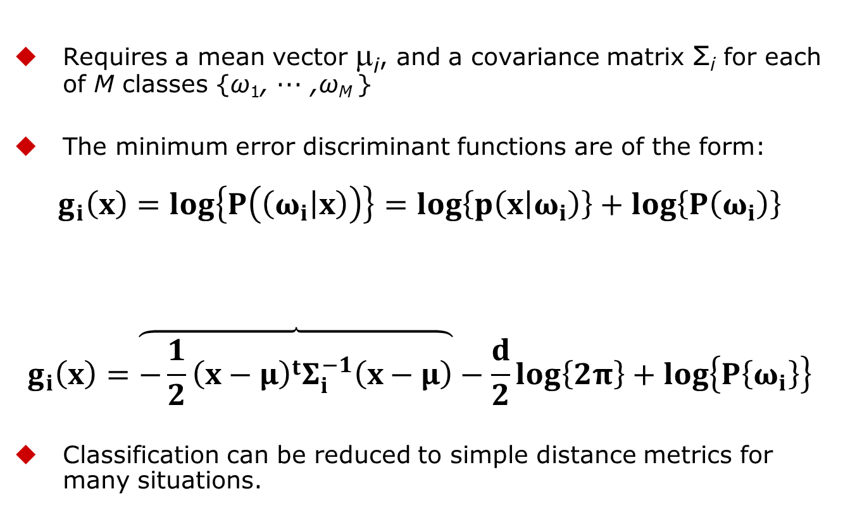
Multivariate Gaussian Classifier
Requires a mean vector μ_{i}, and a covariance matrix Σ_{i} for each of M classes {ω₁, ··· ,ω_{M} }
The minimum error discriminant functions are of the form:
$$g_{i}\left(x\right)=log\left\{P\left(\left(ω_{i} | x\right)\right)\right\}=log\left\{p\left(x | ω_{i}\right)\right\}+log\left\{P\left(ω_{i}\right)\right\}$$
$$g_{i}\left(x\right)=\overset{}{\overbrace{−\frac{1}{2}{\left(x−μ\right)}^{t}Σ_{i}^{−1}\left(x−μ\right)}}−\frac{d}{2}log\left\{2π\right\}+log\left\{P\left\{ω_{i}\right\}\right\}$$
Classification can be reduced to simple distance metrics for many situations.
What is this called?

Slide 46
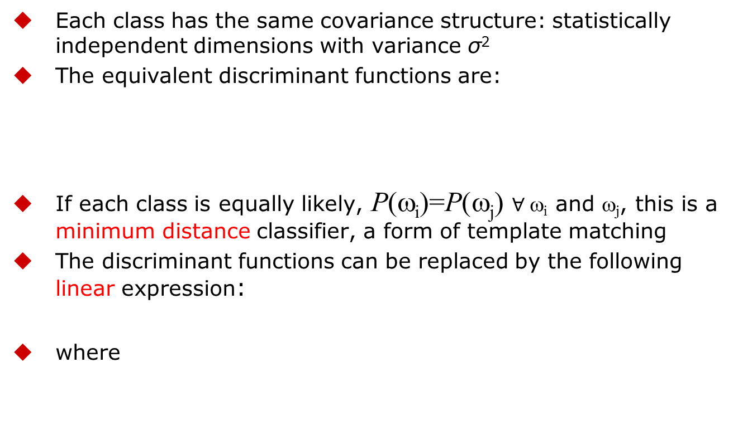
Gaussian Classifier: Σ_{i} = σ²I
Each class has the same covariance structure: statistically independent dimensions with variance σ²
The equivalent discriminant functions are:
If each class is equally likely, P(ω_{i})=P(ω_{j}) $∀ \text{w}\text{i}$ and ω_{j}, this is a minimum distance classifier, a form of template matching
The discriminant functions can be replaced by the following linear expression:
where

Slide 47
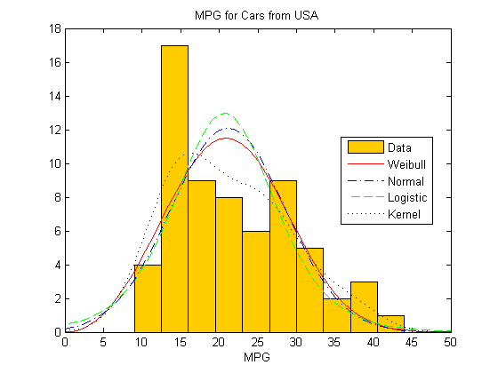
Example of PDFs for USA Cars

Slide 48
Gaussian Classifier: Σ_{i} = σ²I
For distributions with a common covariance structure the decision regions are a hyper-planes.

Slide 49
Gaussian Classifier: Σ_{i}=Σ
Each class has the same covariance structure Σ
The equivalent discriminant functions are:
If each class is equally likely, the minimum error decision rule is the squared Mahalanobis distance
The discriminant functions remain linear expressions:
where

Slide 50
Gaussian Classifier: Σ_{i} Arbitrary
Each class has a different covariance structure Σ_{i}
The equivalent discriminant functions are:
The discriminant functions are inherently quadratic:
where

Slide 51
Gaussian Classifier: Σ_{i} Arbitrary
For distributions with arbitrary covariance structures the decision regions are defined by hyper-spheres.

Slide 52
3 Class Classification (Atal & Rabiner, 1976)
Distinguish between silence, unvoiced, and voiced sounds
Use 5 features:
Zero crossing count
Log energy
Normalized first autocorrelation coefficient
First predictor coefficient, and
Normalized prediction error
Multivariate Gaussian classifier, ML estimation
Decision by squared Mahalanobis distance
Trained on four (4) speakers (2 sentences/speaker),
Tested on 2 speakers (1 sentence/speaker)

Slide 53
Maximum A Posteriori Parameter Estimation

Slide 54
Maximum A Posteriori Parameter Estimation
Maximum likelihood estimation approaches assume the form of the PDF p(x|θ) is known, but the value of θ is not
Maximum A Posteriori (MAP) Parameter Estimation techniques assume that parameter vector θ is a random variable with a prior distribution p(θ)

Slide 55
Maximum A Posteriori Parameter Estimation
Knowledge of θ is contained in:
An initial a priori PDF p(θ)
A set of independent and identically distributed (i.i.d.) data X = {x₁,...,x_{n}} with PDF p(X|θ)
According to Bayes rule, posterior distribution of θ is defined as:
One intuitive interpretation is that a prior pdf p(θ) represent the relative likelihood before the values of x₁,...,x_{n} have been observed.

Slide 56
Maximum A Posteriori Parameter Estimation
Posterior PDF p(θ|X) represents the relative likelihood after the values of x₁,...,x_{n} have been observed. Choosing that maximizes is intuitively consistent.
The previous estimator defines MAP

Slide 57
Gaussian MAP Estimation: One Dimension
For a Gaussian distribution with unknown mean μ:
MAP estimates of μ and x are given by
As n increases, p(μ|X) converges to μ, and p(x,X) converges to the ML estimate ~ N(μ,σ²)
^
^

Slide 58
Significance Testing
Significance testing in parameter estimation and in model comparisons is an important topic of SR and is part of Statistical Inference.
For more information check reference [1] in next slide - chapter 3.3.

Slide 59
References
Huang, Acero, and Hon, Spoken Language Processing, Prentice-Hall, 2001.
Duda, Hart and Stork, Pattern Classification, John Wiley & Sons, 2001.
Atal and Rabiner, A Pattern Recognition Approach to Voiced-Unvoiced-Silence Classification with Applications to Speech Recognition, IEEE Trans ASSP, 24(3), 1976.

