Slide 1
Speech Recognition
Speech Signal Representations

Slide 2
Speech Signal Representations
Fourier Analysis
  Discrete-time Fourier transform
  Short-time Fourier transform
  Discrete Fourier transform
Cepstral Analysis
  The complex cepstrum and the cepstrum
  Computational considerations
  Cepstral analysis of speech
  Applications to speech recognition
  Mel-Frequency cepstral representation
Performance Comparison of Various Representations

Slide 3
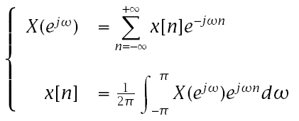

Discrete-Time Fourier Transform
Definition:
Sufficient condition for convergence:
  Although x[n] is discrete, X(e^{jω}) is continuous and periodic with period 2ƒπ.

Slide 4
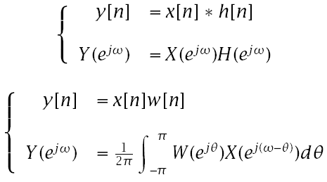
Discrete-Time Fourier Transform
  Convolution/multiplication duality:

Slide 5
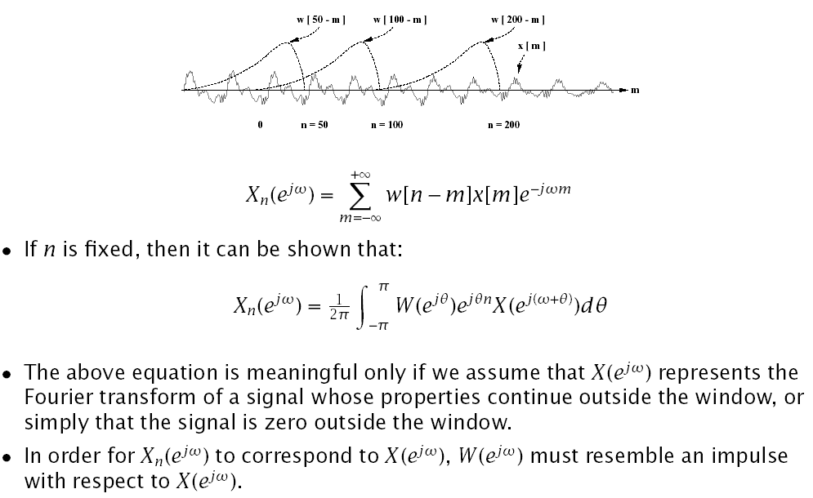
Short-Time Fourier Analysis (Time-Dependent Fourier Transform)

Slide 6
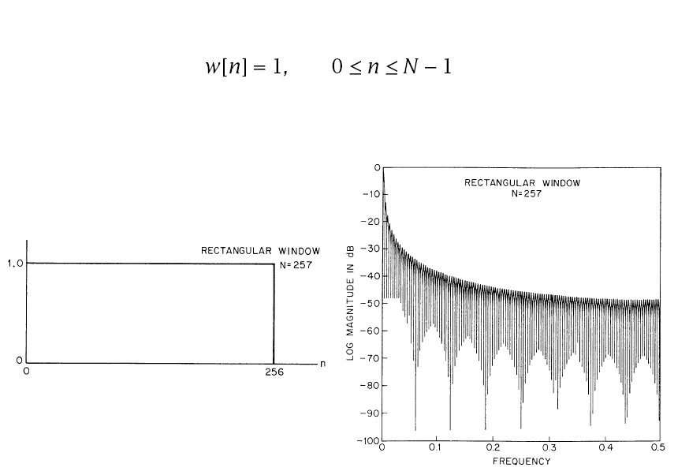
Rectangular Window

Slide 7
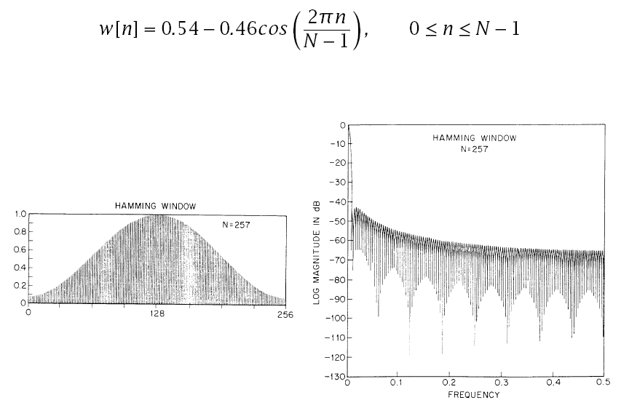
Hamming Window

Slide 8
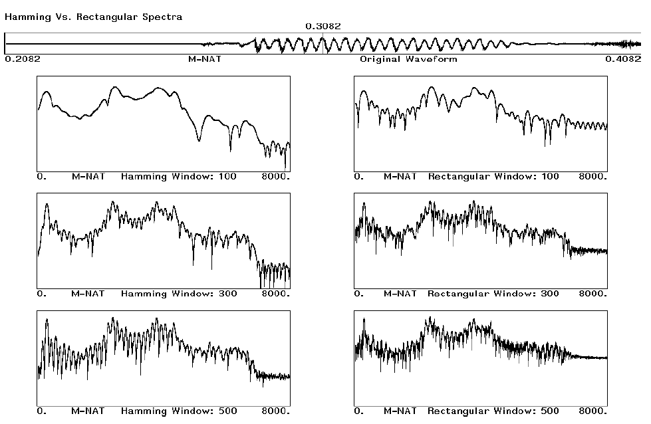
Comparison of Windows

Slide 9
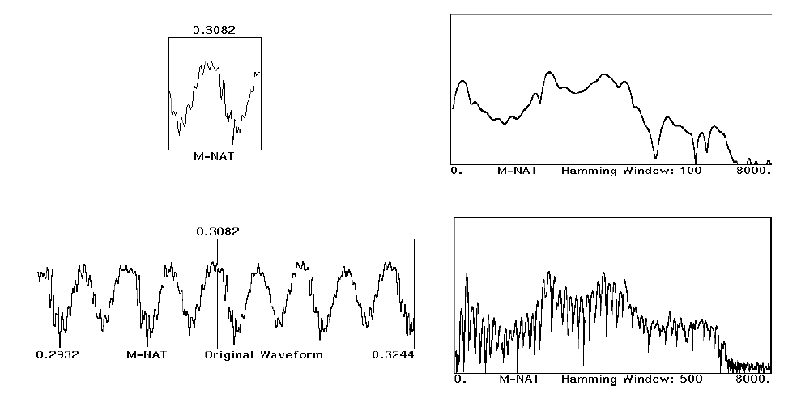
Comparison of Windows (cont’d)

Slide 10
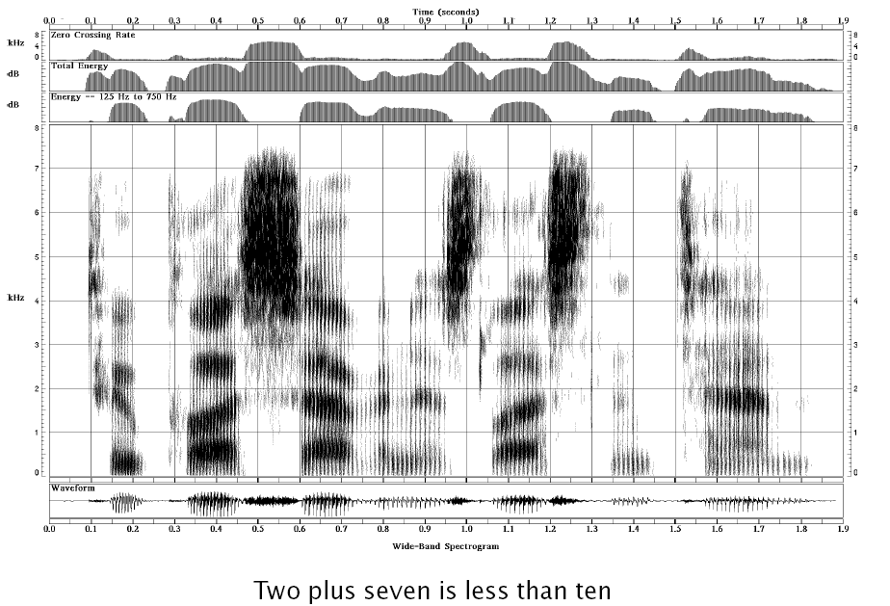
A Wideband Spectrogram

Slide 11
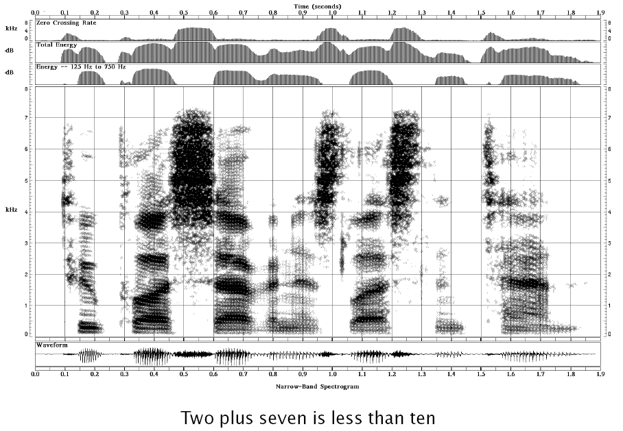
A Narrowband Spectrogram

Slide 12
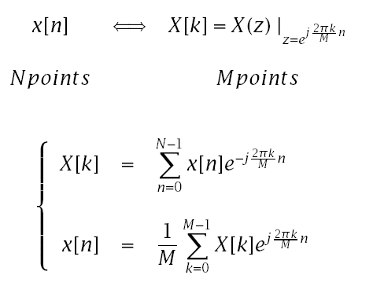
Discrete Fourier Transform
In general, the number of input points, N, and the number of frequency samples, M, need not be the same.
  If M>N , we must zero-pad the signal
  If M<N , we must time-alias the signal

Slide 13
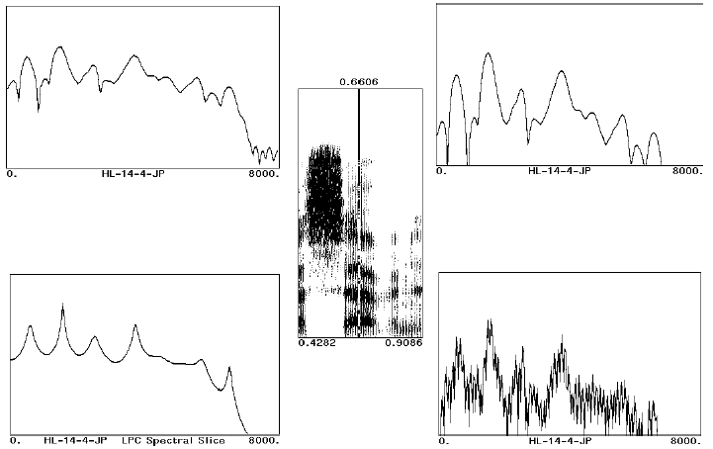
Examples of Various Spectral Representations

Slide 14
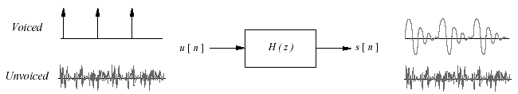
Cepstral Analysis of Speech
The speech signal is often assumed to be the output of an LTI system; i.e., it is the convolution of the input and the impulse response.
  If we are interested in characterizing the signal in terms of the parameters of such a model, we must go through the process of de-convolution.
  Cepstral, analysis is a common procedure used for such de-convolution.

Slide 15



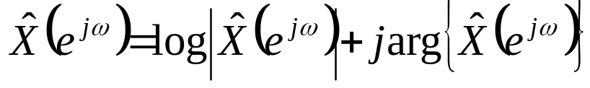
Cepstral Analysis
Cepstral analysis for convolution is based on the observation that:
  x[n]= x₁[n] * x₂[n] ⇒ X (z)= X₁(z)X₂(z)
  By taking the complex logarithm of X(z), then
  log{X (z)} =log{X₁(z)} + log{X₂(z)} =
If the complex logarithm is unique, and if is a valid z-transform, then
  The two convolved signals will be additive in this new, cepstral domain.
If we restrict ourselves to the unit circle, z = e^{jω}, then:
It can be shown that one approach to dealing with the problem of uniqueness is to require that arg{X(e^{jω})} be a continuous, odd, periodic function of ω.

Slide 16
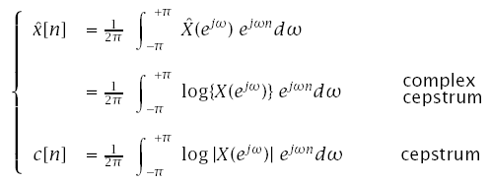
Cepstral Analysis (cont’d)
^
To the extent that X(z)=log{X(z)} is valid,
It can easily be shown that c[n] is the even part of x[n].
If x[n] is real and causal then x[n], be recovered from c[n]. This is known as the Minimum Phase condition.
^
^
^

Slide 17
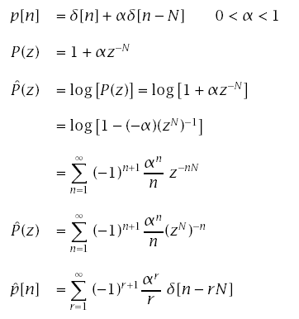
An Example

Slide 18
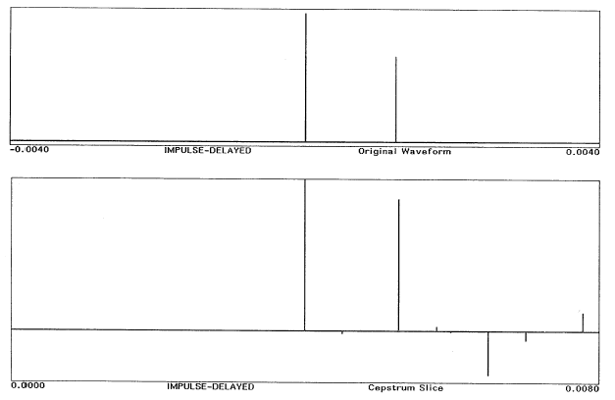
An Example (cont’d)

Slide 19
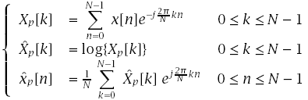
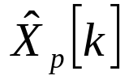

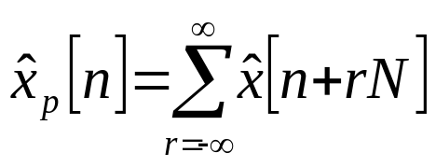
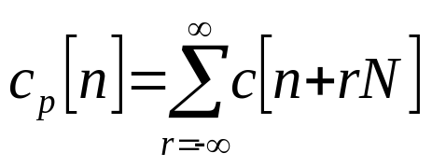
Computational Considerations
We now replace the Fourier transform expressions by the discrete Fourier transform expressions
is a sampled version of . Therefore,
Likewise,
where

Slide 20
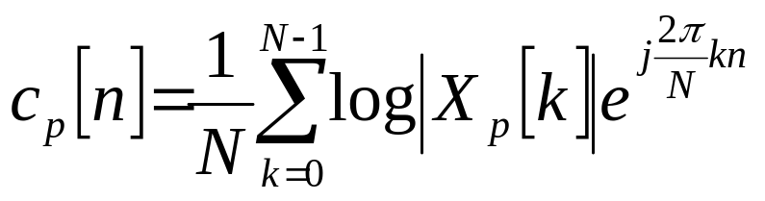
Computational Considerations (cont.)
To minimize aliasing, N must be large

Slide 21
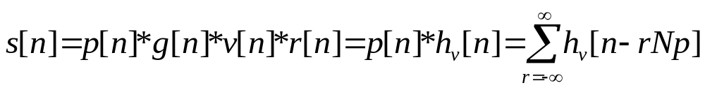
Cepstral Analysis of Speech
For voiced speech:
For unvoiced speech:
s[n]=w[n]*v[n]*r[n]= w[n]* h_{u}[n].
Contributions to the cepstrum due to periodic excitation will occur at integer multiples of the fundamental period.
Contributions due to the glottal waveform (for voiced speech), vocal tract, and radiation will be concentrated in the low quefrency region, and will decay rapidly with n.
Deconvolution can be achieved by multiplying the cepstrum with an appropriate window, l[n].

Slide 22
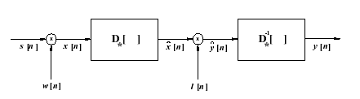
Cepstral Analysis of Speech
Where D* is the characteristic system that converts convolution into addition.
Thus cepstral analysis can be used for pitch extraction and formant tracking.

Slide 23
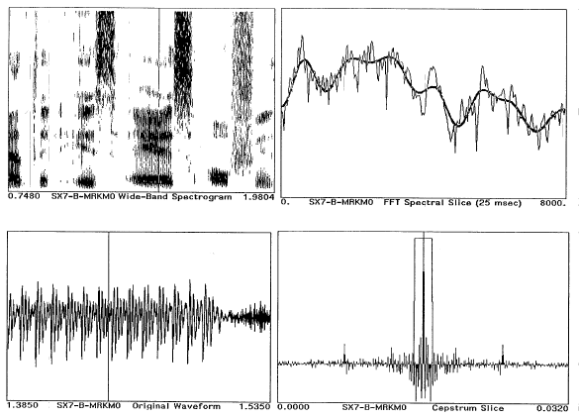
Example of Cepstral Analysis of Vowel (Rectangular Window)

Slide 24
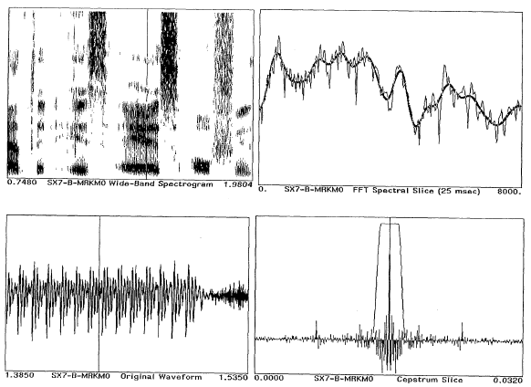
Example of Cepstral Analysis of Vowel (Tapering Window)

Slide 25
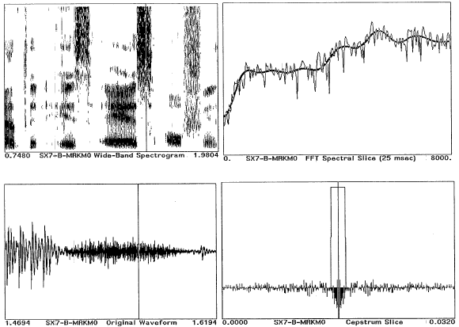
Example of Cepstral Analysis of Fricative (Rectangular Window)

Slide 26
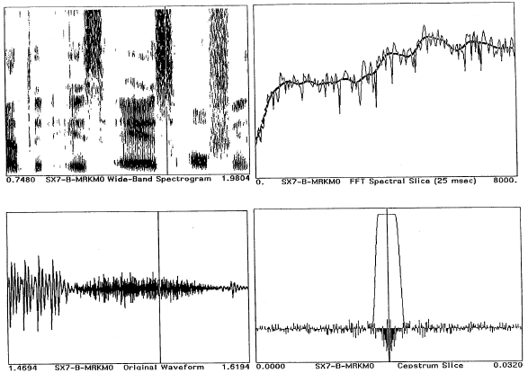
Example of Cepstral Analysis of Fricative (Tapering Window)

Slide 27
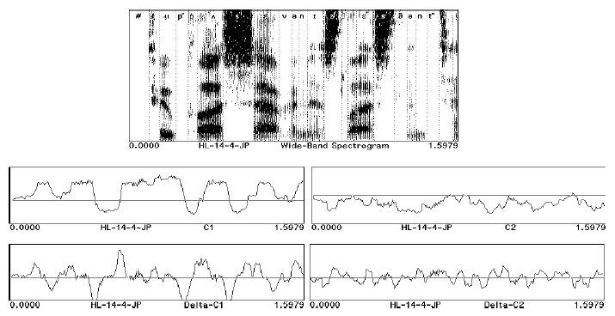
The Use of Cepstrum for Speech Recognition
Many current speech recognition systems represent the speech signal as a set of cepstral coefficients, computed at a fixed frame rate. In addition, the time derivatives of the cepstral coefficients have also been used.

Slide 28
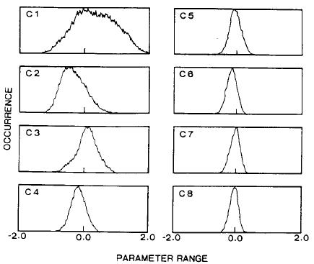
Statistical Properties of Cepstral Coefficients (Tohkura, 1987)
From a digit database (100 speakers) over dial-up telephone lines.

Slide 29
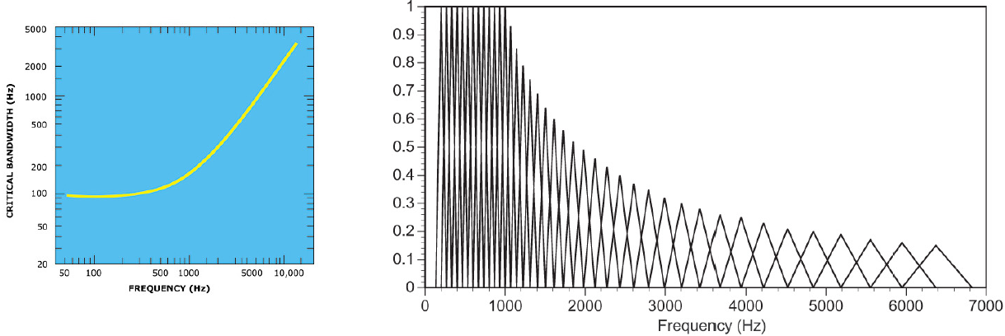
Mel-Frequency Cepstral Representation
(Mermelstein & Davis 1980)
Some recognition systems use Mel-scale cepstral coefficients to mimic auditory processing. (Mel frequency scale is linear up to 100 Hz and logarithmic thereafter.) This is done by multiplying the magnitude (or log magnitude) of S(e^{jω}) with a set of filter weights as shown below:

Slide 30
Typical MFCC Based System
Front-End Processing of a Speech Recognizer

Slide 31
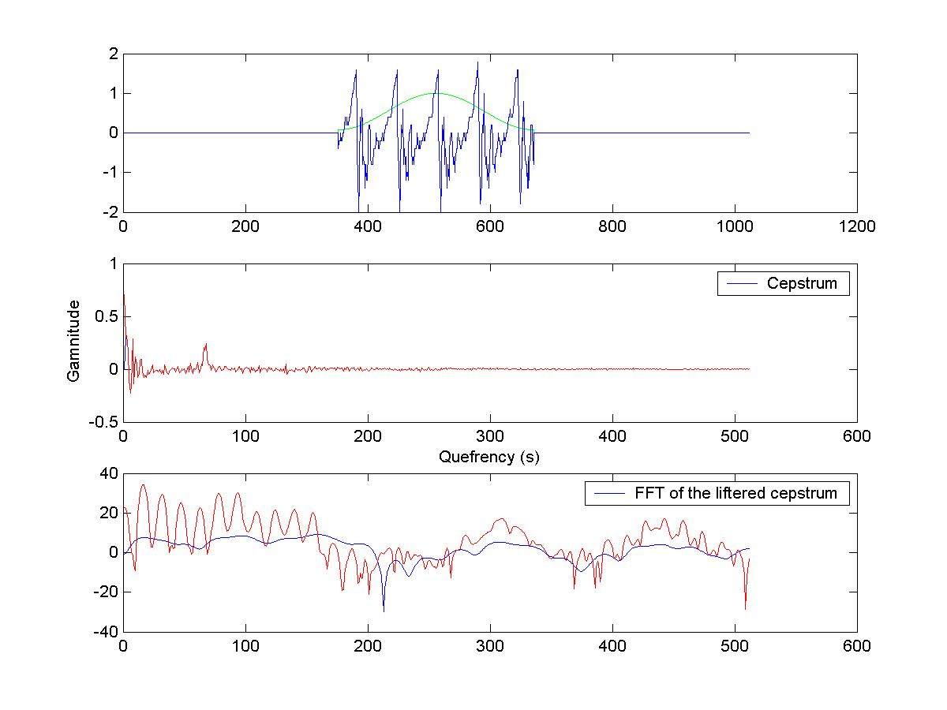
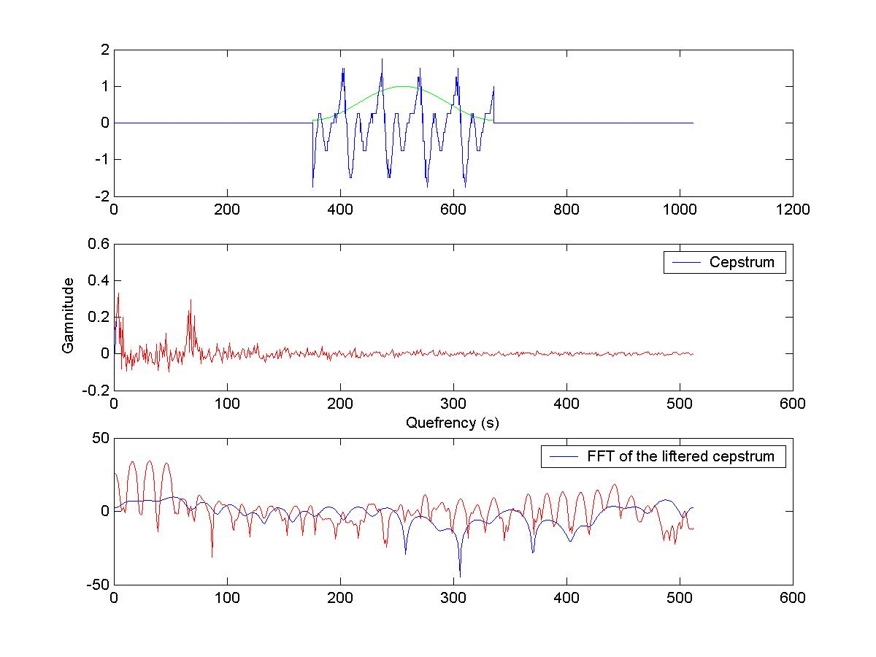
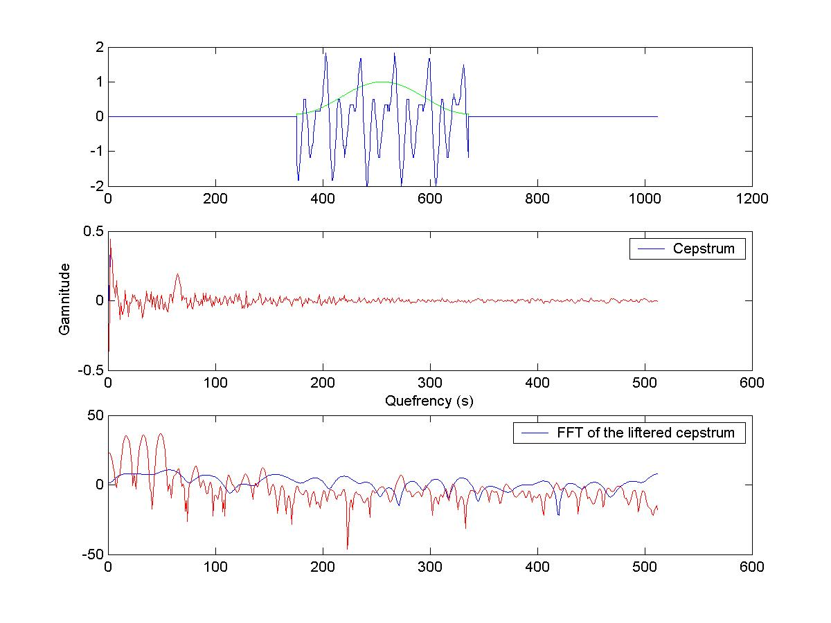
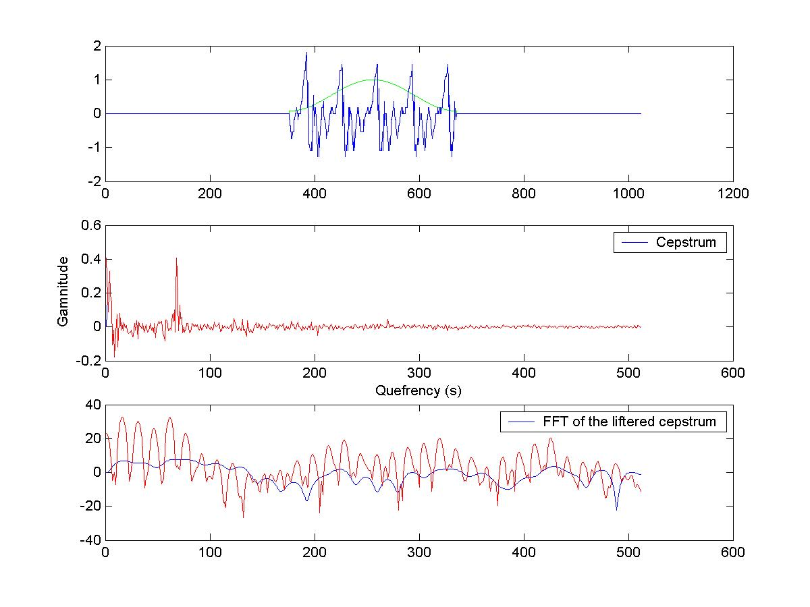

Slide 32
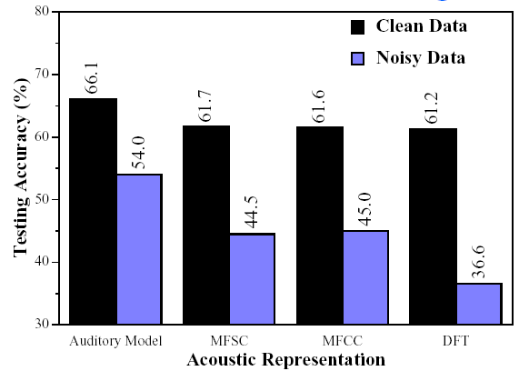
Signal Representation Comparisons
Many researchers have compared cepstral representations with Fourier-, LPC-, and auditory-based representations.
Cepstral representation typically out-performs Fourier-and LPC-based representations.
Example: Classification of 16 vowels using ANN (Meng, 1991)

Slide 33
Signal Representation Comparisons (cont.)
Performance of various signal representations cannot be compared without considering how the features will be used, i.e., the pattern classiffication techniques used. (Leung, et al., 1993).

Slide 34
Things to Ponder...
Are there other spectral representations that we should consider (e.g., models of the human auditory system)?
What about representing the speech signal in terms of phonetically motivated attributes (e.g., formants, durations, fundamental frequency contours)?
How do we make use of these (sometimes heterogeneous) features for recognition (i.e., what are the appropriate methods for modeling them)?

Slide 35
References
Tohkura, Y., “A Weighted Cepstral Distance Measure for Speech Recognition," IEEE Trans. ASSP, Vol. ASSP-35, No. 10, 1414-1422, 1987.
Mermelstein, P. and Davis, S., “Comparison of Parametric Representations for Monosyllabic Word Recognition in Continuously Spoken Sentences," IEEE Trans. ASSP, Vol. ASSP-28, No. 4, 357-366, 1980.
Meng, H., The Use of Distinctive Features for Automatic Speech Recognition,SM Thesis, MIT EECS, 1991.
Leung, H., Chigier, B., and Glass, J., “A Comparative Study of Signal Represention and Classi.cation Techniques for Speech Recognition," Proc. ICASSP,Vol.II, 680-683, 1993.

