Slide 1
Speech Recognition
Hidden Markov Models for Speech Recognition

Slide 2
Outline
Introduction
  Information Theoretic Approach to Automatic Speech Recognition
Problem formulation
  Discrete Markov Processes
Forward-Backward algorithm
Viterbi search
Baum-Welch parameter estimation
Other considerations
  Multiple observation sequences
  Phone-based models for continuous speech recognition
  Continuous density HMMs
  Implementation issues

Slide 3
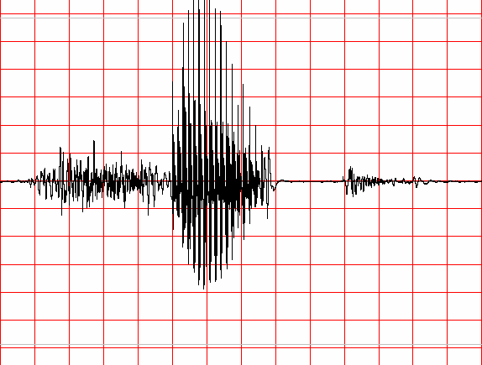
Information Theoretic Approach to ASR
Speaker's
Mind
Speech
Producer
Acoustic
Processor
Linguistic
Decoder
W
Speech
A
Ŵ
Speaker
Acoustic Channel
Speech Recognizer
Statistical Formulation of Speech Recognition
A – denotes the acoustic evidence (collection of feature vectors, or data in general) based on which recognizer will make its decision about which words were spoken.
W – denotes a string of words each belonging to a fixed and known vocabulary.

Slide 4
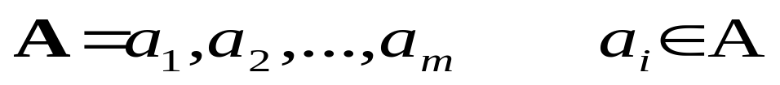
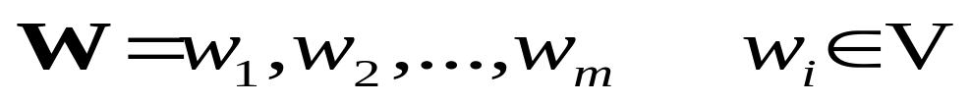
Information Theoretic Approach to ASR
  Assume that A is a sequence of symbols taken from some alphabet A.
  W – denotes a string of n words each belonging to a fixed and known vocabulary V.

Slide 5
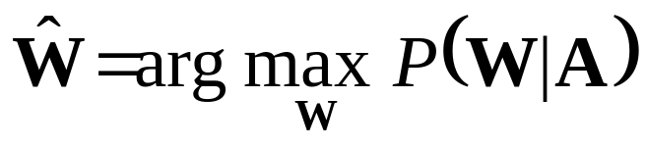
Information Theoretic Approach to ASR
  If P(W|A) denotes the probability that the words W were spoken, given that the evidence A was observed, then the recognizer should decide in favor of a word string Ŵ satisfying:
  The recognizer will pick the most likely word string given the observed acoustic evidence.

Slide 6
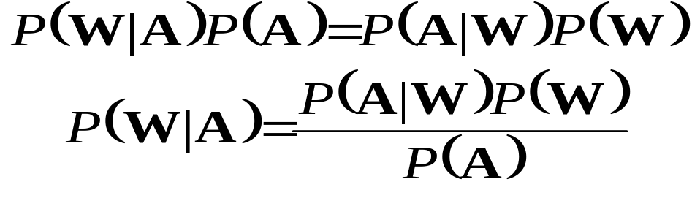
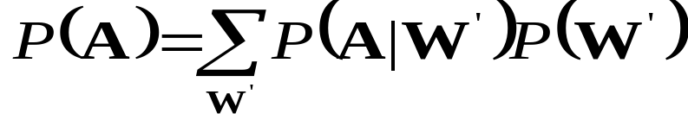
Information Theoretic Approach to ASR
From the well known Bayes’ rule of probability theory:
P(W) – Probability that the word string W will be uttered
P(A|W) – Probability that when W was uttered the acoustic evidence A will be observed
P(A) – is the average probability that A will be observed:

Slide 7
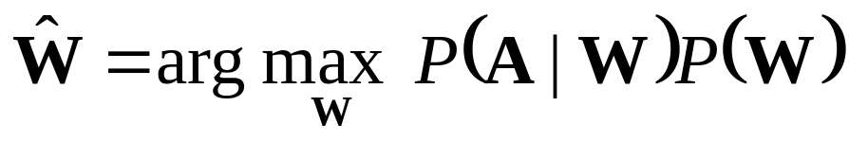
Information Theoretic Approach to ASR
Since Maximization in:
Is carried out with the variable A fixed (e.g., there is not other acoustic data save the one we are give), it follows from Baye’s rule that the recognizer’s aim is to find the word string Ŵ that maximizes the product P(A|W)P(W), that is

Slide 8
Markov Processes
About Markov Chains
  Sequence of a Discrete Value Random Variable:
    X₁, X₂, …, X_{n}
  Set of N Distinct States
    Q = {1,2,…,N}
  Time Instants
    t={t₁,t₂,…}
  Corresponding State at Time Instant
    q_{t} at time t

Slide 9
Discrete-Time Markov Processes Examples
Consider a simple three-state Markov Model of the weather as shown:
State 1: Precipitation (rain or snow)
State 2: Cloudy
State 3: Sunny
0.4
0.3
0.6
1
2
0.2
0.1
0.1
0.3
0.2
3
0.8

Slide 10
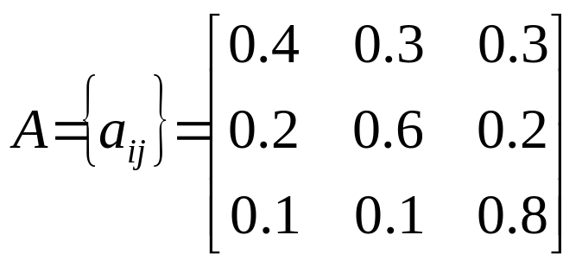
Discrete-Time Markov Processes Examples
Matrix of state transition probabilities:
Given the model in the previous slide we can now ask (and answer) several interesting questions about weather patterns over time.

Slide 11
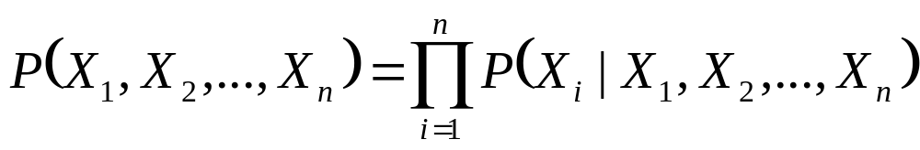
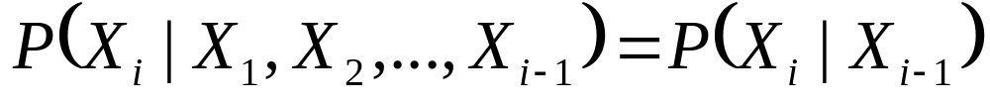
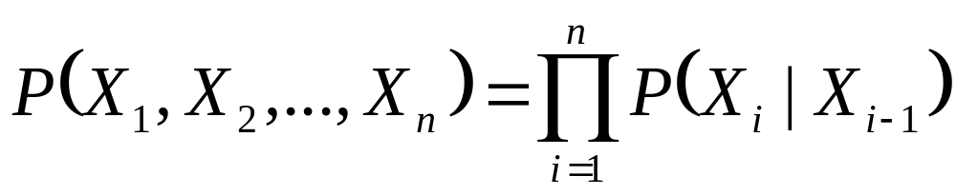
Bayesian Formulation under Independence Assumption
Bayes Formula:
  Probability of an Observation Sequence
  First Order Markov Chain is defined when Bayes formula holds under following simplification:
  Thus:

Slide 12
Markov Chain
Random Process has the simplest memory in First Order Markov Chain:
  The value at time t_{i} depends only on the value at the preceding time t_{i-1} and on
  Nothing that went on before

Slide 13
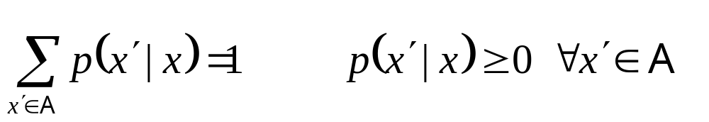
Definitions
Time Invariant (Homogeneous):
i.e. is not dependent on i.
Transition Probability Function p(x’,x) – N x N Matrix
For all x ∈ A

Slide 14
Definitions
Definition of State Transition Probability:
  a_{ij} = P(q_{t+1}=s_{j}|q_{t}=s_{i}), 1 ≤ i,j ≤ N

Slide 15
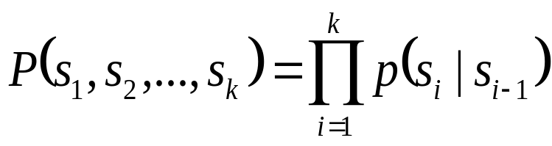
Discrete-Time Markov Processes Examples
Problem 1:
  What is the probability (according to the model) that the weather for eight consecutive days is “sun-sun-sun-rain-sun-cloudy-sun”?
Solution:
  Define the observation sequence, O, as:
  Day 1 2 3 4 5 6 7 8
    O = ( sunny, sunny, sunny, rain, rain, sunny, cloudy, sunny )
    O = ( 3, 3, 3, 1, 1, 3, 2, 3 )
  Want to calculate P(O|Model), the probability of observation sequence O, given the model of previous slide. Given that:

Slide 16
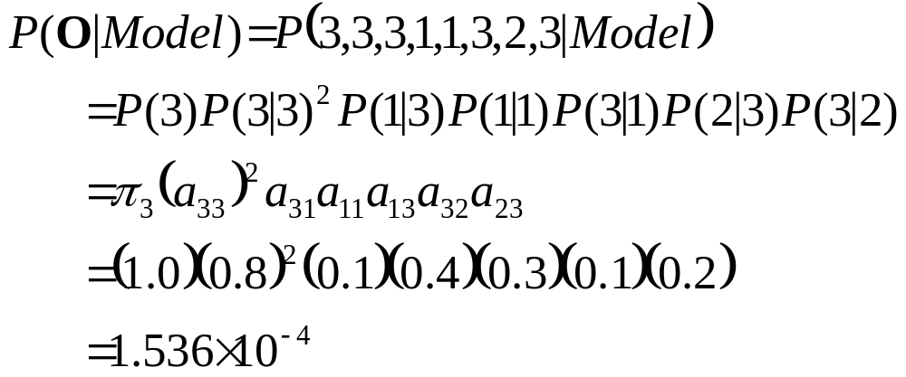
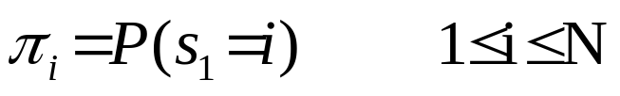
Discrete-Time Markov Processes Examples
Above the following notation was used

Slide 17
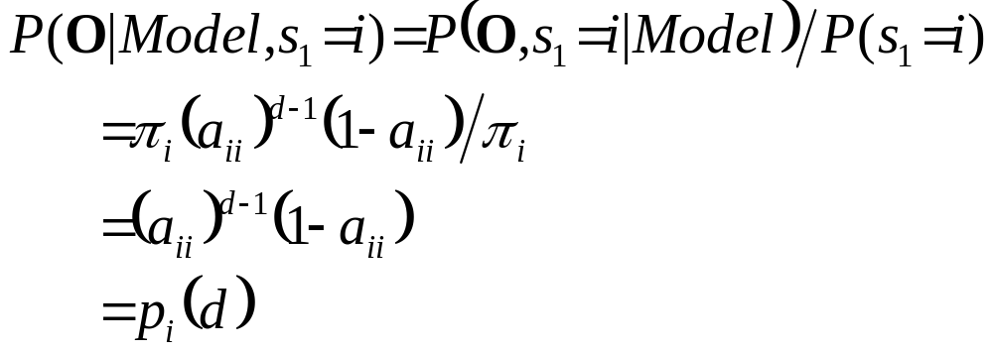
Discrete-Time Markov Processes Examples
Problem 2:
  Given that the system is in a known state, what is the probability (according to the model) that it stays in that state for d consecutive days?
Solution
  Day 1 2 3 d d+1
    O = ( i, i, i, …, i, j≠i )
The quantity p_{i}(d) is the probability
distribution function of duration d in
state i. This exponential distribution is
characteristic of the sate duration in
Markov Chains.

Slide 18
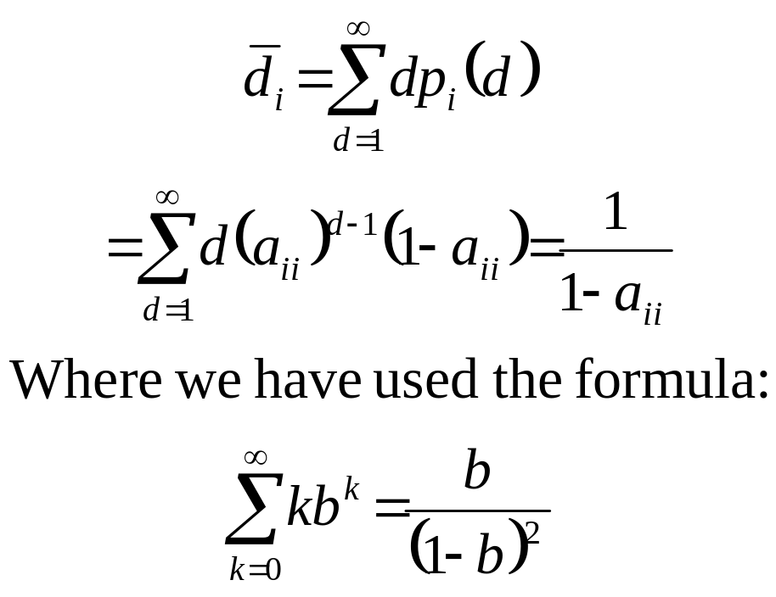
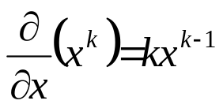
Discrete-Time Markov Processes Examples
  Expected number of observations (duration) in a state conditioned on starting in that state can be computed as ⇨
  Thus, according to the model, the expected number of consecutive days of
    Sunny weather: 1/0.2=5
    Cloudy weather: 2.5
    Rainy weather: 1.67
Exercise Problem: Derive the above formula or directly mean of p_{i}(d)
Hint:

Slide 19
Extensions to Hidden Markov Model
In the examples considered only Markov models in which each state corresponded to a deterministically observable event.
This model is too restrictive to be applicable to many problems of interest.
Obvious extension is to have observation probabilities to be a function of the state, that is, the resulting model is doubly embedded stochastic process with an underlying stochastic process that is not directly observable (it is hidden) but can be observed only through another set of stochastic processes that produce the sequence of observations.

Slide 20
Elements of a Discrete HMM
N: number of states in the model
  states s = {s₁,s₂,...,s_{N}}
  state at time t, q_{t} ∈ s
M: number of (distinct) observation symbols (i.e., discrete observations) per state
  observation symbols, V = {v₁,v₂,...,v_{M} }
  observation at time t, o_{t} ∈ V
A = {a_{ij}}: state transition probability distribution
  a_{ij} = P(q_{t+1}=s_{j}|q_{t}=s_{i}), 1 ≤ i,j ≤ N
B = {b_{j}}: observation symbol probability distribution in state j
  b_{j}(k) = P(v_{k} at t|q_{t}=s_{j} ), 1 ≤ j ≤ N, 1 ≤ k ≤ M
π = {π_{i}}: initial state distribution
  π_{i} = P(q₁=s_{i} ) 1 ≤ i ≤ N
HMM is typically written as: λ = {A, B, π}
  This notation also defines/includes the probability measure for O, i.e., P(O|λ)

Slide 21
State View of Markov Chain
Finite State Process
Transitions between states specified by p(x’,x)
For a small alphabet A Markov Chain can be specified by a diagram as in next figure:
p(1|3)
p(1|1)
1
p(3|1)
3
p(3|2)
p(2|3)
2
p(2|1)
Example of Three State Markov Chain

Slide 22
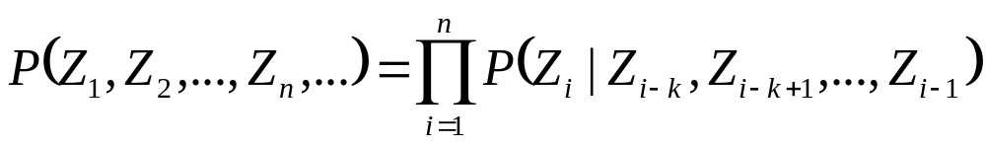
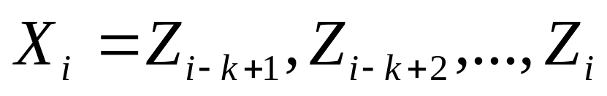
One-Step Memory of Markov Chain
Does not restrict in modeling processes of arbitrary complexity:
Define Random Variable X_{i}:
Then the Z-sequence specifies the X-sequence, and vice versa
The X process is a Markov Chain for which formula holds.
Resulting space is very large and the Z process can be characterized directly in a much simpler way.

Slide 23
The Hidden Markov Model Concept
Two goals:
  More Freedom to model the random process
  Avoid Substantial Complication to the basic structure of Markov Chains.
Allow states of the chain to generate observable data while hiding the state sequence itself.

Slide 24
Definitions
An Output Alphabet:
v = {v₁,v₂,...,v_{M} }
A state space with a unique starting state s₀:
S = {s₁,s₂,...,s_{N}}
A probability distribution of transitions between states:
p(s’|s)
An output probability distribution associated with transitions from state s to state s’:
b(o|s,s’)

Slide 25
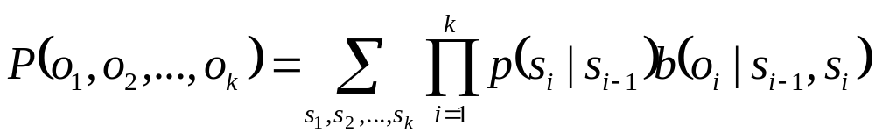
Hidden Markov Model
Probability of observing an HMM output string o₁,o₂,..o_{k} is:
Example of an HMM with b=2 and c=3
b(o|3,1)
p(1|3)
1
b(o|1,2)
1
b(o|1,3)
3
1
0
3
p(1|1)
p(3|1)
b(o|2,3)
0
b(o|3,2)
0
1
p(3|2)
1
1
p(2|3)
b(o|2,1)
2
2
p(2|1)
0

Slide 26

Hidden Markov Model
Underlying State Process still has only one-step memory:
The memory of observables is unlimited. For k≥2:
Advantage:
  Each HMM transition can be identified with a different identifier t and
  Define an output function Y(t) that assigns to t a unique output symbol taken from the output alphabet Y.

Slide 27
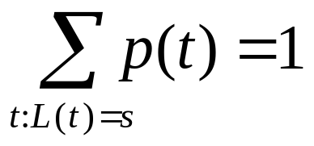
Hidden Markov Model
For a transition t denote:
  L(t) – source state
  R(t) – target state
  p(t) – probability that the state is exited via the transition t
  Thus for all s ∈ S

Slide 28
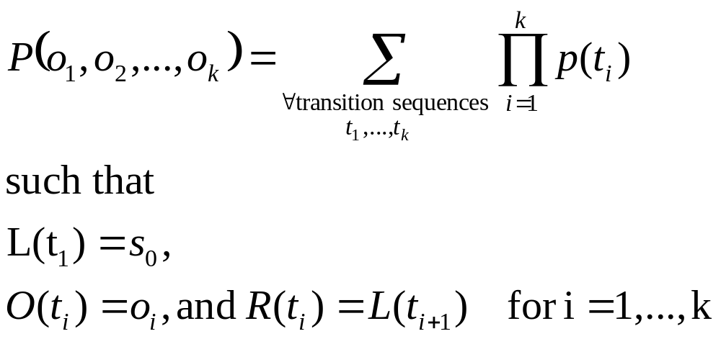
Hidden Markov Model
Correspondence between two ways of viewing an HMM:
When transitions determine outputs, the probability:

Slide 29
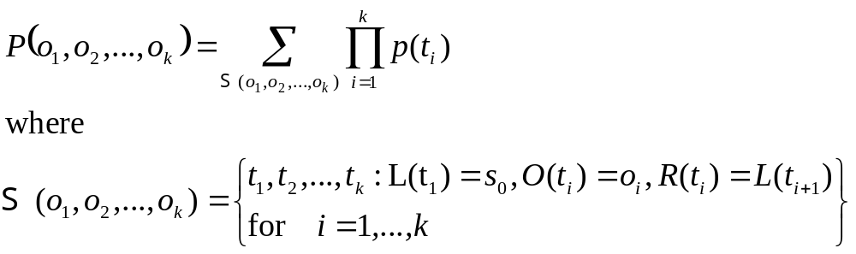
Hidden Markov Model
More Formal Formulation:
Both HMM views important depending on the problem at hand:
  Multiple transitions between states s and s’,
  Multiple possible outputs generated by the single transition s→s’

Slide 30
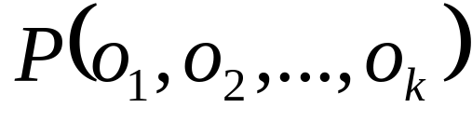
Trellis
Example of HMM with output symbols associated with transitions
Offers easy way to calculate probability:
Trellis of two different stages for outputs 0 and 1
o=0
1
1
1
1
0
3
2
2
0
0
1
1
1
3
3
2
o=1
0
1
1
2
2
3
3

Slide 31
Trellis of the sequence 0110
1
1
1
1
1
2
2
2
2
2
3
3
3
3
3
o=0
o=1
o=1
o=0
s₀
1
1
1
1
1
2
2
2
2
2
3
3
3
3
3
t=1
t=2
t=2
t=3
t=4

Slide 32
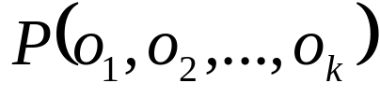
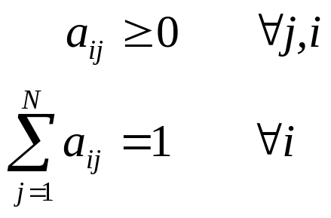
Probability of an Observation Sequence
Recursive computation of the Probability of the observation sequence:
Define:
  A system with N distinct states S = {s₁,s₂,…,s_{N}}
  Time instances associated with state changes as t=1,2,…
  Actual state at time t as s_{t}
  State-transition probabilities as:
a_{ij} = p(s_{t}=j|s_{t-i}=i), 1≤i,j≤N
  State-transition probability properties
a_{ij}
j
i

Slide 33
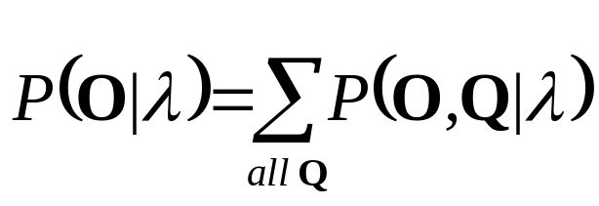
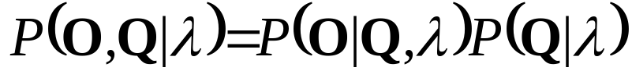
Computation of P(O|λ)
Wish to calculate the probability of the observation sequence, O={o₁,o₂,...,o_{T}} given the model λ.
The most straight forward way is through enumeration of every possible state sequence of length T (the number of observations). Thus there are N^{T} such state sequences:
Where:

Slide 34
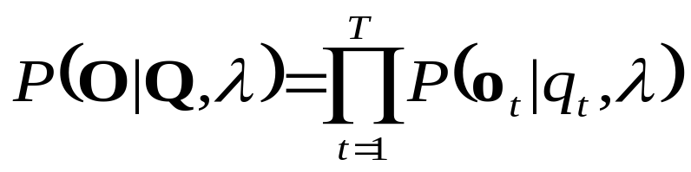
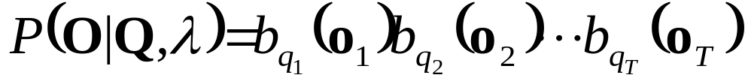
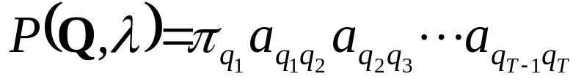
Computation of P(O|λ)
Consider the fixed state sequence: Q= q₁q₂ ...q_{T}
The probability of the observation sequence O given the state sequence, assuming statistical independence of observations, is:
Thus:
The probability of such a state sequence Q can be written as:

Slide 35
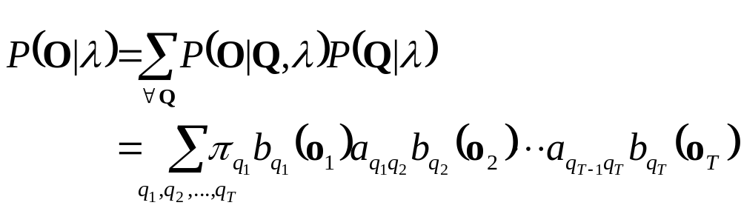
Computation of P(O|λ)
The joint probability of O and Q, i.e., the probability that O and Q occur simultaneously, is simply the product of the previous terms:
The probability of O given the model λ is obtained by summing this joint probability over all possible state sequences Q :

Slide 36
Computation of P(O|λ)
Interpretation of the previous expression:
  Initially at time t=1 we are in state q₁ with probability π_{q1}, and generate the symbol o₁ (in this state) with probability b_{q1}(o₁).
  In the next time instance t=t+1 (t=2) transition is made to state q₂ from state q₁ with probability a_{q1q2} and generate the symbol o₂ with probability b_{q2}(o₂).
  Process is repeated until the last transition is made at time T from state q_{T} from state q_{T-1} with probability a_{qT-1qT} and generate the symbol o_{T} with probability b_{qT}(o_{T}).

Slide 37
Computation of P(O|λ)
Practical Problem:
  Calculation required ≈ 2T · N^{T} (there are N^{T} such sequences)
  For example: N =5 (states),T = 100 (observations) ⇒ 2 · 100 · 5¹⁰⁰ = 10⁷² computations!
  More efficient procedure is required ⇒ Forward Algorithm

Slide 38
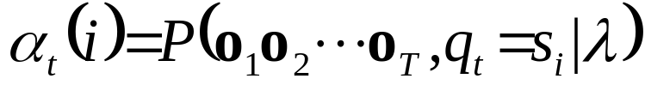
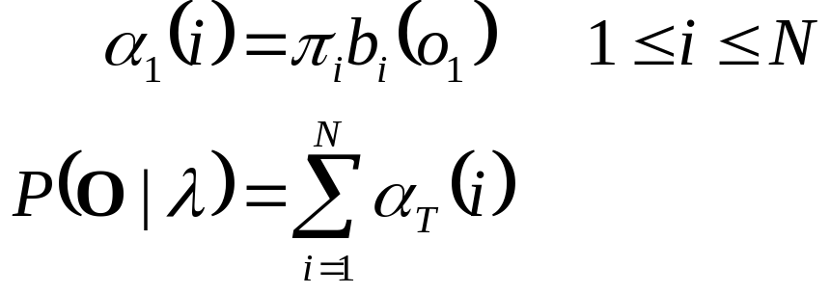
The Forward Algorithm
Let us define the forward variable, α_{t}(i), as the probability of the partial observation sequence up to time t and state s_{i} at time t, given the model λ, i.e.
It can be easily shown that:
Thus the algorithm:

Slide 39
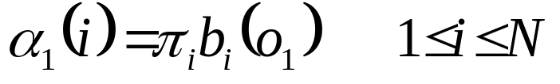
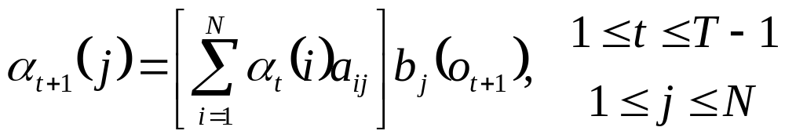
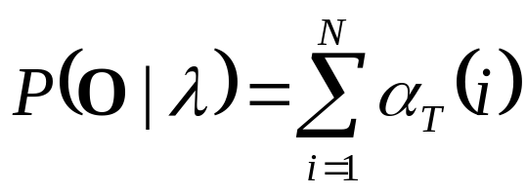
The Forward Algorithm
Initialization
Induction
Termination
t
t+1
s₁
s₂
a_{1j}
a_{2j}
s₃
a_{3j}
s_{j}
a_{Nj}
s_{N}
α_{t}(i)
α_{t+1}(j)

Slide 40
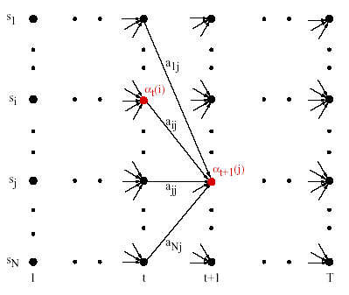
The Forward Algorithm

Slide 41
References
Huang, Acero, and Hon, Spoken Language Processing, Prentice-Hall, 2001.
Rabiner, Juang, Fundamentals of Speech Recognition, Prentice-Hall, 1993.
Jelinek, Statistical Methods for Speech Recognition. MIT Press, 1997.
Duda, Hart and Stork, Pattern Classification, John Wiley & Sons, 2001.
Bishop, Neural Networks for Pattern Recognition, Clarendon Press, 1995.
Gillick and Cox, Some Statistical Issues in the Comparison of Speech Recognition Algorithms, Proc. ICASSP, 1989.

